Slide 1


Slide 2
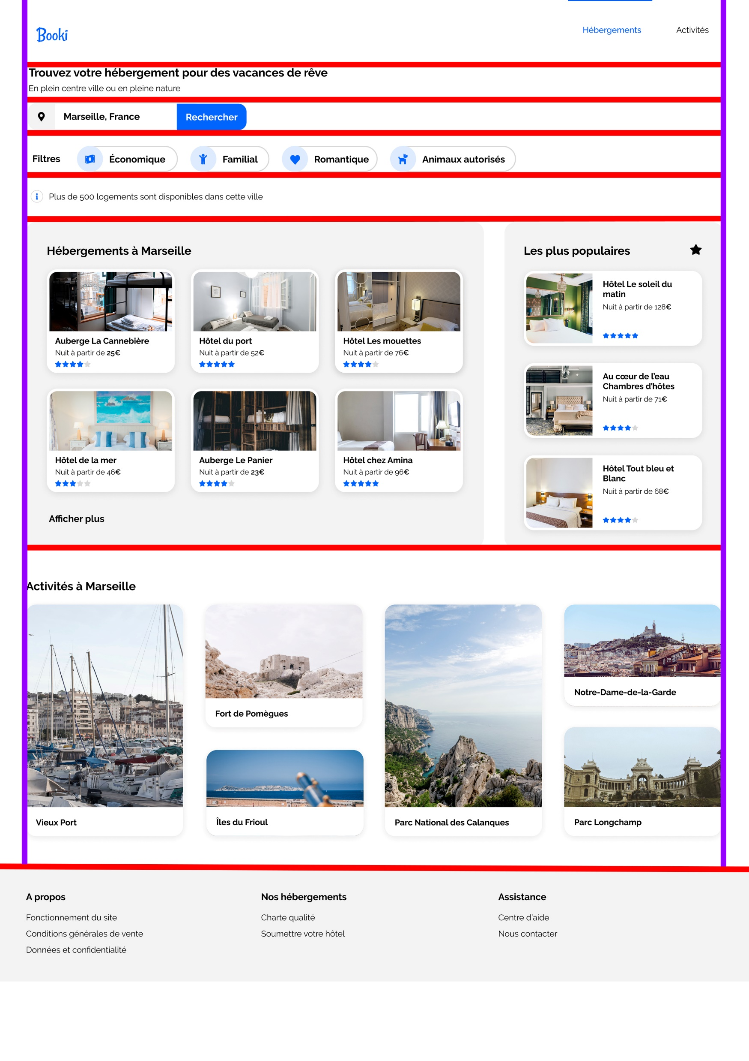
Header
Banner
Searchbar
Filters
Information
Results + trends
Activity
Footer

