Slide 1
Hi-Fi Prototype
Name : Kirath Singh (U1822329J)
Low-fi Reviewer : Wang Annan(U1923430G)
Instructions:-
Please use only right arrow key to navigate the slides and kindly wait for the animation delays.
The text-boxes with ‘yellow background’ indicate annotations for explaining some key features where necessary.
Slide number 39 can only be viewed by simulating the slide-show as it contains overlapped text-boxes due to animation.
- this symbol indicates ‘left mouse click’ wherever applicable.
Kindly refrain from using mouse-click as it could alter the animation effect that has been applied in the slides.

Slide 2







Undo
Edit
Language :
English
Groups
Broadcast Groups
Search
New Group
Group-1
User clicks on the group he/she wants to visit
You 9:45 AM
This is… message-3
3
Group-2
Participant-10 9:25 AM
This is message-30
8
Group-3
Participant-100 9:15 AM
This is message-300
2
Status
Settings
Webcam
Status

Slide 3











Language :
Undo
English
Group-1
Participant-1,Participant 2… You
Go Back
List
Participant-5
Referenced message
Participant-1 2 references
This is… message-1
9:45 AM
Inspect Message
Mark as Important
Mark as Irrelevant
Add to List
Participant-1 0 references
This is….message-2
9:45 AM
View
You 0 references
This is.... message-3
9:45 AM
Compose a message…….

Slide 4
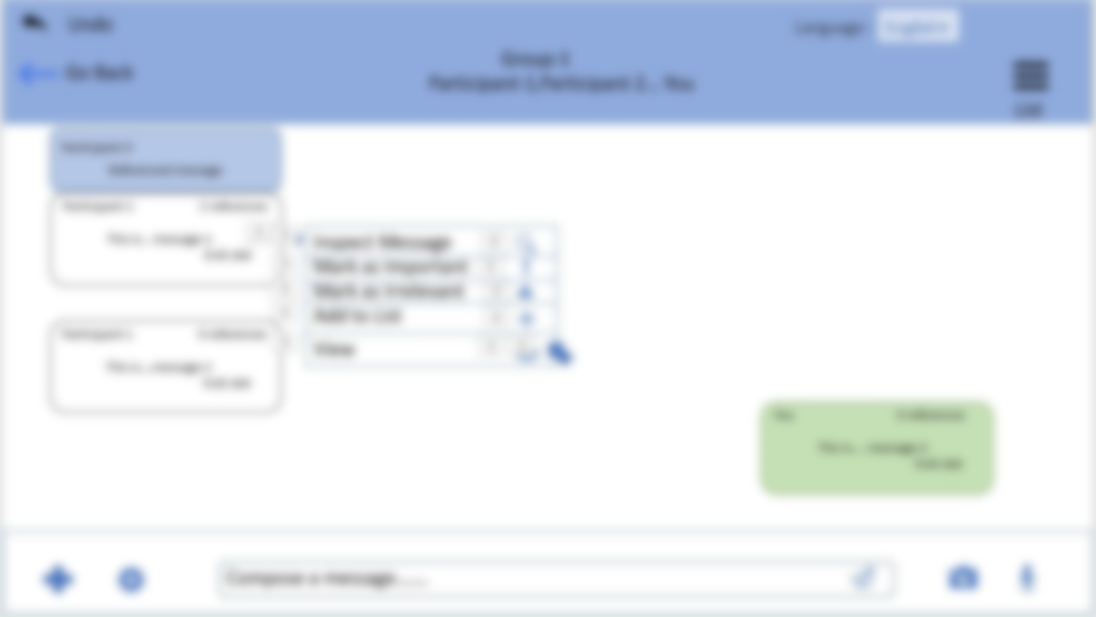


Language :
Undo
English
Group-1
Participant-1,Participant 2… You
Go Back
List
Participant-5
Referenced message
This is of important and a sample message and it is called message-1.
Participant-1 2 references
This is… message-1
9:45 AM
Inspect Message
Mark as Important
Mark as Irrelevant
Add to List
Participant-1 0 references
This is….message-2
9:45 AM
View
OK
You 0 references
This is.... message-3
9:45 AM
Compose a message…….

Slide 5
Language :
Undo
English
Group-1
Participant-1,Participant 2… You
Go Back
List
Participant-5
Referenced message
Participant-1 2 references
This is…. message-1
9:45 AM
Inspect Message
Mark as Important
Mark as Irrelevant
Add to List
Participant-1 0 references
This is….message-2
9:45 AM
View
You 0 references
This is.... message-3
9:45 AM
This icon can be used by the user to include documents like pdf/word/ppt, etc.
Compose a message…….

Slide 6
Language :
Undo
English
Group-1
Participant-1,Participant 2… You
Go Back
List
Participant-5
Referenced message
User can mark a message as important or irrelevant and the background colour of that message will change to purple or yellow correspondingly
Participant-1 2 references
This is…. message-1
9:45 AM
Participant-1 0 references
This is.... message-2
9:45 AM
Inspect Message
Mark as Important
Mark as Irrelevant
Add to List
You 0 references
This is.... message-3
9:45 AM
View
Compose a message…….

Slide 7
Language :
Undo
English
Group-1
Participant-1,Participant 2… You
Go Back
List
Participant-5
Referenced message
User can add messages to list using add to list.
Participant-1 2 references
This is…. message-1
9:45 AM
Inspect Message
Mark as Important
Mark as Irrelevant
Add to List
Participant-1 0 references
This is.... message-2
9:45 AM
View
You 0 references
This is.... message-3
9:45 AM
Compose a message…….

Slide 8
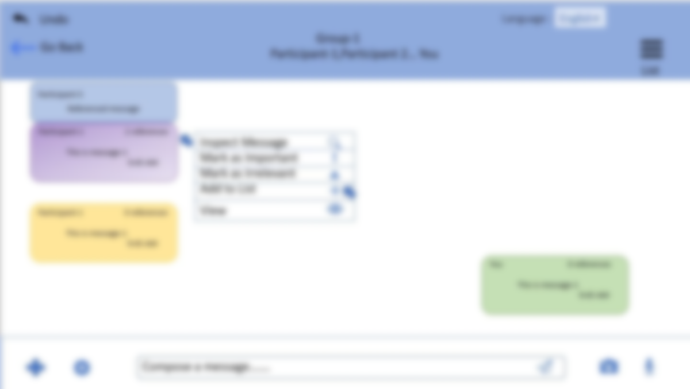

List of References- List of messages that the user wants to refer to in his/her next message
Sub-list 1 and Sub-list 2 – Custom created lists
Common list- Default list for storing messages(meant for novice users who do not like to save messages in separate lists
List of References
Sub-list 1
Sub-list 2
Common list
Select
View
Select
View
Select
View
Select
View
Confirm
Undo

Slide 9

User selects the lists where the messages has to be stored.
List of References
Sub-list 1
Sub-list 2
Common list
Select
View
Select
View
Select
View
Select
View
Confirm
Undo

Slide 10

List of References
Sub-list 1
Sub-list 2
Common list
Select
View
Select
View
Select
View
Select
View
Confirm
Undo

Slide 11
Add This is of important ……. message-1 to ‘List of references’ and ‘Sub-list 1’?
YES
NO

Slide 12
This is of important ……. message-1 added to ‘List of References’ and ‘Sub-list 1’ successfully!
OK

Slide 13
Language :
Undo
English
Group-1
Participant-1,Participant 2… You
Go Back
List of References
Important Messages
Common List
Sub-list - 1
Sub-list - 2
Participant-5
Referenced message
View
Sidebar shows the default lists and custom created list of messages
View
Participant-1 2 references
This is….. message-1
9:45 AM
View
View
Delete
Participant-1 0 references
This is….. message-2
9:45 AM
View
Delete
Add a Sub-list
Delete all
You 0 references
This is….. message-3
9:45 AM
Compose a message…….

Slide 14

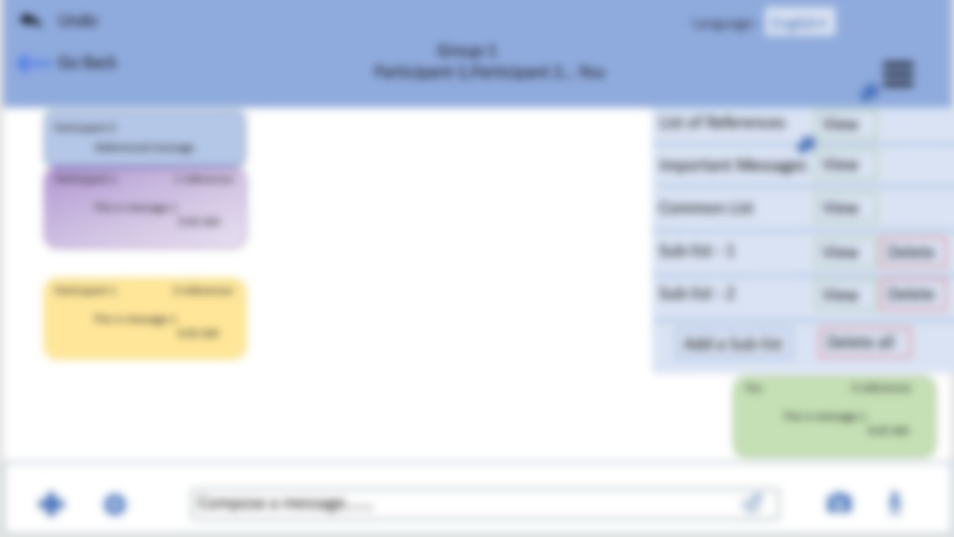
User can select the portions of the message he/she wants to store and refer.
List of References
This is… message-1 view>>
Select
Delete
Confirm
Delete all

Slide 15
User can select portion of a message by dragging mouse on the respective portions or by using voice commands(meant for disabled users)
This is of important and a sample message and it is called message-1.
Confirm
Undo

Slide 16
‘This is of important and a sample message’ has been edited and saved successfully!
OK

Slide 17
Language :
Undo
English
Group-1
Participant-1,Participant 2… You
Go Back
List of References
Important Messages
Common List
Sub-list - 1
Sub-list - 2
Participant-5
Referenced message
The reference that was added in the message last is displayed on top of that message. However, all the references in the message can be viewed with the help of ‘inspect message’
View
View
Participant-1 2 references
This is….. message-1
9:45 AM
View
View
Delete
Participant-1 0 references
This is….. message-2
9:45 AM
View
Delete
Add a Sub-list
Delete all
You 0 references
This is….. message-3
9:45 AM
Compose a message…….

Slide 18
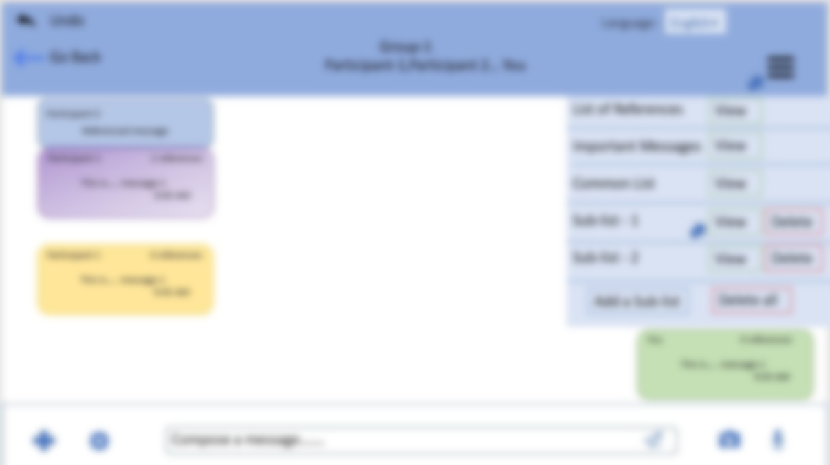
User can mark messages to be included as references in various lists.
Sub-list - 1
This is… message view>>
Select
Delete
This is… message-10 view>>
Select
Delete
Confirm
Delete all

Slide 19
Sub-list - 1
This is… message view>>
Select
Delete
This is… message-10 view>>
Select
Delete
Confirm
Delete all

Slide 20
Language :
Undo
English
Group-1
Participant-1,Participant 2… You
Go Back
List of References
Important Messages
Common List
Sub-list - 1
Sub-list - 2
Participant-5
Referenced message
View
View
Participant-1 2 references
This is….. message-1
9:45 AM
View
View
Delete
Participant-1 0 references
This is…. message-2
9:45 AM
View
Delete
Add a Sub-list
Delete all
You 0 references
This is….. message-3
9:45 AM
Compose a message…….

Slide 21
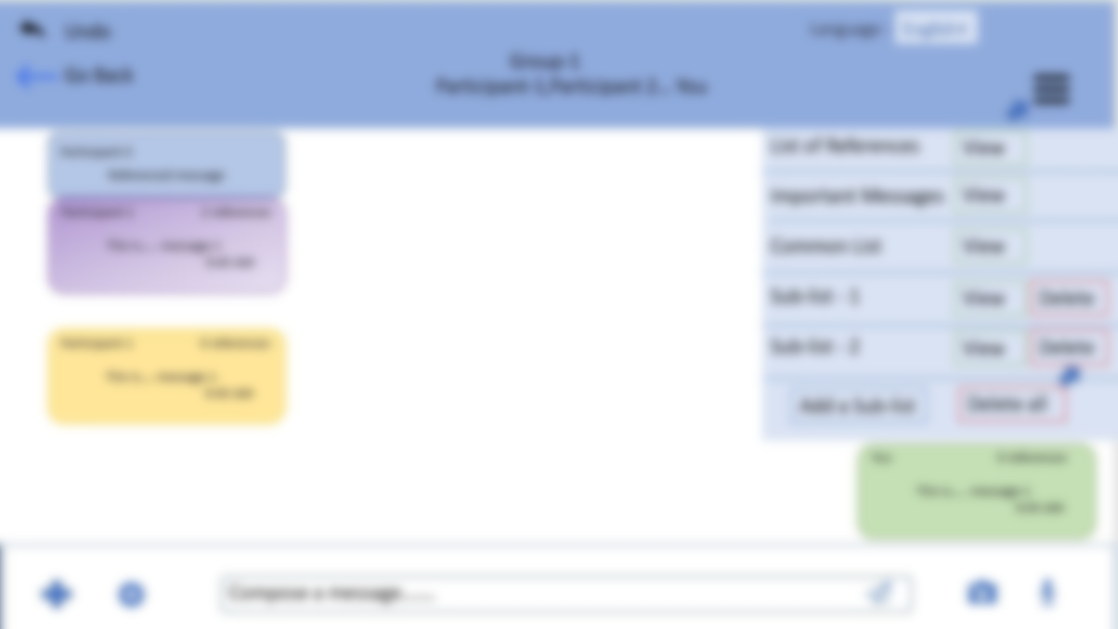
Delete Sub-list-2?
YES
NO

Slide 22
Sub-list-2 deleted successfully!
OK

Slide 23
Language :
Undo
English
Group-1
Participant-1,Participant 2… You
Go Back
List of References
Important Messages
Common List
Sub-list - 1
Participant-5
Referenced message
View
View
Participant-1 2 references
This is….. message-1
9:45 AM
View
View
Delete
Participant-1 0 references
This is…. message-2
9:45 AM
Add a Sub-list
Delete all
You 0 references
This is….. message-3
9:45 AM
Compose a message…….

Slide 24

Language :
Undo
English
Group-1
Participant-1,Participant 2… You
Go Back
Pop-ups for all references get stacked when the user types a message. User can alse add/delete references here.
Participant-1 0 references
This is….. message-2
9:45 AM
You 0 references
This is….. message-3
9:45 AM
Add reference
Delete All
Participant -1
This is… message view>>
Edit
Inspect
Delete
Participant -10
This is… message-10 view>>
Edit
Inspect
Delete
I am writing this message, it has 2 references

Slide 25
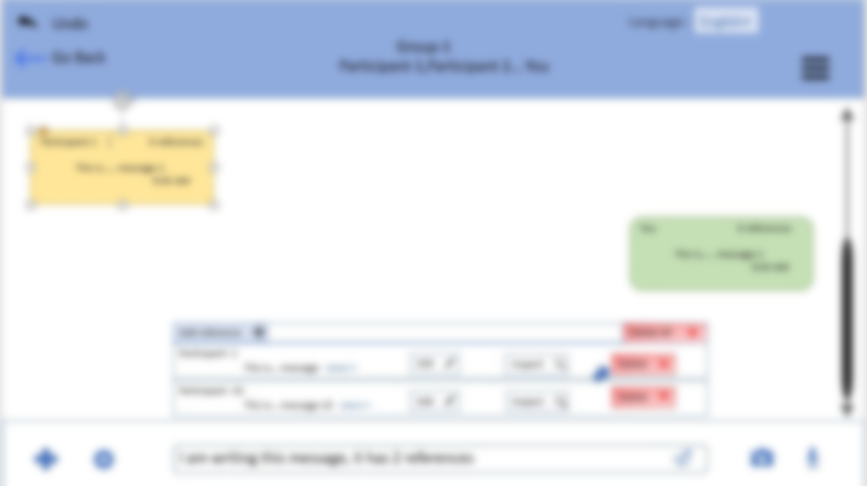
Language :
Undo
English
Group-1
Participant-1,Participant 2… You
Go Back
Participant-1 0 references
This is….. message-1
9:45 AM
Delete This is… message?
You 0 references
This is….. message-1
9:45 AM
YES
NO
Add reference
Delete All
Participant -1
This is… message view>>
Edit
Inspect
Delete
Participant -10
This is… message-10 view>>
Edit
Inspect
Delete
I am writing this message, it has 2 references

Slide 26
Language :
Undo
English
Group-1
Participant-1,Participant 2… You
Go Back
Participant-1 0 references
This is….. message-1
9:45 AM
This is… message deleted successfully!
You 0 references
This is….. message-1
9:45 AM
OK
Add reference
Delete All
Participant -1
This is… message view>>
Edit
Inspect
Delete
Participant -10
This is… message-10 view>>
Edit
Inspect
Delete
I am writing this message, it has 2 references

Slide 27
Language :
Undo
English
Group-1
Participant-1,Participant 2… You
Go Back
Participant-1 0 references
This is….. message-2
9:45 AM
You 0 references
This is….. message-3
9:45 AM
Add reference
Delete All
Participant -10
This is… message-10 view>>
Edit
Inspect
Delete
I am writing this message, it has 2 references

Slide 28
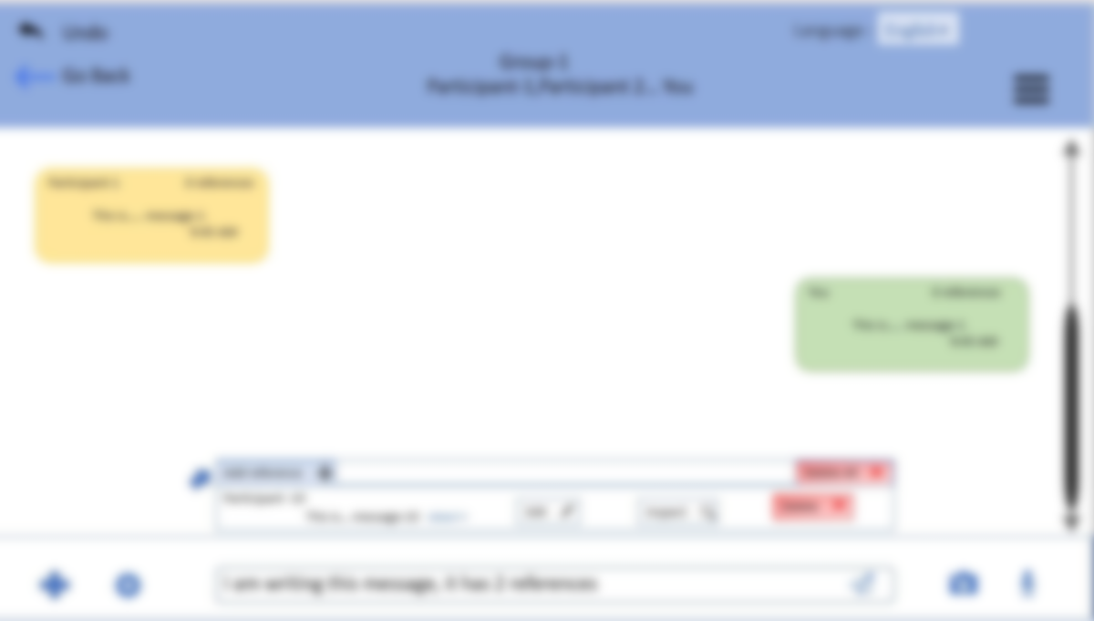
Language :
Undo
English
Group-1
Participant-1,Participant 2… You
Go Back
Participant-1 0 references
This is….. message-1
9:45 AM
List of References
Select
Sub-list 1
Select
Important Messages
You 0 references
This is….. message-1
9:45 AM
Select
Common List
Select
Cancel
Add reference
Delete All
Participant -10
This is… message-10 view>>
Edit
Inspect
Delete
I am writing this message, it has 2 references

Slide 29
Language :
Undo
English
Group-1
Participant-1,Participant 2… You
Go Back
Participant-1 0 references
This is….. message-1
9:45 AM
Common List
This is… message-100 view>>
Select
Delete
You 0 references
This is….. message-1
9:45 AM
Confirm
Delete all
Add reference
Delete All
Participant -10
This is… message-10 view>>
Edit
Inspect
Delete
I am writing this message, it has 2 references

Slide 30
Language :
Undo
English
Group-1
Participant-1,Participant 2… You
Go Back
Participant-1 0 references
This is….. message-1
9:45 AM
‘This is … message-100’ has been added!
You 0 references
This is….. message-1
9:45 AM
Add more
Exit
Add reference
Delete All
Participant -10
This is… message-10 view>>
Edit
Inspect
Delete
I am writing this message, it has 2 references

Slide 31
Language :
Undo
English
Group-1
Participant-1,Participant 2… You
Go Back
User clicks send button to post a message
Participant-1 0 references
This is….. message-1
9:45 AM
You 0 references
This is….. message-3
9:45 AM
Add reference
Delete All
Participant -10
This is… message-10 view>>
Edit
Inspect
Delete
Participant -100
This is… message-100 view>>
Edit
Inspect
Delete
I am writing this message, it has 2 references

Slide 32
Language :
Undo
English
Group-1
Participant-1,Participant 2… You
Go Back
Participant-1 0 references
This is….. message-2
9:45 AM
User can view all the references in a message with the help of ‘inspect message’
You 0 references
This is….. message-3
9:45 AM
Participant-100
This is message….100
Inspect Message
Mark as Important
Mark as Irrelevant
Add to List
You 2 references
I am writing……. 2 references
9:50 AM
Delete
Compose a message……

Slide 33


Language :
Undo
English
Group-1
Participant-1,Participant 2… You
Go Back
Home
Graph view
Normal view
Participant-100 0 references
This is…. message-100
9:50 AM
Participant -10 0 references
This is…. message-10
9:50 AM
You 2 references
I am writing……. 2 references
9:50 AM
Inspect Message
Mark as Important
Mark as Irrelevant
Add to List
Delete

Slide 34
Language :
Undo
English
Group-1
Participant-1,Participant 2… You
Go Back
Home
Graph view
Normal view
Inspect message has 2 views:-
Graph view – for advanced users.
Normal view- for novice users
Participant-100 0 references
This is…. message-100
9:50 AM
Reference -1
Participant -10 0 references
This is…. message-10
9:50 AM
Reference -2
You 2 references
I am writing……. 2 references
9:50 AM
Current Message

Slide 35
Language :
Undo
English
Group-1
Participant-1,Participant 2… You
Go Back
Participant-1 0 references
This is….. message-2
9:45 AM
You 0 references
This is….. message-3
9:45 AM
Participant-100
This is message….100
You 2 references
I am writing……. 2 references
9:50 AM
Compose a message……

Slide 36






Language :
Undo
English
Group Information
Go Back
Home
Group-1
Group description………
Media, Links, Documents
Chat Search
Mute group
Trending Messages
Messages marked as Important(By other users)

Slide 37


Language :
Undo
English
Group-1
Participant-1,Participant 2… You
Go Back
Home
Trending Messages
This feature allows new users to view messages that have been referenced frequently. This feature aids the new group members in understanding the overall discussion flow.
Graph view
Normal view
Participant-100 0 references
This is…. message-100
9:45 AM
Participant -10 0 references
This is…. message-10
9:45 AM
Previous
You 2 references
I am writing……. 20 references
9:50 AM
Next
Participant -10 1 references
This is…. message-10
9:45 AM
Participant -10 1 references
This is…. message-10
9:45 AM
Participant -10 1 references
This is…. message-10
9:45 AM

Slide 38
Language :
Undo
English
Group Information
Go Back
Home
Group-1
Group description………
Media, Links, Documents
Chat Search
Mute group
Trending Messages
Messages marked as Important(By other users)

Slide 39
Language :
Undo
English
Group-1
Participant-1,Participant 2… You
Go Back
Home
Messages marked as important(By other users)
This feature shows the messages that have been marked as important by most number of group member. This feature aids the new group members in understanding the overall discussion flow.
Participant-1 0 references
This is a message that was marked as important by 4 other users. That is why this message is here
9:30 AM
Previous
Next

Slide 40
Language :
Undo
English
Group-1
Participant-1,Participant 2… You
Go Back
Home
Messages marked as important(By other users)
Participant-2 1 reference
This is a message that was marked as important by 3 other users. That is why this message is here
9:30 AM
Previous
Next

Slide 41

Language :
Undo
English
Group Information
Go Back
Home
Participant-1 Admin
Participant-2 Admin
Participant-3
Group-1
Participant-100
You
Group description………
Add Participant
Media, Links, Documents
Chat Search
Mute group
Export group
Clear Chat
Exit Group
Trending Messages
Messages marked as Important(By other users)

Slide 42
Language :
Undo
English
Group-1
Participant-1,Participant 2… You
Go Back
Participant-1 0 references
This is….. message-2
9:45 AM
You 0 references
This is….. message-3
9:45 AM
Participant-100
This is message….100
You 2 references
I am writing……. 2 references
9:50 AM
Compose a message……

Slide 43
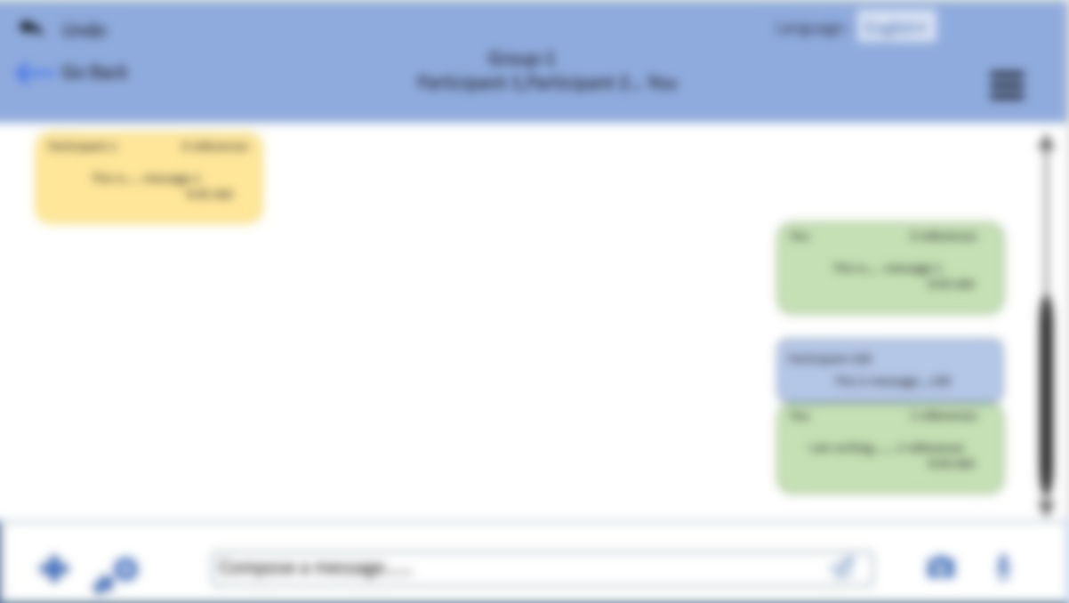
Language :
Undo
English
Group-1
Participant-1,Participant 2… You
Go Back
Participant-1 0 references
This is….. message-1
9:45 AM
Default Settings
Settings
Small
Medium
Large
Font-type-
You 0 references
This is….. message-1
9:45 AM
Dark
Theme-type-
Light
Colour-scheme-
Normal
Colour-blind
Participant-100
This is message….100
Add Shortcut Keys….
You 2 references
I am writing……. 2 references
9:50 AM
Confirm Changes
Undo
Compose a message……

Slide 44

Language :
Undo
English
Group-1
Participant-1,Participant 2… You
Go Back
Participant-1 0 references
This is….. message-1
9:45 AM
Default Settings
Settings
Advanced users can add shortcut keys to increase the speed of performing tasks.
Normal
Colour-blind
Colour-scheme-
You 0 references
This is….. message-1
9:45 AM
Add Shortcut Keys….
Help
Users can view FAQs . The help feature also allows the user to contact the customer care for any additional assistance. Users can also contact customer care in case of any emergency or any online threats.
Participant-100
This is message….100
You 2 references
I am writing……. 2 references
9:50 AM
Confirm Changes
Undo
Compose a message……

Slide 45
Language :
Undo
English
Group-1
Participant-1,Participant 2… You
Go Back
Participant-1 0 references
This is….. message-2
9:45 AM
You 0 references
This is….. message-3
9:45 AM
Participant-100
This is message….100
You 2 references
I am writing……. 2 references
9:50 AM
Compose a message……

Slide 46
End of Demo Thank You

