Slide 1
IST 615 Cloud Management
Team 7
Topic: Car Retail Website
Members: Mikhail Pinto, Kirat Saran

Slide 2
Project Objective
To create a website which lets user look for used cars for sale
To help user with finding a resale estimate for their own car
To let users post their own listing on the website

Slide 3
About the Dataset
The dataset is from the site Craigslist which was uploaded to Kaggle.com
Link: https://www.kaggle.com/datasets/austinreese/craigslist-carstrucks-data?datasetId=62920.
Size of the dataset is 1.5gb
Dataset has 236k rows and 22 columns
Few important columns - price, year, manufacturer, model, condition, odometer, fuel, etc
Data cleaning was done and a few new columns were derived.

Slide 4
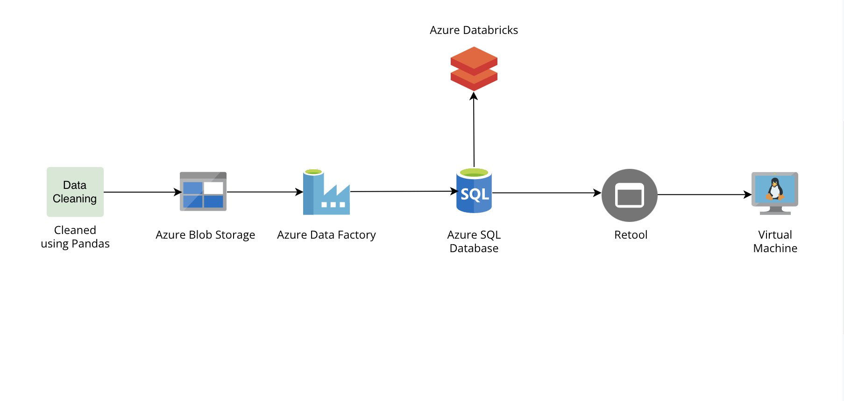
Solution Architecture

Slide 5
Azure Blob Storage
To store the dataset in a container which be accessed by Azure SQL Database
We have used 2 blob storages in our project.
One to store our dataset file and the other to store our price prediction prices

Slide 6
Azure Data Factory
To create a data flow which goes from Azure Blob Storage to Azure SQL Database
Creating a pipeline and running the job to move data from Azure Blob Storage to Azure SQL Database

Slide 7
Retool Service
To create frontend we used retool which enabled us to connect our Azure SQL Database to the frontend for creating an application.
To make this work we had to add firewall rules to our SQL Database which allowed us a smooth integration between our frontend and backend.

Slide 8
Azure Virtual Machine
To deploy and host our website on Azure we have used a virtual machine.
To deploy the retool website onto the virtual machine we have used docker
Many new inbound network rules were added to let retool communicate with the database and the Virtual Machine.

Slide 9
Azure Databricks
This platform was used for scripting purposes to create a model to predict prices for cars to be posted online for sale.
Data was retrieved from the blob storage where our dataset was stored.
Analysis results were stored in another blob storage which will further be retrieved from PowerBi to make interactive dynamic dashboards.

Slide 10
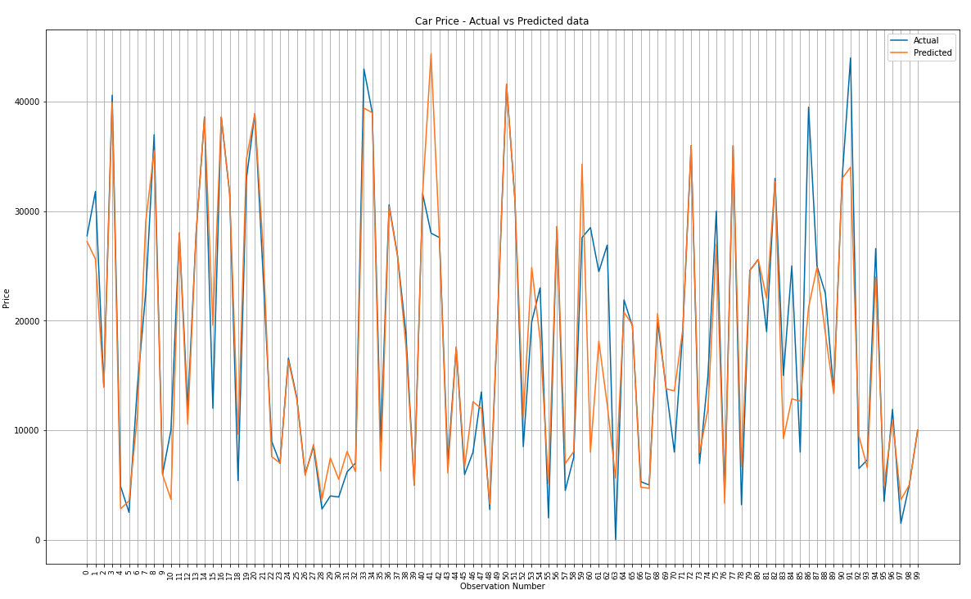
Price Prediction Accuracy
Implemented 3 models - Linear regression, Random Forest and XGBoost.
Best Performing Model was Random Forest which was used to make price predictions.

Slide 11
Issues encountered
Initially it was decided that we will be using App Service (Web app + Database) an Azure service to implement our frontend. It was difficult to use .NET frame to create our front end as we have no experience working with it.
Creating dashboards on Power BI from the insights that were obtained from Azure Databricks.
Managing and monitoring the credit remaining on our Azure Students account.

Slide 12
Demo
Link:- https://video.syr.edu/media/t/1_otwvepue

Slide 13
Thank You

