Slide 1


COVID State-Wise Analysis
Kirat Saran - 550246249
Pranav Addipalli - 482561915
Vinit Horakeri - 537701299

Slide 2
Introduction
COVID originated in China around December 2019 when fifty people developed pneumonia-like symptoms.
Several new cases of COVID infections were reported daily after that, resulting in the World Health Organization declaring COVID 19 an epidemic
We track and analyze variables that can help us understand the US outbreak: testing, hospitalization, recovery, and mortality rate, etc.
Our dataframe spans from 13th Jan 2020-7th March 2021.

Slide 3
Data Pre-Processing & Preparation
We have used data cleaning techniques to process data
We have done the following:
Checking null values and removing them
Checking for duplicate values
Checking for outliers.
Checking the data type and converting to others where required
Set index as date
Group the data by date for time-series analysis
Slice data into new data-frame for easy application

Slide 4
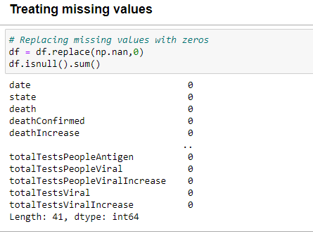
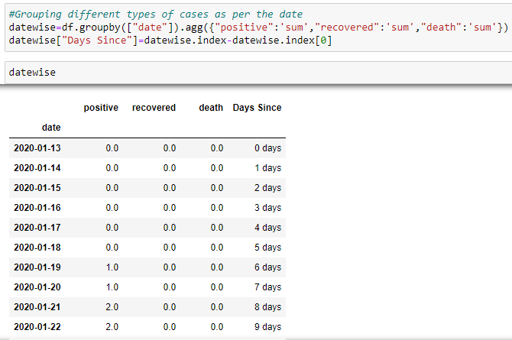
Data Pre-Processing & Preparation

Slide 5
Data Visualization & Exploratory Analysis
To understand the data and establish a relationship between the attributes and the dataset we must visualize it.
These attributes help us understand and explore the depth of data through visualization.
Exploratory data analysis helps us understand the statistical aspect of the data.
It also helps elucidate the descriptive statistics of the dataset.

Slide 6
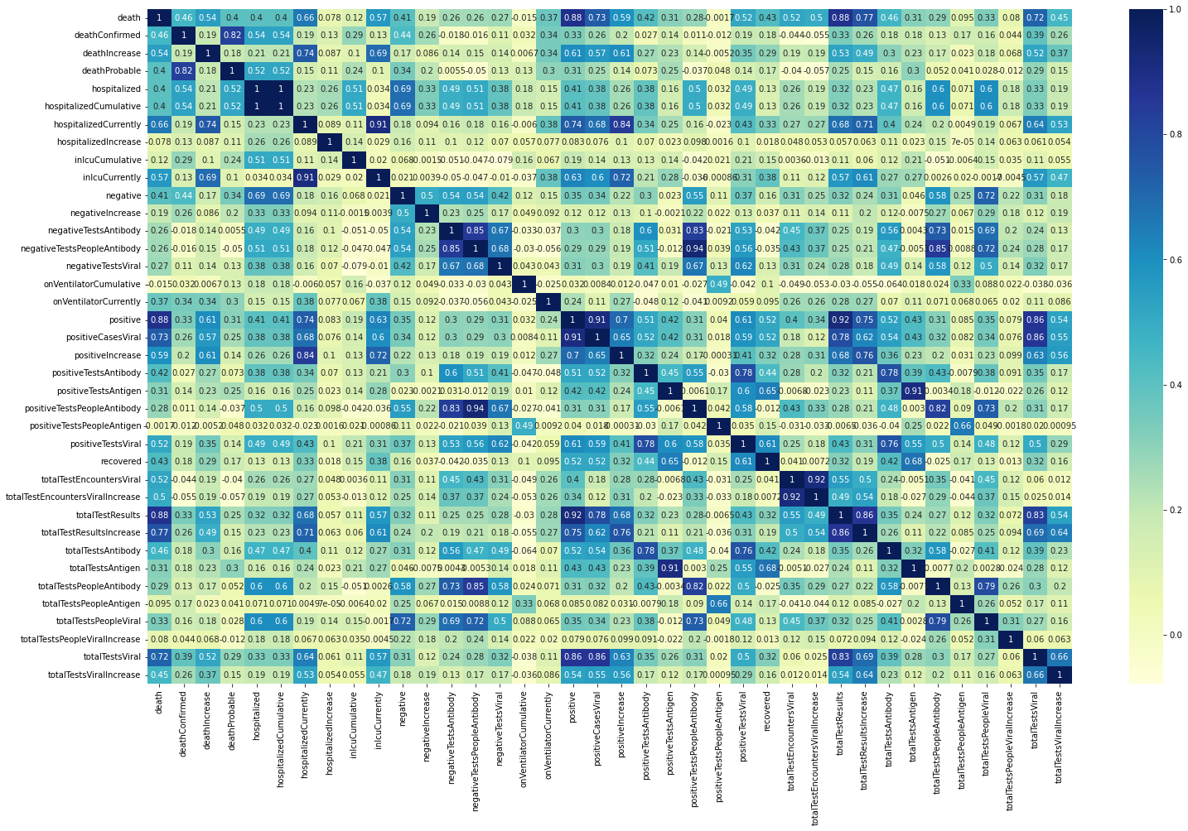
Basic Data Visualization

Slide 7
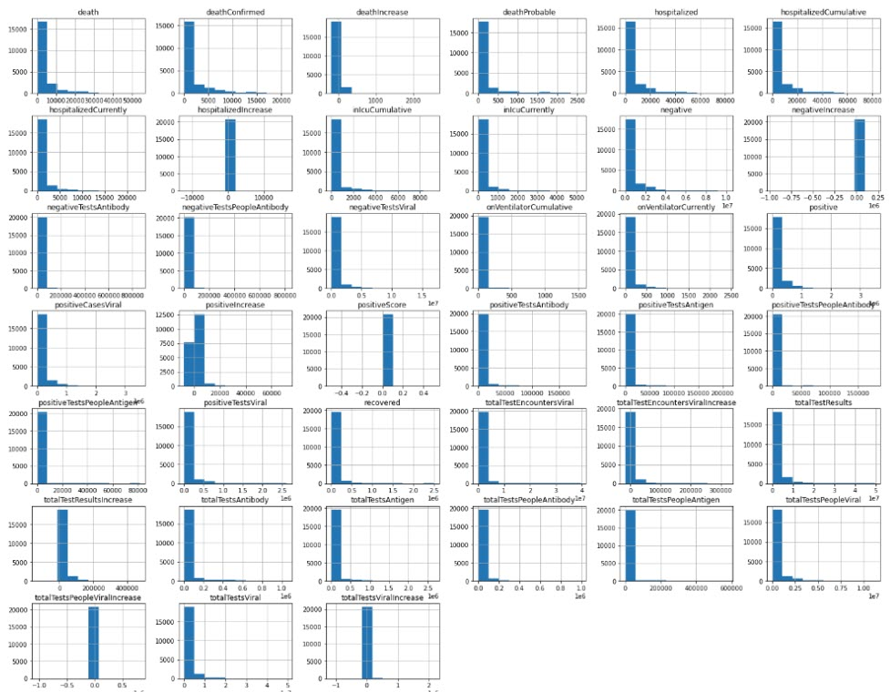
Basic Data Visualization

Slide 8
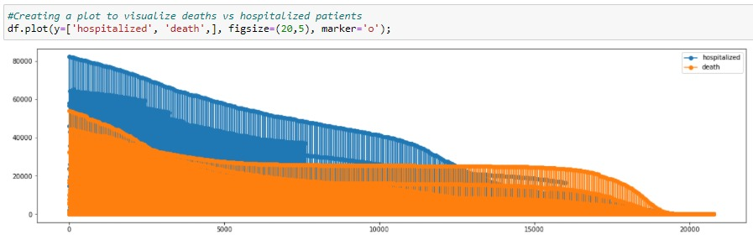
Basic Data Visualization

Slide 9
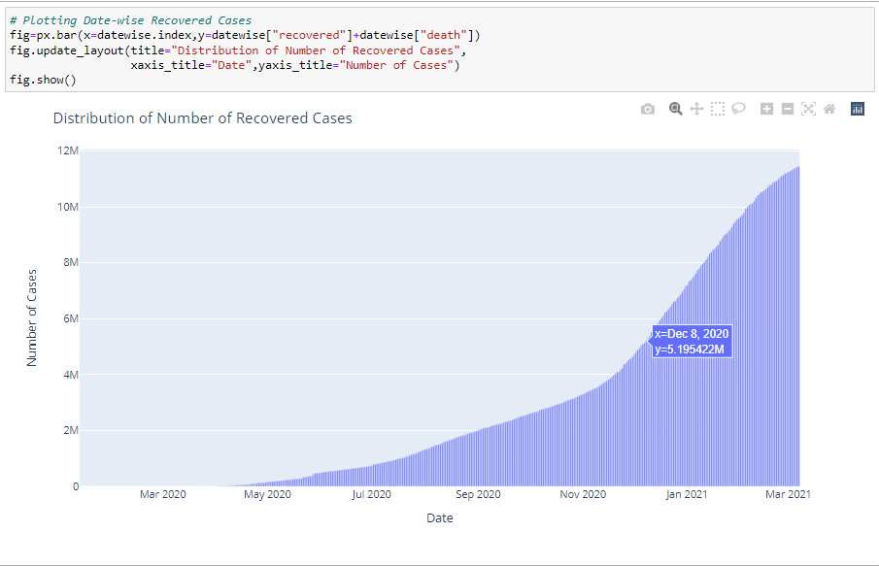
Derived Data Visualization

Slide 10
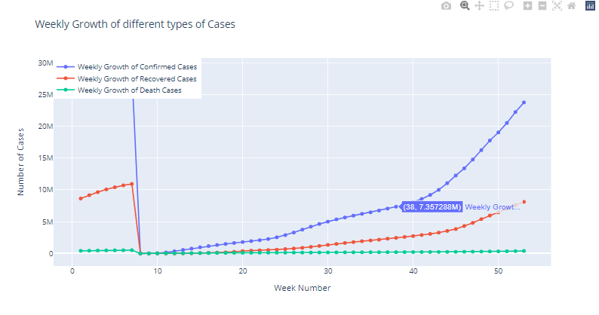
Derived Data Visualization

Slide 11
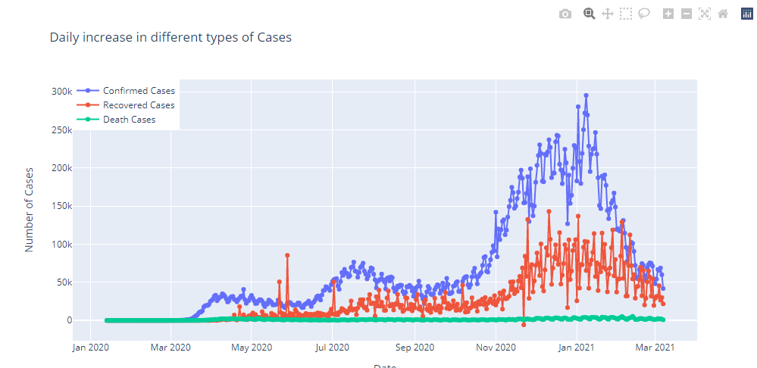
Derived Data Visualization

Slide 12
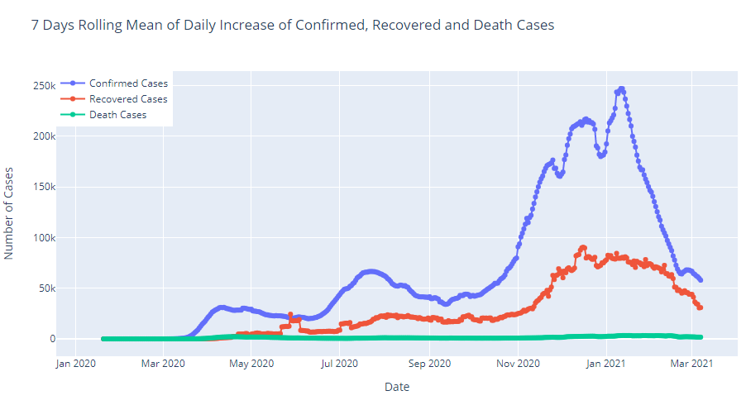
Derived Data Visualization

Slide 13
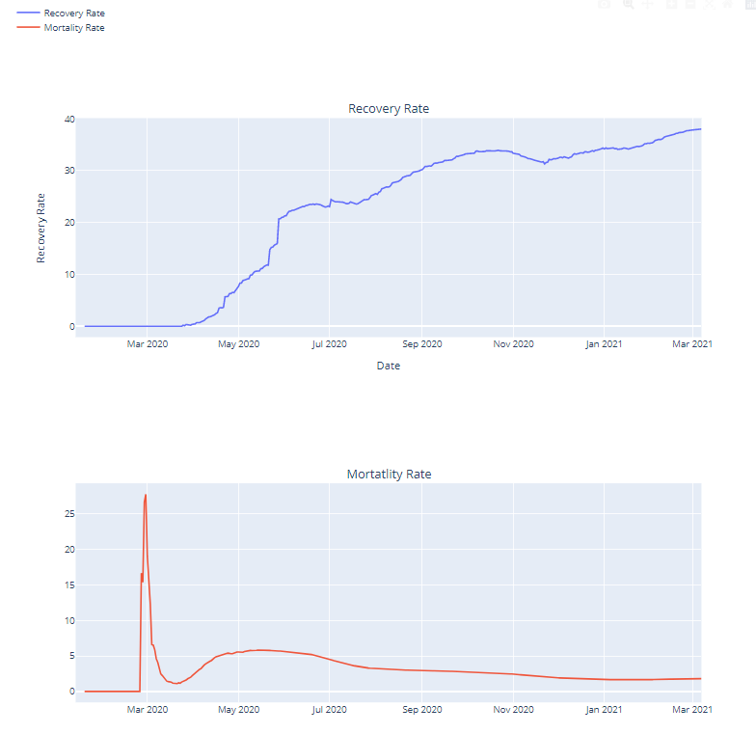
Derived Data Visualization

Slide 14
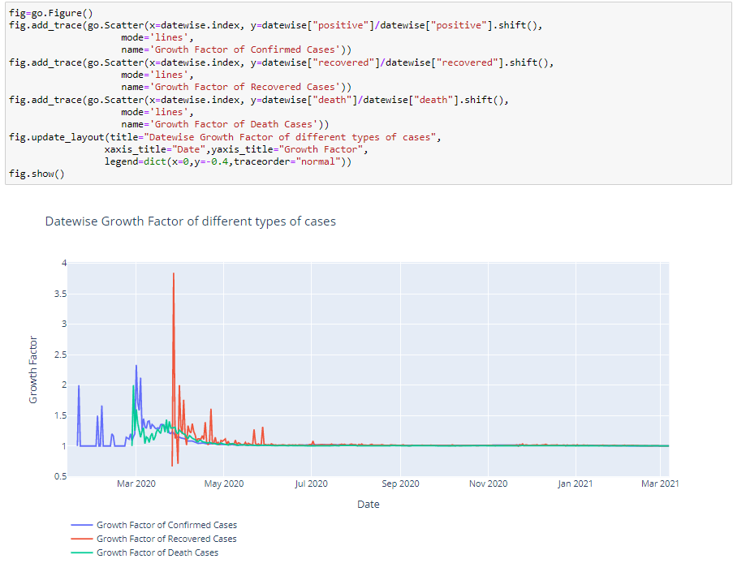
Exploratory Analysis
Growth Rate is the factor by which a quantity multiplies itself over time
Growth factor above 1 indicates an increase corresponding cases.
Growth factor above 1 but trending downward is a positive sign, whereas a growth factor constantly above 1 is the sign of exponential growth.
Growth factor constant at 1 indicates there is no change in any kind of cases.

Slide 15
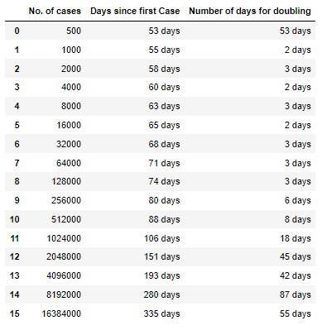
Exploratory Analysis
The doubling rate represents the number of days it takes for the number of cases to double, an indicator of how quickly cases are increasing.
The doubling rate can also be applied to assess the trajectory of hospitalizations and deaths, providing key information on whether a region is slowing the spread of the disease.
The longer the doubling rate, the slower the disease spread and the flatter the curve becomes.
Conversely, a shorter doubling rate indicates the disease is spreading more quickly.

Slide 16
Prediction Models
▪Prediction is done using Linear Regression and Support-Vector Machine model
▪Model Evaluation Metrics is Mean Absolute Error(MAE).
▪For positive cases prediction MAE for the Linear Regression model is 2843 and for SVM it is 3593.
▪For Deaths prediction the MAE for the linear Regression model is 334 and for the SVM it is 372

Slide 17
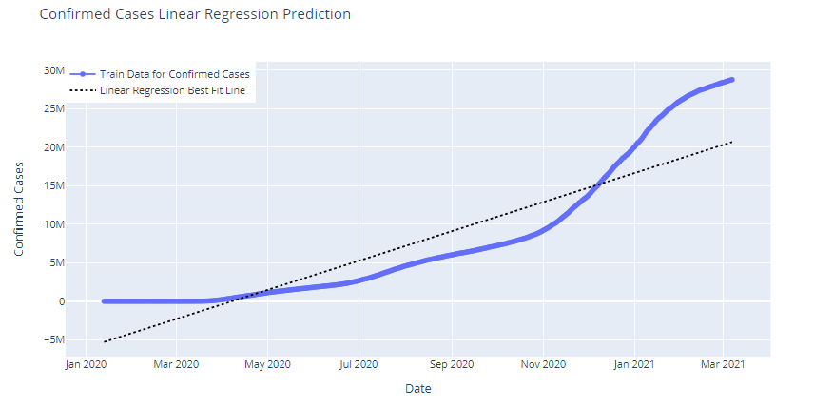
Prediction Models

Slide 18
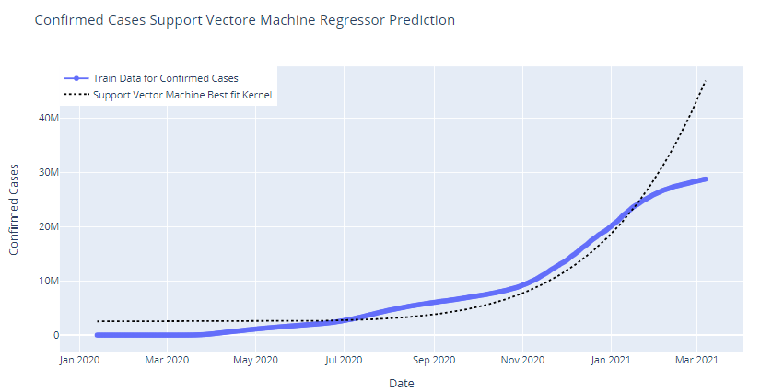
Prediction Models

Slide 19
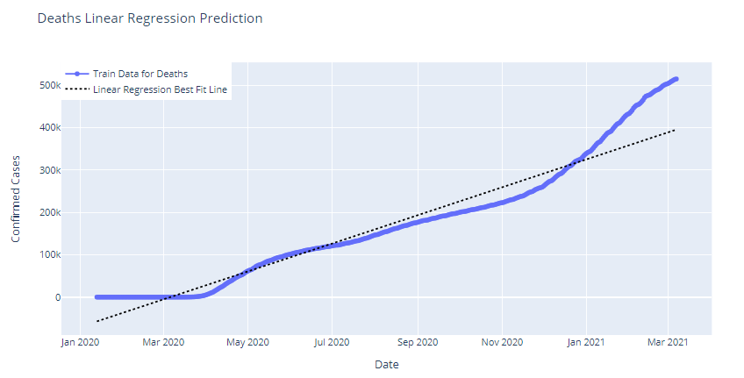
Prediction Models

Slide 20
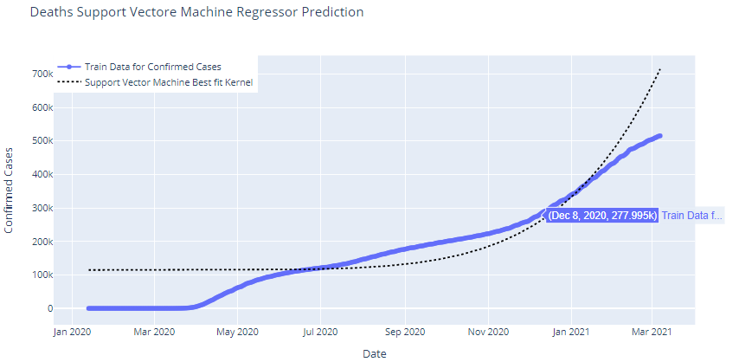
Prediction Models

Slide 21
Insights and Conclusion
The Healthy Recovery Rate implies the disease is curable.
The only matter of concern is the exponential growth rate and spread of infection.
The growth of Confirmed and Death Cases seems to have slowed down since the past few days. Which is a good sign.
Rolling mean of confirmed cases is decreasing after a peak in Jan 2021.
Doubling rate of positive cases is increasing which also a good sign.
New York state was the most affected as it had the highest number of positive cases and deaths.

Slide 22
Questions
Thank You!

