Slide 1

Pair Trading Strategy
in Technology Section
Menglu Hou / Olivia Wang / Kira Yan

Slide 2
Executive Summary
Backgound and Problem
The 2020 stock market crash occurred as a result of the COVID-19 pandemic,
How to trade stocks in order to hedge the risk of loss and make profits under the 2020 stock market crash caused by Covid-19 pandemic?
Strategy Implementation
Data
Selection of a pair
Model
Optimization
Backtest of the model
.
Strategy
Pair Trading Strategy
Keys to Success
Selection of a valid pair
Model optimization and backtesting
Resources: Database; Programing tools (R); Data Visualization tools (Tableau)
Notes:
First we will introduce the back group and identify the problem, next we will coming up with a strategy that can solve the problem. Finally we will show how we implement our strategy.

Slide 3
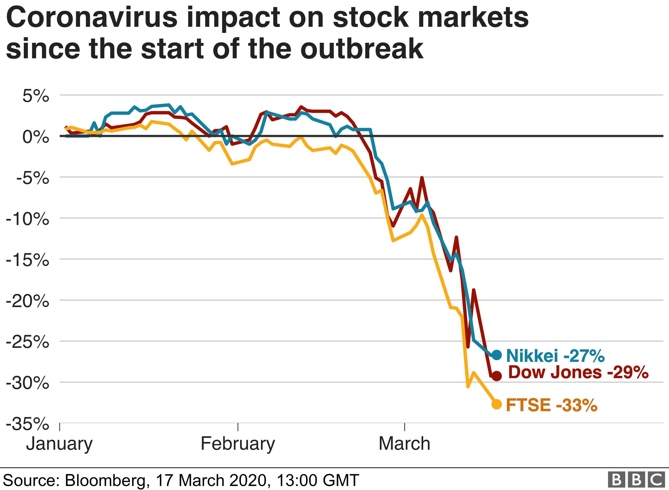
Background
2020 Stock Market Crash
Significant drop of stock prices globally
Huge loss
Problem
For traders, how to trade stocks in order to hedge the risk of loss and make profits under the 2020 stock market crash caused by Covid-19 pandemic?
Notes:
Background:
The world of stocks and securities is filled with uncertainties and risks, expeccilly in 2020, The 2020 stock market crash occurred as a result of the COVID-19 pandemic, it became a nighmare for traders who are focus on the stock prices and are about buying and selling stocks for short-term profit,
Look at the gragh above , there are Significant drops of stock prices happned globally due to covid 19. so it caused a a huge loss for traders who did not make any actions for getting over this situation.
Problems:
…
There is a popular trading strategy that can help us to overcome this problem and even to make profits, it is called pair trading strategy.

Slide 4
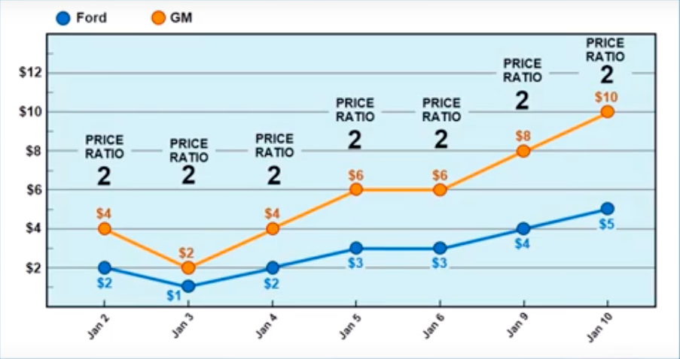
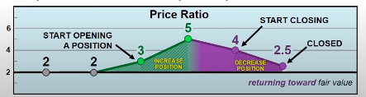
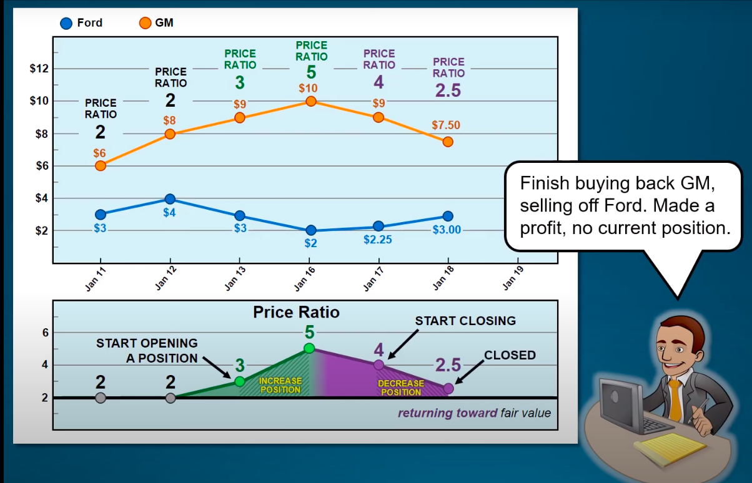
Strategy-Pair Trading Strategy
Two stock prices with price ratio =2
Two stock prices with price ratio moving around the mean, and eventually going back to mean
Purpose of Our Project
We are about to build a pair trading model for traders based on Vhinny’s database to hedge risk of loss and make profits during the period of Covid-19 pandemic.
A pair which price ratio is stable
Cointegration-> stable price ratio
A pair which co-integrated
A pair is co-integrated now != A pair is cointegrated in the future
A pair tends to have a similar business model
Notes:
Startegy to overcome the problem- pair trading strategy
Pairs trading one of the most popular types of trading strategy. In this strategy, usually a pair of stocks are traded in a market-neutral strategy, in other word, it doesn’t matter whether the market is trending upwards or downwards, in our case, the market trednding downwards.
How it work?
The trader would find a pair which price ratio is moving around the mean. for example, we found GM and Ford stock, the price ratio is moving around the 2. take look for the right graph, price ratio is above mean too much like 3 and 5 , we will sell GM since we are expect the stock to will decrease. and buy Ford since we are expect the stock price will increase. when price ratio going back to the mean, we will exit the position, it means to buy back GM and sell Ford. So we can make a profit from price diffrence . Same princple apply to the situition which price ratio is below the mean too much.
Purpose of project:
…

Slide 5

Strategy Implementation
Notes:
亮亮图文旗舰店https://liangliangtuwen.tmall.com

Slide 6
Implementation Outline
Data
Model
Backtest of Model
Database: Vhinny
Data Simple Exploration
Features: Window Lengths; Z-Socre
Feature selection
Training model to show trading signals
Optimized model performance on test data
Final optimal model
Evaluation of our optimal model: profitable!
Decision-making
Selection of a Pair
Model Optimization
Measurements of relationship btw variables : Cointegration
Cointegration Test: ADF test
Group Visualization before Conducting: industry; asset scales
Observing Pair candidates
Conduct of ADF test
Optimized Features: threshold of exit position signals and window length

Slide 7
Data Basic Exploration
Database Source:
Vhinny Database
Number of companies in Technology Section :
418
Time Range of Stock Price of technology companies
2019/09/20-2020/07/29
(Notes: new stock prices have updated to database)
Information about the companies:
Balance Sheet: Total Assets; Current Assets; Shareholder’s equity, etc
Income Statement: Revenue; Operation Expense, Gross Profit, etc
Company Basic Information: Section; Industry; company description, etc
A pair which price ratio is stable
Cointegration-> stable price ratio
A pair which co-integrated
A pair is co-integrated now != A pair is cointegrated in the future
A pair tends to have a similar business model

Slide 8
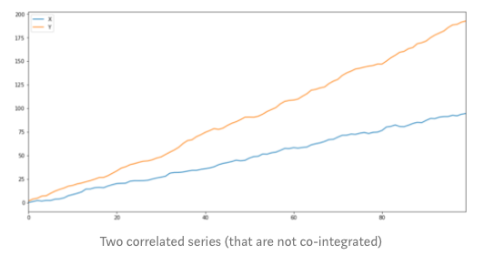
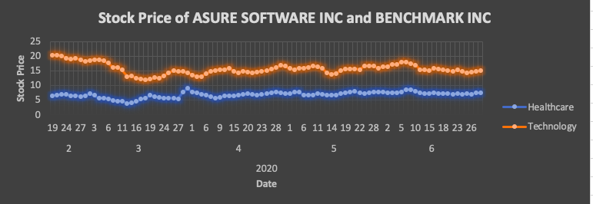
Selection of a Pair
Measuring the Stability of Price Ratio
(more details on Appendix )
Correlation: the degree of correlation relationship between the two variables[-1,1]
Cointegration: the stability of the linear combination of two variables. Y(t)=α+θX(t)+z(t)
Other statistical measurements: Stochastic; Stochastic differential residual
Plot of two stock prices with almost perfect positive correlation relationship
Cointegration Test
(more details on Appendix )
ADF Test
Johansen Test
The Engle-Granger Test
Plot of two stock prices
Cointegrated now ≠ Cointegrated future
A pair which price ratio is stable
Cointegration-> stable price ratio
A pair which co-integrated
A pair is co-integrated now != A pair is cointegrated in the future
A pair tends to have a similar business model
Notes:
Now, we have already identified that we need to find a pair having price ratio moving around the mean or stable.
So next Our goal is to find a meansurement that can meansure the stability of stock prices the best. There are conple of meansurest that meansure the realtionships bwtween varables
Here I am only going to compare correltaion and cointegration since they are measnurement that people used to use for obersving the realshipns
Corelation measures the degree of correlation relationship between the two variables. We assume that higher correlation results in hign degreee of stability of the price ratio. Here is a plot that shows two stock prices with almost perfect postitive correlation relationship. If one stock prices goes up ,the another stock price goes up as well.but It is clealy that price ratio between this two stocks is not moving around a constant or stable. So correlation is not a good measures. Cointgration meansthe stability of the linear combinition of two varables. In our case two stock prices. In other ward, it measure the stability of linear combition of stock prices. It means it meansure the stability of the price ratio. So conintegration is a good measurement. For more details about why I select conintegration but not others, I put it in the appendix.
So far, we have identified that we are going to find a pair which is coinitegred, our next goal is to select best cointegration test in terms
Best cointegration test Interms of accuracy level of result and resriction of tests.

Slide 9
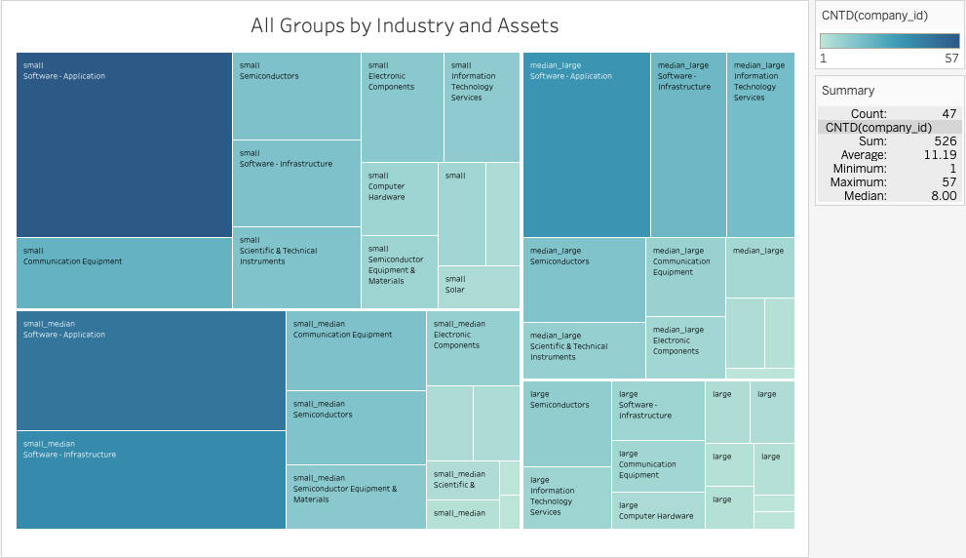
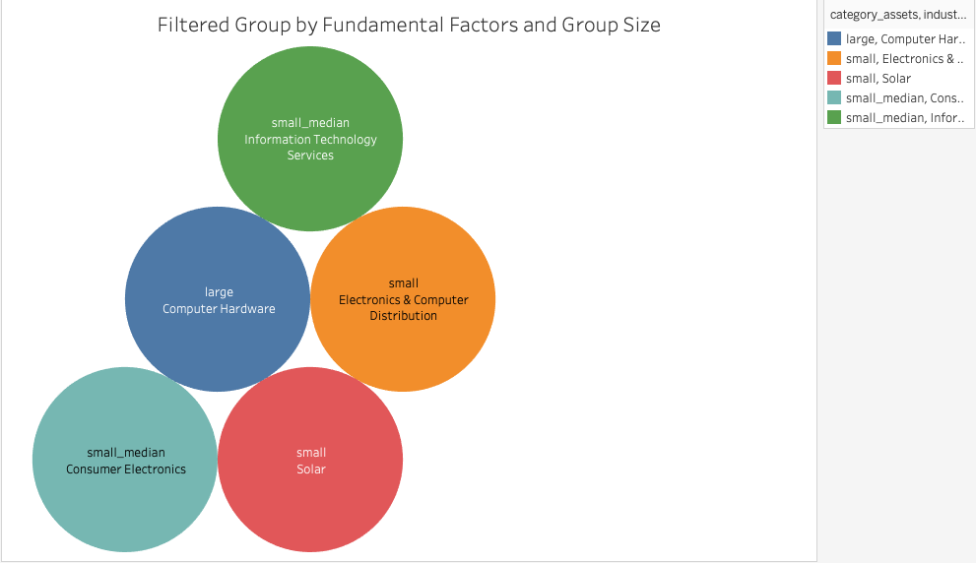
Selection of a Pair
Group Visualization before Conducting Test
Avoid
comparison bias
Group Size: 5
Notes:
Before we conduct the adf test. In this group, we can delecte some the pair candistaes that are not not clearly conintegrated with others in the group to double mininizingthe comparison bias.

Slide 10
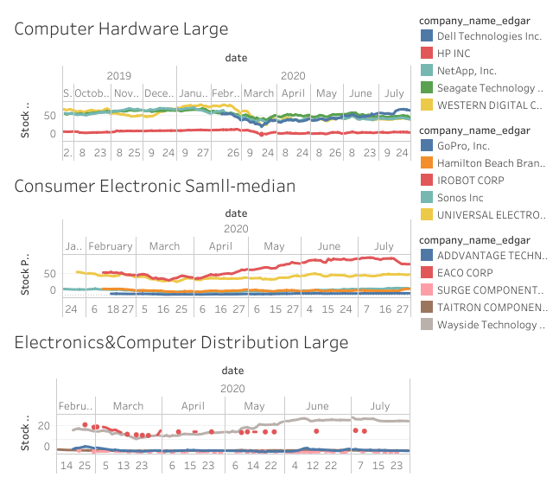
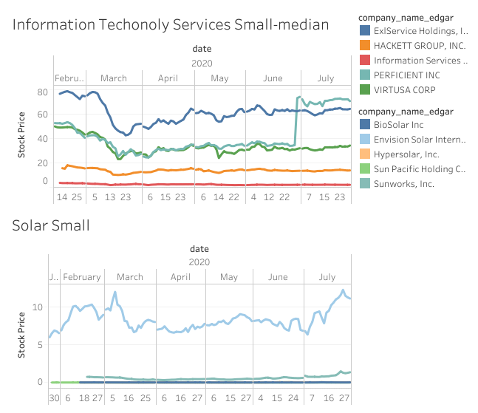
Selection of a Pair
Observing Cointegrated Pair Candidates
CH Group
IT Group
CE Group
SS Group
EC Group
Stock Prices in Each Group

Slide 11
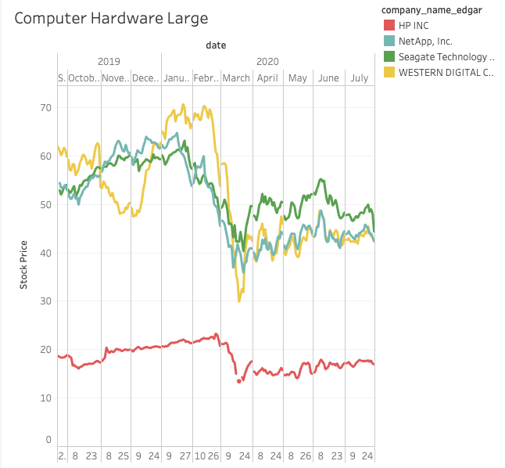
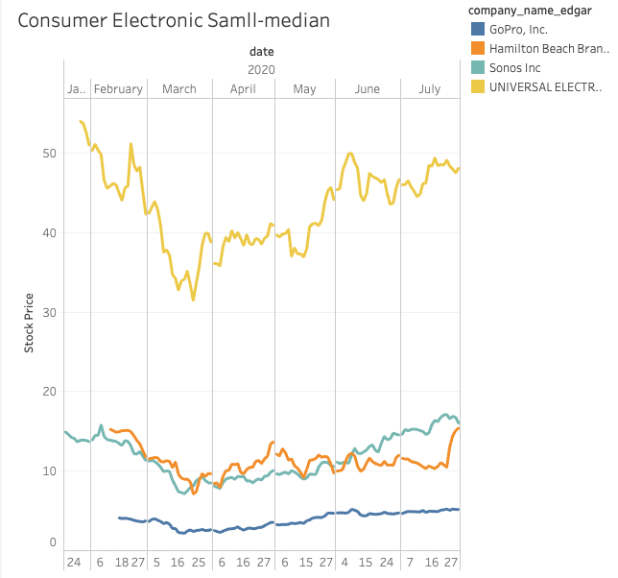
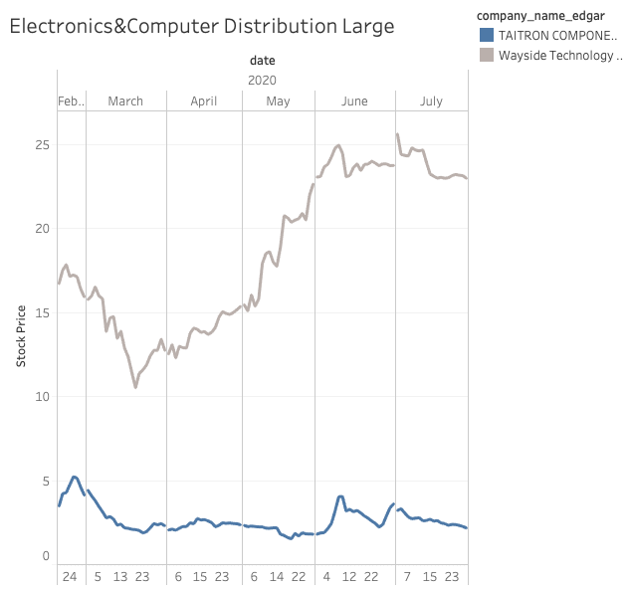
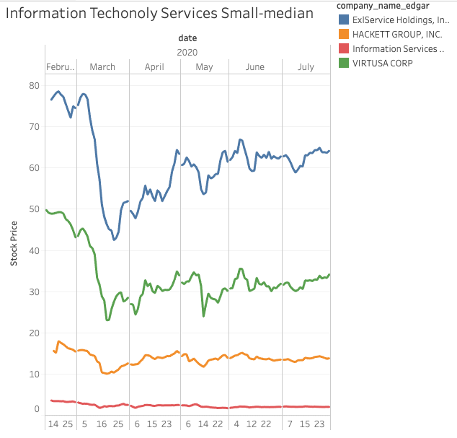
Selection of a Pair
CH Group
CE Group
EC Group
IT Group
4 Candidates
4 Candidates
2 Candidates
4 Candidates
Pair candidates to be conducted with ADF test

Slide 12
Selection of a Pair
Conduct of ADF Test
Threshold of P-value: 5%
The lower the P-value(<=5%), the better (more confidence to believe)
P-value
P-value
P-value
P-value
P-value
P-value
CH Group
HP-Net
0.62
HP-Seg
0.76
HP-Wes
0.48
Net-Seg
0.04
Net-Wes
0.44
Seg-Wes
0.49
CE Group
Go-Ham
0.60
Go-Uni
0.02
Ham-Uni
0.33
So-Uni
0.19
So-Go
0.61
So-Ham
0.41
EC Group
Ad-Tai
0.30
Ad-way
0.20
Tai-Way
0.01
/
/
/
IT Group
Ex-Hack
0.18
Ex-In
0.45
Ex-Vir
0.07
Ha-Vir
0.12
Hack-In
0.42
In-Vir
0.03
The pair to be built a model on
(code output: see Appendix )

Slide 13
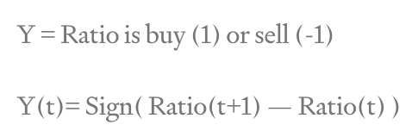
Model
Problem Statement
To generate the signal that tells us to buy or sell at the next instant time.
Data Preparation
Cleaned dataset: stock prices of W and T from 2020/02/19-2020/07/29 from Vhinny dataset
Split data: 70% of the dataset → train and optimize the model
30% of the dataset→ Backtest optimized model
Notes:
Problem:
…
Spilt the data:
To validate the model, We choose to split the dataset, that is, the 70% of the dataset will be used to train our model, and the rest 30% dataset will be used to test the performance of the optimized model.

Slide 14
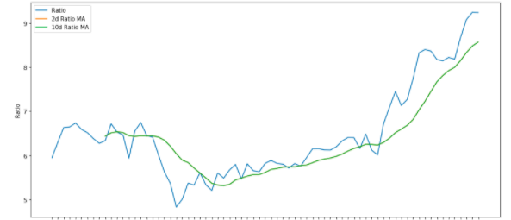
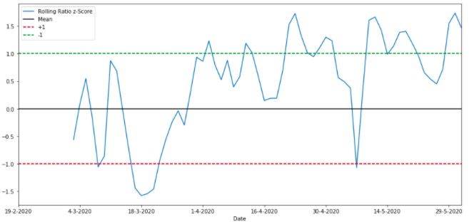
Model
Features
10 days Moving Average of Ratio: Measure of rolling mean
2 days Moving Average of Ratio: Measure of current value of mean
10 days Standard Deviation
Z - score: (2 MA — 10 MA) /10d SD
2d and 10d ratio MA
Feature Selection
Buy Low Sell High
When Z-score < -1, Set buy signal - Buy(-1).
When Z-score >1, Set sell signal - Sell(1).
Rolling Mean of Z-Score
(code: see Appendix )
Notes:
we normalize the price ratio by using Z-score in order to better observing the degree that price ratio is moving around mean. z is defined as 10days Moving avg, 2 date moving avg, 10days SD, we call the moving average as window length。
Take look for the rolling mean of z-score, z-score =1 and -1 are good trading threshold, therefore, we select, when..

Slide 15
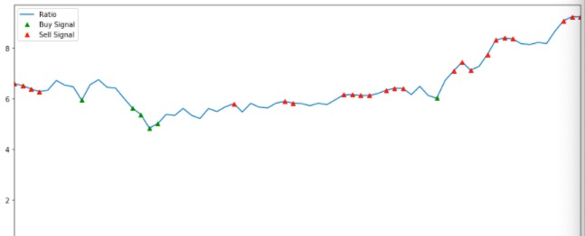
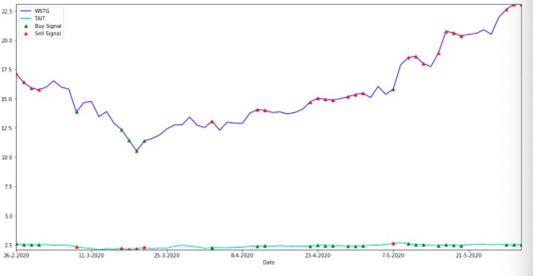
Model
Training model to show signals
Trading Signals on price ratio
Trading Signals on two stocks, S1, S2
(code: see Appendix )
Notes:
See the pic, green measn buy signal, read means sell signal. in the second pic, that is, buy S1, Sell S2.

Slide 16
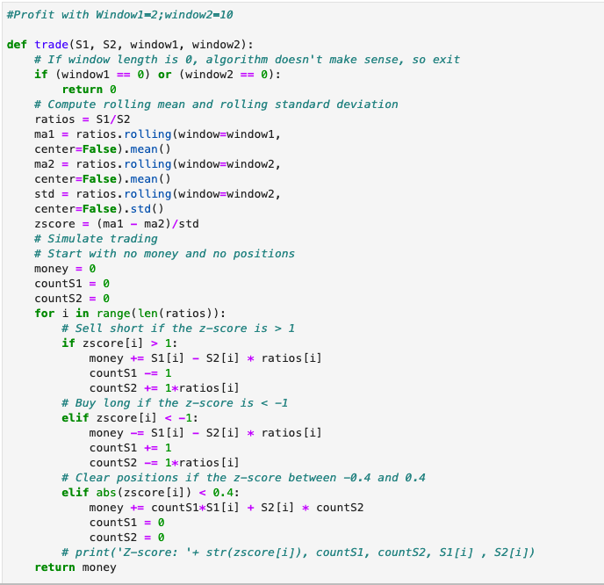
Model Optimization
Goal - Maximum Profits
- Optimization to ensure the maximum profit on the train data
How we calculate profits
Profits += Sell (+) /Buy (-) Price of S1 * Positions of S1 + Sell (+) /Buy (-1) Price of S2 * Positions of S2
Start with no money and no position.
Clear all the positions at the final price when we exit.
Profit does not consider commission fee.
(code: see Appendix )
Notes:
Goal:
…
How we calculate profits:
Formula:..
Start with no money and no position.
Clear all the positions at the final price when we exit.
* profit does not consider commission fee.

Slide 17




Model Optimization
Optimized Features
- Find the best combination of window length calculated in the Z-Score and and exist threshold of Z-Score.
Threshold: trade:>1 or <-1 ;exist: [-0.3,03])
Threshold: trade:>1 or <-1 ;exist: [-0.4,04])
Threshold: trade:>1 or <-1 ;exist: [-0.5,05])
Threshold: trade:>1 or <-1 ;exist: [-0.6,06])
(code: see Appendix )
Notes:
To opotmize model we are to optimze feature
Optimize feasure
Best combination
..

Slide 18
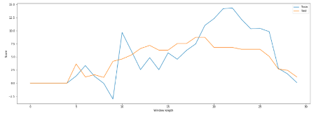
Backtest of Optimized Model
Model Performance on Test Data
Checkout overfitting:
5.19
Plot of profit on train and test data with models with different window length
Final Optimal Model
Exit threshold: [-0.3,03]
Window length: 16-22
(code: see Appendix )
Notes:
Model Performance on test data:
When apply optimized model to test dataset, we have 5.19 profits.
Checj out overfiiting:
By oberseving the grapgh above, we found some … above 5.19. so our chosen model on test data is far from optimal. It is because our model is overfitted to the train data.
Final Optimal Model:
By oberving above plot, we can see when window length between 16 to 22, we can make profit around or more than 5.19, so models with window length that is between 16 to 22 can be our options to apply in the real life.

Slide 19
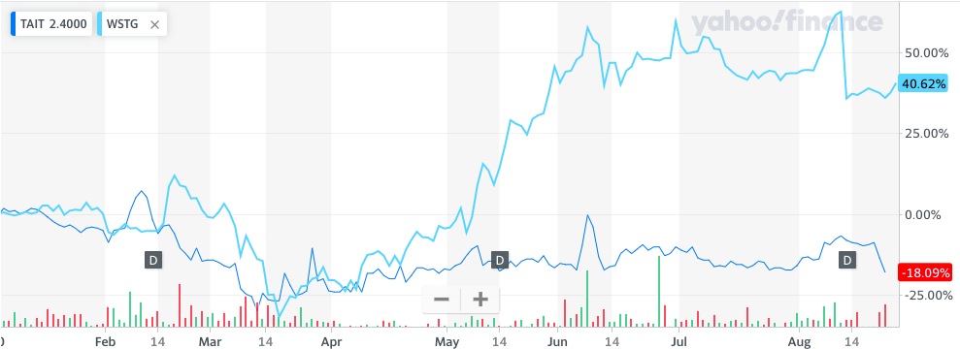
Backtest of Optimized Model
Comparison of Different Strategies
(Sheet: see Appendix )
Notes:
From April, the stock market entering the bull market, whih means the overall stock prices are rsifing up. Same as the the T and W. now we are tesing if our model can actually make more profit comparied to other strategies. The date range if our test data is belsongs to the perido of bull market, which stock prices are remainsing stable.

Slide 20
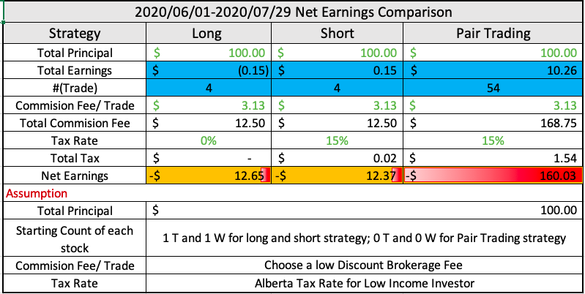
Backtest of Optimized Model
Comparison of Different Strategies
(Sheet: see Appendix )
Notes:
there are acouple of strategies for trading. Here is a comparison of net eargings of three simple startegyies: long positon ,short positon and pair trading startegy.
Theretically. Our model can make more profit if not taking account commition fee, taxes. We can gain 10.26 as maxim profit as total earnings from th etable shown.
But in reality. There are some costs reading to the trading stocks that we have to consider: commission fee and taxes.
In this case. Our net earing= total earing- total commision fee- taxes
Here we choose discount vraokeage fee as 3.13/trade that is avg of common discount braokerage fee. Also, we assume our income is below 48k a year, it gives us tax rate on income is 15%.
After taking all cost into our account. We surprising found we have the hugest loss from paur trading that is 160.03. that rest two are -12.65 and -12.37 respectively.
The reason that we have such loss is we pay too much commision fee that is 168.75, which is 16 times of our profit from pair trading. Commision fee of other two strategy are only 3.13. so we have to consider commisionision fee in toacount when it comes to pair trading.
This result based on the case that stock prices are stable. We can expecct that the future stocks price are still maintain stable or rise if there is no more huge event happens for covid-19. reagrding to this three strategy. so are more unlikely to use pair trading startegy since we can expect we can make more peits if suning long strategy.
Therefore. If we want to select a trading strategy from now, pair trading startegy is not a good strategy you can choose. If sleect startegies amogst these three strategy. Long postion strategy can be a choice.

Slide 21
Backtest of Optimized Model
Decision-Making
For traders who want to trade stocks from now, pair trading strategy is NOT a good strategy to choose. If selecting strategies amongst these three strategy, long position strategy can be a better choice.
(Sheet: see Appendix )
Notes:
afte

Slide 22
Summary
Summary
Statistical measurement: Cointegration
Statistical test: ADF test
Grouping companies: Industry;Assest scales; (Goup size)
Pair candidates: Four groups (IT, CH, EC, CE)
Pair: Taitron and Wayside
Optimal model: models with window length between 16 to 22 and exit threshold is abs(0.3)
Decision-Making: NOT use our pair trading model
Challenges
Database: fundamental grouping(or analysis)-Y ; selecting a cointegrated pair and building a model –N
→ after grouping companies, use yahoo finance (time length: 10-year)
- Calculation of Profit: commission fee cost is huge factor affect the profit calculation, therefore affecting the optimization of window length
→ Include the commission fee cost for calculating profit and selecting the optimal model, then comparing performance of three strategy to make trading decision.
- A change in future cointegration relationship: change of company structure; mergers and acquisitions, etc.
→ keep eyes closed on news and factors that may affect fundamental correlation and cointegration of the pair.
Notes:
Summary:
Here, for building an optimal pair trading model, we narrowed down pair candidates by fundamental factors.
Then by using the cointegration test, we identified a cointegrated pair, which is Taitron and Wayside.
Based on this pair, we selected an optimal model that can bring us the most profit in the future. In order to improve the accuracy of the model, we need a large size of dataset to build a more accurate model.
Challenges :
1. Accuracy of model need to improved
2. Even we can build a more accurate model, since the correlation and cointegration of two stocks we selected may decrease caused by company structure, the profitability of company and etc. we still need to keep our eyes closed on factors affecting correlation and cointegration score of this pair, if scores are getting lower, we may need to take a look for other competitive pairs in order to make a profit by applying pair trading strategy.

Slide 23
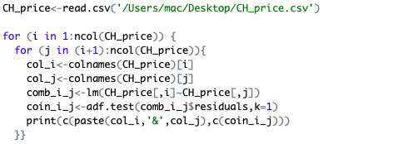
Appendix
Measuring relationships btw variables:
https://www.aptech.com/blog/a-guide-to-conducting-cointegration-tests/v
A guide to conduct cointegration test :
https://www.aptech.com/blog/a-guide-to-conducting-cointegration-tests/
A Code Sample of ADF test (CH Group)
A pair which price ratio is stable
Cointegration-> stable price ratio
A pair which co-integrated
A pair is co-integrated now != A pair is cointegrated in the future
A pair tends to have a similar business model

Slide 24





















Appendix
Code output of ADF test
CE:
CH:
EC:
IT:
Model Code Notebook:
file:///Users/mac/Downloads/Model_final_code%20(1).html
A pair which price ratio is stable
Cointegration-> stable price ratio
A pair which co-integrated
A pair is co-integrated now != A pair is cointegrated in the future
A pair tends to have a similar business model
Notes:
Summary:
Here, for building an optimal pair trading model, we narrowed down pair candidates by fundamental factors.
Then by using the cointegration test, we identified a cointegrated pair, which is Taitron and Wayside.
Based on this pair, we selected an optimal model that can bring us the most profit in the future. In order to improve the accuracy of the model, we need a large size of dataset to build a more accurate model.
Challenges :
1. Accuracy of model need to improved
2. Even we can build a more accurate model, since the correlation and cointegration of two stocks we selected may decrease caused by company structure, the profitability of company and etc. we still need to keep our eyes closed on factors affecting correlation and cointegration score of this pair, if scores are getting lower, we may need to take a look for other competitive pairs in order to make a profit by applying pair trading strategy.

