Slide 1
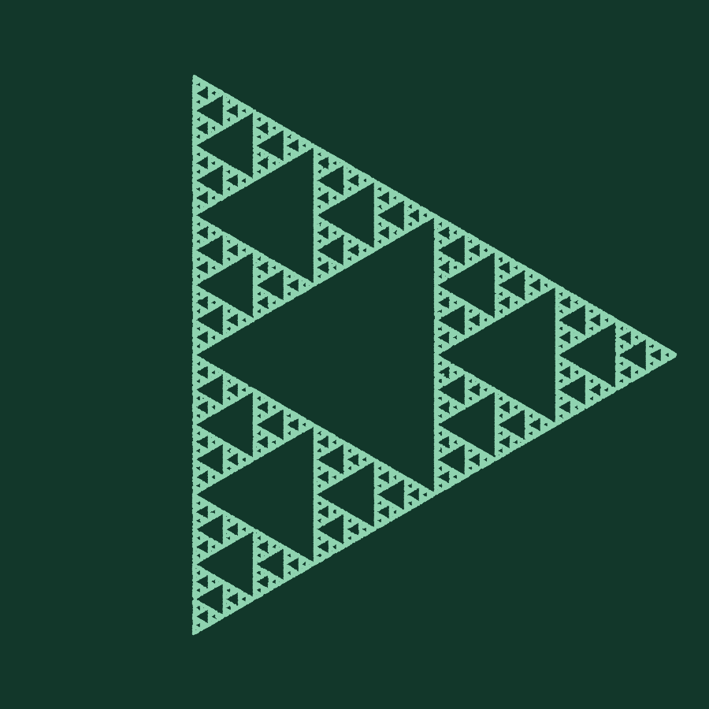
Chaos Game
Fractals from linear maps
MFAD Mini Project · Kirby, PES University
Notes:
Open by showing the picture: this complex triangle is built by a very simple random rule. The next slides explain the rule and the linear algebra behind it.

Slide 2
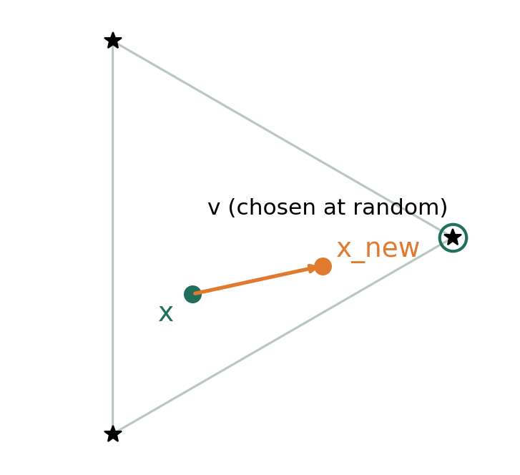
One step of the game
x_new = T (x − v) + v
Pick a vertex v of the polygon at random
Move the point toward v: T = r·I shrinks the distance to v by the ratio r
Repeat 10,000+ times and plot every point
Each step is a contraction toward the chosen vertex. With r = 1/2, x_new is the midpoint.
Notes:
Explain T as a matrix: T = r times the identity. The map x -> T(x - v) + v is a scaling centered at v. With r = 1/2 the new point is the midpoint of x and v.

Slide 3
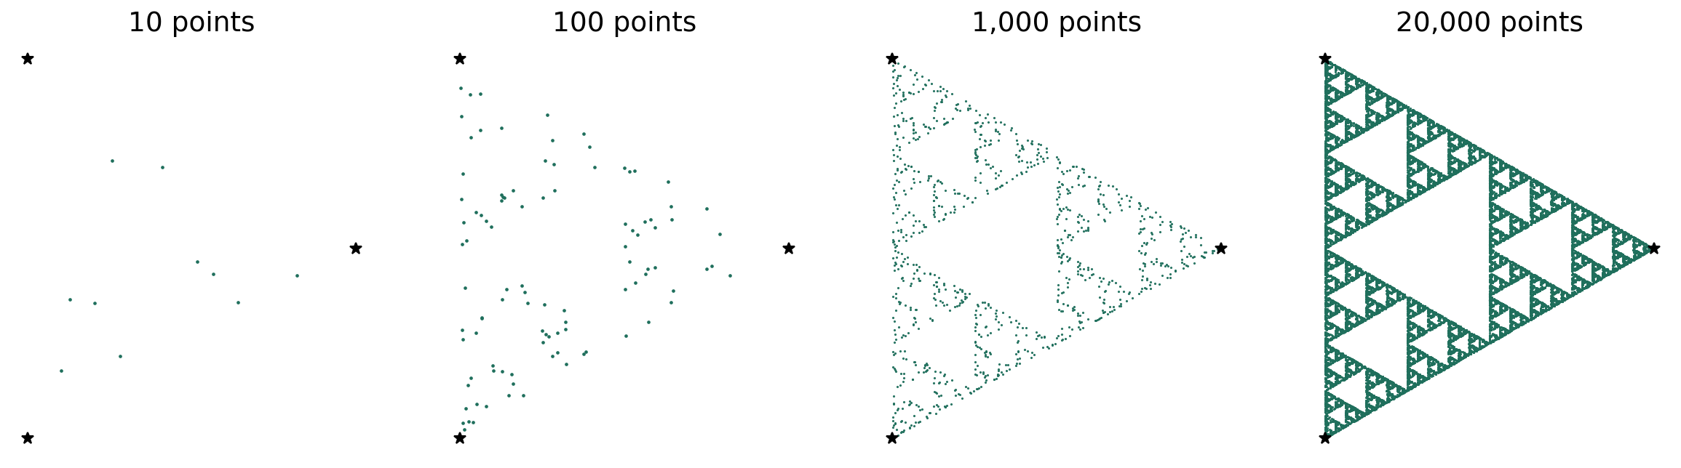
Watch the structure emerge
Same rule, more points
Live demo: figures/chaos_game.gif
Early points look random. By 20,000 the Sierpinski triangle is unmistakable, and nothing in the rule mentions a triangle.
Notes:
The GIF in the repo plays this build-up live. Open figures/chaos_game.gif in a browser if you want to show it animated.

Slide 4
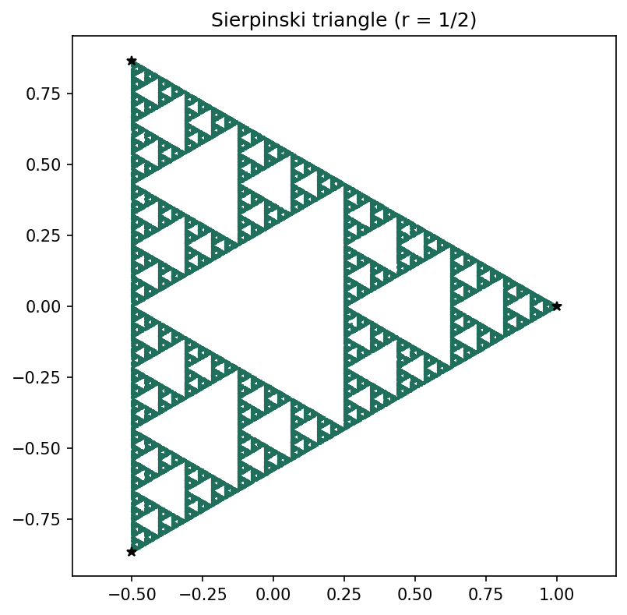
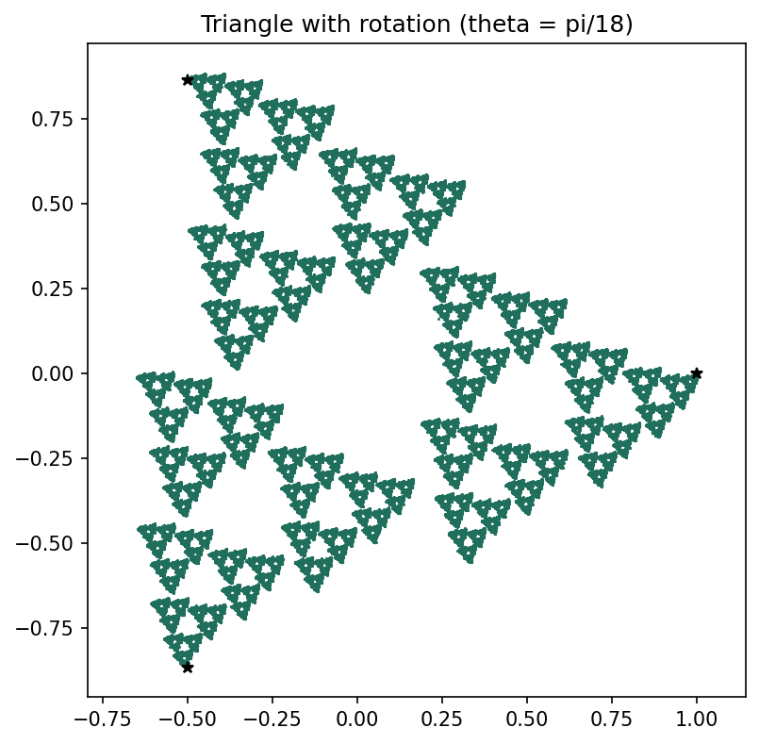
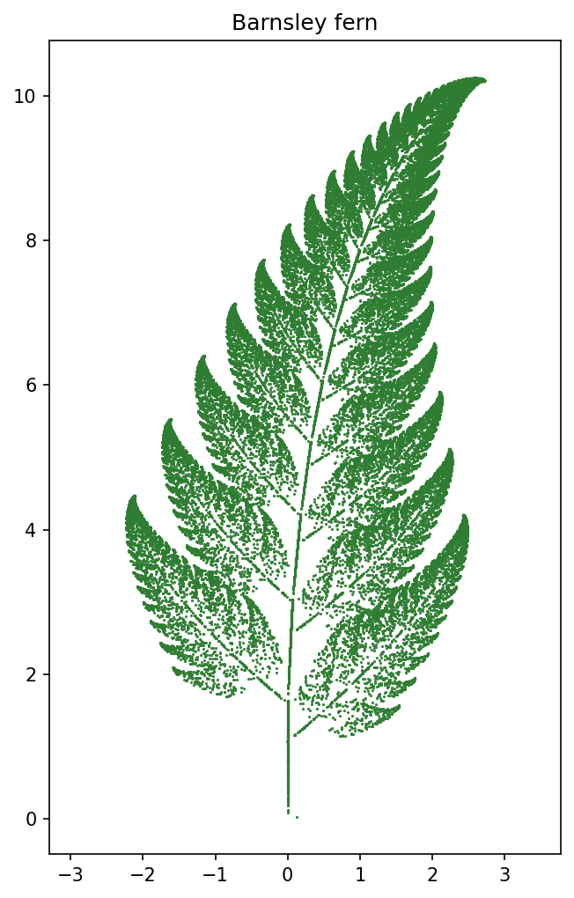
The linear algebra behind it
Scaling
Scale + rotate
Affine map
T = r·I
T = r·R(θ)
x → T x + Q
det T = r², so areas shrink by r² each step. Both eigenvalues equal r.
Eigenvalues are complex with modulus r, so every step spins by θ and shrinks.
Q translates. Four different T's, chosen with probabilities, grow a fern.
Notes:
det(T) is the area scaling factor. Eigenvalues of modulus below 1 mean the map contracts, which is why the iteration settles onto an attractor.

Slide 5
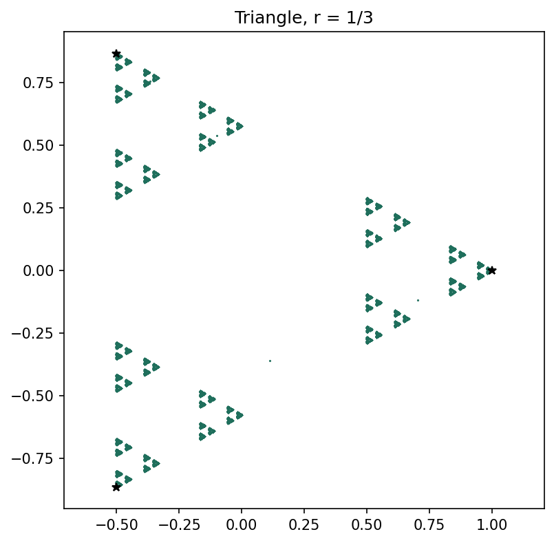
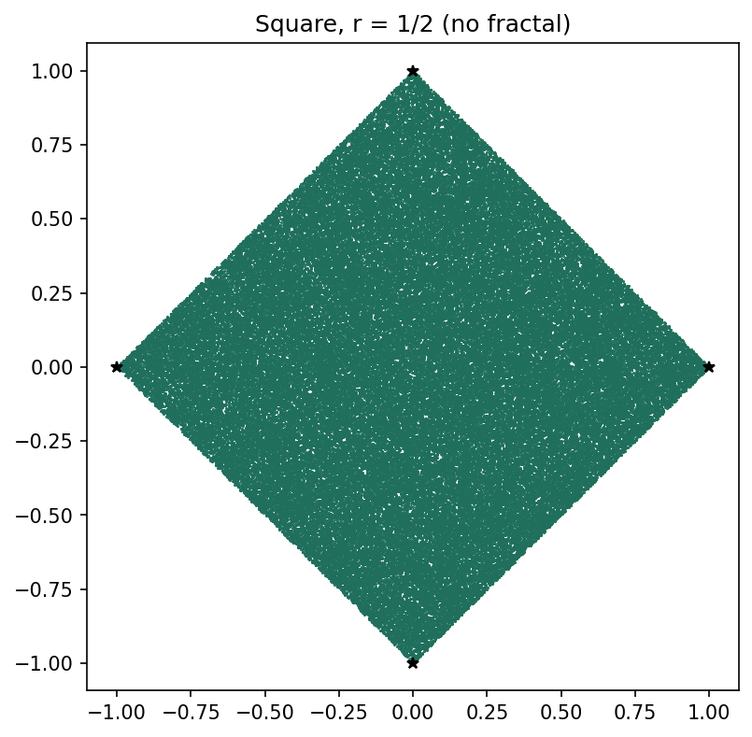
Ratio and rotation change the picture
r = 1/3 on a triangle
r = 1/2 with rotation π/18
Square, r = 1/2
Pieces no longer touch: the set breaks into separate specks (dimension 1).
A small twist per step turns the clean triangle into a swirl of tilted copies.
The pieces overlap so much that the whole square fills in. No fractal.
Notes:
The ratio decides whether the copies overlap, touch, or separate. That is the whole story of the square at 1/2 versus 1/3.

Slide 6
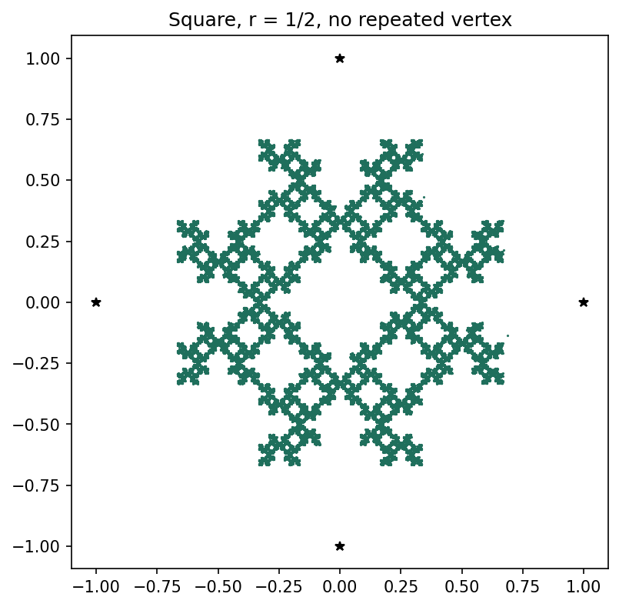
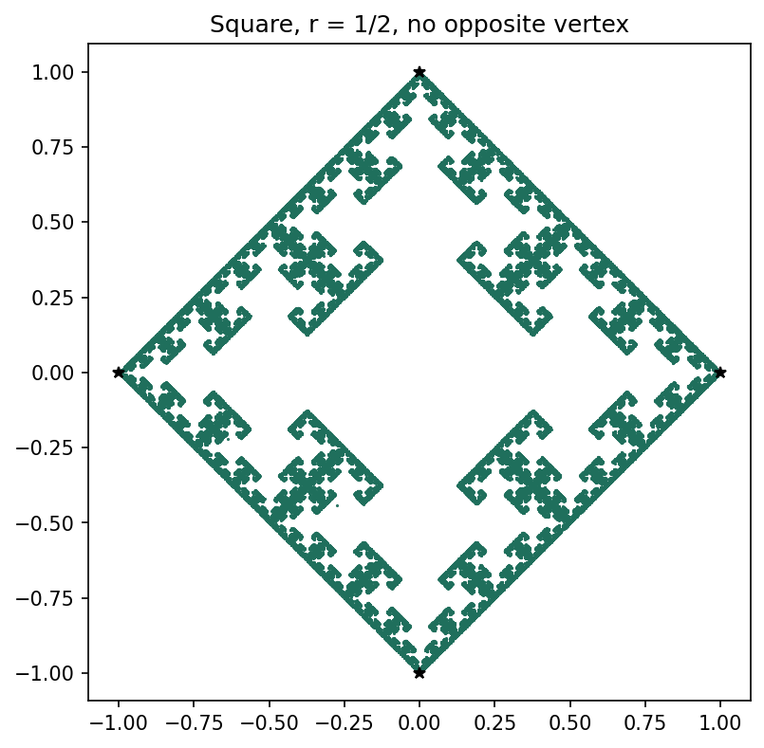
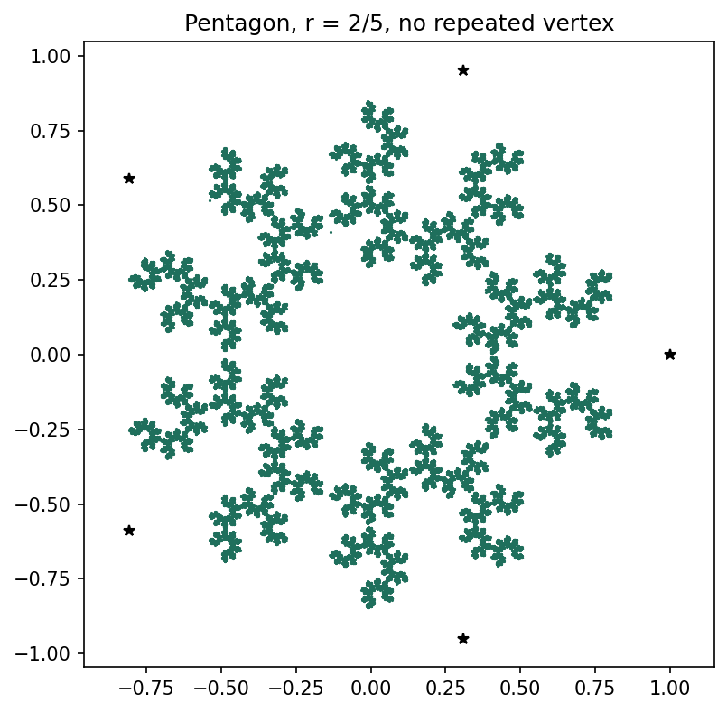
Forbidding a vertex creates structure
Square: no repeated vertex
Square: no opposite vertex
Pentagon, r = 2/5, no repeat
Banning a repeat already breaks the overlap and a fractal appears.
Skipping the opposite corner leaves clear gaps with copies at every scale.
Clusters ring an empty center, and each cluster is a miniature of the whole.
Notes:
Same ratio, different rule about which vertex may follow which. The restriction changes the dynamical system, so the attractor changes.

Slide 7
Barnsley fern: four matrices, one plant
Map | Probability | det(T) | |eigenvalues| | Role
T1 | 85% | 0.724 | 0.851, 0.851 | Main frond, slightly rotated copy
T2 | 7% | −0.109 | 0.288, 0.378 | Side leaflet
T3 | 7% | 0.104 | 0.322, 0.322 | Side leaflet
T4 | 1% | 0 | 0, 0.16 | Stem: singular, flattens to a line
det(T4) = 0 means the plane is crushed onto a line. That is exactly where the stem comes from.
Notes:
All four matrices have spectral radius below 1, so the system contracts. The singular T4 is a nice linear algebra moment: rank 1, so it maps the whole plane onto the y-axis.

Slide 8
Measured dimension matches the theory
1.585
log 3 / log 2
Sierpinski triangle
Dimension = log n / log(1/r) for n copies at ratio r. We checked it by box counting the plotted points.
Notes:
Theory is exact only when the pieces don't overlap, which is why square 1/3 differs a little: box counting at finite resolution is rough on the clustered pieces.

Slide 9
Takeaways
det(T)
|λ| < 1
log n / log(1/r)
Area scaling
Contraction
Dimension
Tells you how fast each map shrinks the plane. det = 0 collapses it to a line.
Eigenvalues inside the unit circle guarantee the iteration settles on one attractor.
Counts how the copies scale, and our measurements agree with it.
Simple matrices plus a coin flip give infinite detail, and linear algebra explains why.

Slide 10
Live demo
$ pip install -r requirements.txt
$ python main.py --show
$ python visuals.py
main.py opens each fractal and prints the dimension and eigenvalue tables. visuals.py makes the step diagram, build-up strip and GIF.
Repo: chaos_game.py · main.py · visuals.py · README.md
Notes:
Fallback if the live run fails: the figures/ folder has every image saved, and chaos_game.gif shows the build-up.

