Slide 1
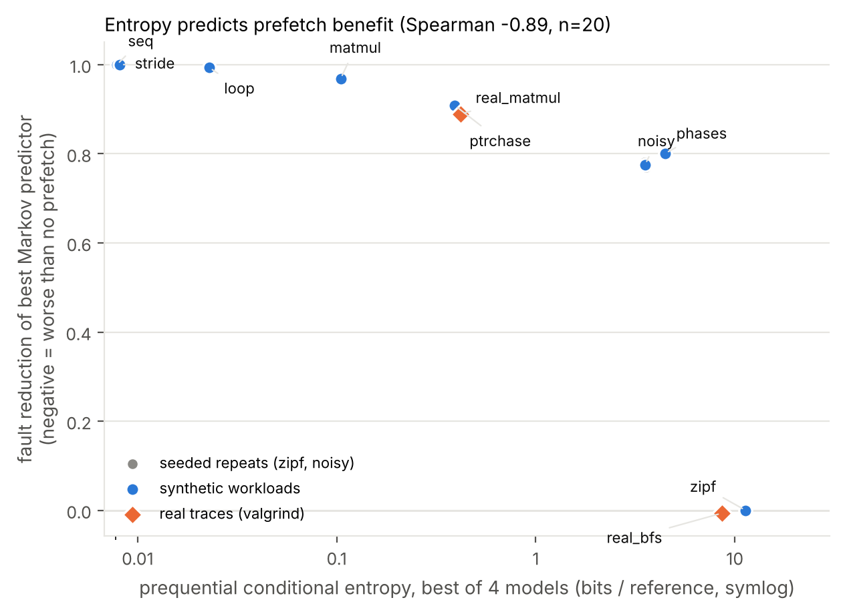
When Does Markov Prefetching Pay Off?
An entropy-based study with an adaptive throttle
Pala Gaurav Reddy · PES1UG25AM254
UE25CS242A Operating Systems · Mini project P11 · PES University
Notes:
One sentence: when does Markov prefetching actually help, and how do we stop it hurting when it does not? The figure on the right is the punchline.

Slide 2
Why prefetch pages?
1
2
3
A fault is expensive
Prefetching can hide it
A wrong guess hurts
Every fault stalls the process while the page is fetched from disk. Faults, not instructions, often set the running time.
If we guess the next page, it is already resident when the process asks for it, so the fault never happens.
A useless prefetch wastes I/O and pushes out a page that was useful. On random access this can make things worse.
Notes:
A page fault costs orders of magnitude more than a memory access. Prefetching tries to load the page before the fault. A wrong prefetch costs I/O and evicts a page you needed.

Slide 3
The question
Not “does Markov prefetching work?” but when, and how do we stop it from hurting when it doesn’t?
A reproducible C simulator and workload suite for comparing prefetchers under LRU
An empirical link between a trace’s conditional entropy and the benefit of a Markov predictor
A small accuracy-driven throttle, with what it saves and what it costs
We do not claim Markov prefetching itself is new.
Notes:
Markov prefetching is not new (Joseph and Grunwald, ISCA 1997). The contribution is an empirical study of when it helps, plus a throttle.

Slide 4
How the simulator works
Frames + LRU
Trace
256 frames. A prefetched page is tagged until it is used.
Metrics
One page number per reference. Synthetic and real (valgrind) traces.
Fault rate, accuracy, wasted prefetches, table size.
Predictor
none, next-page, stride, or Markov (page or delta state, order 1 to 3).
The predictor sees each reference and issues prefetches; the frame cache counts what was useful.
Notes:
Trace-driven: we replay a list of page numbers. Prefetched pages are tagged; useful if used before eviction, useless otherwise.

Slide 5
The Markov predictor
State = last k symbols (k = 1, 2, 3)
Table maps each state to 4 successor counters
Prefetch the top successors whose share of the counts is above a confidence threshold
Table: 2^16 entries, direct-mapped and tagged
 | Page state | Delta state
Symbol | page number | page − previous page
Table size | about one entry per page | tiny: one per delta pattern
Good at | fixed jumps (loops, pointer chasing) | regular strides (scans, arrays)
Rule of thumb: the right state matters as much as the algorithm.
Notes:
State is the last k symbols. A symbol is either the page number or the delta from the previous page. The table maps state to four successor counters.

Slide 6
Adaptive throttle
Every 2,048 references | Action
Accuracy below 0.3 | Raise the confidence threshold (prefetch less)
Accuracy above 0.6 | Lower the threshold (prefetch more)
Fewer than 32 outcomes | Relax one level to probe again
Threshold levels: 0.1, 0.4, 0.7, 0.95. Hand-chosen, not tuned on held-out workloads.
Notes:
Every 2,048 references we look at what fraction of resident prefetched pages were actually used and move the confidence threshold. Levels and cut-offs are hand-chosen, not tuned.

Slide 7
Workloads
Trace | What it is
seq | cyclic scan of 30,000 pages
stride | stride-7 scan
loop | 600-page loop
ptrchase | fixed random cycle, 5,000 pages
matmul | naive i-j-k, 1024×1024 doubles
noisy | ptrchase with 10% random pages
zipf | independent Zipf references
phases | four behaviours in sequence
real_matmul | 384×384 matrix multiply (valgrind)
real_bfs | BFS on a 100k-node random graph (valgrind)
Notes:
Eight synthetic workloads that I designed to span predictable to unpredictable, plus two real traces from valgrind. zipf and noisy have five more seeds.

Slide 8
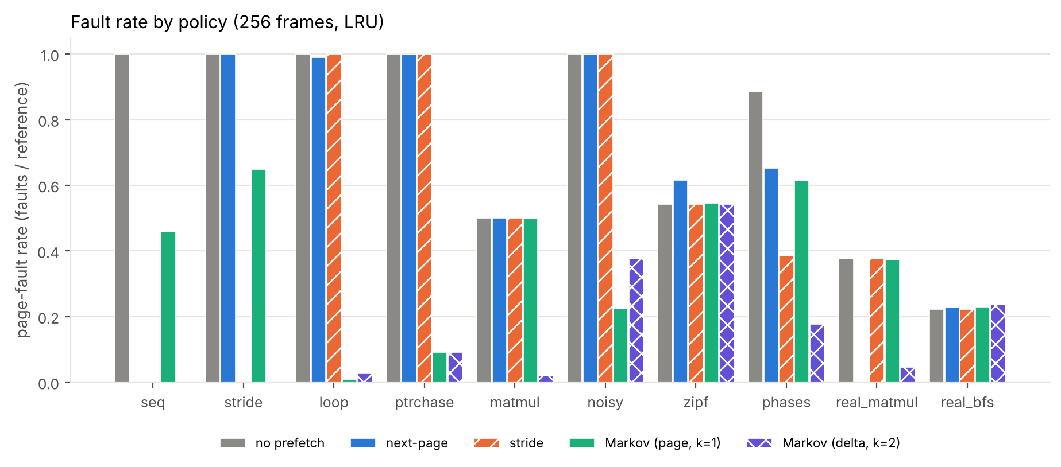
Result 1: access structure decides
Structured streams are almost fully fixed. On zipf, next-page raises faults from 0.542 to 0.615.
Notes:
Delta Markov fixes the scans and matmul. Page Markov fixes loop, ptrchase, noisy. Nothing fixes zipf; next-page makes zipf worse.

Slide 9
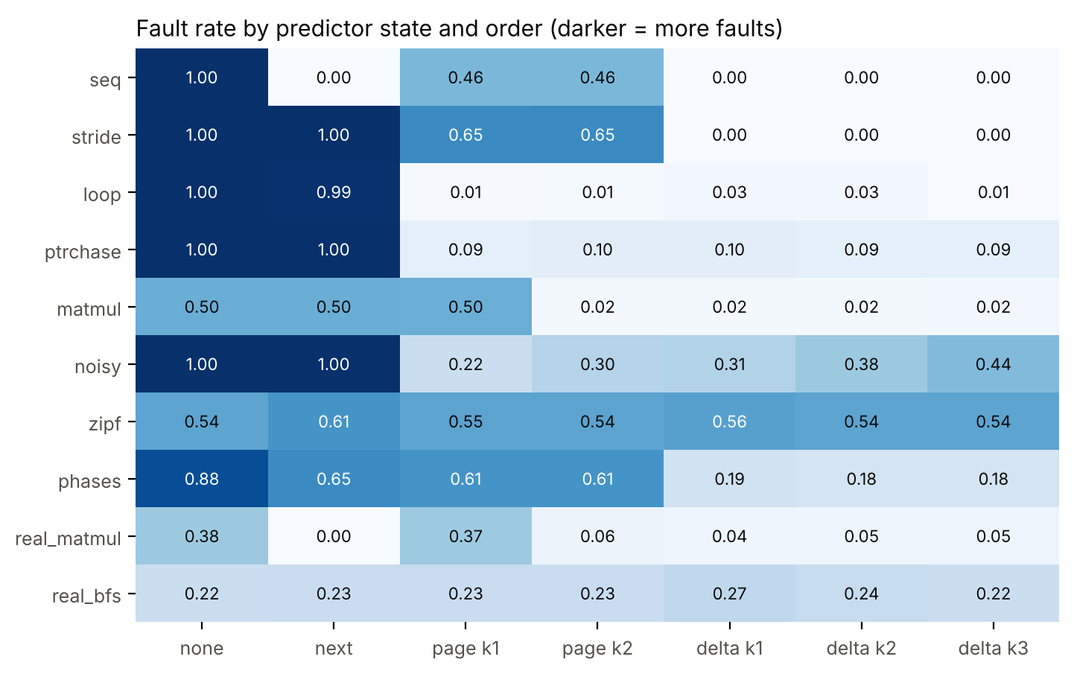
Result 2: state and order matter
matmul: page order 1 = 0.499, order 2 = 0.016
seq: page state 0.458 vs delta state 0.000
noisy: fault rate rises with order for delta states
Notes:
Page order 1 fails on matmul because the same page is followed by different pages. Order 2 resolves it. On noisy streams higher order hurts.

Slide 10
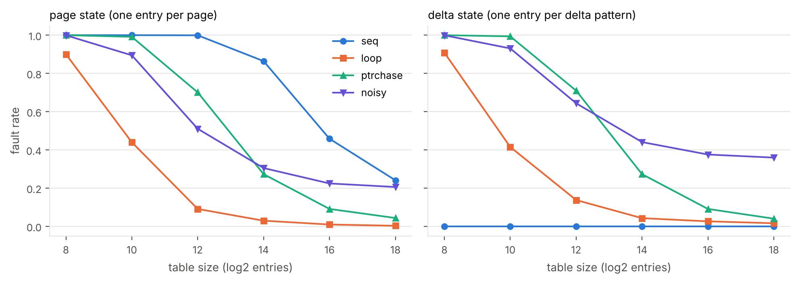
Result 3: table size
seq (30,000 pages), page state: 0.458 at 2^16 entries, 0.241 at 2^18. Delta state stays at 0.000 even at 2^8.
Notes:
A page-state predictor needs about one entry per page; collisions evict learned successors (not isolated with an associative table). Delta state is insensitive.

Slide 11
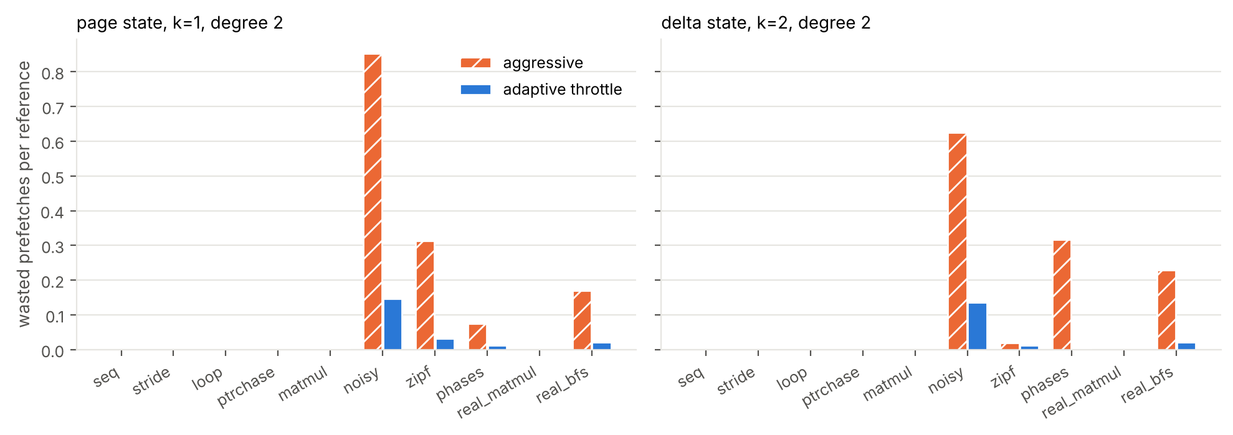
Result 4: the throttle removes waste
Wasted prefetches per reference: zipf 0.314 → 0.032, noisy 0.852 → 0.147, with essentially unchanged fault rates.
Notes:
Same fault rate, far fewer wasted prefetches. Page state k=1, degree 2.

Slide 12
Result 5: entropy predicts benefit
ρ = -0.89
Spearman, entropy vs fault reduction, 20 traces
Low entropy: almost fully fixed
Mid entropy (noisy, phases): partly fixed
High entropy (zipf, real_bfs): not fixed
Caveat: partly circular, effective n = 10
Notes:
Prequential conditional entropy: online, includes learning cost. Correlation is partly built in since both come from the same counts; effective sample is ten workloads. Vitter and Krishnan make the connection formal.

Slide 13
Real traces: the honest result
real_matmul
real_bfs
384×384 matrix multiply
BFS, 100k-node random graph
no prefetch
0.376
no prefetch
0.222
next-page
0.003
next-page
0.227
Markov (delta, k=1)
0.042
Markov (delta, k=2)
0.236
Markov + throttle
0.225
Next-page captures the regularity and needs no table.
Pointer chasing: nothing helps. The throttle limits the damage.
Fault rate = faults per reference. 256 frames, 2^16-entry Markov table, LRU.
Notes:
On real_matmul the simplest heuristic, next-page, beat the Markov predictor. On real_bfs nothing helped. The case for the added complexity is not established on this evidence.

Slide 14
Limitations
Simulator, not a system: no timing model, no I/O bandwidth, no multiprocess interference. Prefetches are free.
All eight synthetic workloads are my own constructions; the real evidence is two programs, 200,000 references each, with rank-compressed page ids.
Entropy and benefit are not independent measurements, so the correlation is partly expected. Effective sample: ten distinct workloads.
The throttle’s levels and cut-offs are hand-chosen, not tuned on held-out workloads.
Direct-mapped table, four successors per entry, no aging of old counts (may hurt on phase changes).
Notes:
Be upfront about these in the viva.

Slide 15
Takeaways
Low entropy
State + order
Throttle
Worth it
Match the pattern
Safe default
Markov prefetching pays off when the reference stream is predictable.
Delta state for strides, page state for jumps, higher order for interleaved streams.
On high-entropy traces prefetching only wastes I/O, so cap it by accuracy.
Repo: github.com/kirb-ash/markov-chains · make all reproduces every figure and table
Notes:
On the two real traces, next-page was as good as or better than Markov wherever any prefetching helped, so the practical case for the complexity is not established.

