Slide 1

GROUP 8
Effect of Crime on the Housing Market in the Houston Metro-Area
Prepared by Andres, Christy, Radhika, Samuel, Zhanna
Notes:
The largest and most important purchase that a consumer will make in his lifetime is a house. A lot of time and energy goes into determining exactly what one wants in a new home. The buyer must figure out their preferences regarding the location of the house, including the city, neighborhood, and proximity to certain amenities and general aesthetic style. Significant amount of attention is drawn into crime, school and life quality. Theoretically, homebuyers would pay a premium in order to live in a physically safe environment to avoid crime, as well as the mental security of knowing that they are safe.

Slide 2
PROJECT DESCRIPTION
This project is intended to be used as baseline for understanding the housing market economy and the impact of crime on property values across the Houston metropolitan area by population.
We have therefore chosen these major cities for our analysis:
Baytown
Friendswood
Galveston
Houston
La Porte
League City
Missouri City
Pasadena
Sugar Land
Texas City
Notes:
10 Largest cities in the Houston metropolitan area within a 50-mile radius
All cities have a population greater than 30,000 people

Slide 3
RESOURCES
Housing data
Redfin | Real Estate Tips for Home Buying, Selling
Crime Data
UCR Publications | Federal Bureau of Investigation
Census Housing Data United States Census

Slide 4
RESEARCH OBJECTIVES
Trends in the Houston metropolitan area:
Average crime rate
Median sales price of homes
Days on market
Relationship between housing trends and crime rate:
Impact of crime rate on home sales
Impact of crime rate on home prices
Notes:
What is the average crime rate across the top 10 largest cities in the Houston metropolitan area?
What is the average and median sales price across the top 10 largest cities in the Houston metropolitan area?
Do houses stay on the market longer in higher crime areas?
Is there a correlation between average or median sales price and the average crime rate crime?
Does crime have a bigger impact on home sales?

Slide 5
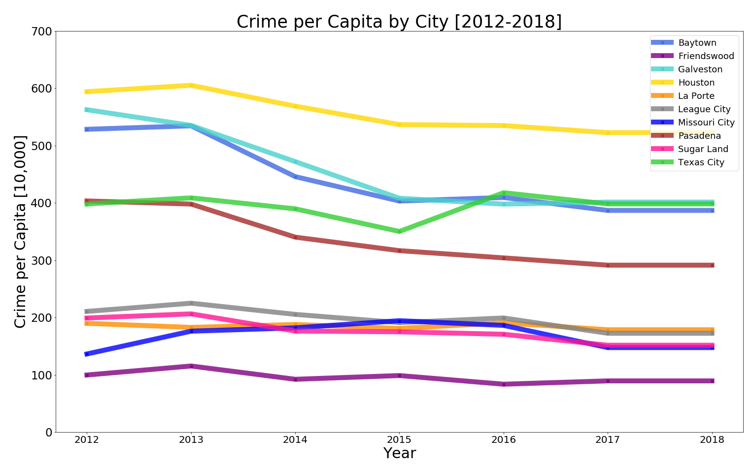

TOTAL CRIME PER CAPITA FOR EACH CITY
Notes:
•Top cities: Houston, Galveston, Baytown, Texas City, and Pasadena •Bottom cities: League city, Sugar Land, La Porte, Missouri City, Friendswood •For the top cities with the exception for Pasadena, the crime has decreased by 35-100 crimes per capita. •Our bottom cities saw little change over the last 7 years.

Slide 6
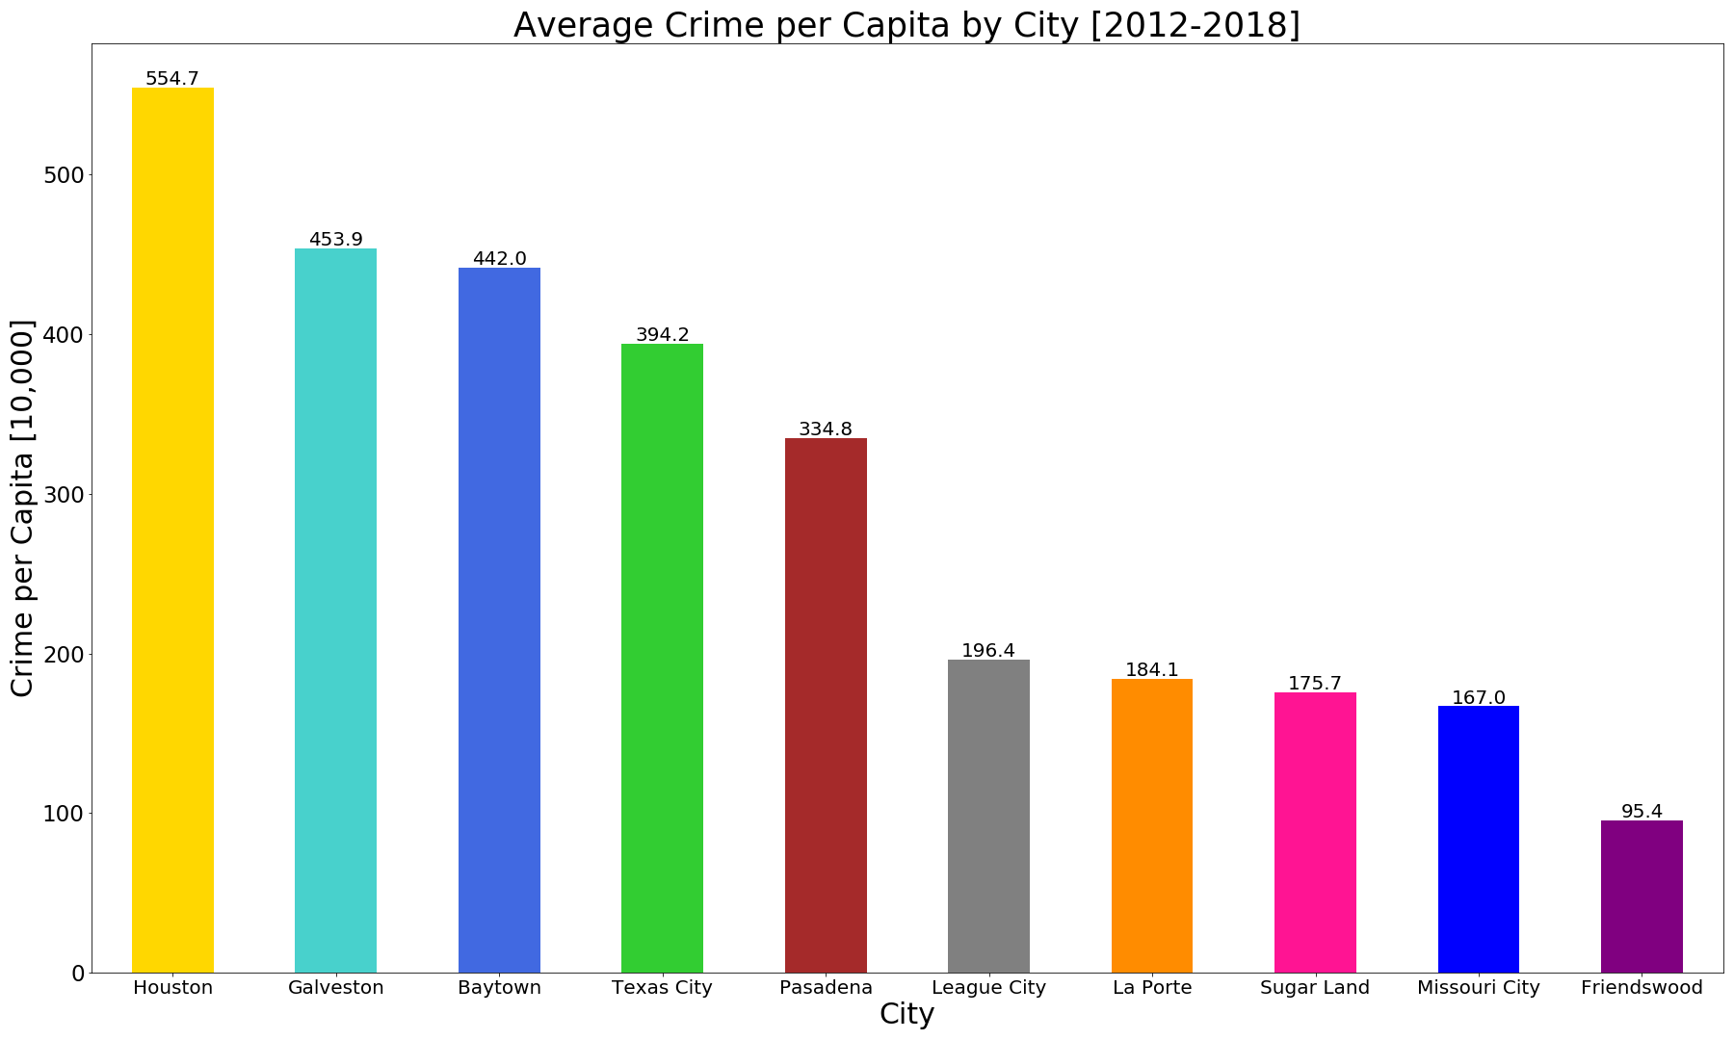

AVERAGE CRIME
PER CAPITA VS CITY
Notes:
•It’s no surprise that Houston as a large metropolitan city leads in crime rate by roughly 100 crimes more than the runner up Galveston. •Friendswood is our least dangerous city, more residential/suburbs which will provide a good comparison against our other cities

Slide 7
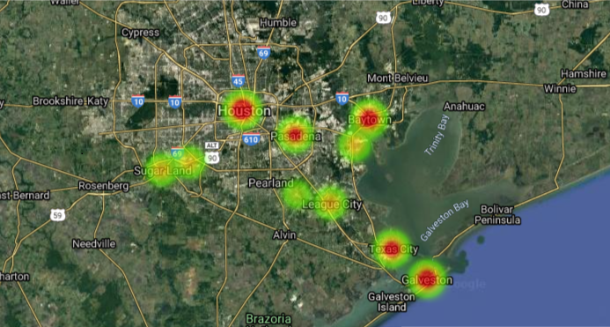
CRIME HEAT MAP
City | Total Crime (Per Capita)
Houston | 554.7
Galveston | 453.9
Baytown | 442.0
Texas City | 394.2
Pasadena | 334.8
League City | 196.4
La Porte | 184.1
Sugar Land | 175.7
Missouri City | 167.0
Friendswood | 95.4
Notes:
Residential burglaries and crime hot spots are illustrated in this map. Crime is not spread evenly, as it clumps in some areas and is absent in others.

Slide 8
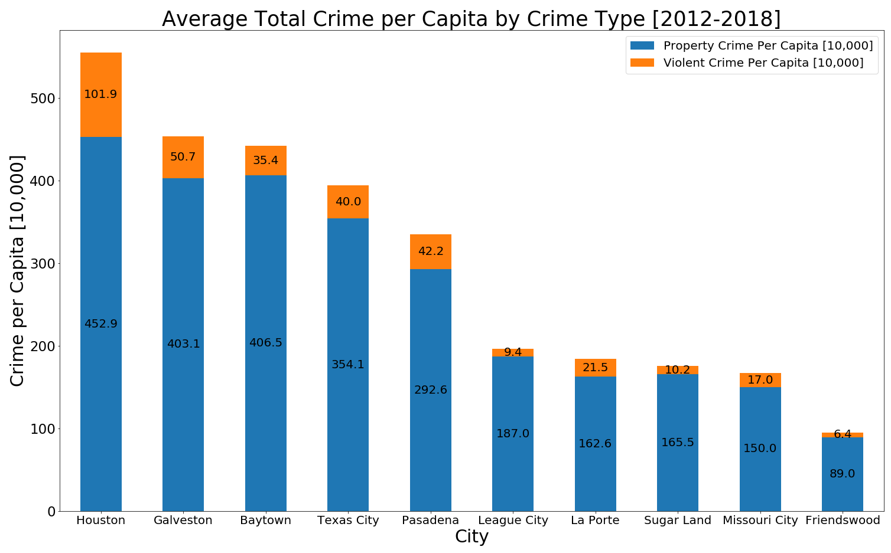
TOTAL CRIME AVG. PER CAPITA IN CITIES
Notes:
•The breakdown shows that violent crime accounts for roughly 5-20% of the total crime therefore most of our total crime comes from property crime •Here is a breakdown by type of crime. •Violent Crime: Murder, Rape, Robbery, Aggravated Assault. •Property Crim: Property Crime Burglary Larceny Theft, Morto Vehicle, Arson •Now Andres will walk us through how the housing prices for the housing market looked like for these cities.

Slide 9
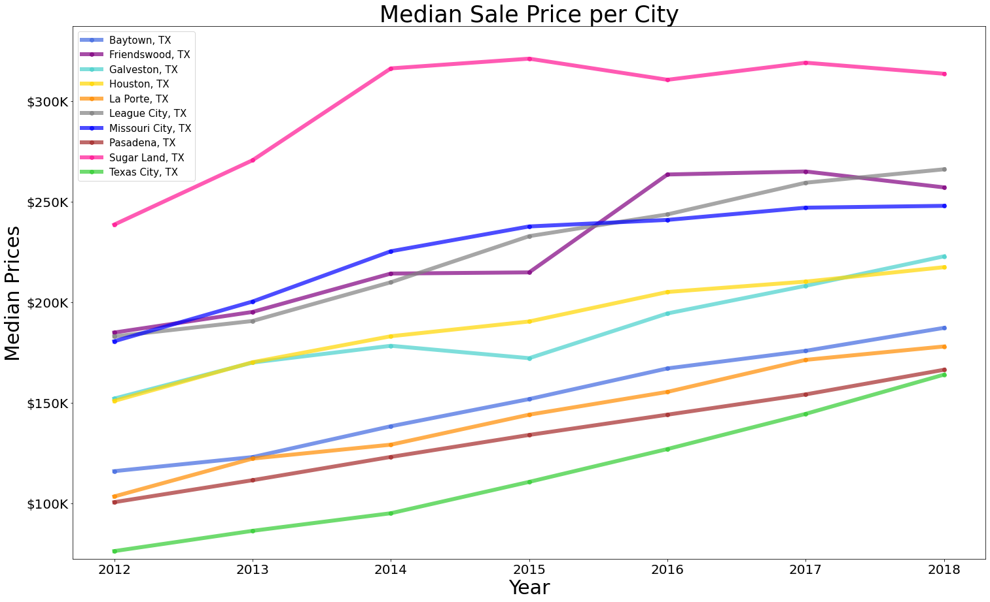

MEDIAN SALE
PRICE PER CITY
Notes:
This graph shows a steady increase of house values from 2012 through 2018, can see sugar land up top …_ cities in the middle …__cities at the bottom

Slide 10
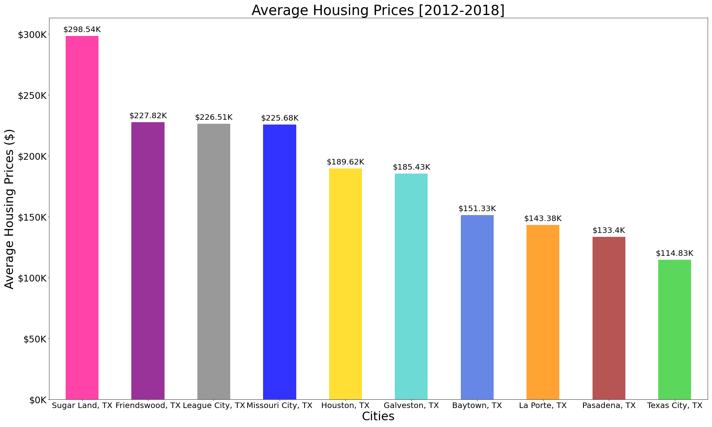

AVERAGE HOUSING PRICES
Notes:
For our analysis we want to exploit the variation in crime that occurs within cities from 2012-2018.
The proportion of crime in the area has a negative impact on the price. If the proportion of crime increases by one percentage point, prices are expected to drop by 1.5%.

Slide 11
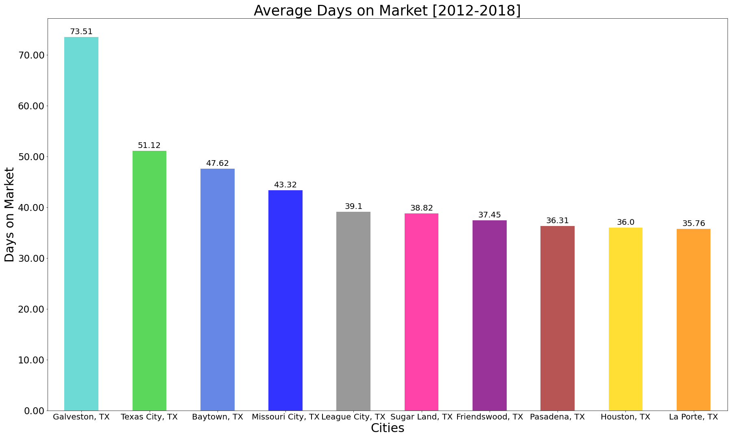

AVERAGE Days on Market
Notes:
Where are houses staying on the market longer?

Slide 12
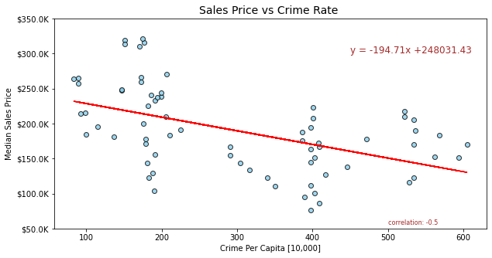
Sales Price vs Crime Rate

Slide 13
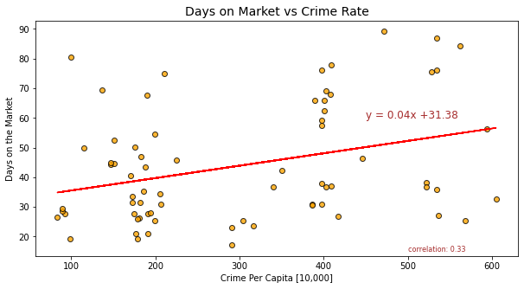
Days on Market vs Crime Rate

Slide 14
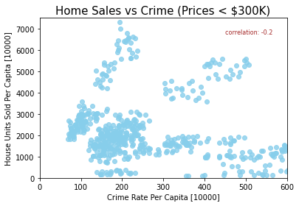
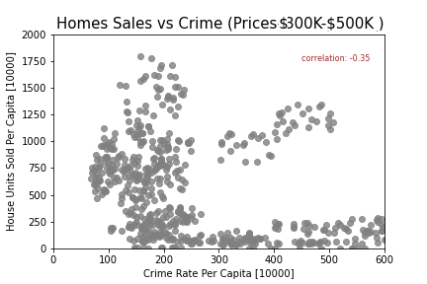
HOME SALES by Price vs Crime Rate

Slide 15
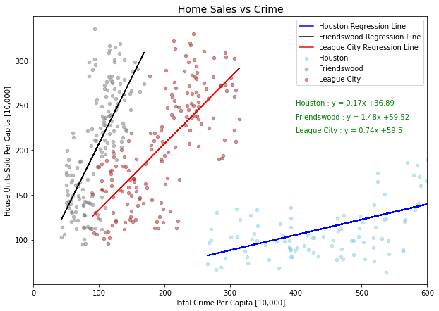
HOME SALES vs CRIME RATE IN FRIENDSWOOD, LEAGUE CITY AND HOUSTON

Slide 16
observations
When looking at crime rate and the housing market in the Houston metropolitan area we observed:
No significant change in crime rate has occurred since 2012, while home prices have gone up overall
There are more homes sold in safer neighborhoods while home sales decrease as crime rate increases
There is not a difference in the relationship between home sales and crime rate when analyzing home values
While we see there is a relationship between the crime rate and the housing market, we acknowledge there are other factors affecting the housing market such as school districts, amenities, commute times, demographics, etc.
There is a moderate inverse correlation (-0.5) between crime and the housing prices
There is a low correlation (0.33) between crime and the days on market
WHY DID WE PICK THESE CITIES. (POPULATION)
Notes:
The study is limited to 10 cities in the Houston metropolitan area and results may differ from the national crime rate and housing market

Slide 17
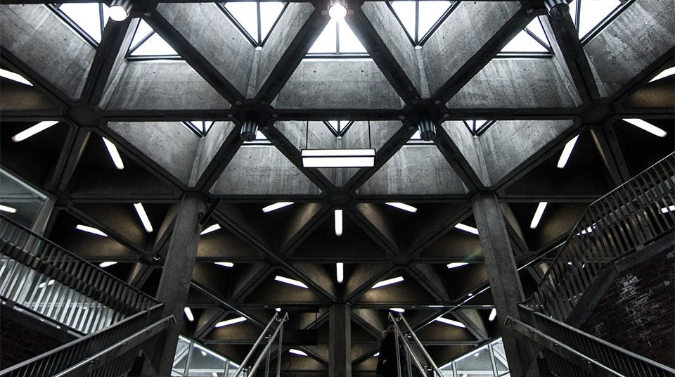
THANK YOU
2
+
2
+

