Slide 1
DataSet
Represents raw data. Data can be live
or static. Static data can be saved
and loaded from disk. Live data can be
saved as static data. Data is a list of
points with a number of dimensions and
a unit per dimension. 2D should be first
class support.
Source
Retrieves data from a source such as:
Coinbase, Stock provider, etc..
Graph
A graph has a dataset that it is
graphing and details about the graph
such as axis labels, domain/range
Math
Contains math operations on data
GraphRendering
Renders a graph to something TBD
UI
Contains windows that do things with
everything else. Each window should
be for some task.

Slide 2
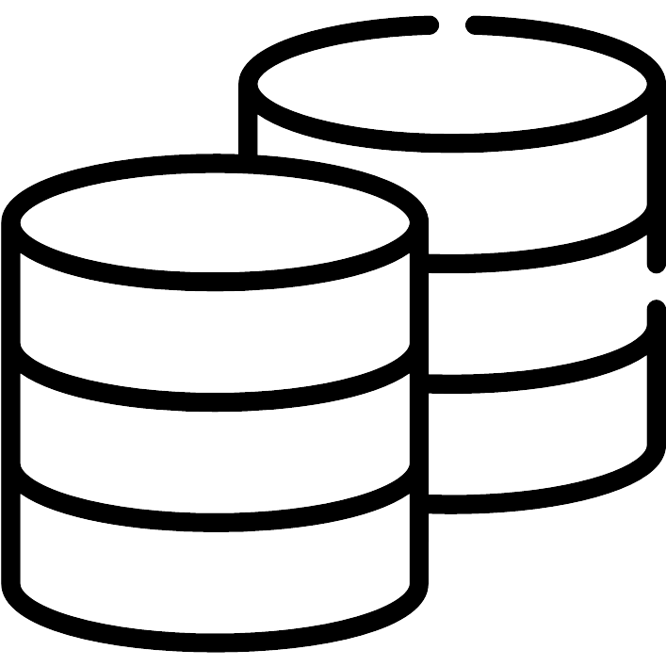


Create Data Set
View Data Sets
Quit

Slide 3
Create Data Set
Source
Type
From
From
Coinbase
Static
Yahoo Finance
Live
Yahoo Finance
To
...
Cancel
Create

