Slide 1
EDA Presentation
Team Member Details: Data Collector, Katrina Kirby, katkirby9217@gmail.com, United States, Virginia Commonwealth University, Specialization (Data Analyst)

Slide 2
Problem Description
XYZ company is collecting the data customer using google forms/survey monkey and they have floated in number of forms on the web. Company wants to create a pipeline which will collect all the data of these google forms/survey monkey and visualize the data in the dashboard. Company wants clean data and if there is any data issue present in the data then it should be treated by this pipeline (duplicate data or junk data). dedup check should be performed on the email id of the customer

Slide 3
GitHub Repo Link
https://github.com/kirbykt/Data-Analyst-Project

Slide 4
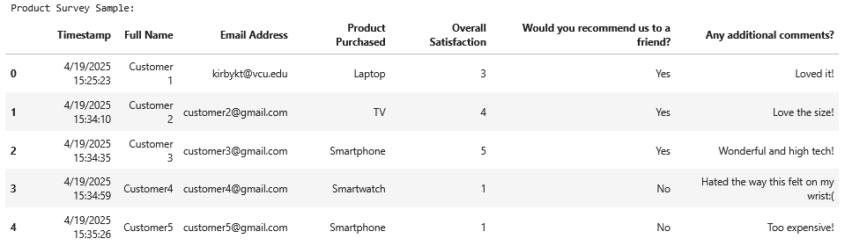
Exploratory Data Analysis
Using JupyterLab, I have successfully explored the manually made data for this project to address the problem at hand for Company XYZ
The first few steps involved downloading and importing necessary libraries such as pandas, matplotlib.pyplot, and seaborn
Next, I loaded the two csv files into the jupyter lab environment and used commands “print and “display” to preview both of the data frames

Slide 5
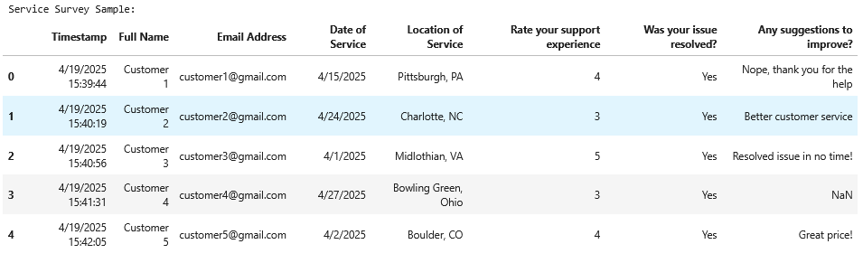
Exploratory Data Analysis
Below shows the second survey sample:

Slide 6
Exploratory Data Analysis
After viewing the datasets, I combined the two into a master dataset and saved it as a master file
Next, I loaded the master dataset and displayed the first few rows
I tagged each original dataset and recombined with source info
Explored and cleaned the data by:
Cleaning column names
Standardizing emails
Dropping duplicates
Checked for missing values
Creating visuals

Slide 7
Data Summary
Merged datasets from 2 manually made google forms
Total records: 20
Total columns: 13
Format: CSV
Common issue: Missing values in service-related fields

Slide 8
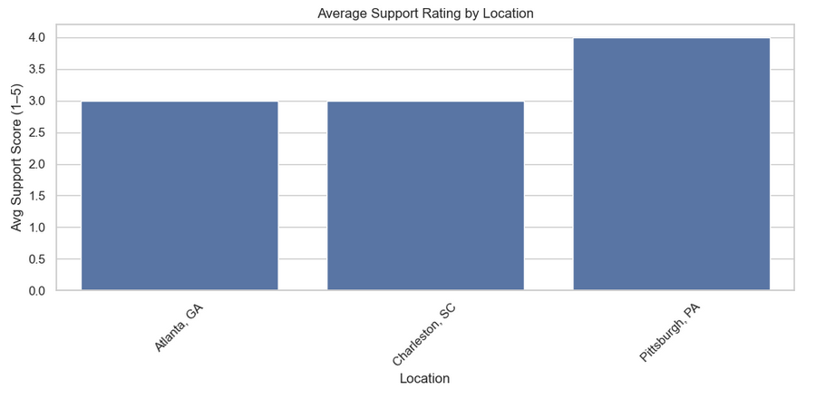
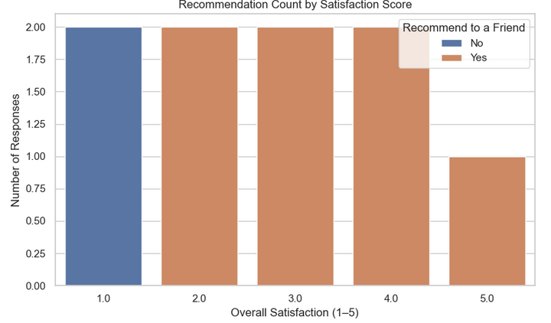
Visuals

Slide 9
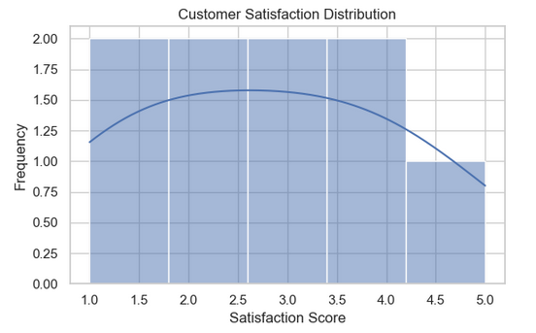
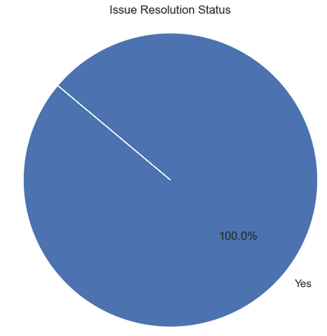
Visuals

Slide 10
Insights
Product Feedback:
Satisfaction scores ranged from 4-5
Most customers recommended the products
Dissatisfaction correlated with lower recommendation rates
Service Experience:
100% of issues were resolved
Midlothian, VA had the highest average support score
Support rating were above average across all locations

Slide 11
Business Takeaway & Recommended Models
Customer satisfaction is high for both product and service lines
High support scores contribute to positive talk
Continue investing in service teams at high performing locations
Technical:
Problem types- Classification (Predict recommendation) & Regression (Predict satisfaction/support rating scale)
Recommended Models:
Logistic Regression- Decision tree for classification
Linear regression – random forest for regression
Justification- Simple models easy for survey data size and type

