Slide 1

WORKSHOP FORMAT FOR CHAPTER MANAGERS
Operational AI
Excellence
for Chapter Managers
Two hours · your laptop · your own questions
Community format by a YPO member · not official YPO material

Slide 2

THE WALL · 3 QUESTIONS FROM CHAPTER MANAGERS
Which one burns most today?
1 · REACH
2 · KNOW
3 · PERSIST
How do I reach my members — email and WhatsApp?
How do I build a knowledge base, with automation where possible?
How do I survive the yearly change of officers without losing what we know?
We start with KNOW: one assistant, built once, used 3 times.
Community format by a YPO member · not official YPO material

Slide 3
WHO IS SPEAKING
I have sat on the other side of your desk.
Past chair. Regional officer.
And I still don’t know your job
as well as you do.
Community format by a YPO member · not official YPO material

Slide 4
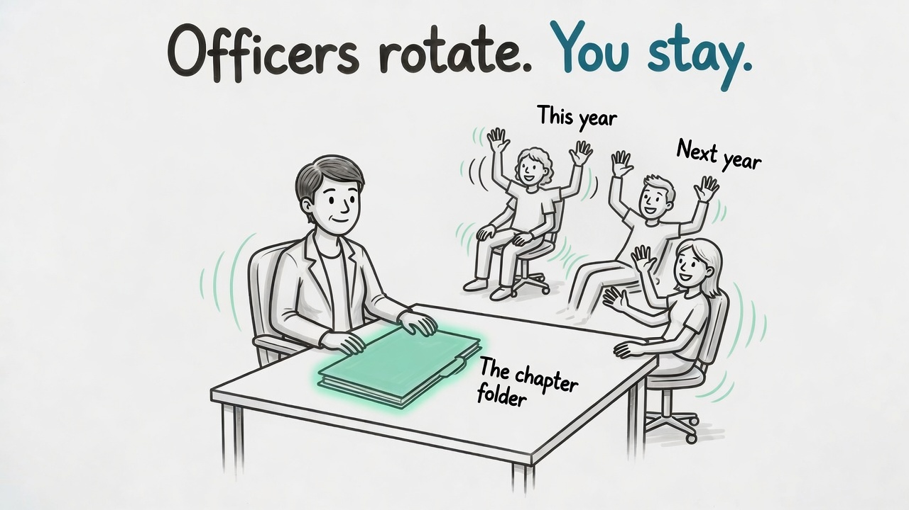
THE ONE IDEA
Chairs and officers rotate every year. The Chapter Manager stays.
AI helps you become — and keep — the memory of the chapter, without more hours. That is the bet.
Community format by a YPO member · not official YPO material

Slide 5
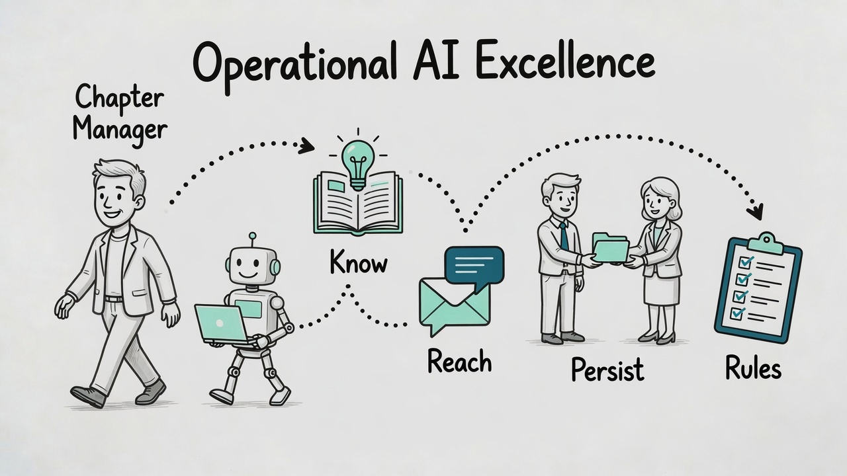
THE PATH · TWO HOURS
Know. Reach. Persist. And a few simple rules.
1
Opening & foundation
2
KNOW · Lab A
☕
Coffee break
3
REACH · Lab B
4
PERSIST · Chairs rotate
5
Show & close
Community format by a YPO member · not official YPO material

Slide 6
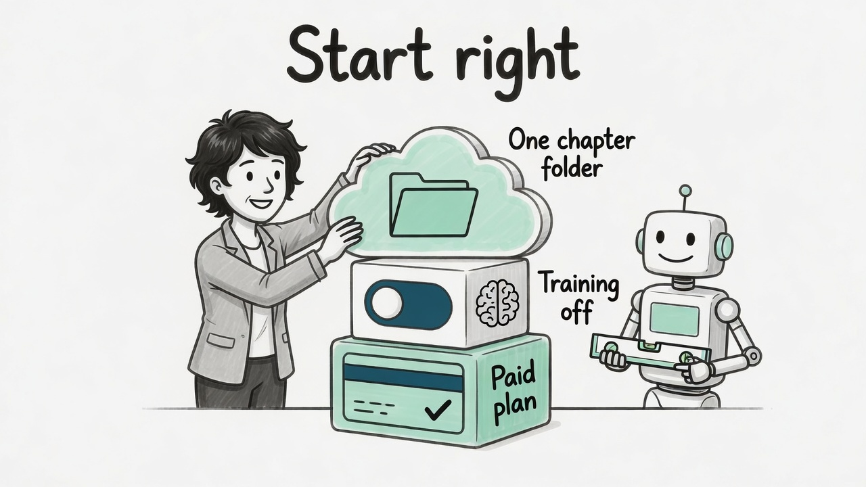
FOUNDATION
Paid plan, chapter accounts, desktop app.
Paid plan, training off
A business plan is ideal. On a personal plan, switch training off before you start.
Chapter accounts + one folder
You and your Chair: accounts in the chapter’s Microsoft 365 or Google Workspace.
Today: the desktop app
ChatGPT or Claude — one folder, and the assistant saves every file itself.
Community format by a YPO member · not official YPO material

Slide 7
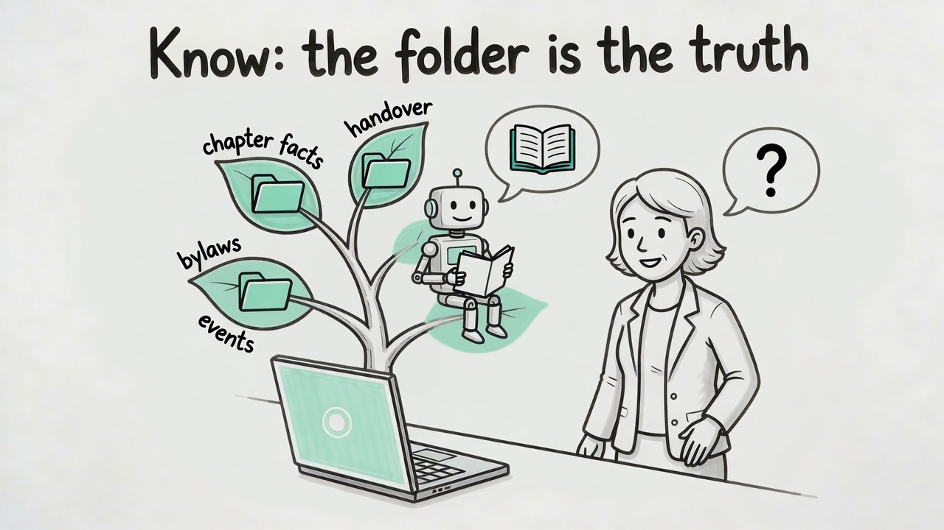
KNOW · QUESTION 2
Your own files are the truth.
The assistant reads before it answers — or says UNCHECKED.
Community format by a YPO member · not official YPO material

Slide 8
LAB A · 20 MINUTES
Build your assistant.
STEP 1
STEP 2
STEP 3
STEP 4
4 min
5 min
8 min
3 min
Create CM-Workspace. Unzip _kit.zip into it. Open it in the desktop app. Paste the core as your first message.
Prompt 1: build and see your chapter folder.
Prompt 2: 6 short answers. It saves
chapter-facts.md
in 02-chapter-knowledge/.
Unknown = [verify].
Prompt 3: your yearly question — read, quote, check. Look in the folder.
The core: _kit/02-your-assistant/cm-assistant-instructions.md, below the line.
Stop when the time is up. Who is ahead helps a neighbour. The full interview is tonight’s homework.
Community format by a YPO member · not official YPO material

Slide 9
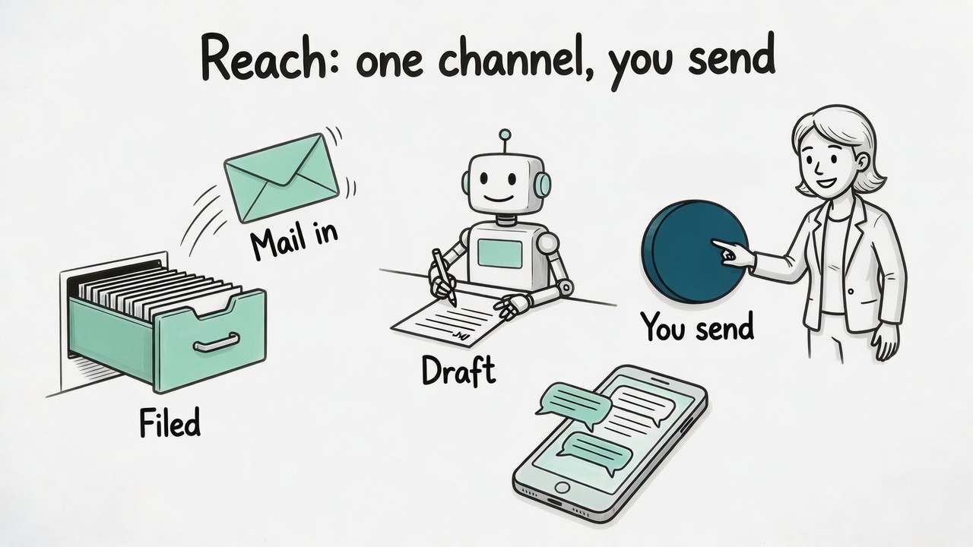
REACH · QUESTION 1
Mail in, filed, draft. You read it. You send it.
Email for what is binding. WhatsApp for what is short. One channel to you.
Community format by a YPO member · not official YPO material

Slide 10
REACH · WHATSAPP
Export today. Your own app later — built by your AI.
TODAY · STAGE 1
LATER · STAGE 2
Export chat
Your own small app
WhatsApp’s own export, without media → summary → one-to-one drafts. No setup.
Your AI tool builds it on your laptop from the build guide. It reads the chats you choose and drafts replies.
Your number stays yours. AI reads and drafts, you send — one message at a time.
Forum groups and any chat with Forum content — mixed chats too — are never exported.
Community format by a YPO member · not official YPO material

Slide 11
LAB B · 12 MINUTES
1 email, the new way.
1
Paste the practice block from
_kit/02-your-assistant/lab-b-practice-pack.md
PROMPT
New email below, followed by our rules.
1) Say which folder it belongs in and give a file name
(YYYY-MM-DD_sender-role_topic.md).
2) Give me one log line for 00-handover/log.md.
3) Draft a reply in my voice; answer only from the rules below and cite the section; mark every fact without a source as [verify]. I send it myself.
---
[the fictional mail — from the practice pack]
---
[sections 4.1 and 4.2 — from the practice pack]
2
Then type:
Save all three now.
3
Open the folder:
mail, log line, draft — saved.
4
Read the draft.
Do not send.
Stop when the time is up. Your own mails come tonight — Forum content stays out of the chat.
Community format by a YPO member · not official YPO material

Slide 12
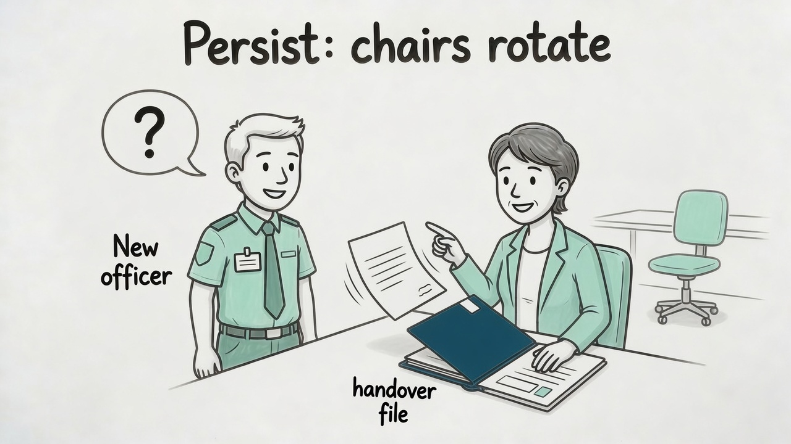
PERSIST · QUESTION 3
A new officer asks. The folder answers.
Officers change every year. You are the continuity — when your system is the chapter’s.
Community format by a YPO member · not official YPO material

Slide 13
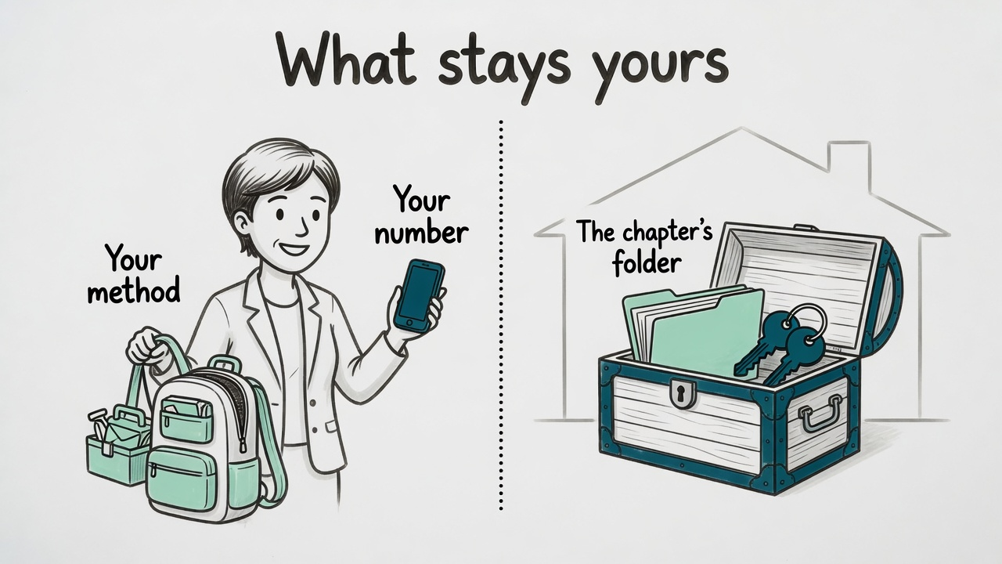
PERSIST · WHAT STAYS YOURS
Your method and your number. The chapter keeps its folder.
You work for your chapter — self-employed or employed by it. Your know-how goes with you.
YOURS
Know-how · your templates and prompts · your method · your WhatsApp number · your AI account
THE CHAPTER’S
Data · decisions · event files · role accounts · the handover note and the log
The test: Would the next Chapter Manager need it to run this chapter? Chapter folder. Would you use it with any chapter or client? Yours.
Community format by a YPO member · not official YPO material

Slide 14
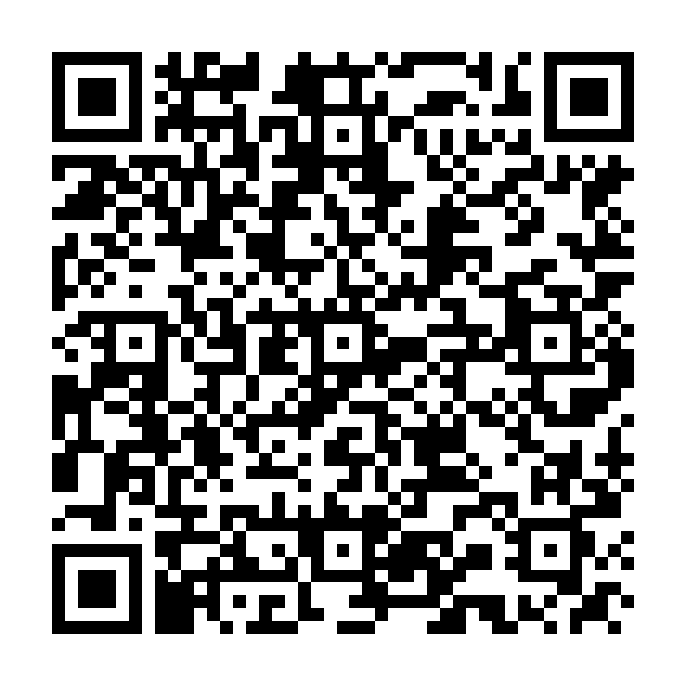
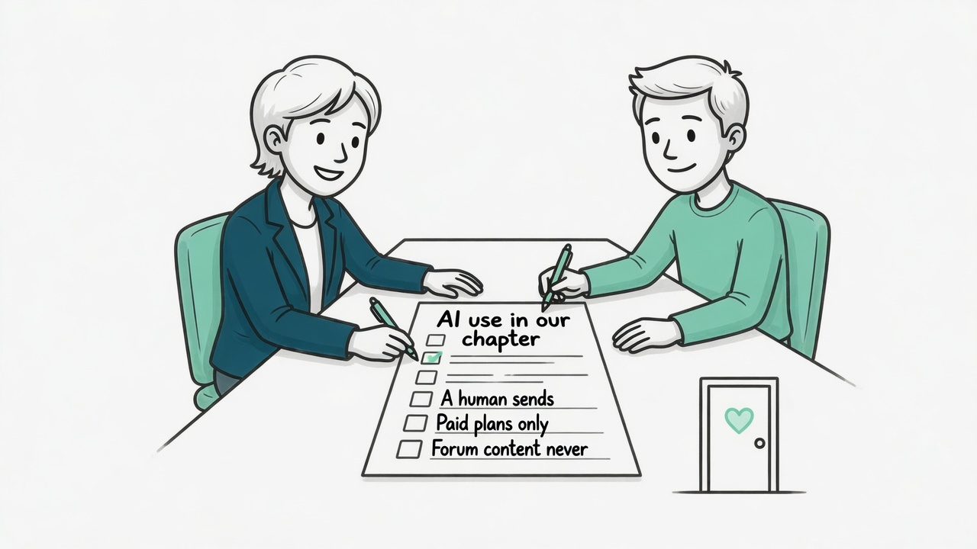
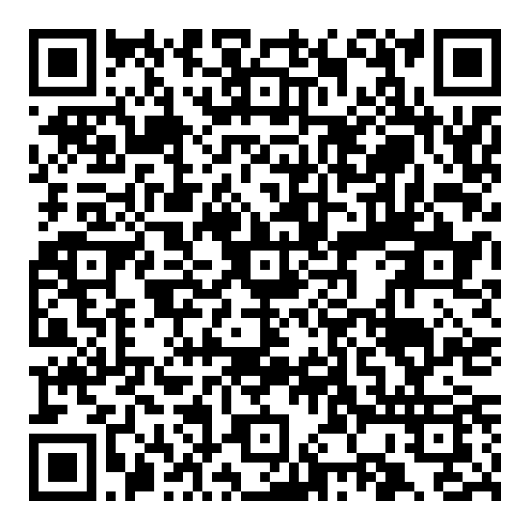
PERSIST · A ONE-PAGER FOR YOUR EXCO
AI use in our chapter.
1
Forum logistics yes. Forum content never. A conduct case is chapter business.
PART B · OUR TOOLS
Only what is on this list.
ChatGPT Business or Claude Team
2
Paid plans only, training off — ideally a business plan.
drafts, summaries, the chapter folder
Microsoft 365 or Google Workspace
3
A human sends.
mail, calendar, files
Mini CRM (kit module 12)
contacts and events, on your laptop
4
Role accounts — at least manager@ and chair@ — and one chapter folder.
Something new — Airtable, a plugin, an app? On the list first, with your Chair's OK.
5
Our own files are the truth.
Prepared with your Chair, adopted once by the ExCo. Then you are free to work.
Scan: Word template
Community format by a YPO member · not official YPO material

Slide 15
PERSIST · OPERATING GUARDRAILS
5 rules. They cost no money — they ask for discipline.
1
One channel
All requests via the Chair or 1 named person. The Chapter Manager receives one prioritised list.
2
Lead time
Officer updates and material arrive 1 week before they are needed.
3
Response target
24 hours or a date — the ExCo does the same when the Chapter Manager asks for a decision.
4
Fixed dates
ExCo dates and deadlines are not moved at short notice. Event work is budgeted separately from the Chapter Manager’s base agreement.
5
Briefing before taking office
Every new officer gets a briefing from the Chapter Manager and our AI house rules before they start.
Proposed by the Chair. Decided by the ExCo. Reviewed each year at the officer handover.
Community format by a YPO member · not official YPO material

Slide 16
LAB C · 4 MIN, THEN CHAIRS ROTATE · 6 MIN
It’s 1 July. You are the new Learning Officer.
FIRST · LAB C · 4 MINUTES · PASTE INTO YOUR DESKTOP TASK — IT SAVES THE FILE
Checkpoint now. Refresh 00-handover/handover.md: what is set up, open items (each with what “done” looks like), paths touched. Then stop.
1
Switch · 1 min
2
B asks · 2½ min
3
Swap · 2½ min
A stays with the laptop. B takes their own laptop and moves 1 chair along.
A starts a new task with CM-Workspace and sends the restart prompt with B’s 2 questions.
A asks B the same 2 questions — on B’s laptop.
No file says it? UNCHECKED — that is homework, not a failure.
Community format by a YPO member · not official YPO material

Slide 17
1
What is open right now, and what does done look like?
2
Who do I ask for the venue contract?
Community format by a YPO member · not official YPO material

Slide 18

OUTLOOK · WHERE YOUR HOURS GO
Your log tells you. Your assistant keeps it.
Member communication, events, region and global, administration — in your own words.
DAY ONE · ONE LINE
After each task your assistant suggests one hours line. Only minutes you confirm count.
YOUR AREAS
About ten, in your words. Event hours from your comms logs count too.
LATER · YOUR OWN APP
Your AI builds it from the build guide: a timer per area and a month report. Runs in your browser, no install.
Your numbers, your folder. You decide what you show your Chair — for planning and for a talk about priorities and scope. Nothing goes anywhere by itself.
Community format by a YPO member · not official YPO material

Slide 19
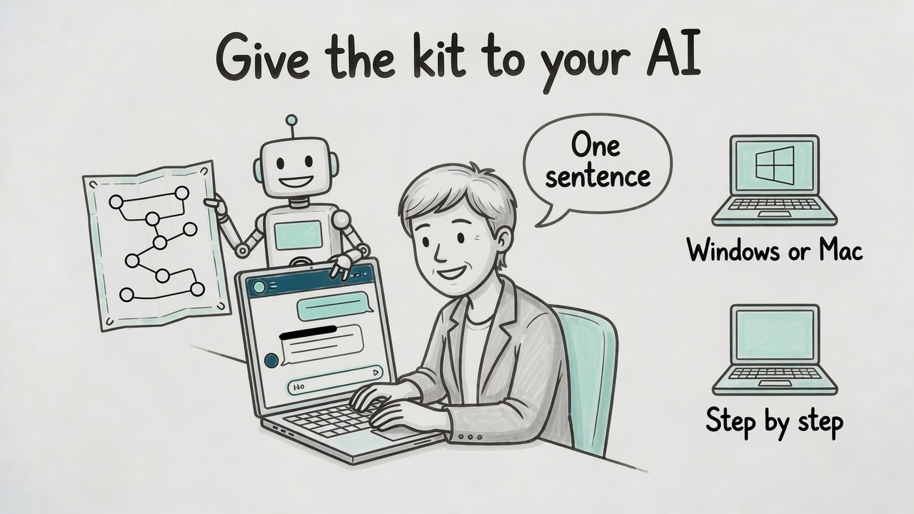

GET STARTED
Give the kit to your AI.
PASTE INTO A NEW CHAT IN YOUR PAID AI TOOL
Read https://raw.githubusercontent.com/kirchbergcapital/ypo-chapter-manager-best-practice/main/AI-GUIDE.md and guide me step by step.
1 · Everyone
Best in the desktop app, one folder open.
2 · Your AI can’t open links
Attach KIT-START.txt to a new chat and say: “This is my kit. Read the AI guide section first and guide me step by step.”
Scan: the kit
always the latest
3 · The whole kit in your folder
Unzip _kit.zip in CM-Workspace, open the folder, say: “Read _kit/AI-GUIDE.md and guide me.”
No GitHub account. No plugin. No connector.
Community format by a YPO member · not official YPO material

Slide 20
CLOSE · YOUR NEXT 2 WEEKS
About 3 hours for your basic set-up.
20 min
Paid plan (business ideal), training off
30 min
Interview → chapter-facts.md
15 min
Check laptop, accounts, desktop app
20 min
First real email: filed, log line, draft
15 min
manager@ + chair@ + one storage
15 min
Commitments calendar
15 min
Create the folders
15 min
One-pager to your chair
15 min
Desktop project + house rules
The bet: the hours come from searching and answering twice. Test it with your own week — your log will tell you.
Community format by a YPO member · not official YPO material

Slide 21
FEEDBACK · 3 QUESTIONS · ANONYMOUS
1
What will you use next week?
2
What got in your way today?
3
What would make your chapter easier to work for?
Nothing gets approved today. Every “that won’t work for us” on the wall is how v0.2 gets written.
Operational AI Excellence for Chapter Managers · the kit stays with you
Community format by a YPO member · not official YPO material

