Slide 1

Improving Hotel Ad Performance
General Assembly – Data Science sec. 4
Marc Kirchner – August 2013

Slide 2
Business Context
In the company I work we provide an ad-serving service for different sites
We are focused on the traveling industry
One of our products is to allow hotel advertisers bid for showing on a top position in a search results page of an OTA site
Example: travelocity.com

Slide 3
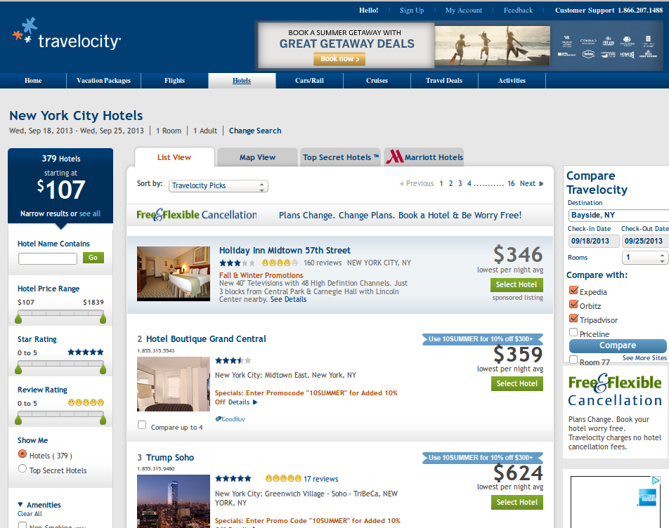
Travelocity sponsored ads

Slide 4
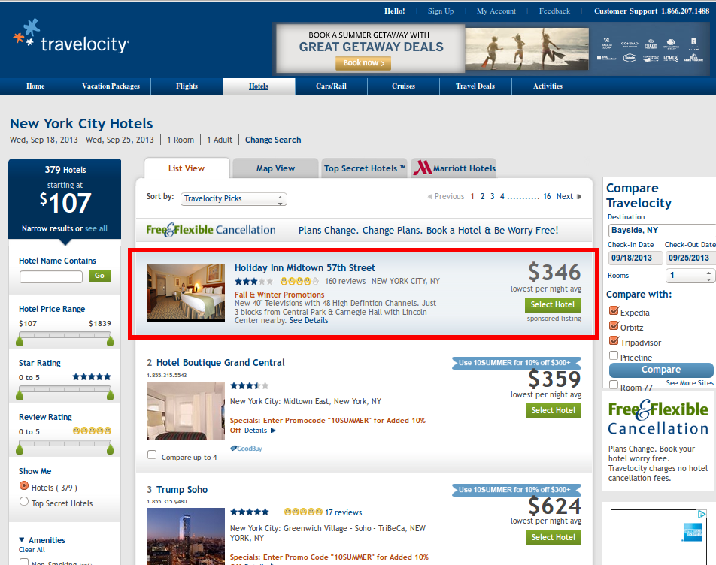
Travelocity sponsored ads

Slide 5
Business Model
Hotel advertisers decide how much are they willing to pay (bid) for placing an ad
They can target specific destinations
When a user performs a search for a hotel, all the advertisers compete for the sponsored placement in an auction
If a user clicks on an sponsored ad, the advertiser pays an amount to the site.

Slide 6

The system
Browser – travelocity.com
Ad Server
Ad call
Relational DB
Auction
and
filtering
Hotel and advertisement data
Impression
Click
Log files
Logger
- ad calls
- impressions
- clicks
Browser
Redirect

Slide 7
Objective
Try to maximize the performance of a hotel ad by showing to the user a hotel relevant to the intent
Types of trips: Leisure vs Business
If we can guess which hotel fits better to the user, we can give priority to that hotel in the auction

Slide 8
How?
We extract ad calls, impressions and clicks data from the logs and join it
We choose specific features from that data
Pairs of user features + hotel features combinations
We train a classifier model using the features and the labels: click / non-click

Slide 9
Features
User - Intent
Number of travelers
Number of rooms
Is weekday?
Advance purchase range
OS (Windows, Mac)
Browser (IE, FF, Ch)
Hotel - advertisement
Hotel star rating
Ad copy: promotion
Ad copy: discount
Ad copy: free

Slide 10
We need hotel features
The hotel data in our system is pretty limited
We decided to scrape travelocity.com hotel details pages
We used a Vectorizer to extract hotel amenities
For each training example, we added the hotel amenities as yes/no features
We generated 190 extra features this way

Slide 11
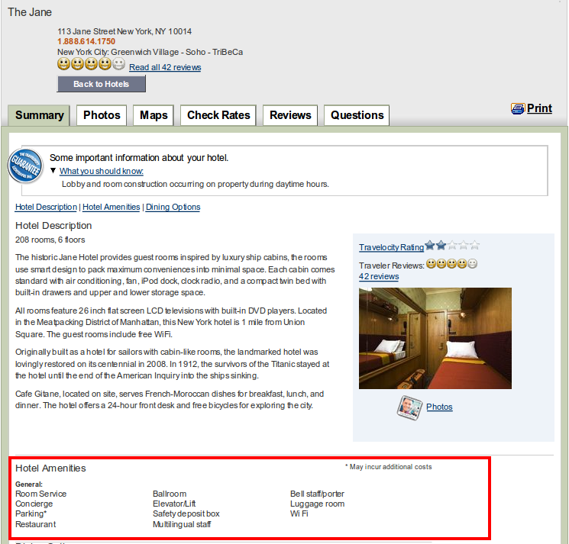
Travelocity hotel details page

Slide 12
Data challenges
Our systems contain lots of data, most of it is not relevant to our problem
One single day of travelocity data is a few Gb of data
We decided to limit the experiment to users searching for hotels in New York
It reduced the data size to approx 25 Mb of relevant data

Slide 13
How does the data look?
(New York hotel destinations in 2013)
Number of impressions: 73,800
Number of clicks: 1,200
There are only 1.67% clicks relative to the number of impressions (CTR)
There are approx 50 different NYC hotels that have been shown in sponsored ads
CPC summary:

Slide 14
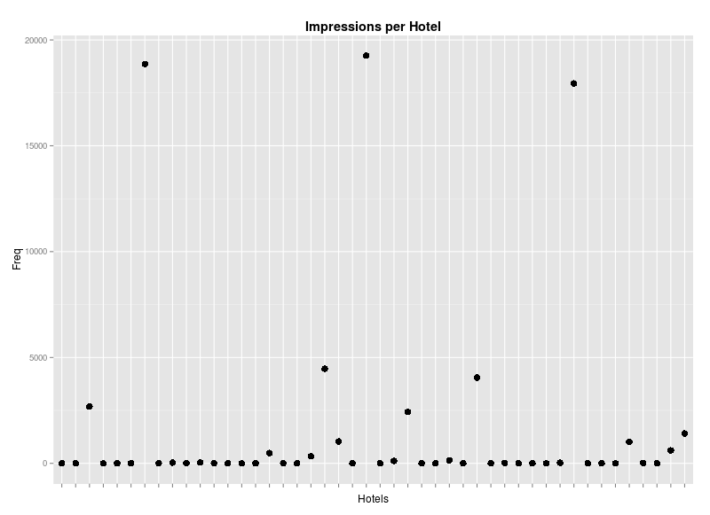
How does the data look?

Slide 15
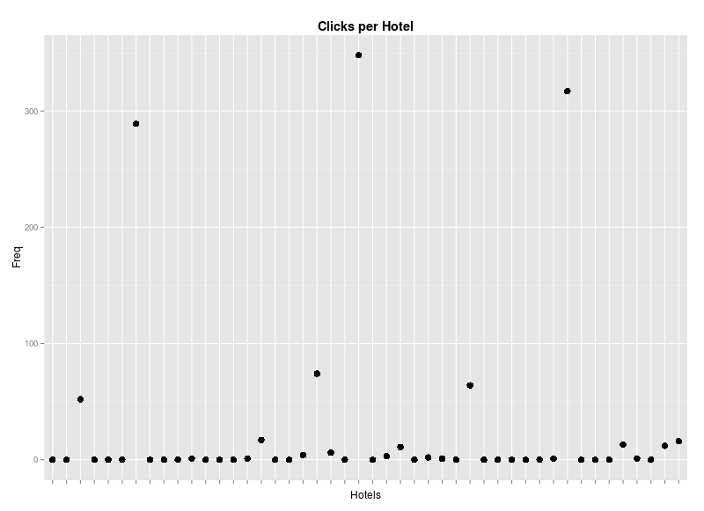
How does the data look?

Slide 16
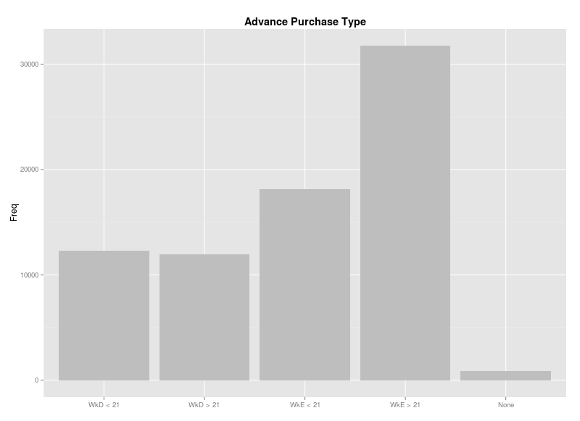
How does the data look?

Slide 17
Testing the model
The vast majority of outcomes in the testing set is negative (no click)
Average AUC cross validation value: 0.58
Better than tossing a coin
Is it enough to make a difference?

Slide 18
Behavior on out of sample data
Predicting the probability of a click on OOS data (7500 predictions)
The probability is very low across examples
Some predictions are far higher than others

Slide 19
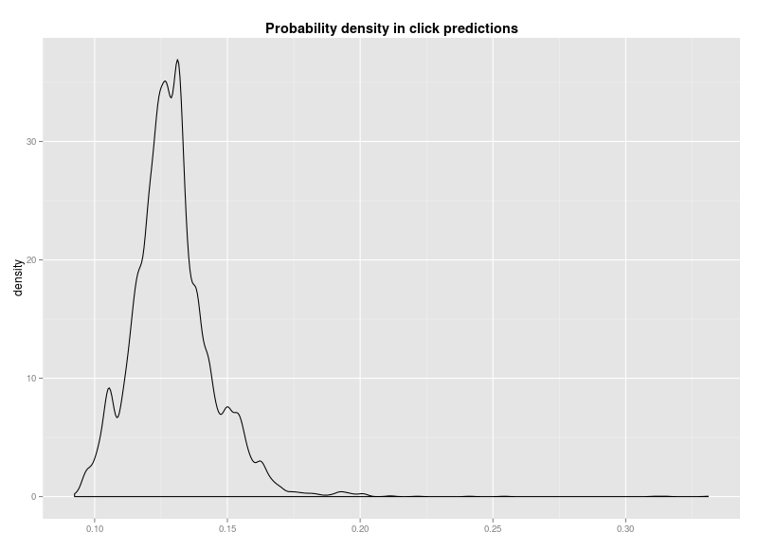
Behavior on out of sample data

Slide 20
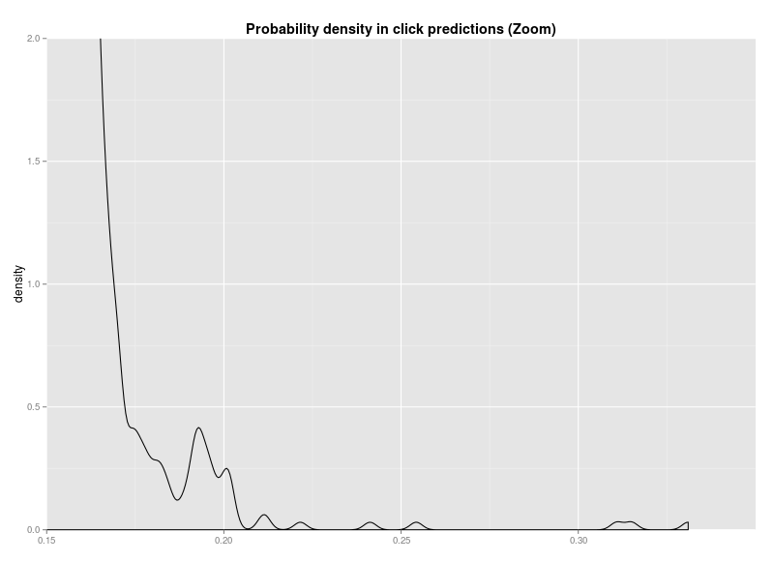
Behavior on out of sample data

Slide 21
Questioning the model
We don't want to predict clicks in general. We want to predict the probability of a click given that we show a specific hotel
Clicks are sparse, it's difficult to extract patterns in type of intent + hotel ad combinations
How can we differentiate between users who would click on the ad anyway?

Slide 22
We can test the model in real life
One way to test the impact is to release the model and use it for a share of the traffic
We can then compare average CTR rates between the two groups
We need a “clean” group anyway because when retraining the model in the future we don't want to introduce bias in the data (the model effectively influences the user behavior)

Slide 23
Possible improvements
Do a better job identifying hotel types: Use a clustering algorithm
Use pricing information
Introduce features related to seasonality
Explore the past behavior of users in a more fine-grained level (browsing patterns)
More data!

