Slide 1
UPS Logistics Optimization SQL PROJECT
Name : KIREETI AVULA
Batch : 1ST NOV DATA SCIENCE
Date : 09-02-2026
DRIVE VIDEO LINK

Slide 2
Task 1: Data Cleaning & Preparation
Checked duplicate Order_IDs (PK enforced)
Replaced NULL Traffic_Delay_Min
Validated date formats
•Flagged invalid delivery dates

Slide 3
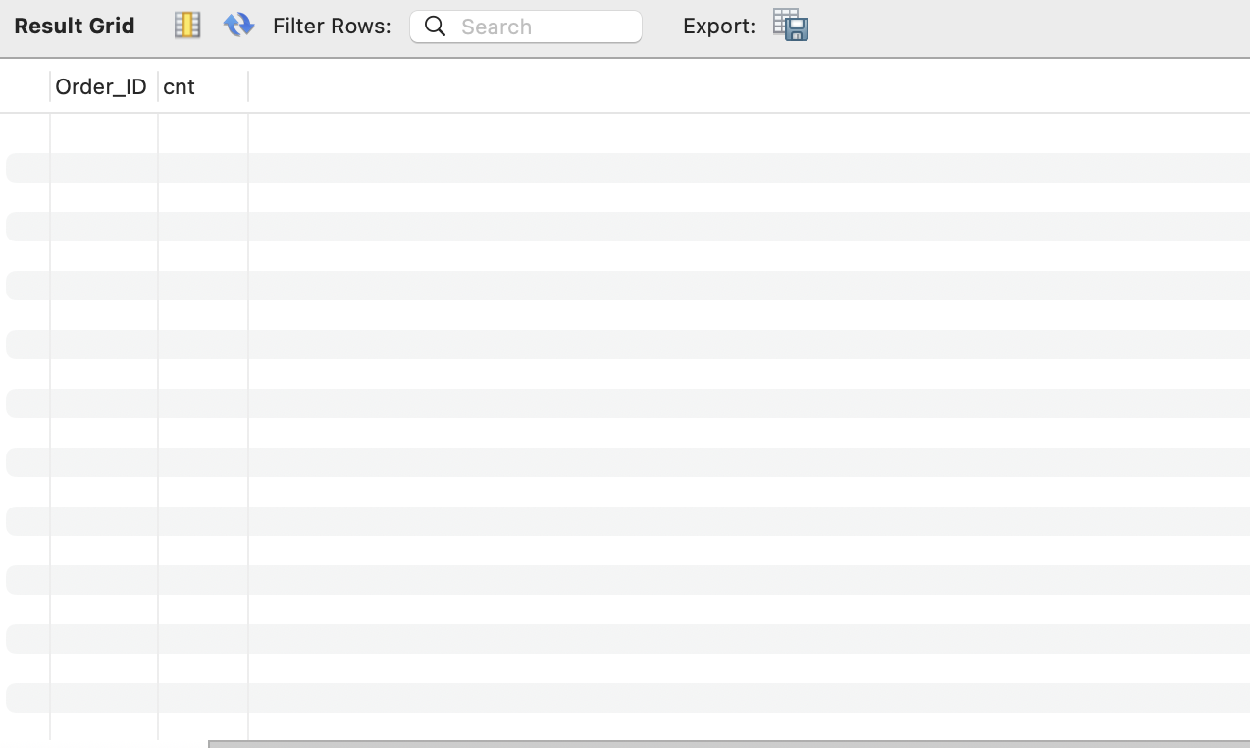
1.1 Identify and delete duplicate Order_ID records
SELECT Order_ID, COUNT(*) AS cnt
FROM Orders
GROUP BY Order_ID
HAVING COUNT(*) > 1;
NOTE:
-- Order_ID is defined as PRIMARY KEY in this schema,
-- therefore duplicate records are structurally prevented.
-- No deletion is required.

Slide 4
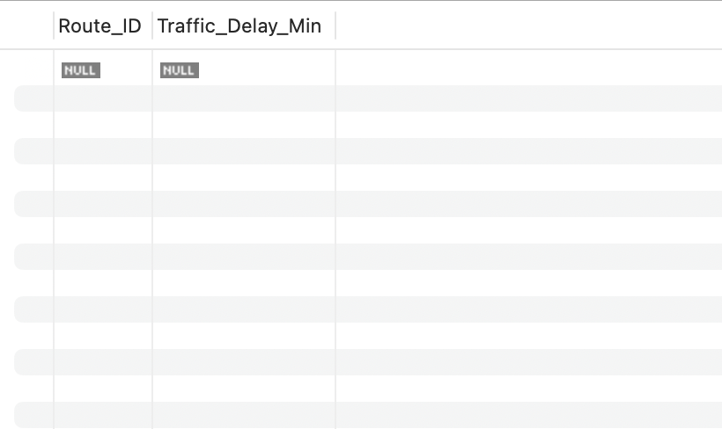
1.2 Replace null Traffic_Delay_Min with the average delay for that route
UPDATE Routes r
JOIN (
SELECT Route_ID, AVG(Traffic_Delay_Min) AS avg_delay
FROM Routes
WHERE Traffic_Delay_Min IS NOT NULL
GROUP BY Route_ID
) t
ON r.Route_ID = t.Route_ID
SET r.Traffic_Delay_Min = t.avg_delay
WHERE r.Traffic_Delay_Min IS NULL;

Slide 5
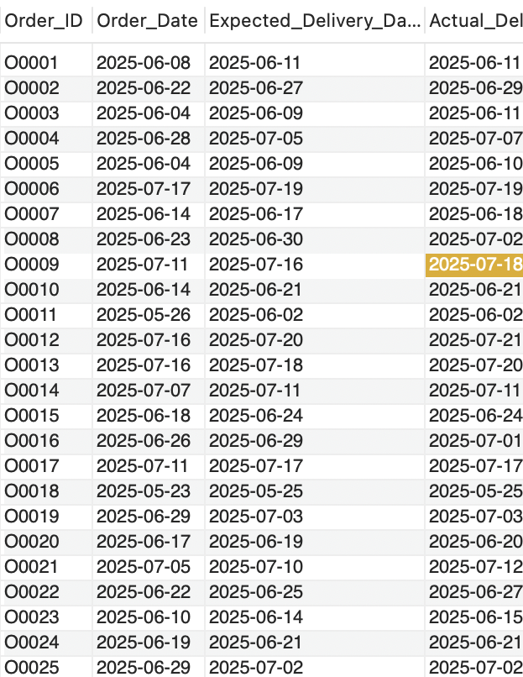
1.3 Convert all date columns into YYYY-MM-DD format using SQL functions
-- All date columns are stored as DATE/DATETIME types.
-- The following query validates the format.
SELECT
Order_ID,
DATE_FORMAT(Order_Date, '%Y-%m-%d') AS Order_Date,
DATE_FORMAT(Expected_Delivery_Date, '%Y-%m-%d') AS Expected_Delivery_Date,
DATE_FORMAT(Actual_Delivery_Date, '%Y-%m-%d') AS Actual_Delivery_Date
FROM Orders;

Slide 6
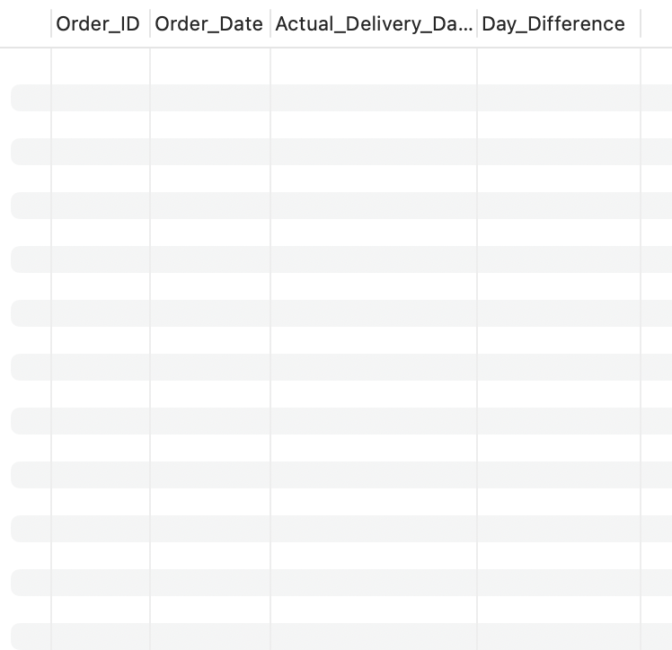
1.4 Ensure that no Actual_Delivery_Date is before Order_Date (flag such records)
SELECT
Order_ID,
Order_Date,
Actual_Delivery_Date,
DATEDIFF(Actual_Delivery_Date, Order_Date) AS Day_Difference
FROM Orders
WHERE Actual_Delivery_Date < Order_Date;

Slide 7
Task 2: Delivery Delay Analysis
Calculated delivery delay in days
Identified top delayed routes
Ranked orders by warehouse delay

Slide 8
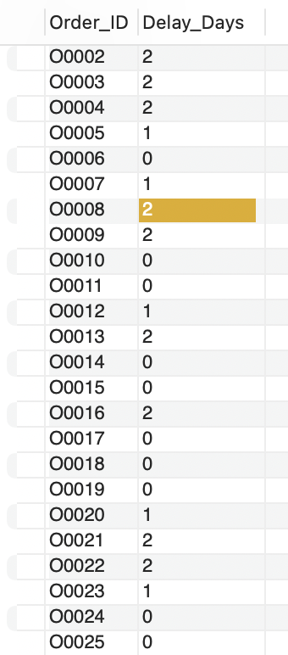
2.1 Calculate delivery delay (in days) for each order
SELECT
Order_ID,
DATEDIFF(Actual_Delivery_Date, Expected_Delivery_Date) AS Delay_Days
FROM Orders

Slide 9
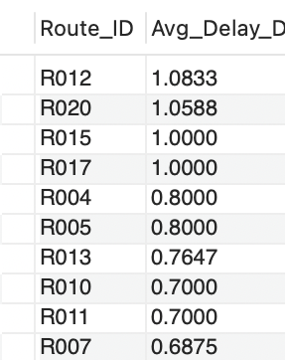
2.2 Find Top 10 delayed routes based on average delay days
SELECT
Route_ID,
AVG(DATEDIFF(Actual_Delivery_Date, Expected_Delivery_Date)) AS Avg_Delay_Days
FROM Orders
GROUP BY Route_ID
ORDER BY Avg_Delay_Days DESC
LIMIT 10;

Slide 10
Routes with higher average delays indicate consistent delivery in efficiencies.

Slide 11
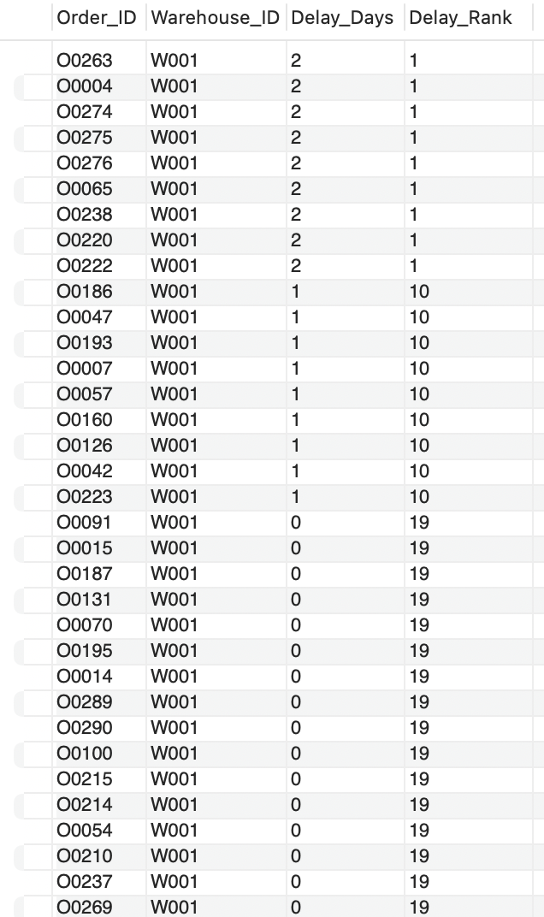
2.3 Use window functions to rank all orders by delay within each warehouse.
SELECT
Order_ID,
Warehouse_ID,
DATEDIFF(Actual_Delivery_Date,Expected_Delivery_Date) ASDelay_Days,
RANK() OVER (
PARTITION BY Warehouse_ID
ORDER BYDATEDIFF(Actual_Delivery_Date,Expected_Delivery_Date) DESC
) AS Delay_Rank
FROM Orders;Days DESC
LIMIT 10;s

Slide 12
Task 3: Route Optimization Insights
Avg delivery time per route
Traffic delay & efficiency ratio
Routes with >20% delays
Optimization recommendations

Slide 13
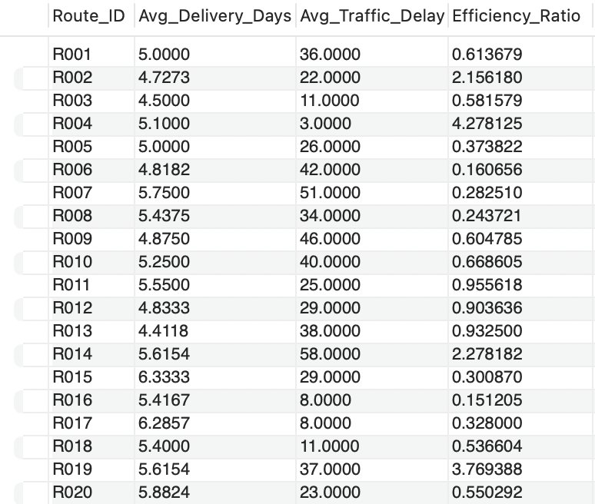
3.1 For each route, calculate: Average delivery time (in days). Average traffic delay. Distance-to-time efficiency ratio: Distance_KM / Average_Travel_Time_Min
SELECT
r.Route_ID,
AVG(DATEDIFF(o.Actual_Delivery_Date, o.Order_Date)) AS Avg_Delivery_Days,
AVG(r.Traffic_Delay_Min) AS Avg_Traffic_Delay,
r.Distance_KM / r.Average_Travel_Time_Min AS Efficiency_Ratio
FROM Routes r
JOIN Orders o ON r.Route_ID = o.Route_ID
GROUP BY r.Route_ID;

Slide 14
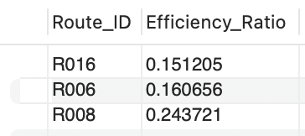
3.2 Identify 3 routes with the worst efficiency ratio.
SELECT
Route_ID,
Distance_KM / Average_Travel_Time_Min AS Efficiency_Ratio
FROM Routes
ORDER BY Efficiency_Ratio ASC
LIMIT 3;
Lower efficiency ratios highlight routes where travel time is disproportionately high

Slide 15
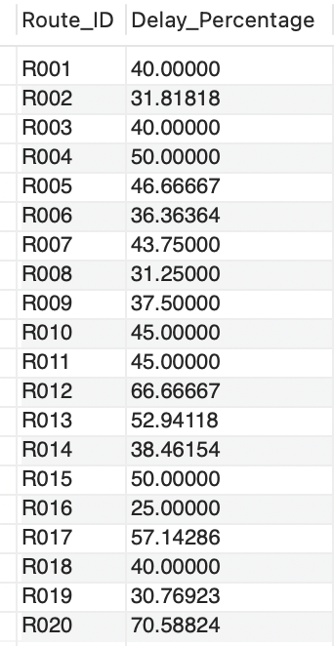
3.3 Find routes with >20% delayed shipments.
SELECT
Route_ID,
COUNT(CASE WHEN Actual_Delivery_Date > Expected_Delivery_Date THEN 1 END)
* 100.0 / COUNT(*) AS Delay_Percentage
FROM Orders
GROUP BY Route_ID
HAVING Delay_Percentage > 20;

Slide 16
3.4 Recommend potential routes for optimization.
Routes with high average delays, poor efficiency ratios,
and more than 20% delayed deliveries were identified as optimization candidates.
Recommendations include route redesign, traffic-aware scheduling,
improved agent allocation, and dynamic delivery planning.

Slide 17
Task 4: Warehouse Performance
Top 3 warehouses by processing time
Delayed vs total orders
Bottleneck warehouse detection
On-time % ranking

Slide 18
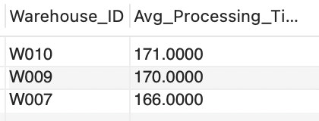
4.1 Find the top 3 warehouses with the highest average processing time.
SELECT
Warehouse_ID,
AVG(Processing_Time_Min) AS Avg_Processing_Time
FROM Warehouses
GROUP BY Warehouse_ID
ORDER BY Avg_Processing_Time DESC
LIMIT 3;

Slide 19
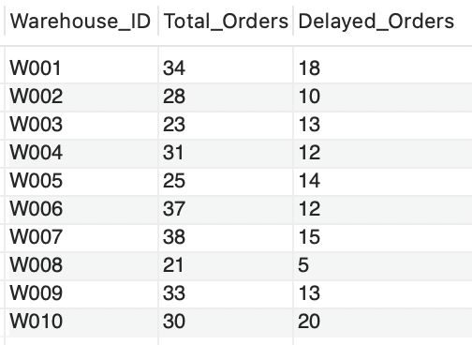
4.2 Calculate total vs. delayed shipments for each warehouse
SELECT
Warehouse_ID,
COUNT(*) AS Total_Orders,
COUNT(CASE WHEN Actual_Delivery_Date > Expected_Delivery_Date THEN 1 END)
AS Delayed_Orders
FROM Orders
GROUP BY Warehouse_ID;

Slide 20
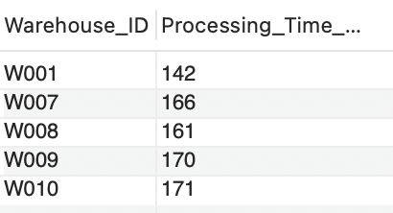
4.3 Use CTEs to find bottleneck warehouses where processing time > global average
WITH AvgProc AS (
SELECT AVG(Processing_Time_Min) AS Global_Avg
FROM Warehouses
)
SELECT
Warehouse_ID,
Processing_Time_Min
FROM Warehouses, AvgProc
WHERE Processing_Time_Min > Global_Avg;

Slide 21
4.4 Rank warehouses based on on-time delivery percentage
SELECT
Warehouse_ID,
COUNT(CASE WHEN Actual_Delivery_Date <= Expected_Delivery_Date THEN 1 END)
* 1 / COUNT(*) AS OnTime_Percentage
FROM Orders
GROUP BY Warehouse_ID
ORDER BY OnTime_Percentage DESC;
Warehouses with lower on-time percentages require process optimization.

Slide 22
Task 5: Delivery Agent Performance
• Agent ranking per route
• Agents with on-time < 80%
• Speed comparison (Top vs Bottom)

Slide 23
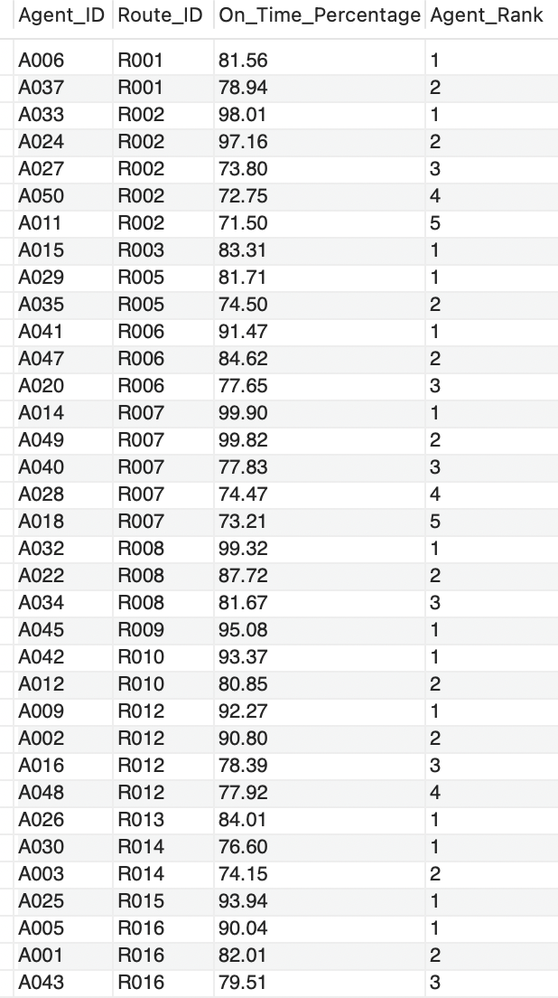
5.1 Rank agents (per route) by on-time delivery percentage
SELECT
Agent_ID,
Route_ID,
On_Time_Percentage,
RANK() OVER (
PARTITION BY Route_ID
ORDER BY On_Time_Percentage DESC
) AS Agent_Rank
FROM Delivery_Agents;

Slide 24
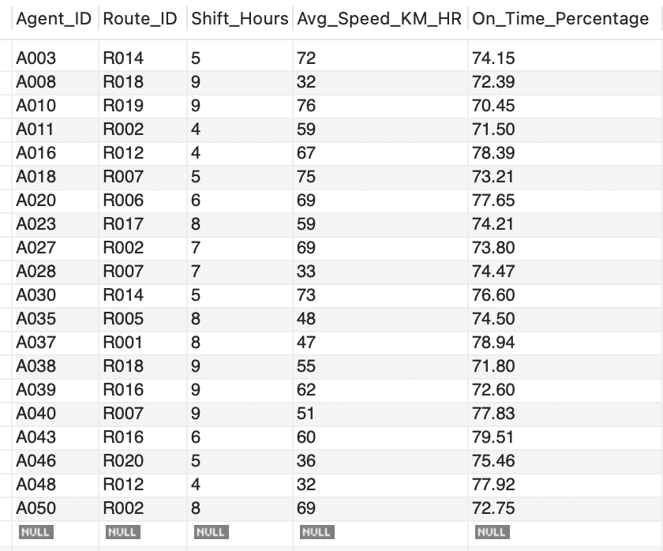
5.2 Find agents with on-time % < 80%.
SELECT *
FROM Delivery_Agents
WHERE On_Time_Percentage < 80;

Slide 25
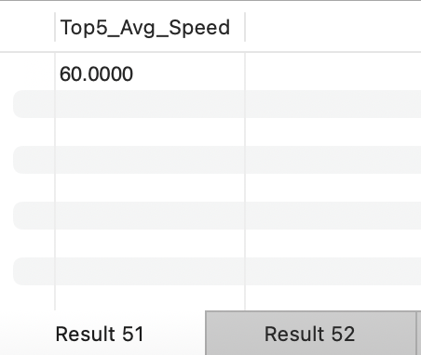
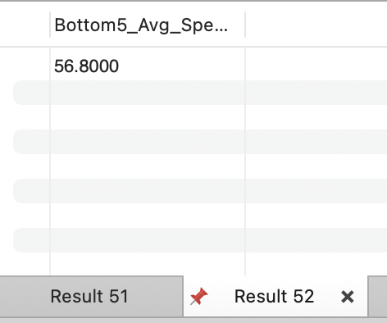
5.3 Compare average speed of top 5 vs bottom 5 agents using subqueries.
SELECT AVG(Avg_Speed_KM_HR) AS Top5_Avg_Speed
FROM (
SELECT Avg_Speed_KM_HR
FROM Delivery_Agents
ORDER BY On_Time_Percentage DESC
LIMIT 5
) t;
SELECT AVG(Avg_Speed_KM_HR) AS Bottom5_Avg_Speed
FROM (
SELECT Avg_Speed_KM_HR
FROM Delivery_Agents
ORDER BY On_Time_Percentage ASC
LIMIT 5
) b;

Slide 26
Task 6: Shipment Tracking Analytics
Last checkpoint per order
Most common delay reasons
Orders with repeated delays

Slide 27
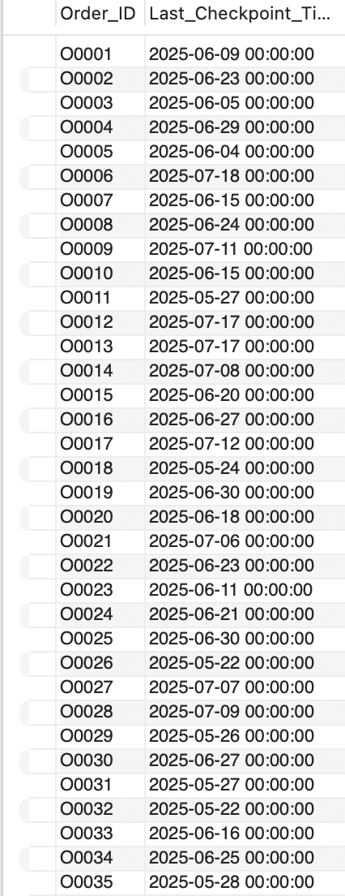
6.1 For each order, list the last checkpoint and time.
SELECT
Order_ID,
MAX(Checkpoint_Time) AS Last_Checkpoint_Time
FROM Shipment_Tracking
GROUP BY Order_ID;

Slide 28
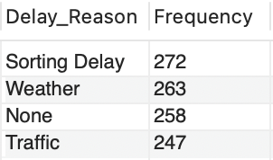
6.2 Find the most common delay reasons (excluding None).
SELECT
Delay_Reason,
COUNT(*) AS Frequency
FROM Shipment_Tracking
WHERE Delay_Reason IS NOT NULL
GROUP BY Delay_Reason
ORDER BY Frequency DESC;

Slide 29
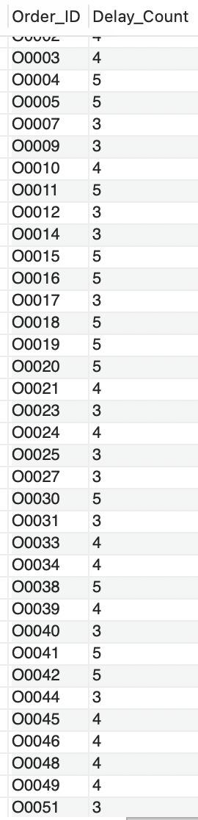
6.3 Identify orders with >2 delayed checkpoints
SELECT
Order_ID,
COUNT(*) AS Delay_Count
FROM Shipment_Tracking
WHERE Delay_Reason IS NOT NULL
GROUP BY Order_ID
HAVING COUNT(*) > 2;

Slide 30
Task 7: KPI Reporting
• On-time delivery percentage
• Avg delay per region
• Avg traffic delay per route

Slide 31
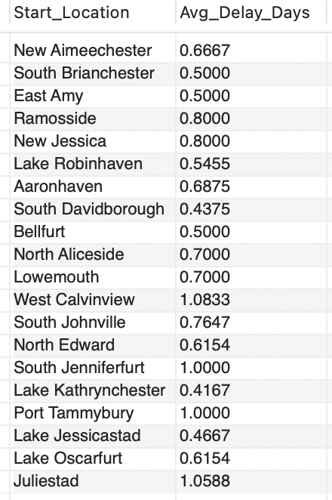
7.1 Average Delivery Delay per Region (Start_Location).
SELECT
Order_ID,
COUNT(*) AS Delay_Count
FROM Shipment_Tracking
WHERE Delay_Reason IS NOT NULL
GROUP BY Order_ID
HAVING COUNT(*) > 2;

Slide 32

7.2 On-Time Delivery % = (Total On-Time Deliveries / Total Deliveries) * 100.
SELECT
COUNT(CASE WHEN Actual_Delivery_Date <= Expected_Delivery_Date THEN 1 END)
* 100.0 / COUNT(*) AS OnTime_Delivery_Percentage
FROM Orders;

Slide 33
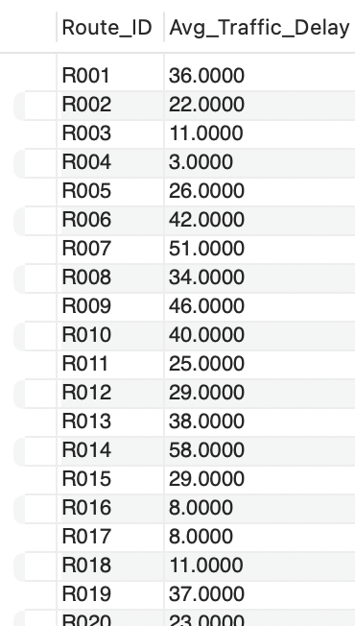
7.3 Average Traffic Delay per Route
SELECT
Route_ID,
AVG(Traffic_Delay_Min) AS Avg_Traffic_Delay
FROM Routes
GROUP BY Route_ID;

Slide 34
Conclusion
• Identified logistics inefficiencies
• Data-driven optimization insights
• SQL enables smarter delivery decisions

Slide 35
THANK YOU
VIDEO LINK

