Slide 1



OrgBrain
SLIDE 01
THE PROBLEM
MEETINGS CREATE DECISIONS.
BUT THE TRUTH IS SCATTERED ACROSS THE ENTERPRISE.
Meeting → Git → Logs → Email → Support → Infrastructure → Internal Knowledge
DUPLICATED WORK
PROJECT VISIBILITY
MEETING WASTE
SILOED KNOWLEDGE
308 HOURS
70%
72%
$31.5B
annual duplicated work per worker
42% dev time on tech debt ·
$85B global cost
of projects fail to deliver
52% scope creep
·27% budget overrun
meeting failure rate
61% time on work-about-work
5 hrs/wk lost
Fortune 500 annual loss
$47M avg loss per large enterprise
We capture what happens in meetings......... but capturing is not the same as knowing what is true!!!!!

Slide 2

OrgBrain
SLIDE 02
THE VISION
AI-powered truth running silently in every meeting room.

Slide 3

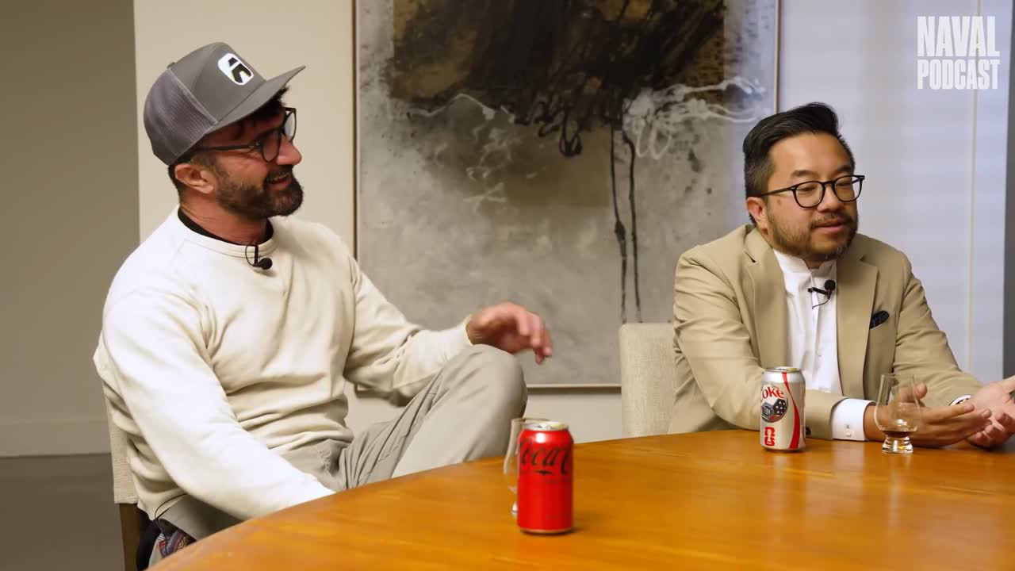

OrgBrain
SLIDE 03
THE SOLUTION
"Google has all meeting transcripts."
MEETING CONVERSATION → OrgBrain → ENTERPRISE GROUND TRUTH → ACTIONABLE DECISION
OrgBrain Live Demonstration

Slide 4




SCENARIO 1
RE-INVENTING THE WHEEL
PM / Developer Claim
"We need 4 weeks to build a new queue service."
Agent Ground-Truth Discovery
Core queue package shipped 8 months ago in /packages/.
Fully tested, documented, and production-ready. Zero new development required.
Business ROI / Saved
$32,000
+ 160 HOURS SAVED
Human Claim
Asset Discovered
Duplicate Work Avoided

Slide 5
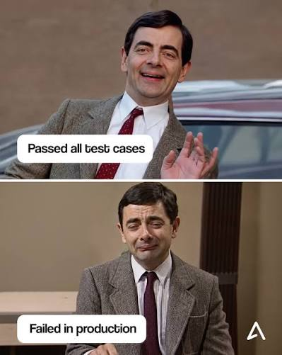








SCENARIO 2
PM / Developer Claim
"Release is 100% stable, zero issues!"
Agent Ground-Truth Discovery
BQL shows 14k DB errors; inbox melting with user complaints.
PREVENTS MAJOR PRODUCTION OUTAGE
Business ROI / Saved
Real-time ground-truth verification catches critical failures before they escalate — protecting revenue, reputation, and customer trust.

Slide 6






SCENARIO 3
SCENARIO 4
Cloud GPU Waste
CLAIM: "Need $15k/mo AWS GPUs for AI inference."
DISCOVERY: Script was running nested IF/ELSE loops runs locally on Spark.
6-Month Rewrite
CLAIM: "Codebase is unmaintainable, freeze features 6 months."
DISCOVERY: 94% of bugs were in one 600-line legacy script.
$180,000
94%
OF BUGS
/ YEAR SAVED
IN ONE 600-LINE LEGACY SCRIPT
ROI: $180,000 / YEAR SAVED
ROI: 6 MONTHS LOST VELOCITY SAVED
2025

