Slide 1
Germany: Sales Analysis
Kärcher Store Stuttgart

Slide 2
Monthly Sales Analysis for Germany

Slide 3
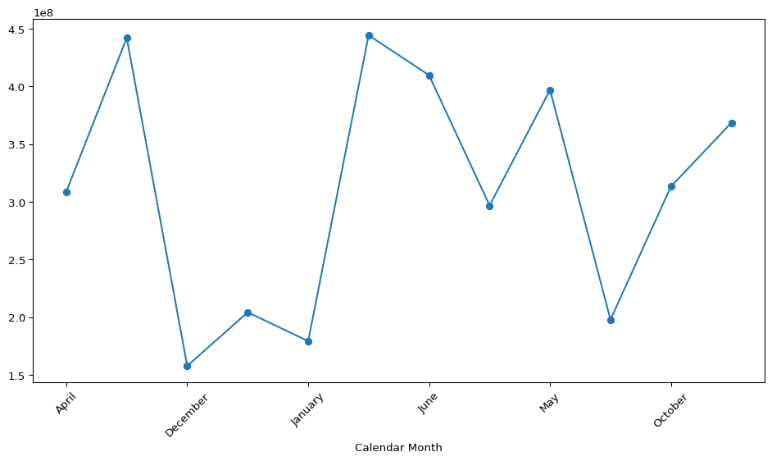
Sales Performance Overview
AI Analysis:
The total revenue of €3.72 billion and an average monthly revenue of approximately €310 million indicate a strong overall performance, with July standing out as the peak month at €444.38 million, suggesting seasonal demand or successful marketing initiatives during that period. This spike in July could imply opportunities for targeted promotions or inventory adjustments in anticipation of similar peaks in future years. To capitalize on this trend, it is recommended to analyze the factors contributing to July's success and consider implementing strategies to boost sales in historically lower-performing months.

Slide 4
Regional Analysis
 | Sales Amount | Revenue EUR | Gross Profit EUR
Sales Region
Germany East | 428,951 | €451,678,367 | €126,386,276
Germany North | 667,888 | €687,595,342 | €219,455,830
Germany South | 1,400,820 | €1,562,815,376 | €496,617,703
Germany West | 991,293 | €1,016,938,345 | €325,293,188

Slide 5
AI Analysis:
The sales performance data reveals that Germany South is the top-performing region, generating €1,562,815,376 in revenue and €496,617,703.16 in profit, significantly outpacing other regions. In contrast, Germany East lags behind with the lowest revenue of €451,678,367 and a profit of €126,386,275.95. This disparity suggests that targeted strategies to enhance sales and profitability in underperforming regions, particularly Germany East, could yield substantial returns. Recommendations include investing in localized marketing efforts, optimizing product offerings to meet regional demands, and exploring partnerships to boost market penetration in these areas.

Slide 6
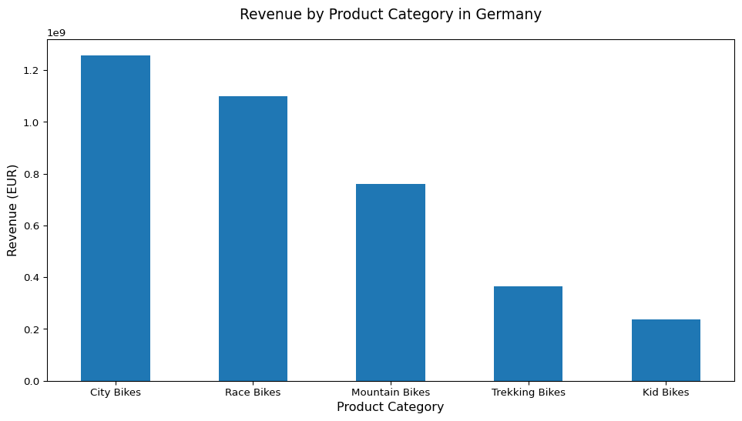
Product Category Performance
AI Analysis:
The sales performance data reveals that City Bikes dominate the market in Germany with a revenue of approximately €1.26 billion, significantly outpacing other categories such as Race Bikes (€1.1 billion) and Mountain Bikes (€760 million). Notably, while City Bikes have a solid profit margin of 31.14%, Mountain Bikes lead with the highest margin at 33.19%. This suggests a potential opportunity to enhance profitability by focusing on the Mountain Bikes segment, possibly through targeted marketing or product enhancements. Additionally, considering the strong performance of City Bikes, the company could explore expanding its product line or introducing premium models to capture a larger market share.

