Slide 1
German Sales Analysis
Mike Farmer

Slide 2
Monthly Sales Analysis for Germany

Slide 3
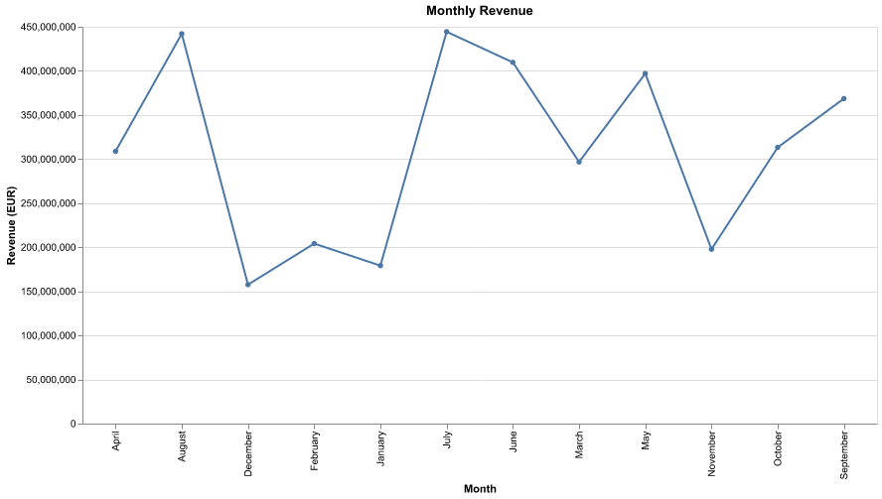
Sales Performance Overview

Slide 4
AI Analysis: The total revenue of €3.72 billion and an average monthly revenue of approximately €310 million indicate a strong overall performance, with May being the peak month at €444.38 million, suggesting seasonal demand or successful marketing initiatives during that period. The significant revenue spike in May could imply opportunities for targeted promotions or inventory adjustments to capitalize on this trend in future years. To enhance overall performance, the business should analyze the factors contributing to the peak month and consider implementing similar strategies in lower-performing months to stabilize revenue throughout the year.

Slide 5
Regional Analysis
 | Sales Amount | Revenue EUR | Gross Profit EUR
Sales Region
Germany East | 428,951 | €451,678,367 | €126,386,276
Germany North | 667,888 | €687,595,342 | €219,455,830
Germany South | 1,400,820 | €1,562,815,376 | €496,617,703
Germany West | 991,293 | €1,016,938,345 | €325,293,188

Slide 6
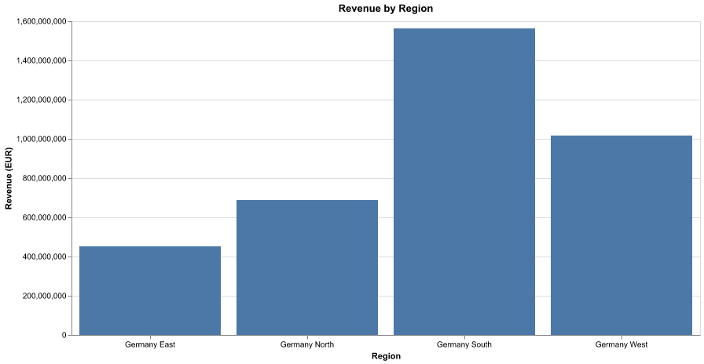

Slide 7
AI Analysis: The sales performance data reveals that Germany South is the top-performing region, generating €1,562,815,376 in revenue and €496,617,703.16 in profit, significantly outpacing other regions. In contrast, Germany East lags behind with the lowest revenue of €451,678,367 and a profit of €126,386,275.95. This disparity suggests a potential opportunity for targeted marketing and sales strategies in underperforming regions, particularly Germany East, to enhance revenue and profitability. Additionally, leveraging the successful strategies from Germany South could help replicate its success in other territories.

Slide 8
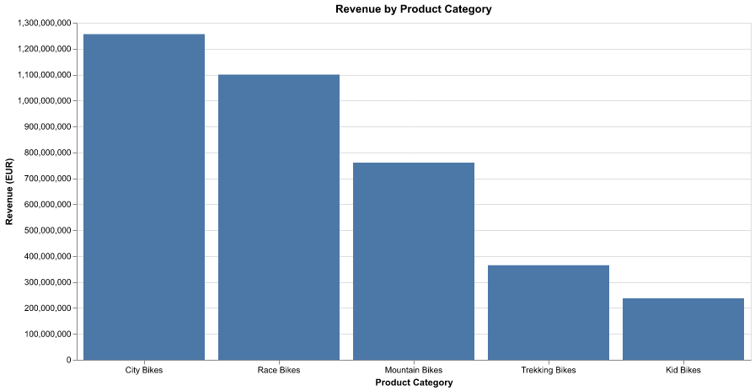
Product Category Performance

Slide 9
AI Analysis: The sales performance data indicates that City Bikes lead the market in Germany with a substantial revenue of €1,256,225,584, representing the highest revenue among all categories. Notably, Mountain Bikes exhibit the highest profit margin at 33.19%, suggesting a strong potential for profitability despite lower sales figures (€760,289,226). To capitalize on this, the business should consider enhancing marketing efforts for Mountain Bikes to boost sales while maintaining focus on the City Bikes segment, which is already performing well. Additionally, exploring cost optimization strategies for Race and Trekking Bikes, which have lower profit margins, could further improve overall profitability.

