Slide 1
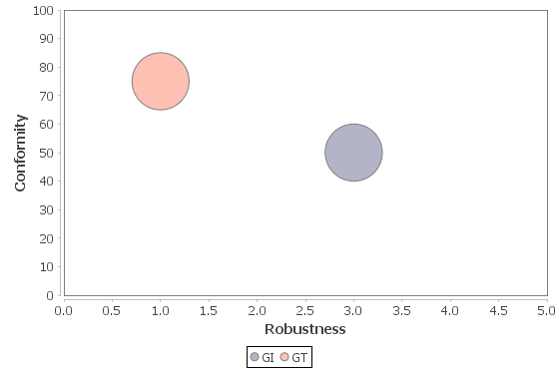
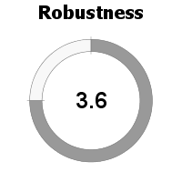
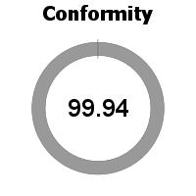


Model 1
Robustness vs target (default)
Conformity vs target (default)

Slide 2
Area | Robustness | Conformity
AA | 4.1 | 99.81
GI | 2.7 | 100
GT | 4.1 | 100

