Slide 1




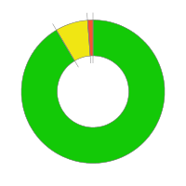
Model 3
Life - Liabilities AA
Frequency
Annual
3.6
Robustness
100%
Conformity
Active controls
161
(0 QEngine)
Automatic
90
Manual
71
Executed
Not executed
82
Results Received
75 OK
6 Below threshold
1 Above threshold

