Slide 1
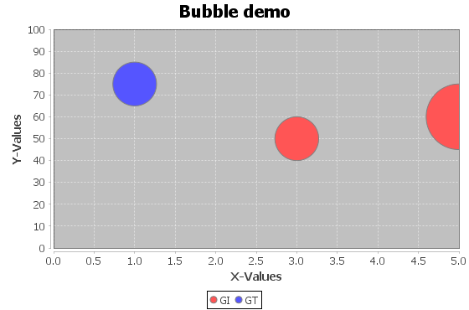
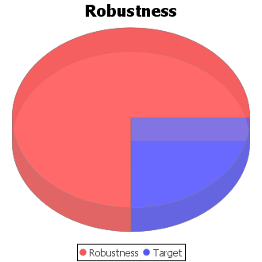
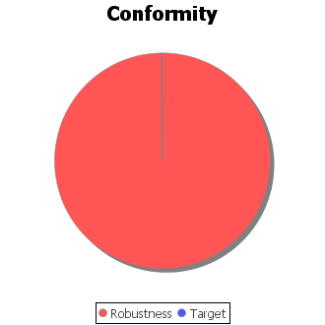
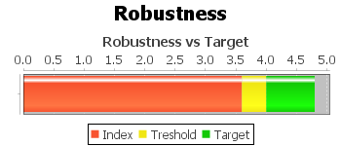
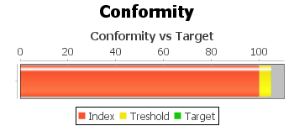
Model 1
Area | Robustness | Conformity
AA Robustness | 4.1 | 99.81
GI Robustness | 2.7 | 100
GT Robustness | 4.1 | 100

Slide 2
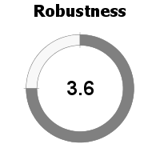
Area | Robustness | Conformity
90 CONTROLS Robustness 1.3 Conformity 100% | 99 | 78.2
90 CONTROLS | 99 | 78.2
90 CONTROLS | 99 | 78.2

