Slide 1
Welcome to PowerPoint
Design and deliver beautiful presentations with ease and confidence.

Slide 2
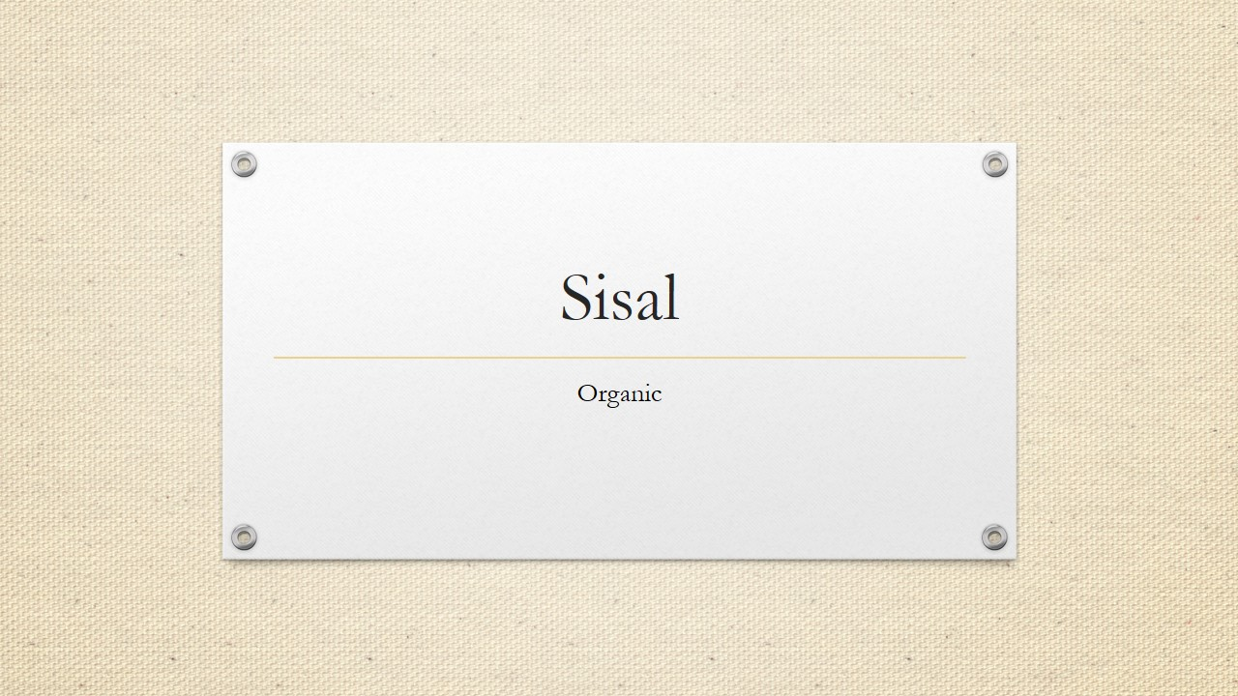
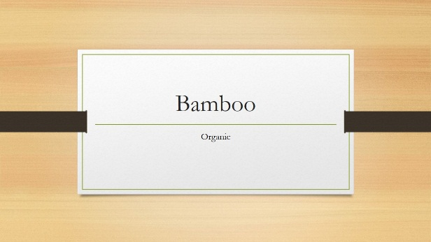
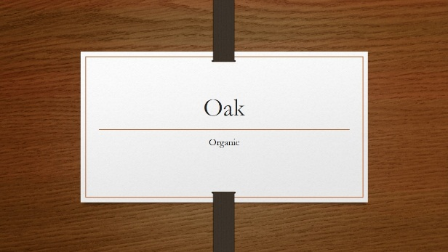
Design
Right from the start, you’ll have access to beautiful, widescreen themes that you can easily change to match your style. Every theme comes with a variety of color variants that you can mix and match.
New features like Merge Shapes and a color-matching Eyedropper open up new possibilities for your designs.
Line up your layouts, photos, and diagrams perfectly in seconds with alignment guides and smart guides.

