Slide 1
SchuLyf
A Student Management System for the university
Digitising admissions, tamper-proof payments, exam-gating, course management & verifiable academic transcripts
PRESENTED BY
«Your Name»
INSTITUTION
«University / Faculty»
DEPARTMENT / COURSE
«Department · Course code»
SUPERVISOR
«Supervisor name»
DATE
«Month Year»
Laravel 13 · Inertia · Vue 3 · PrimeVue · MySQL · Pest

Slide 2
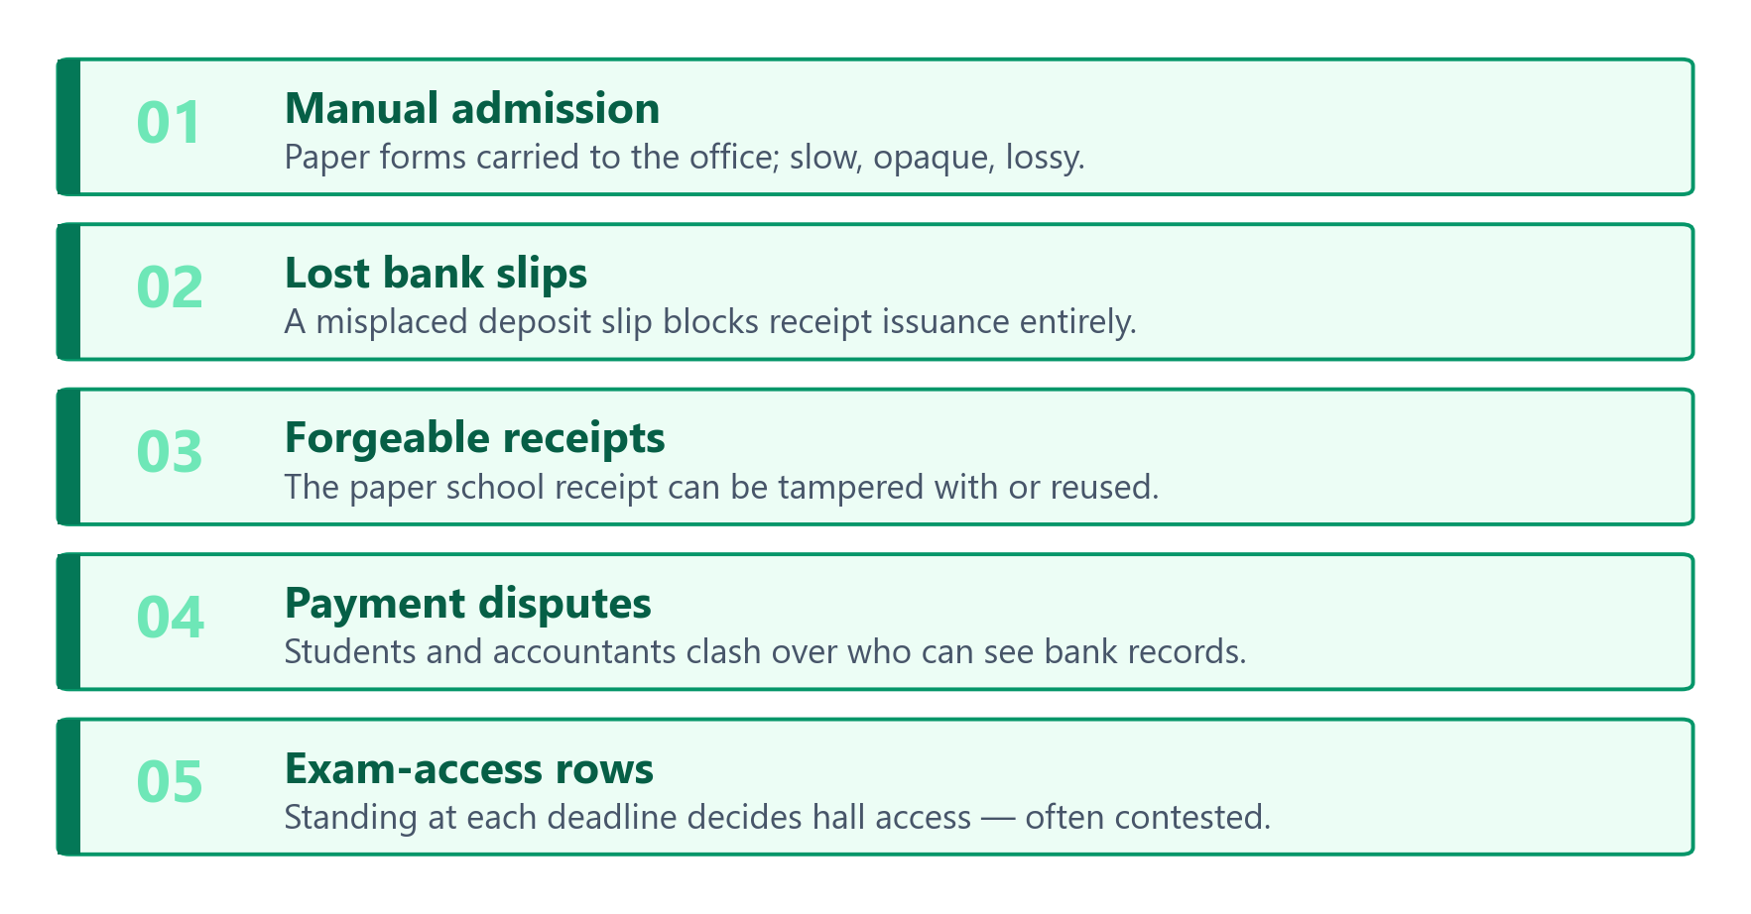
CONTEXT
The problem
Five recurring failures in day-to-day student administration.
SchuLyf · Student Management System
02 / 15

Slide 3
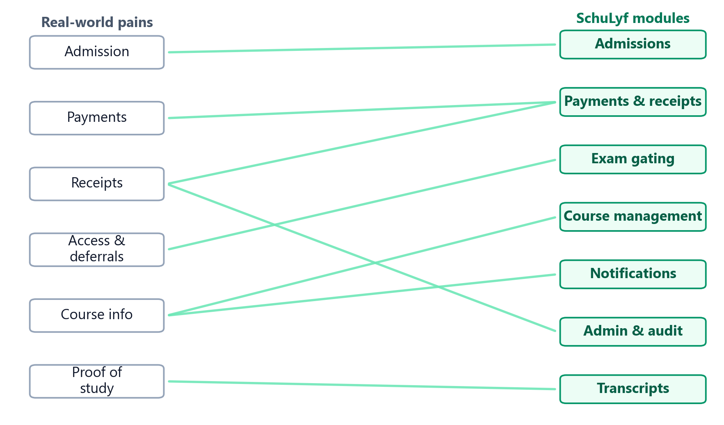
GOALS
Objectives & scope
Each real-world pain maps to a dedicated SchuLyf module.
SchuLyf · Student Management System
03 / 15

Slide 4
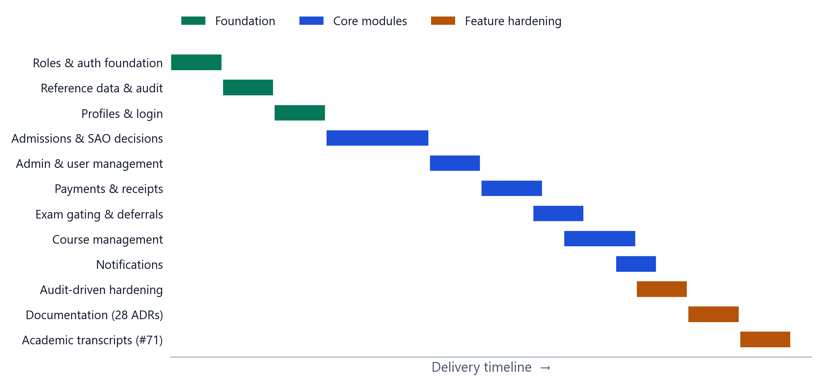
APPROACH
Methodology & delivery
● Laravel 13 + Inertia/Vue 3 full-stack, session-authenticated
● Test-driven (Pest) every change proven by a test
● Per-feature quality gate Pint · types · lint · build
● Audit-driven hardening 34 findings remediated
● Phased, incremental delivery
SchuLyf · Student Management System
04 / 15

Slide 5
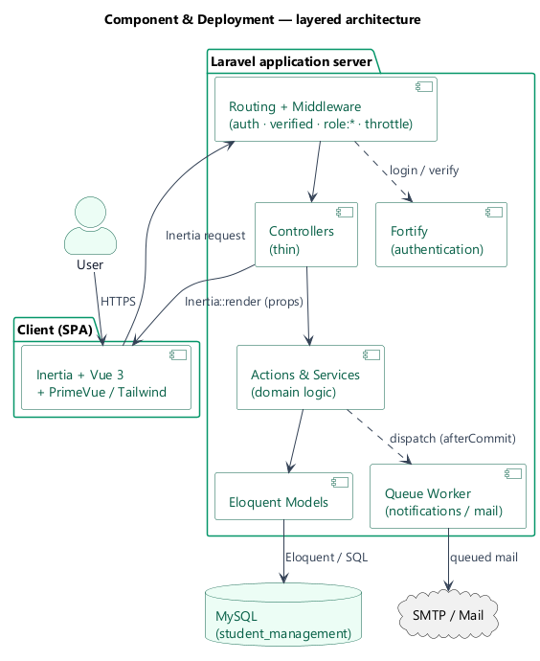
DESIGN
System architecture
Thin controllers → actions/services → Eloquent → MySQL; queued mail; Fortify auth.
SchuLyf · Student Management System
05 / 15

Slide 6
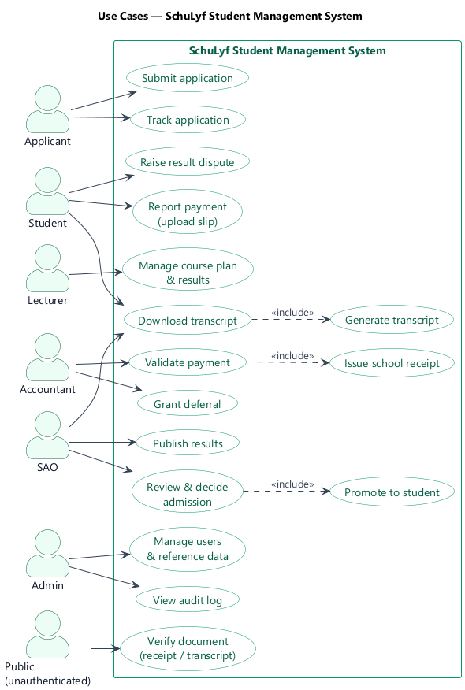
DESIGN
Actors & use cases
Six roles plus an unauthenticated public verifier.
SchuLyf · Student Management System
06 / 15

Slide 7
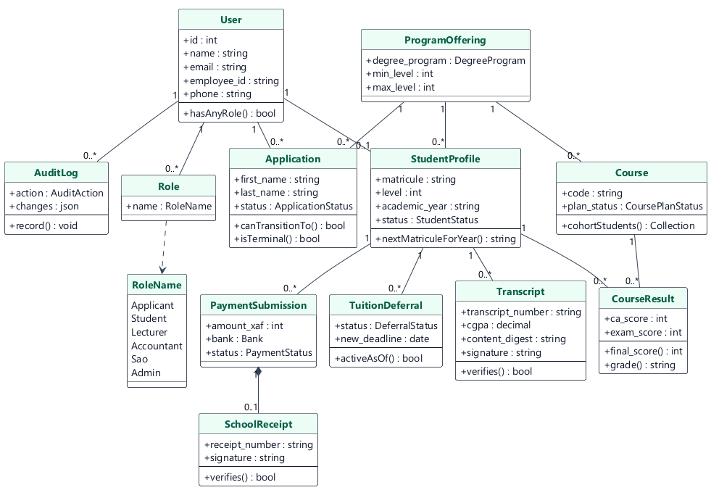
DESIGN
Domain model (UML class diagram)
Core classes, attributes, operations and relationships.
SchuLyf · Student Management System
07 / 15

Slide 8
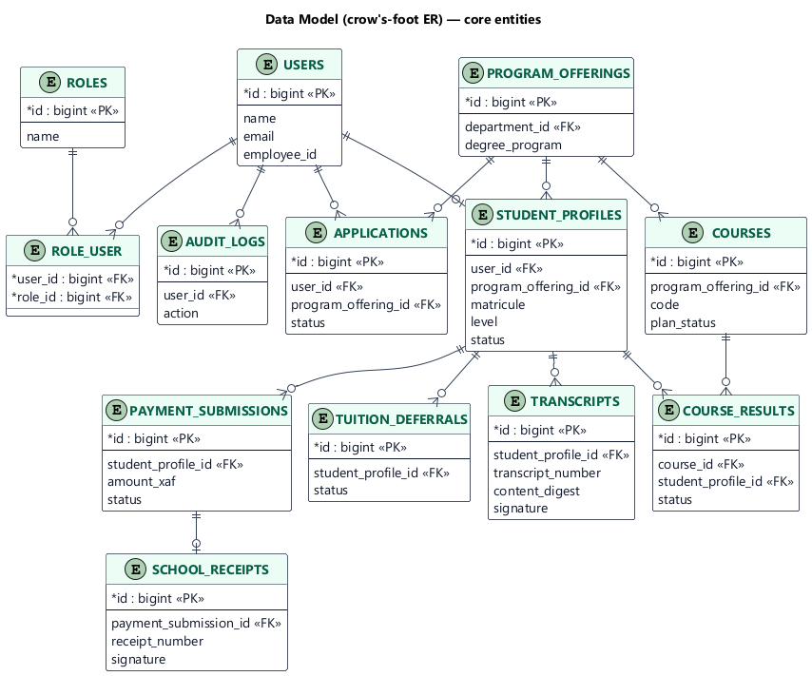
DESIGN
Data model (crow's-foot ER)
34 migrations; the core entities and their cardinalities.
SchuLyf · Student Management System
08 / 15

Slide 9
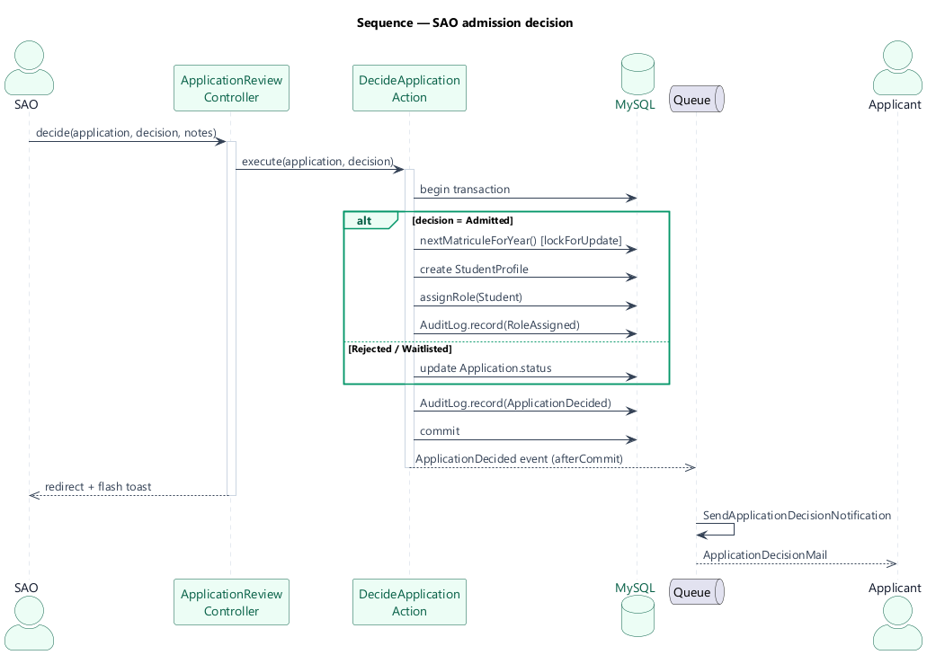
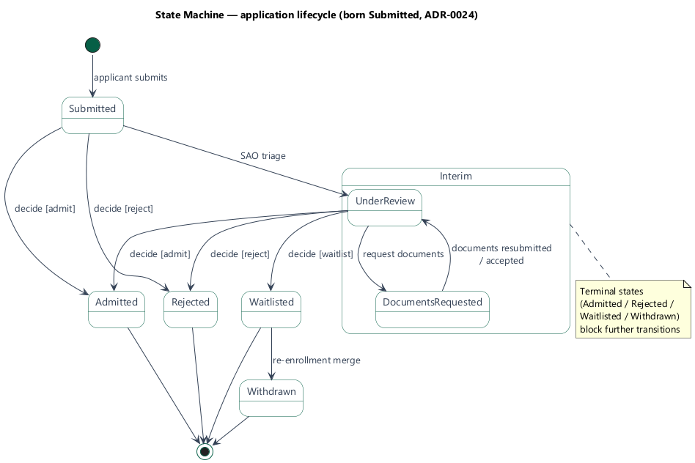
FLOWS
Admissions — decision & lifecycle
SAO decision sequence (admit mints a student)
Application state machine (born Submitted)
SchuLyf · Student Management System
09 / 15

Slide 10
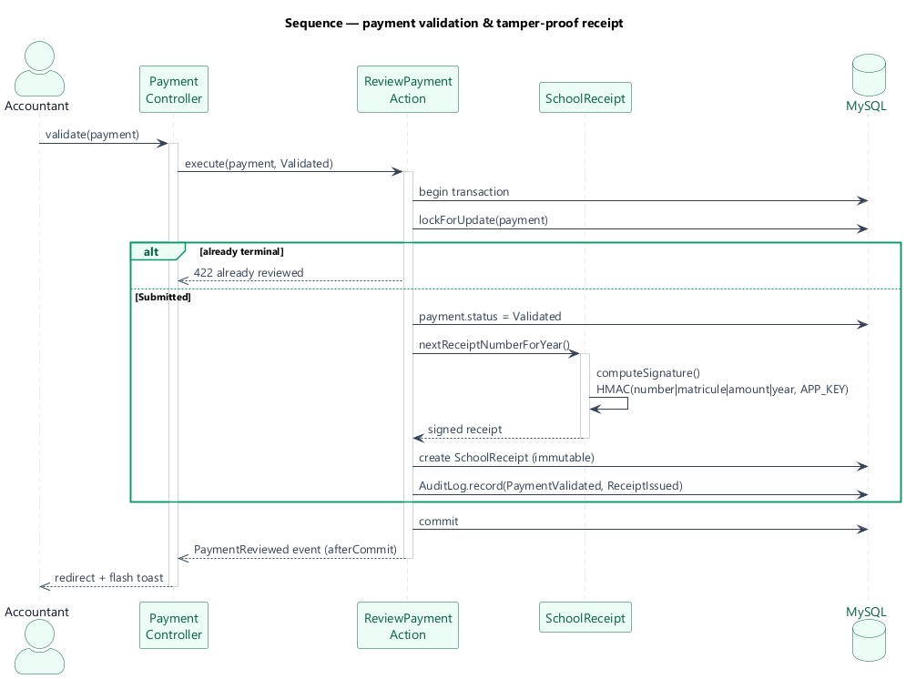
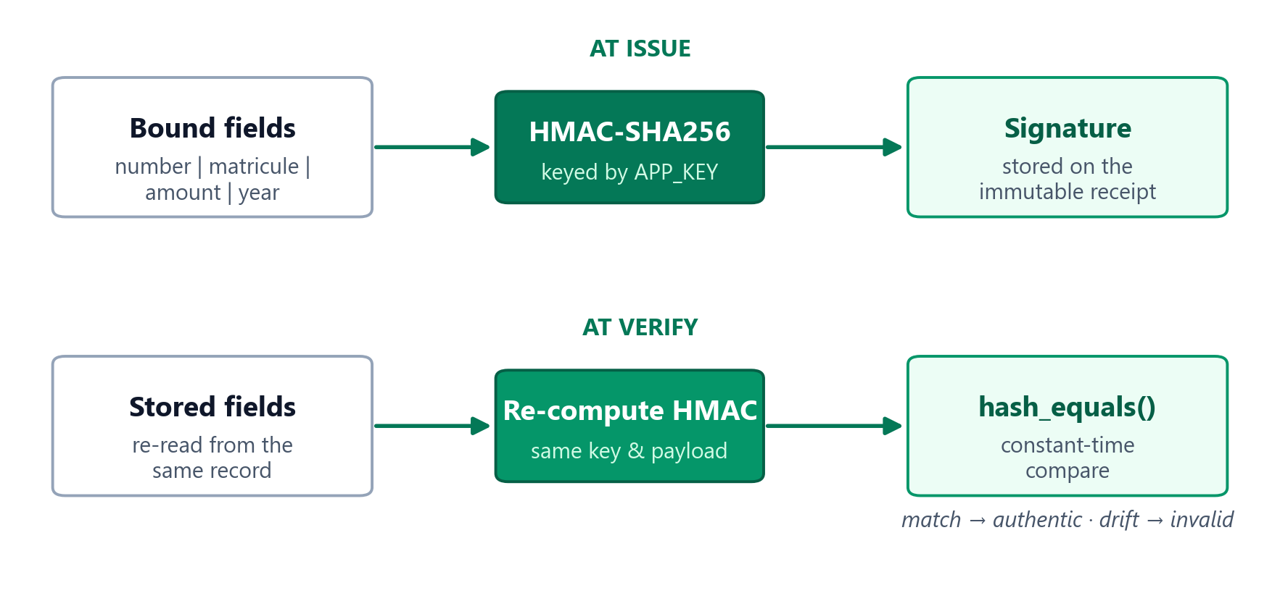
FLOWS
Tamper-proof payments & receipts
Validate → mint an immutable, signed receipt
HMAC binds identity; verify re-derives it
SchuLyf · Student Management System
10 / 15

Slide 11
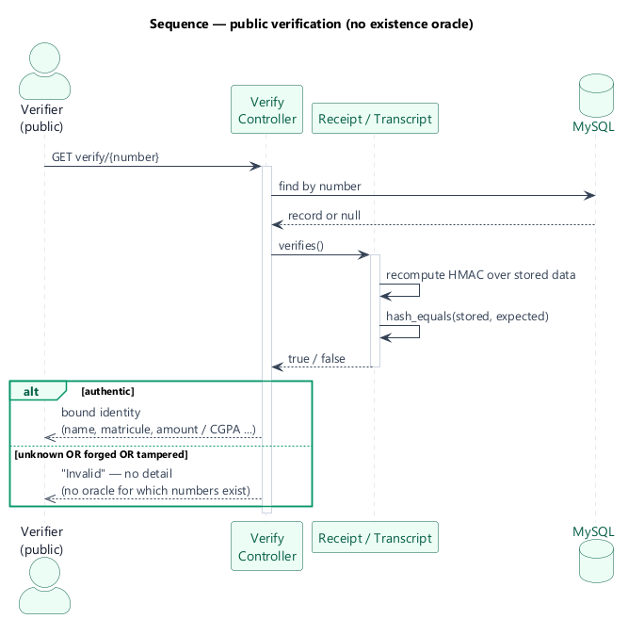
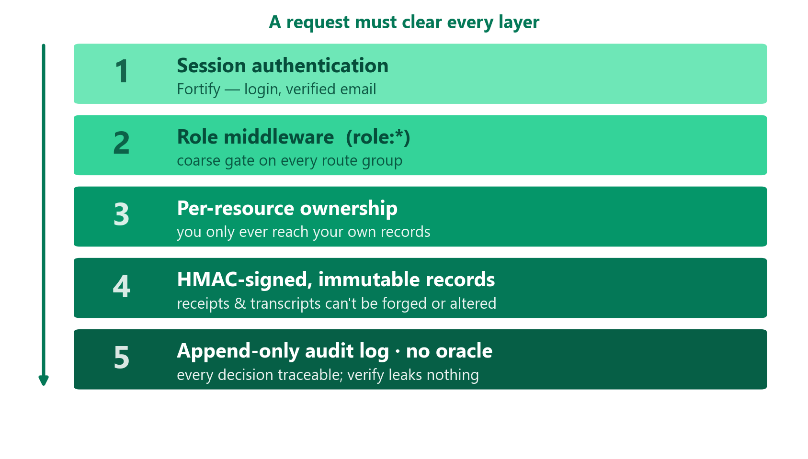
SECURITY
Verification & the security model
Public verify — authentic or “invalid”, no oracle
Defense in depth across five layers
SchuLyf · Student Management System
11 / 15

Slide 12
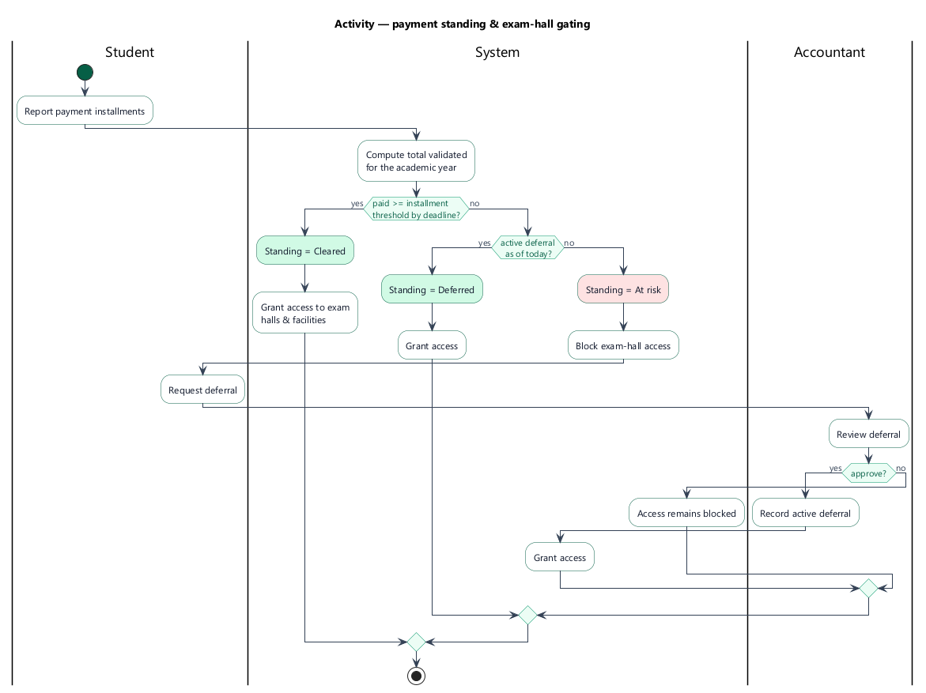
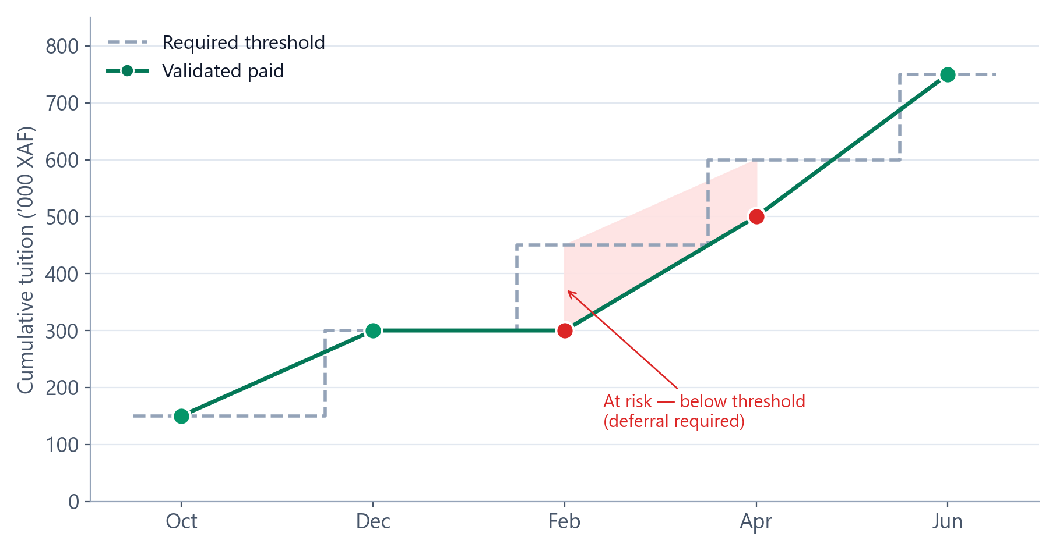
FLOWS
Exam gating — standing & deferrals
Standing decides exam-hall access each deadline
Below threshold → at risk unless deferred
SchuLyf · Student Management System
12 / 15

Slide 13
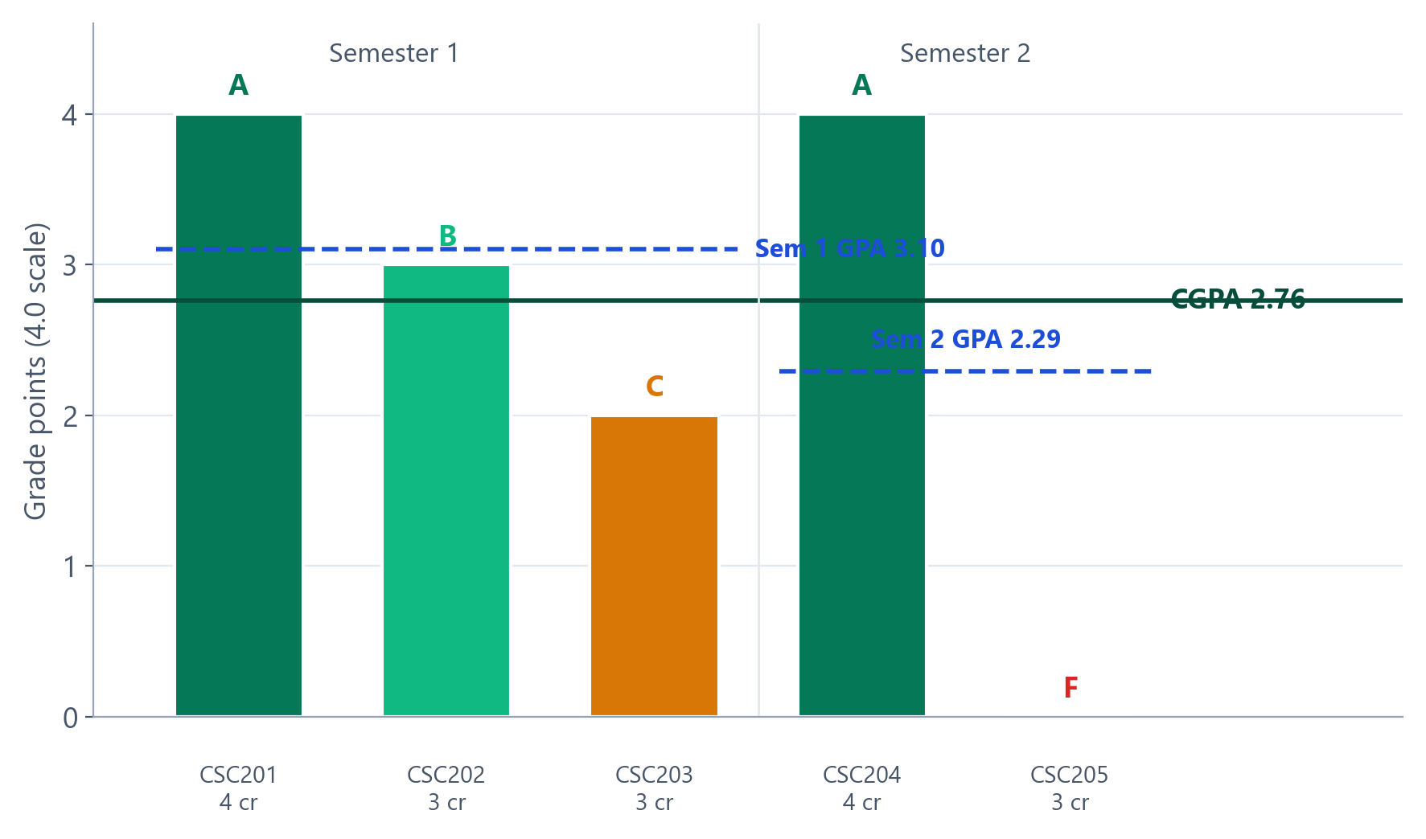
FEATURE
Academic transcripts (#71)
● 4.0 GPA / CGPA credit-weighted, per semester & cumulative
● Immutable snapshot signed at issue; results may change later
● mpdf PDF + QR branded, downloadable transcript
● Public HMAC verify authentic-or-invalid, no oracle
SchuLyf · Student Management System
13 / 15

Slide 14
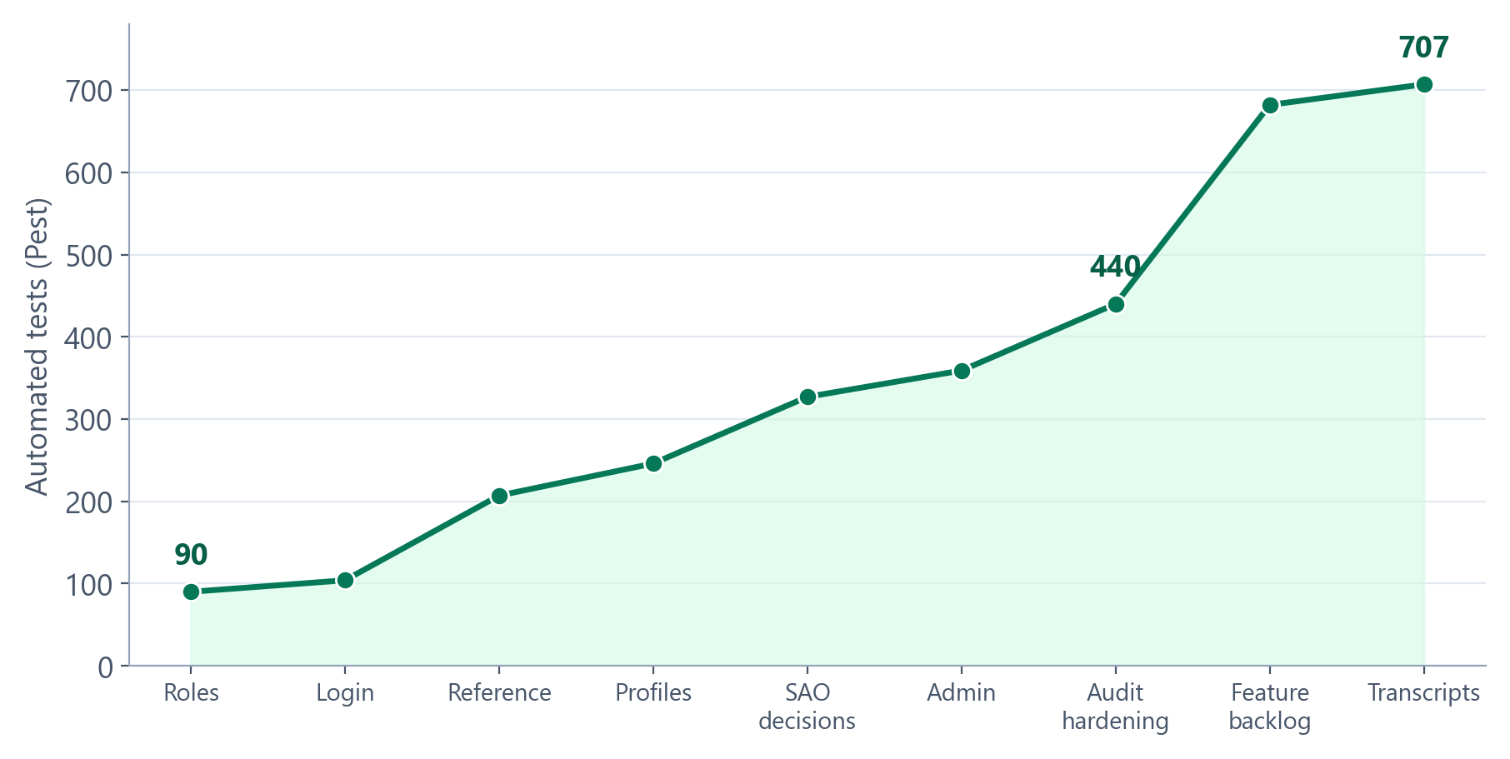
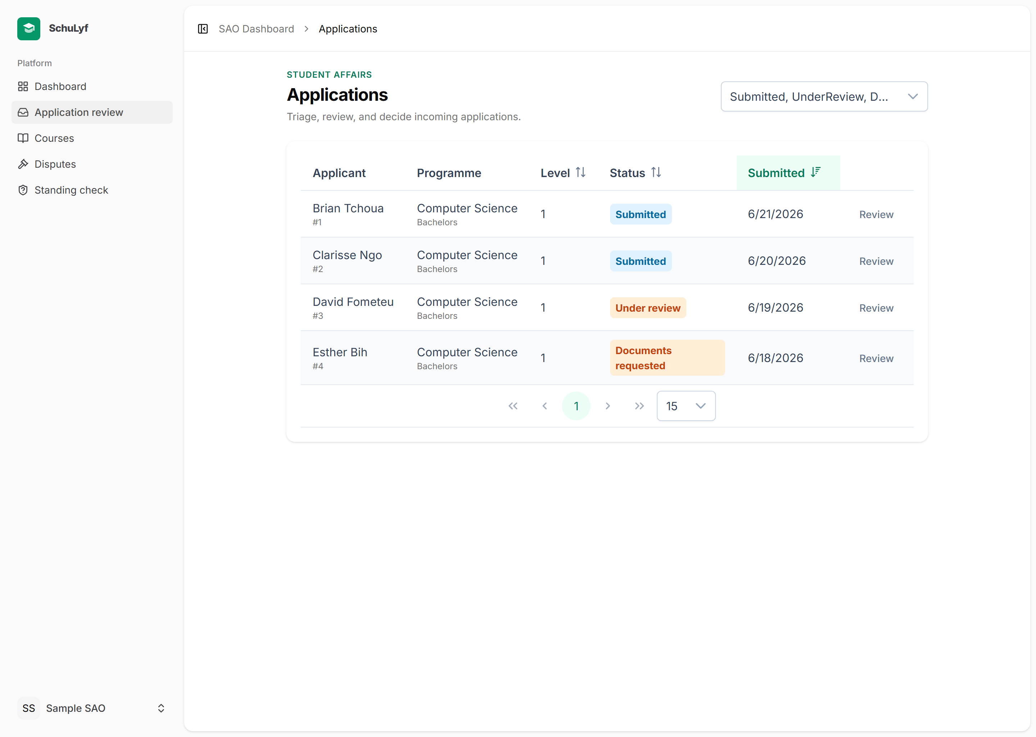
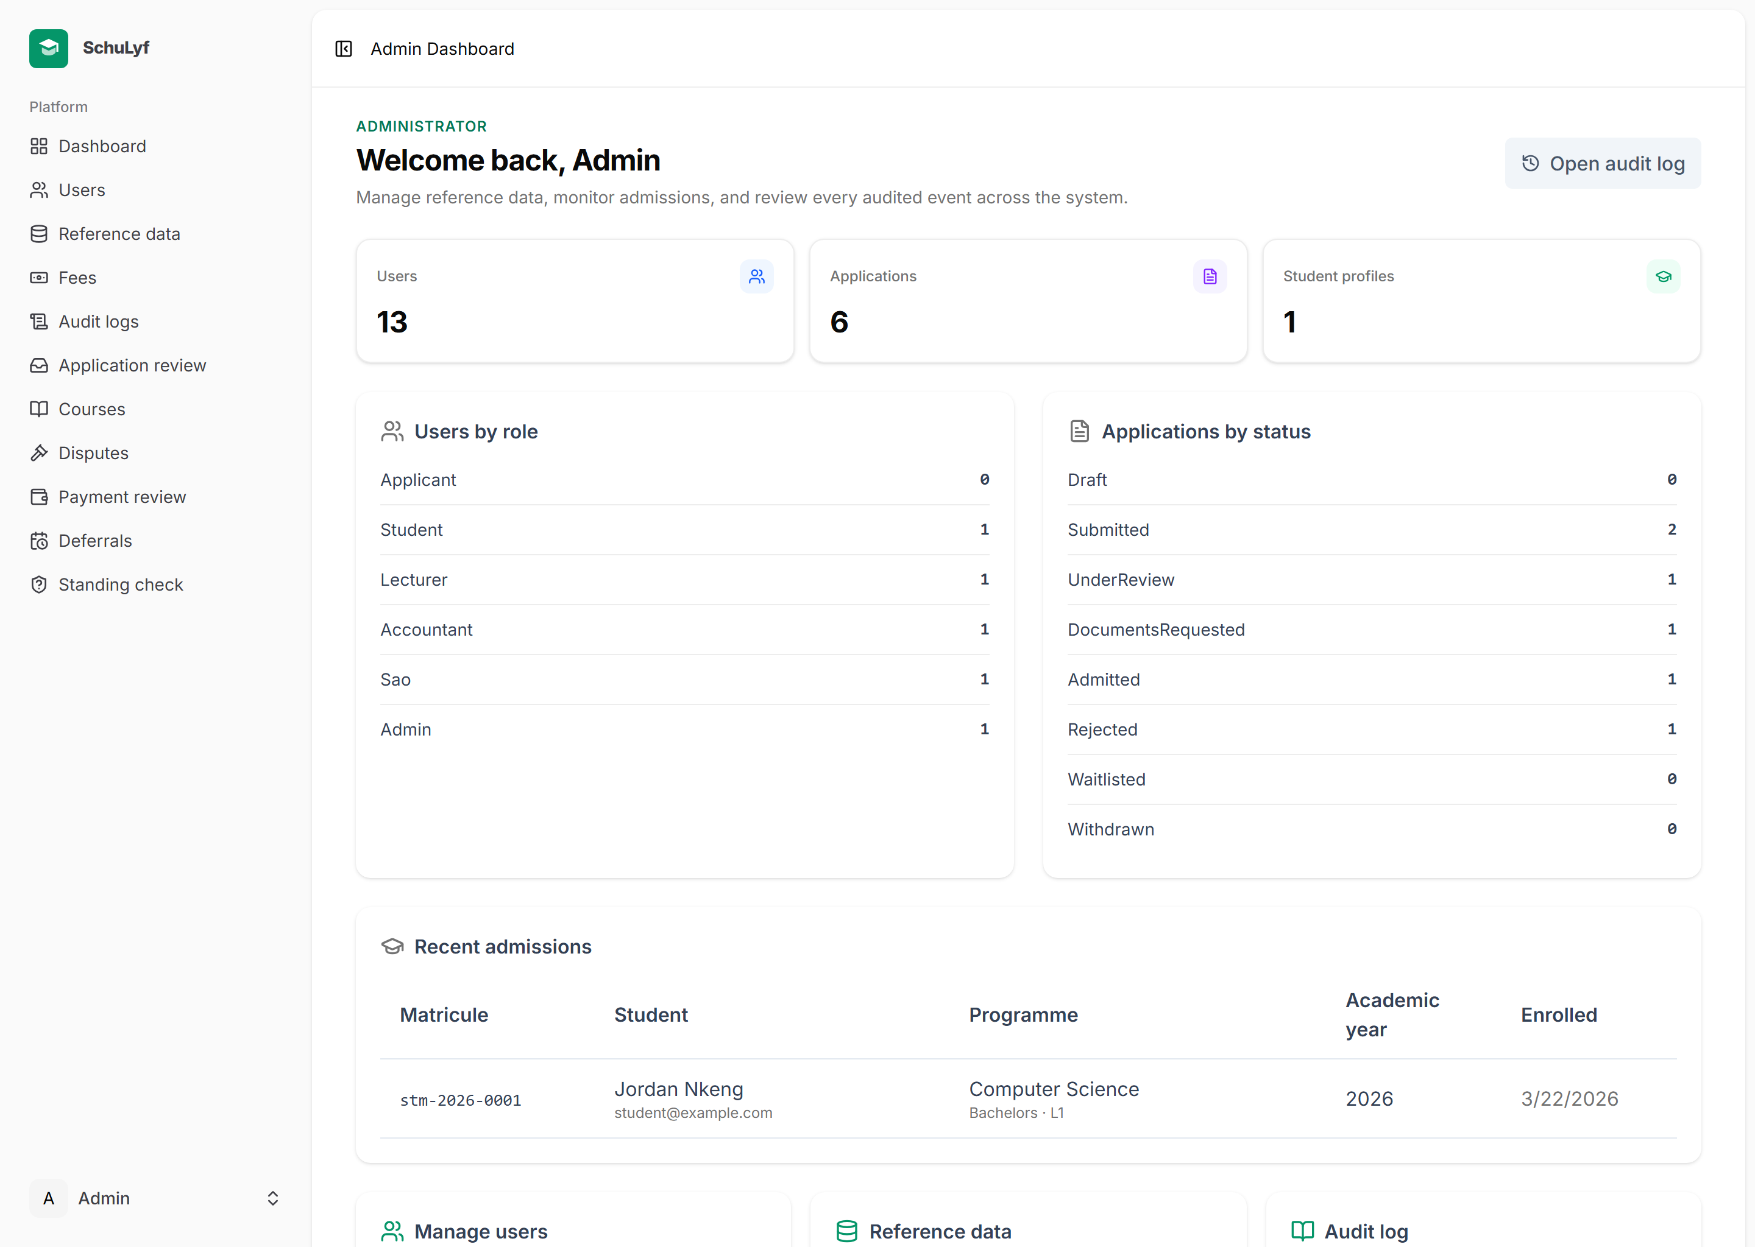
RESULTS
Implementation & results
127
34
28
707
7
6
routes
migrations
ADRs
tests
modules
roles
Real screens — SAO review queue · Admin dashboard
SchuLyf · Student Management System
14 / 15

Slide 15
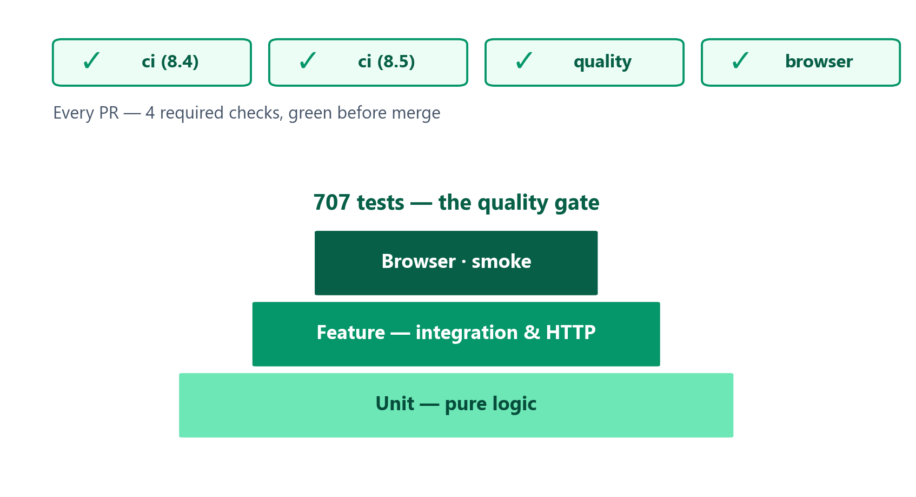
TESTING · CONCLUSION
Testing, a hard-won catch & what's next
Engineering rigor
● Test-driven; 707 automated Pest tests
● 4 required CI checks green before every merge
● Per-feature quality gate (Pint · vue-tsc · ESLint · build)
A notable catch
The final whole-branch review found a MySQL JSON key-order bug that made every genuine transcript read “invalid” — invisible to the SQLite test suite. Fixed by canonicalising the digest.
Future work
SMS notification channel · analytics dashboards · mobile app · timetable & scheduling.
Thank you — questions welcome
SchuLyf · Student Management System
15 / 15

