Slide 1
Kiriakos Krastillis
Hi!
Notes:
- Unfall Messer
- KK
- Api Blueprint
Wer
- kann Deutsch
- weiß Web API
- kennt Api Blueprint
- hat Api Blueprint geschrieben
Erfahrenes Publikum oder nicht.

Slide 2
Kiriakos Kra^$%*@#..wha?
Programmer, admin, architect, analyst, data engineer, entrepreneur, researcher, civil engineer, crypto punk, bookworm, photographer, conversasionalist, swimmer, PnP player, gamer, aviation fan … not a cook!
Notes:
Viele Sachen
Programierer
Architekt
Admin
Hobyfotograf
..
Kein Koch!

Slide 3
Any past?
Had a startup
Went bust
Moved to Germany
Notes:
Vor Zen Jahren IT Sprung

Slide 4
What I do
Enterprise Architecture
Monday software projects
Notes:
Hauptsächlich
EA
Monday
Ggf Produkt Beratung
Rollen
Nachhaltige IT Kultur
Dokumentationskultur
Rollen sind Ursache meiner Einwicklung
Nicht sicher nenen darf….

Slide 5


Slide 6


Slide 7


Slide 8
What I think matters
Sustainable IT Culture
Clear communications
Notes:
Hauptsächlich
EA
Monday
Ggf Produkt Beratung
Rollen
Nachhaltige IT Kultur
Dokumentationskultur
Rollen sind Ursache meiner Einwicklung
Nicht sicher nenen darf….

Slide 9
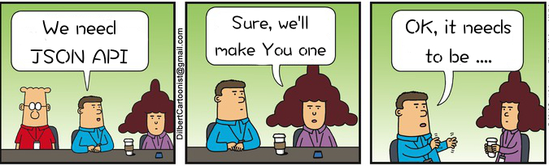
The world

Slide 10

Time passes

Slide 11

The results

Slide 12
Too many problem vectors
Timing/scheduling between unrelated teams
Conceptional deltas
Culture problems
Technical stuff
Pagination
Filtering
Embedded resources
...

Slide 13
A possible remedy
1. Document on the spot
2. Share a live hyperlink
(Apiary, self hosted aglio, etc...)
Notes:
Lebendige Dokumente sind hilfreich
* URL → Kollaboartion
* Singuläre Wahrheitsquelle
* Prinzip: Boundaryless Information flow
* Added win, man baut deswegen passiv gute kommunikations Gewohnheiten.
Live ApiB
* komplette Dev Umgebung durch Tooling

Slide 14
Requirements
1. Concise
2. Understandable
3. Deployable
Notes:
Prägnant
Verstehbar
Nützlich in tools

Slide 15
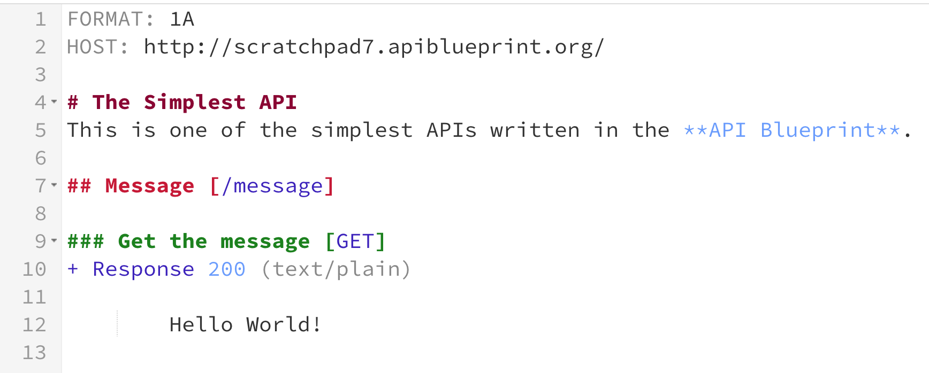
API Blueprint
Notes:
Nein, moment…
Metadata ist Tooling zeugs
Message und Get passen eigentlich in einen Satz.

Slide 16
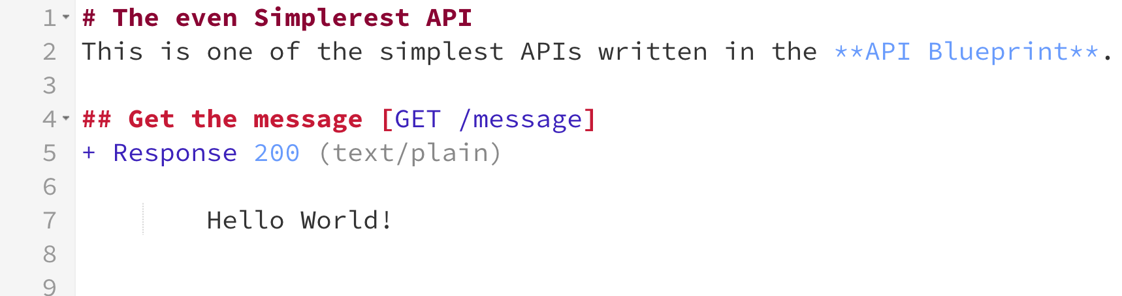
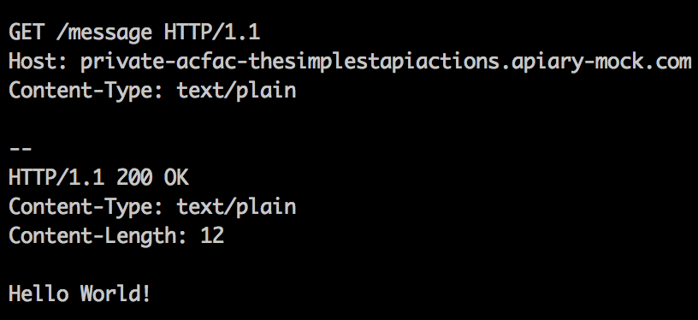
API Blueprint

Slide 17
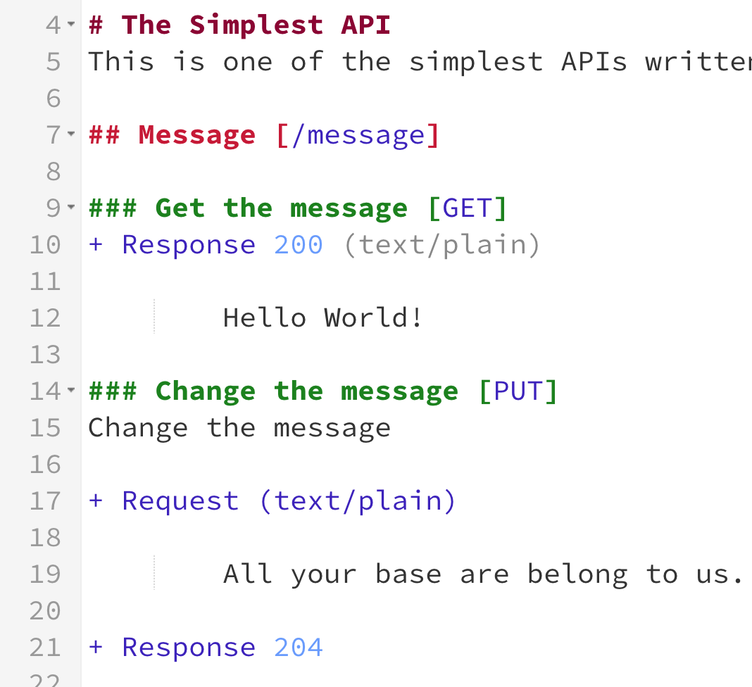
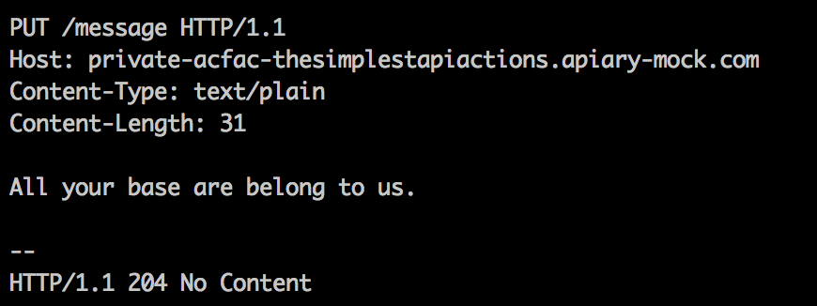
API Blueprint

Slide 18
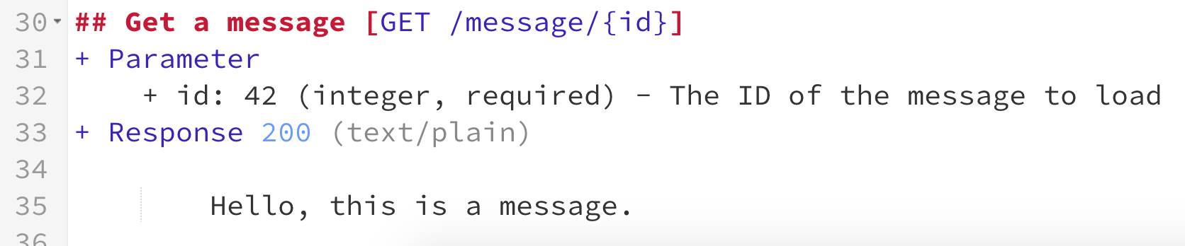
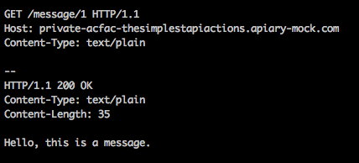
API Blueprint

Slide 19
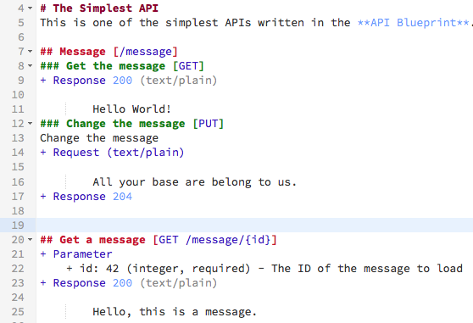
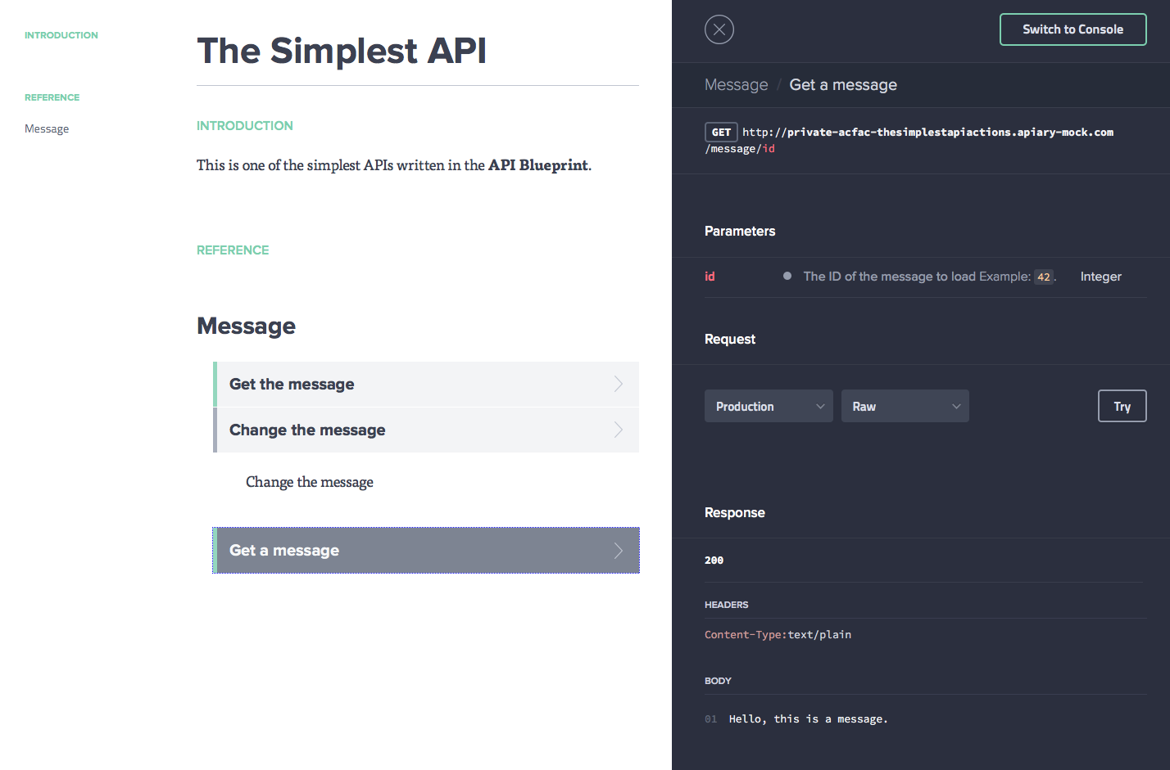
API Blueprint

Slide 20
API Blueprint
Why?

Slide 21
API Blueprint – Why?
Readable

Slide 22
API Blueprint – Why?
Known language (markdown)

Slide 23
API Blueprint – Why?
Design first approach

Slide 24
API Blueprint – Why?
Great tooling
(aglio, dredd, apiary.com, many more...)

Slide 25
Components
Metadata
Resource
Action

Slide 26
Sections
Nested
Section
Section
Nested
Section

Slide 27
Other Sections
Section
Section
Section

Slide 28
API Blueprint Sections
Syntax:
<section symbol> <section keyword> <identifier>
<description>
<section specific content>
<nested sections>
If their text starts with a section keyword:
Every header is a section
Every list item is a section

Slide 29
Header keywords
“Group”
“Data Structures”
HTTP method names
URI templates (e.g. /resource/{id})
Combinations of HTTP method and URI template

Slide 30
List keywords
Request
Response
Body
Schema
Model
Header / Headers
Parameter / Parameters
Values
Attribute / Attributes
Relation

Slide 31
Seems verbose!

Slide 32
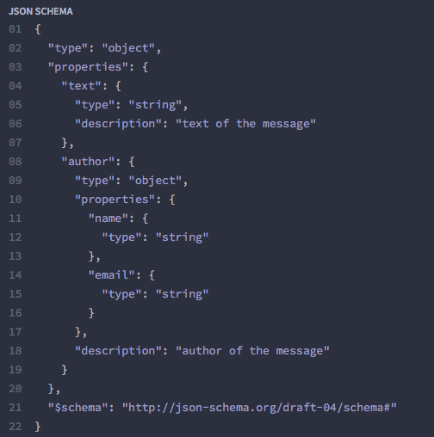
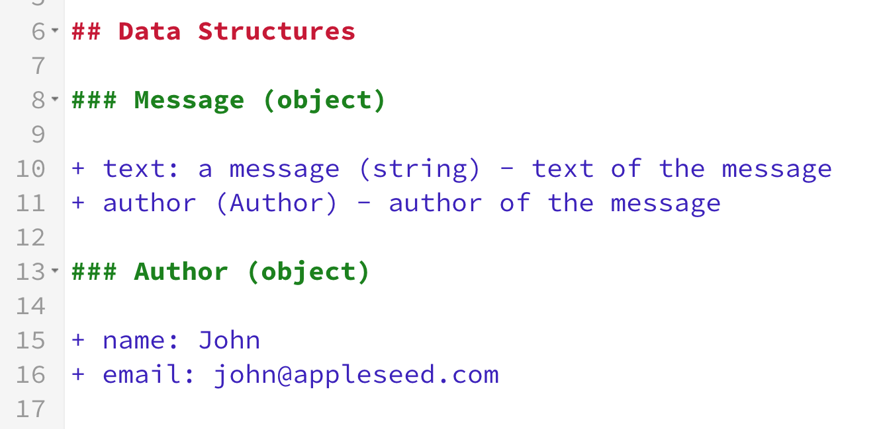
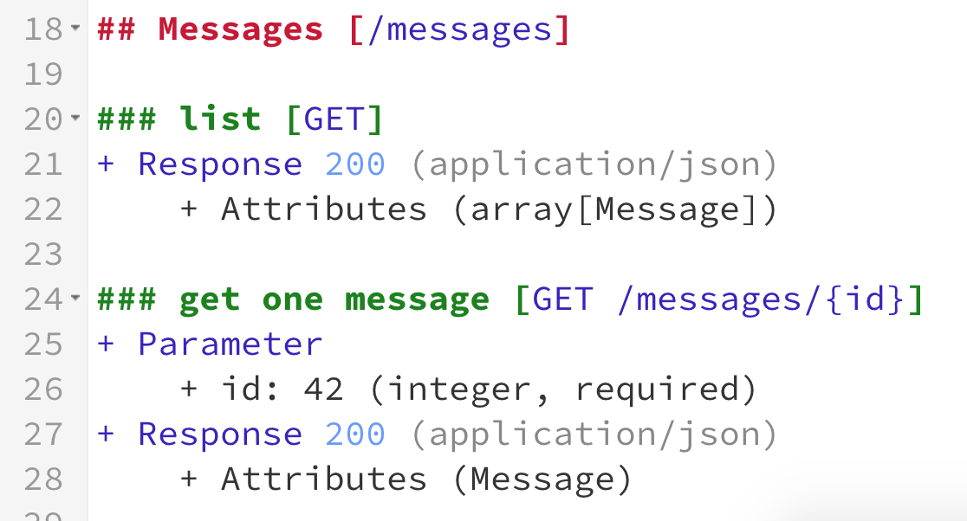
Data Structures

Slide 33
Data Structures

Slide 34
Tooling
Aglio (HTML renderer)
Dredd (CI connector)
Drakov (Mock server)
Apiary.io (Saas solution)
Many more @ apiblueprint.org/tools.html

Slide 35
Fin
Thanks for joining

