Slide 1
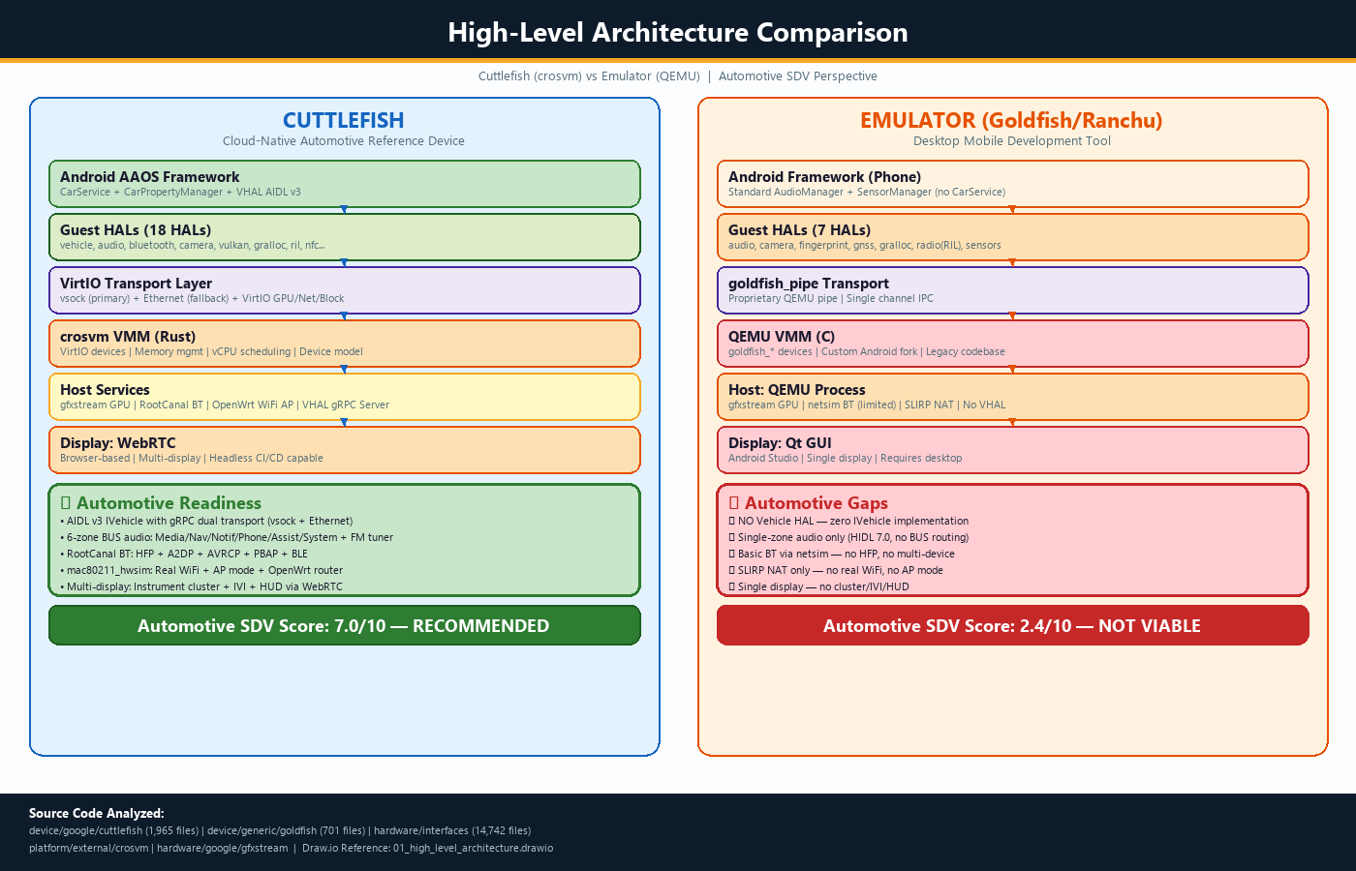
AOSP Virtual Device Platform Analysis
Cuttlefish vs Emulator | Automotive Tier-1 SDV Readiness Assessment | Based on Real AOSP Source Code
KEY FINDINGS
Cuttlefish: RECOMMENDED
Full AIDL v3 Vehicle HAL with gRPC
6-zone BUS audio (AAOS automotive)
RootCanal BT with HFP + A2DP + BLE
Real WiFi via mac80211_hwsim
WebRTC multi-display (headless CI)
Cloud-native, scalable architecture
Emulator: NOT VIABLE
Zero Vehicle HAL implementation
Single-zone audio (phone model)
SLIRP NAT (no real WiFi stack)
Single display, desktop-only
No AAOS build target support
OVERALL SCORES
7/10
2/10
Cuttlefish
Emulator
Source: device/google/cuttlefish (1,965 files) | device/generic/goldfish (701 files) | hardware/interfaces (14,742 files)

Slide 2
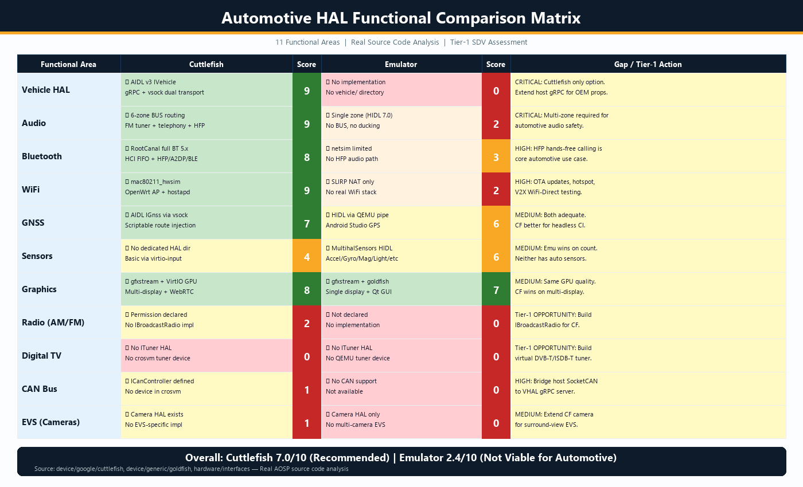
Automotive HAL Functional Gap Analysis
11 Functional Areas | Source Code-Based Scores | Tier-1 Action Items
GAP ANALYSIS SUMMARY
STRENGTHS (Cuttlefish)
Vehicle HAL: 9/10 (AIDL v3 gRPC)
Audio: 9/10 (6-zone BUS routing)
WiFi: 9/10 (mac80211_hwsim)
Bluetooth: 8/10 (RootCanal HFP)
Graphics: 8/10 (multi-display)
GAPS TO ADDRESS
Broadcast Radio: 2/10 (HAL missing)
CAN Bus: 1/10 (no crosvm device)
EVS: 1/10 (no surround-view)
Digital TV: 0/10 (no ITuner impl)
Sensors: 4/10 (no auto sensors)
TIER-1 OPPORTUNITIES
Build IBroadcastRadio for CF
Bridge CAN via host SocketCAN
Implement IEvsCamera
Virtual DVB-T/ISDB-T tuner
Upstream contributions to AOSP
Analysis based on cloned AOSP repos: cuttlefish, goldfish, hw_interfaces, crosvm, gfxstream

Slide 3
Strategic Roadmap: Automotive SDV Platform Investment
Phased Approach | Tier-1 Value Creation | Risk Mitigation
RECOMMENDATION: Adopt Cuttlefish as standard SDV development & CI/CD platform. Invest in targeted extensions.
IMMEDIATE (0-3 Months)
MEDIUM-TERM (3-6 Months)
LONG-TERM (6-12 Months)
Deploy Cuttlefish CI/CD Farm
Cloud-based instances for
automated AAOS testing
Extend VHAL Host Server
OEM-specific vehicle properties
for your vehicle platforms
CAN Bus Bridge
Host SocketCAN to VHAL gRPC
for HIL testing integration
Custom Audio Zones
Rear-seat entertainment,
amplifier DSP chain config
Implement IBroadcastRadio
Virtual FM/DAB tuner HAL
Connect to fm_tuner source
Add EVS Support
IEvsCamera with synthetic
surround-view camera streams
UDS Diagnostic Simulator
UDS/OBD-II service on host
Accessible via VHAL properties
SOME/IP Gateway
Service-oriented architecture
for AUTOSAR Classic bridging
Upstream AOSP Contributions
BroadcastRadio + CAN bus
implementations to AOSP
Multi-Domain Simulation
Cuttlefish + AUTOSAR Classic
VM for full vehicle simulation
ITuner Implementation
Virtual DVB-T/ISDB-T tuner
for rear-seat entertainment
Digital Twin Integration
Connect to CarMaker, CARLA,
dSPACE simulation tools
KEY RISKS:
Missing HALs block testing (HIGH) -- Mitigate with prioritized Radio + CAN + EVS impl
AIDL interface changes (MED) -- Track AOSP main, maintain compatibility layer
Detailed analysis: AOSP_Cuttlefish_vs_Emulator_Automotive_SDV_v2.docx | draw.io diagrams provided
Automotive Tier-1 SDV Platform Assessment

