Slide 1
Instructions for today’s task
Click “Next >” to read the slides →

Slide 2
Task overview

Slide 3
The task has 40 rounds. In each round, you have to choose between two lotteries with different prizes and odds.

Slide 4
The task has 40 rounds. In each round, you have to choose between two lotteries with different prizes and odds.
We will not tell you the exact odds of each lottery. Instead, you can try out the lotteries before deciding which one you want to play.

Slide 5
The task has 40 rounds. In each round, you have to choose between two lotteries with different prizes and odds.
We will not tell you the exact odds of each lottery. Instead, you can try out the lotteries before deciding which one you want to play.
After enough tries, play the lottery you prefer. The prize will be your bonus.

Slide 6
How to try out and play a lottery

Slide 7
Round 1/40
First, the number of the current round is displayed.

Slide 8
Next, two squares appear.
Each square represents a lottery.

Slide 9

To try out the left lottery, press the left arrow key.
To try out the right lottery, press the right arrow key.
Left
Right

Slide 10


When you try out a lottery, you will see the prize that you would have won if you had played the lottery.
3
!!
Left
Right

Slide 11
When you try out a lottery, you will see the prize that you would have won if you had played the lottery.
In the example, you are trying out the left lottery, and you would have won 3 points.
3
!!
Left
Right

Slide 12
Playing the same lottery again may result in a different prize. In this case 2 points.
2
!!
Left
Right

Slide 13
Playing the same lottery again may result in a different prize. In this case 2 points.
So, a lottery will not necessarily show the same points every time you try it.
2
!!
Left
Right

Slide 14
Try out the lotteries as many times as you like until you decide which one you want to play.
Left
Right

Slide 15
Try out the lotteries as many times as you like until you decide which one you want to play.
To see the process of trying out the lotteries, watch the video on the next page.
Left
Right

Slide 16
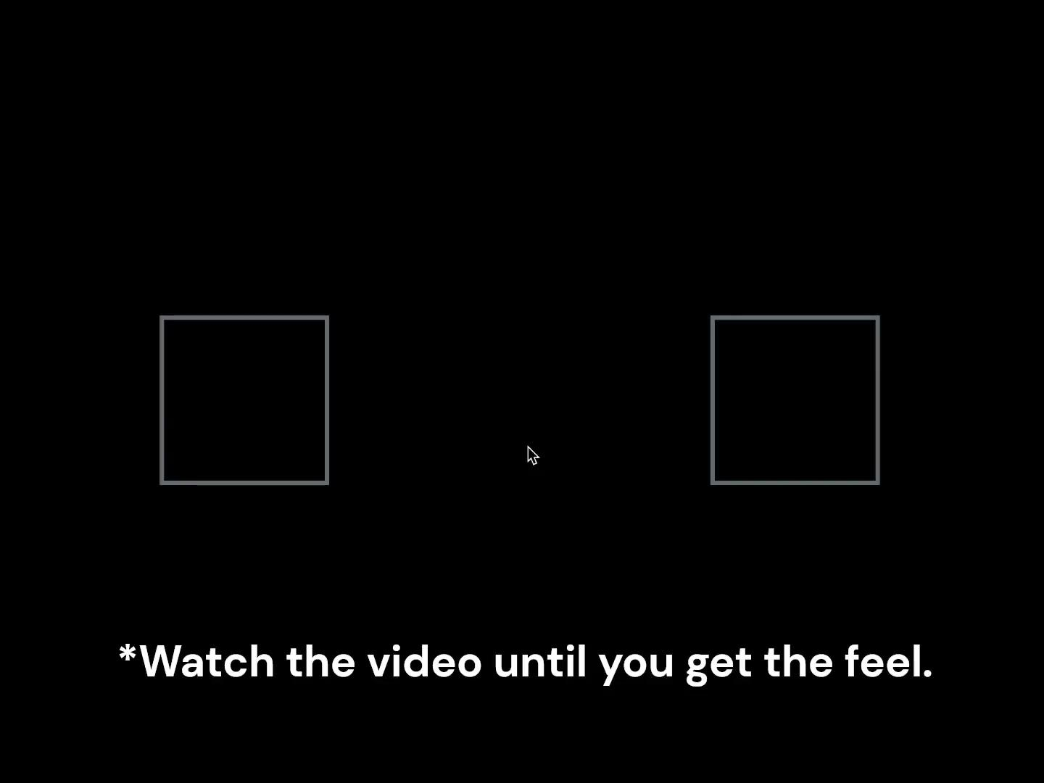

Slide 17



Once you have decided which lottery you want to play, stop pressing the left and right arrow keys and click on the lottery you want to play.
*You can also click with the touchpad.

Slide 18
The selected lottery will turn blue.
You will not see the prize for the lottery you have played.
To see the process of playing a lottery, watch the video on the next page.

Slide 19
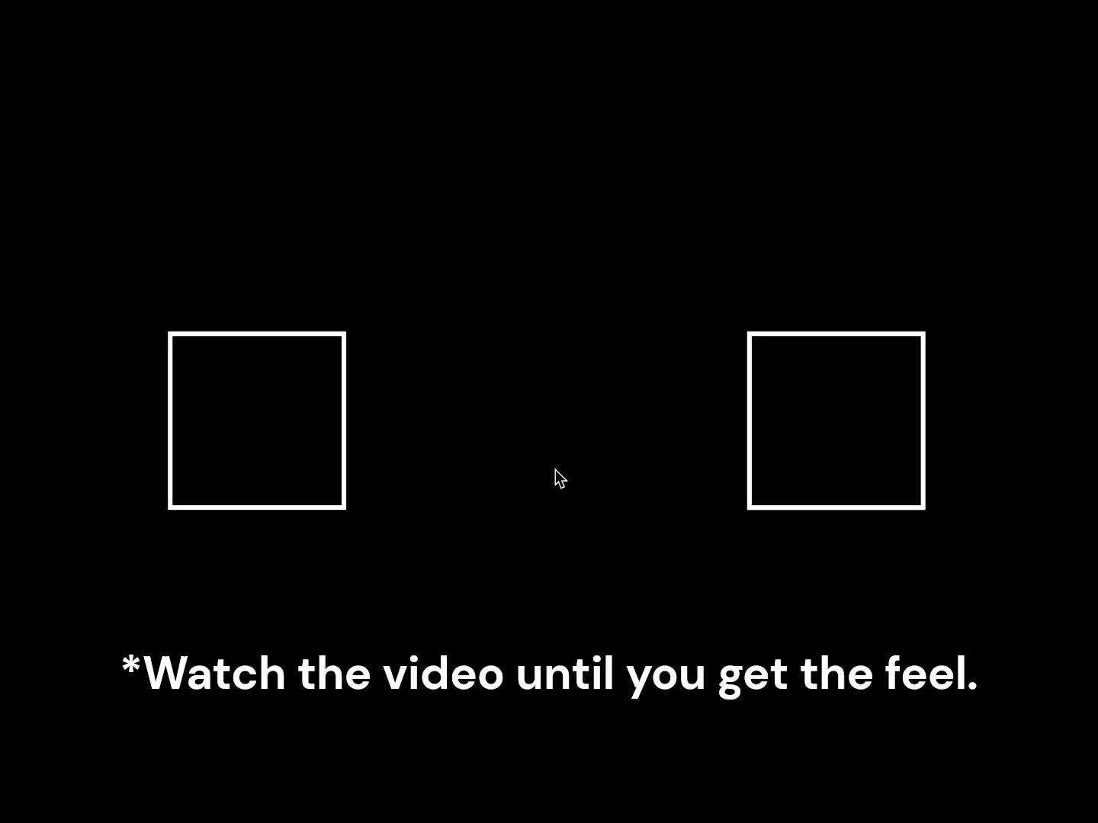

Slide 20
Please try or play a lottery within 3 seconds.
If you do not respond within 3 seconds, a message will prompt you to respond.
Please try or play a lottery now!

Slide 21
If you do not respond within 15 seconds, you will be considered to have dropped out of the task and will not receive any reward.
A timer will appear for the last 5 seconds.
5
Timer

Slide 22
You will not do the task alone.

Slide 23


Before the task, you will be matched with four other participants (= Prolific workers), whom we will call “Players.”
You will work on the task in a group of five.
You
Player 1
Player 2
Player 3
Player 4

Slide 24
While you are trying out the lotteries, the other players are also trying out the same lotteries.
3
*Another player's screen

Slide 25
You and the other players will do the task at the same pace.
This means that you need to wait to see the prize until everyone tries or plays a lottery.
The same goes for the others.
*Your screen until the other players try or play a lottery.

Slide 26
When one of you makes a final choice, that choice becomes visible to everyone.

Slide 27
When one of you makes a final choice, that choice becomes visible to everyone.
This means that you will see other players’ final choices in real time.

Slide 28

If another player plays left, a human icon will appear above your left lottery.

Slide 29

If another player plays left, a human icon will appear above your left lottery.
If another player plays right, a human icon will appear above your right lottery.

Slide 30
For example, if three players have played left and one player has played right, the human icons will be displayed as shown on the left.

Slide 31
The other players will also see your final choice in the same way.
In the example, you play the left lottery, and the others will see that you have played the left one.

Slide 32
You and the other players are NOT in competition.
Your bonus depends only on your own choices.

Slide 33
Round 2/40
Once everyone has played a lottery (= made a final choice), the next round begins.

Slide 34
Let’s recap the flow of a round and do a comprehension check.

Slide 35
Flow of a round
Try out the lotteries until you decide which one you want to play.
X

Slide 36
Flow of a round
Try out the lotteries until you decide which one you want to play.
You may see other players’ final choices along the way.
X

Slide 37

Flow of a round
Try out the lotteries until you decide which one you want to play.
You may see other players’ final choices along the way.
X
When you have tried out the lotteries enough, click on the lottery to play.

Slide 38
Bonus
At the end of the study, 5 of your 40 choices will be drawn, and these lotteries will be played out.
1 point is converted into 3 pence. This will be added to the base reward.
You never know which rounds will be drawn. So, take all your decisions seriously.

Slide 39
If you drop out of the task…
You will not receive any reward.
Reloading or refreshing the tab/window is also considered a drop-out.

Slide 40
If all four other players drop out…
The experiment will end, and you will be paid the base reward and the bonus based on 5 of your choices (or fewer if less than 5 choices are available).

Slide 41
Was everything clear?
Answer the comprehension questions below.
You can try the questions twice. If you fail twice, you will not be allowed to start the task.
You can read the slides again if you are not sure.
Scroll
down

