Slide 1
WARDEN BOT
AUTHOR: KIRILL PARFENOV

Slide 2
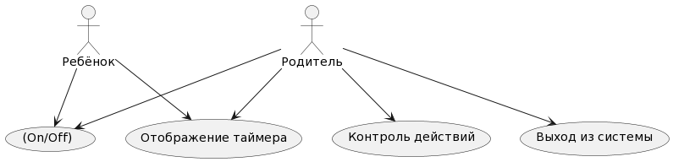
Conceptual scheme
Purpose: to create a bot to monitor the activity of program processes and block them remotely via a phone or computer.

Slide 3
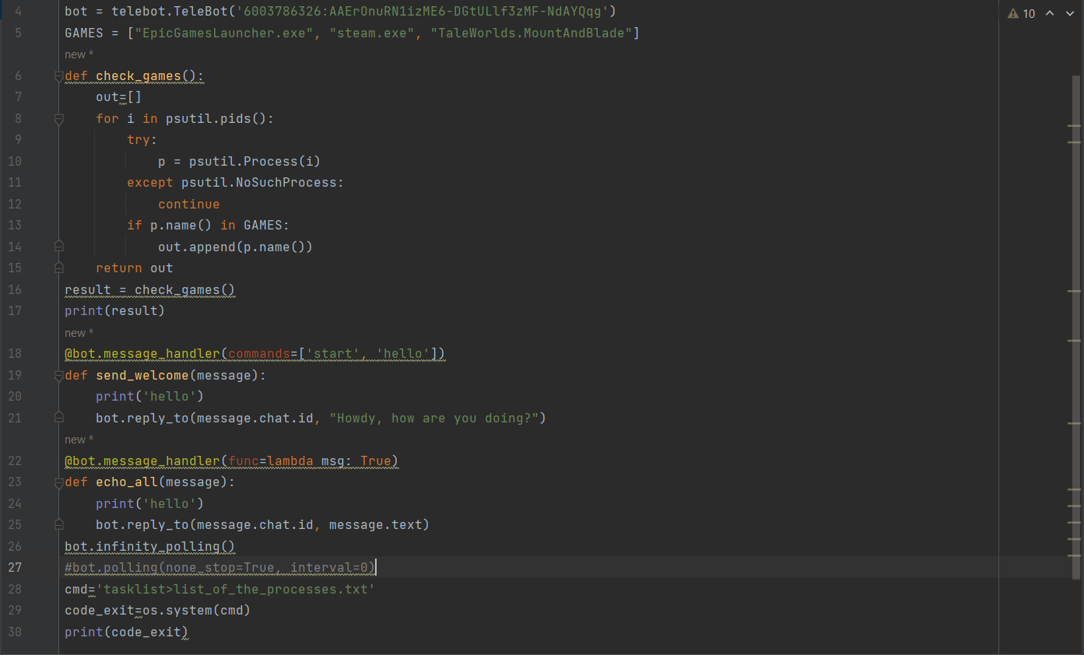
CODE OF BOT

Slide 4
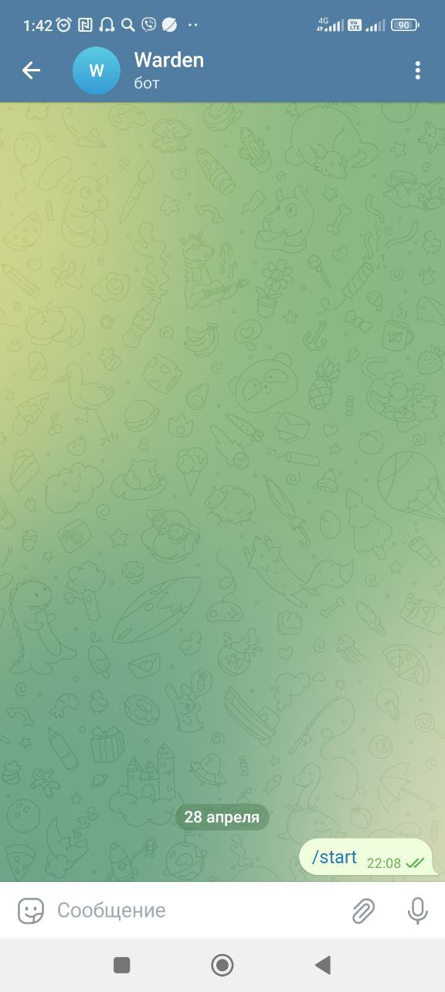
CODE
The beginning of the code and the prescribed programs
import os
import psutil
import telebot
bot = telebot.TeleBot('6003786326:AAErOnuRN1izME6-DGtULlf3zMF-NdAYQqg')
GAMES = ["EpicGamesLauncher.exe", "steam.exe", "TaleWorlds.MountAndBlade"]

Slide 5
CODE
2st CODE
def check_games():
out=[]
for i in psutil.pids():
try:
p = psutil.Process(i)
except psutil.NoSuchProcess:
continue
if p.name() in GAMES:
out.append(p.name())
return out
result = check_games()
print(result)
3st CODE
@bot.message_handler(commands=['start', 'hello'])
def send_welcome(message):
print('hello')
bot.reply_to(message.chat.id, "Howdy, how are you doing?")
@bot.message_handler(func=lambda msg: True)
def echo_all(message):
print('hello')
bot.reply_to(message.chat.id, message.text)
bot.infinity_polling()
#bot.polling(none_stop=True, interval=0)
cmd='tasklist>list_of_the_processes.txt'
code_exit=os.system(cmd)
print(code_exit)

Slide 6
THANKS!

