Slide 1
ITMO UNIVERSITY
Computer vision
in the task of manipulator control
Kirill A. Artemov, gr. P4135
kaartemov@gmail.com
Saint Petersburg, 2017

Slide 2
Computer vision in the task of manipulator control
Outline
What is computer vision (CV)
Where applicable
Typical tasks of CV
Solution for KUKA Youbot Arm
Conclusions

Slide 3
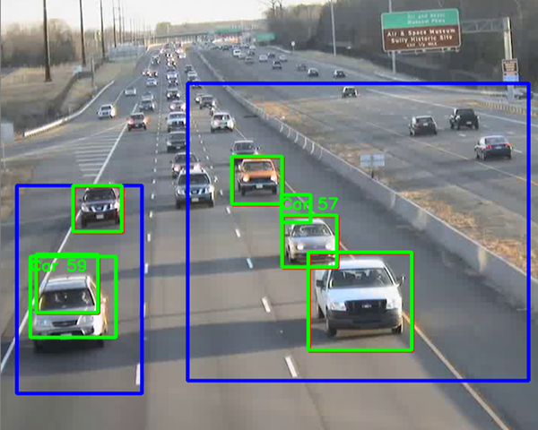
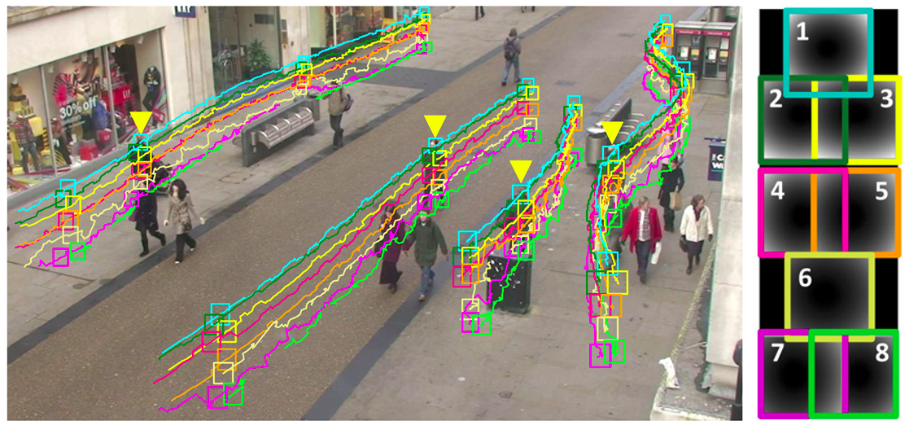
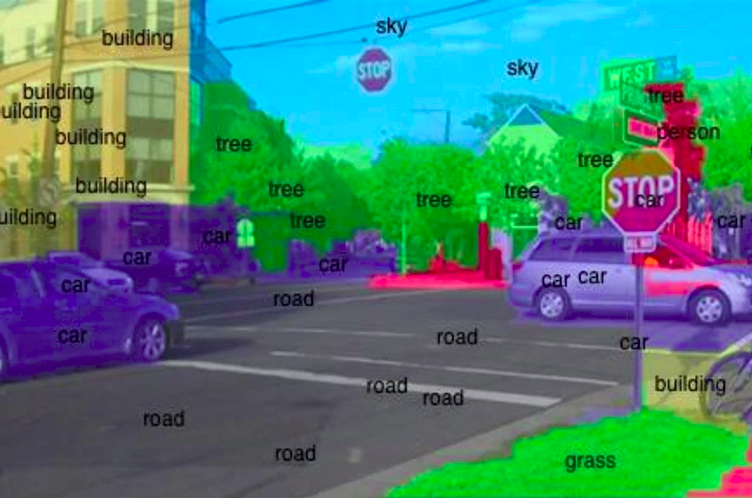
Computer vision in the task of manipulator control
What is computer vision
Computer vision is the theory and technology of creating machines that can detect, track and classify objects

Slide 4
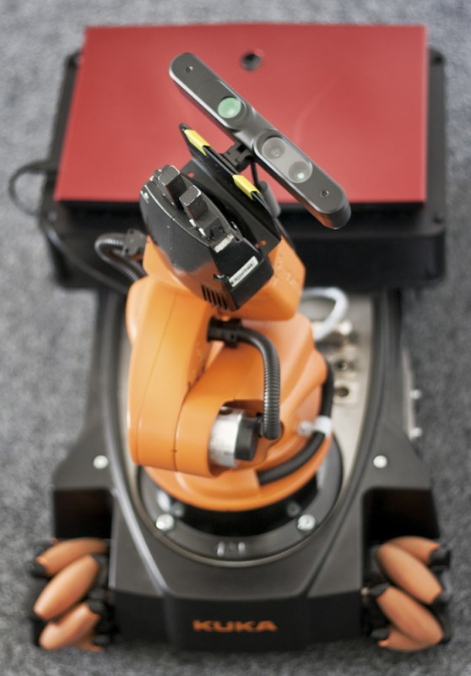
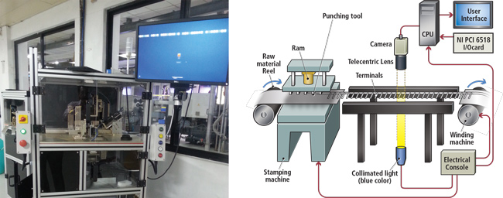
Computer vision in the task of manipulator control
Where applicable
Automatic inspection
Assisting humans in identification tasks
Controlling processes

Slide 5
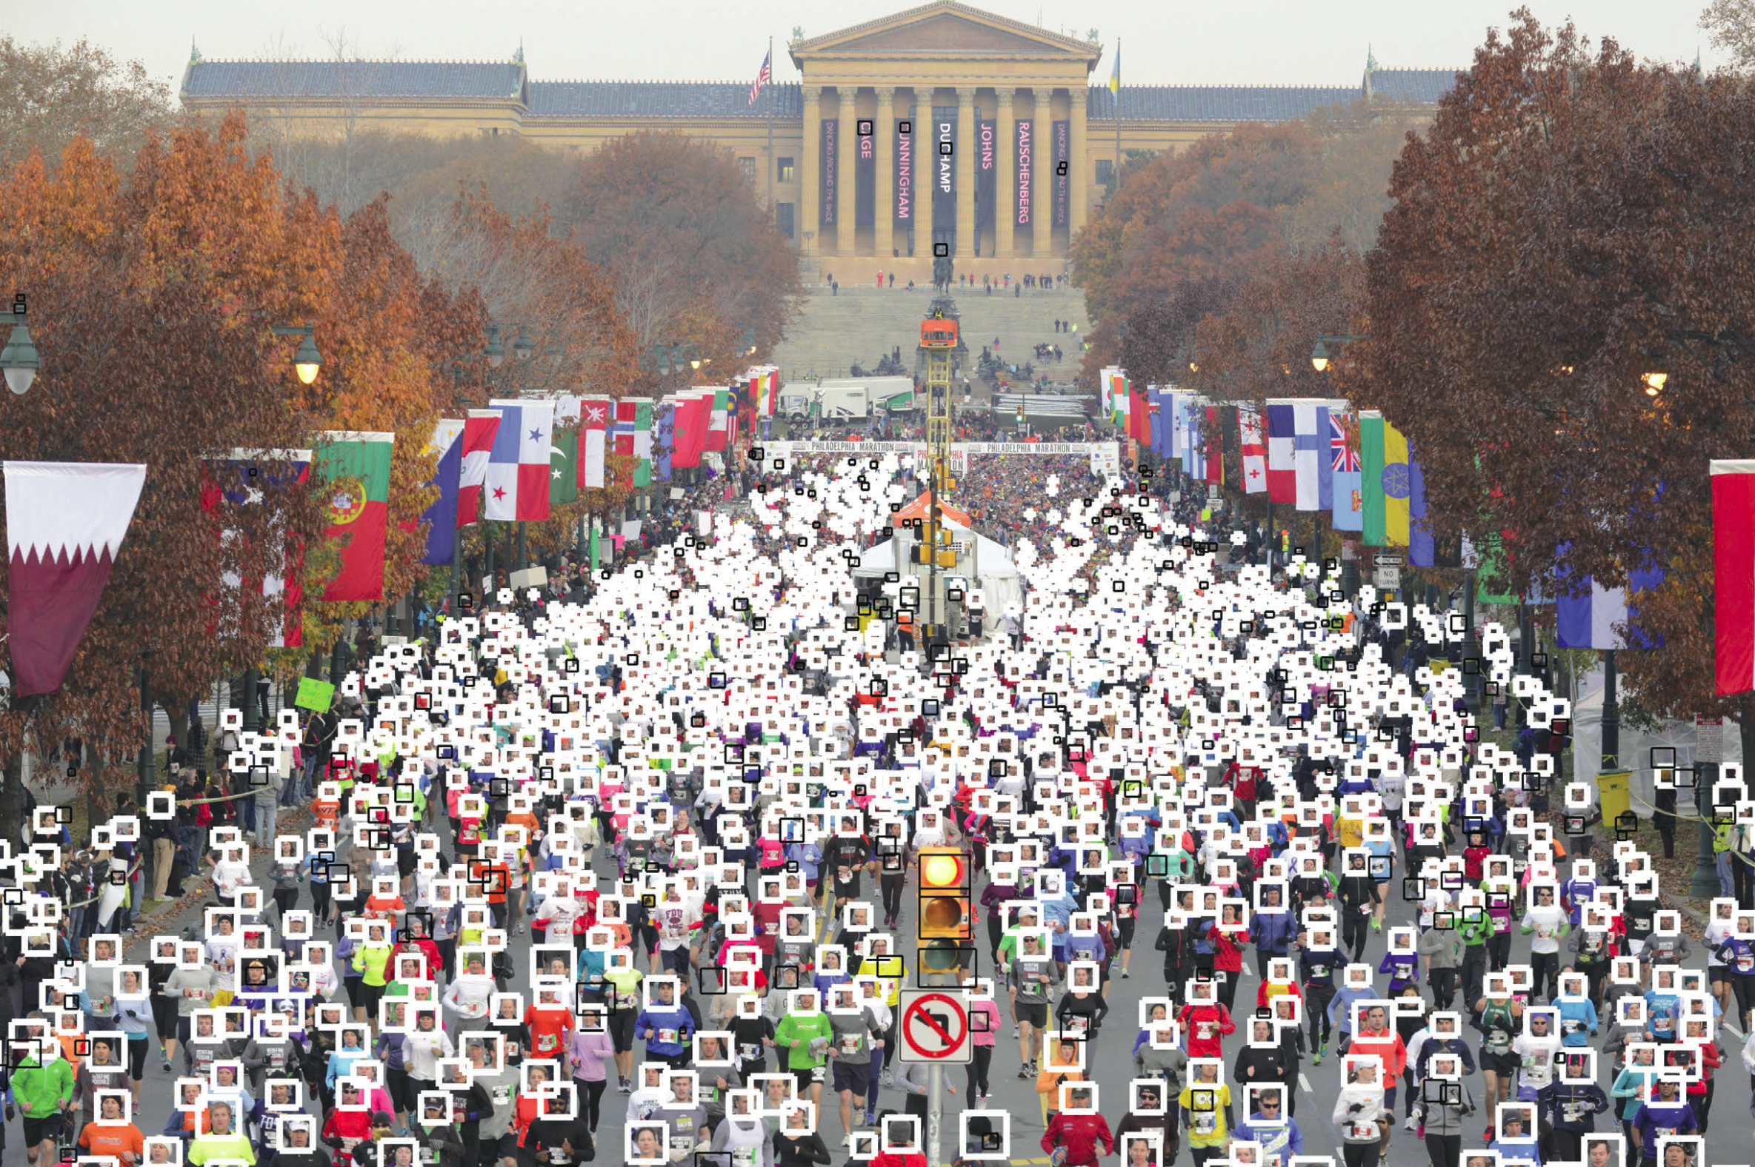
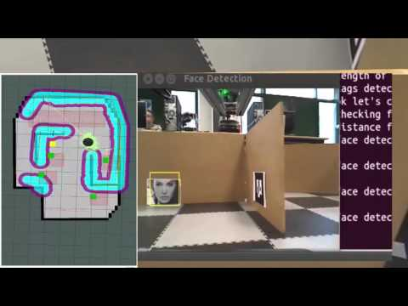
Computer vision in the task of manipulator control
Where applicable
Detecting events
Interaction
Modeling objects or environments
Navigation
Organizing information

Slide 6
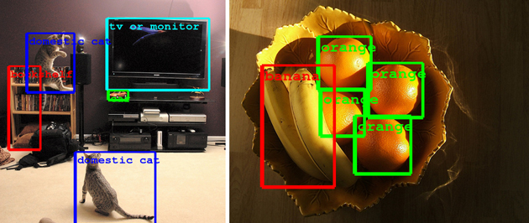
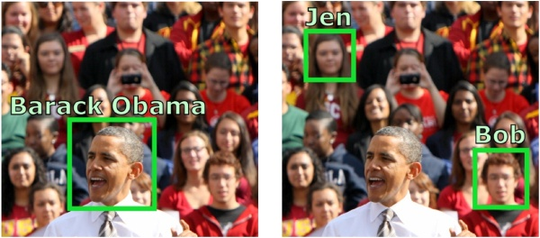
Computer vision in the task of manipulator control
Typical tasks in CV
Content-based image retrieval
Pose estimation
Optical character recognition (OCR)
Facial recognition
Shape Recognition Technology (SRT)

Slide 7
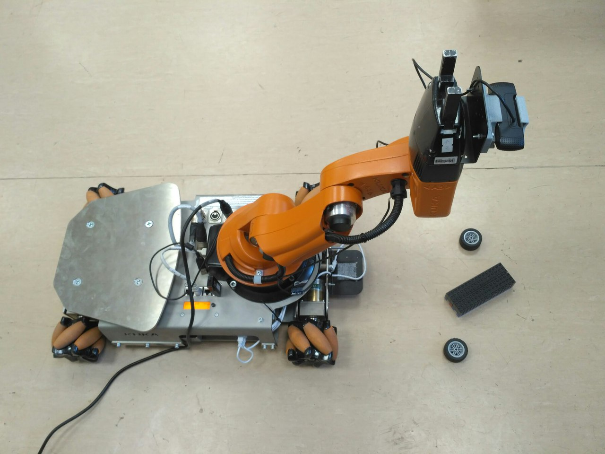
Computer vision in the task of manipulator control
Solution for KUKA Youbot Arm
KUKA Youbot Arm with camera

Slide 8
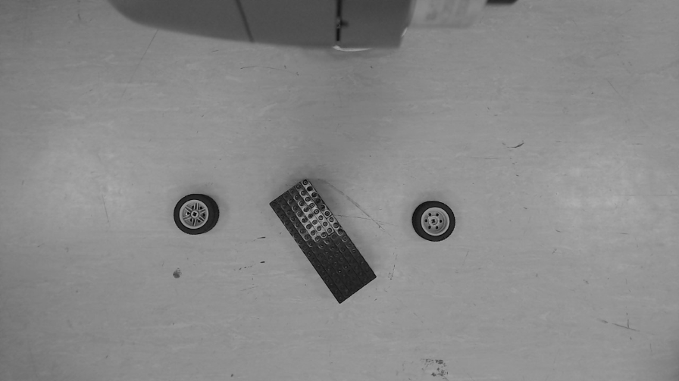
Computer vision in the task of manipulator control
Solution for KUKA Youbot Arm
Step 1: getting gray image from camera

Slide 9
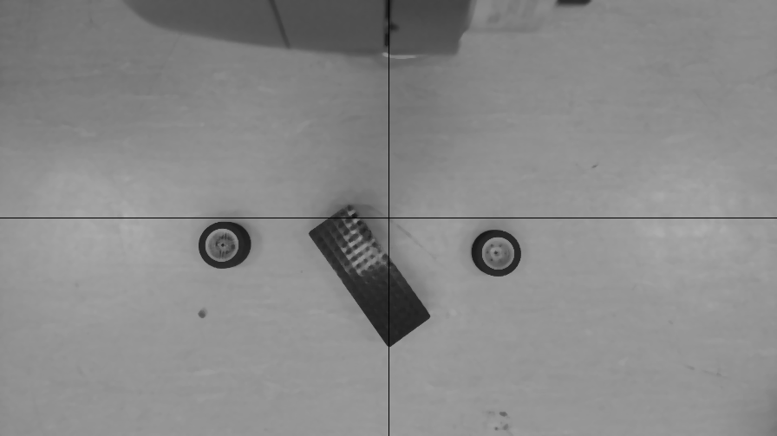
Computer vision in the task of manipulator control
Solution for KUKA Youbot Arm
Step 2: blur the image

Slide 10
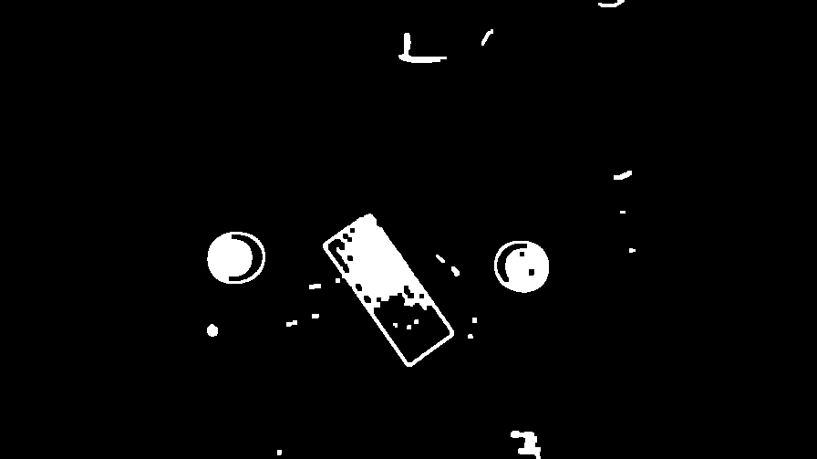
Computer vision in the task of manipulator control
Solution for KUKA Youbot Arm
Step 3: apply Canny filter

Slide 11
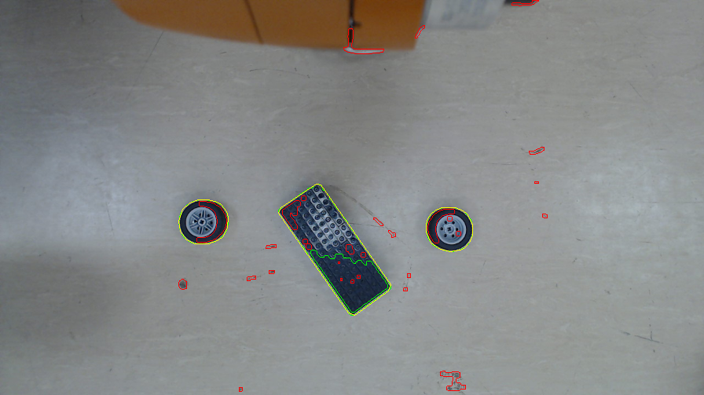
Computer vision in the task of manipulator control
Solution for KUKA Youbot Arm
Step 4: finding all contours

Slide 12
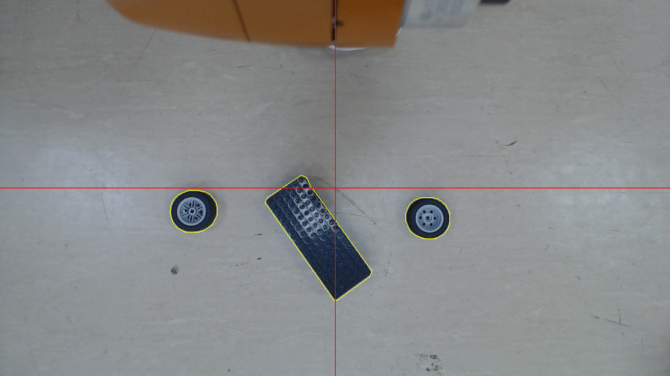
Computer vision in the task of manipulator control
Solution for KUKA Youbot Arm
Step 5: comparing each contour with templates,
find useful

Slide 13
ITMO UNIVERSITY
Thank you
for your attention!
Kirill A. Artemov, gr. P4135
kaartemov@gmail.com
Saint Petersburg, 2017

