Slide 1
Course Project
«Battleship»
By Viktor Kirillov

Slide 2
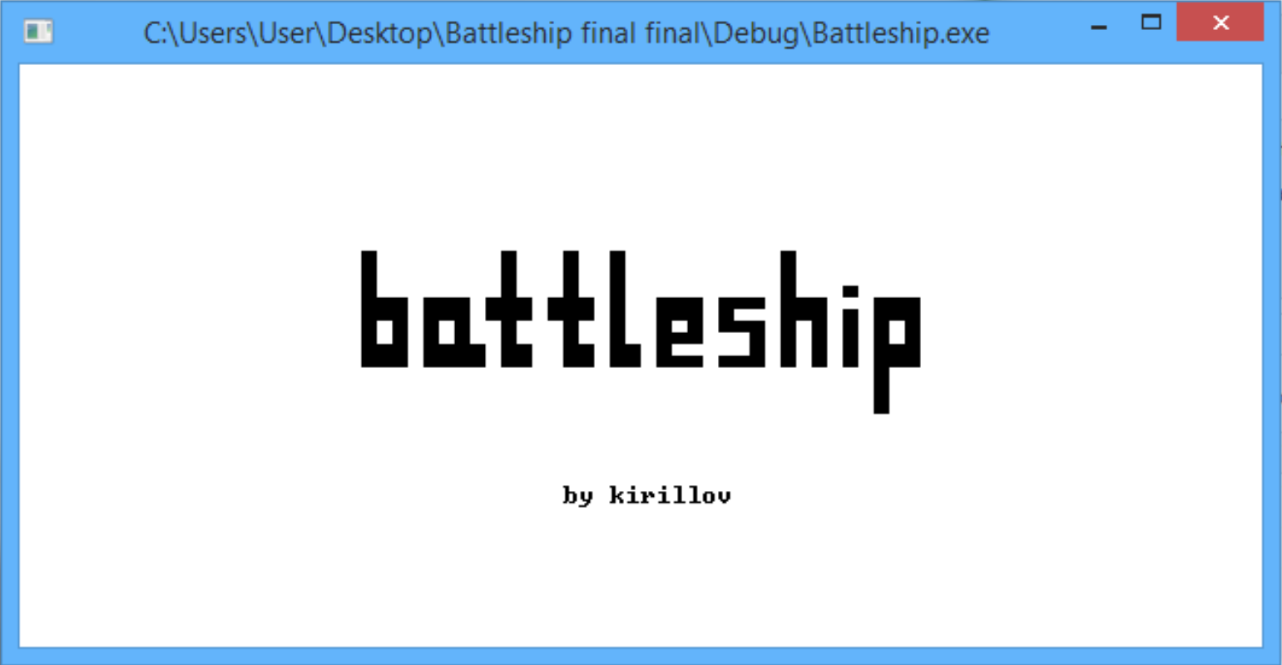

Slide 3
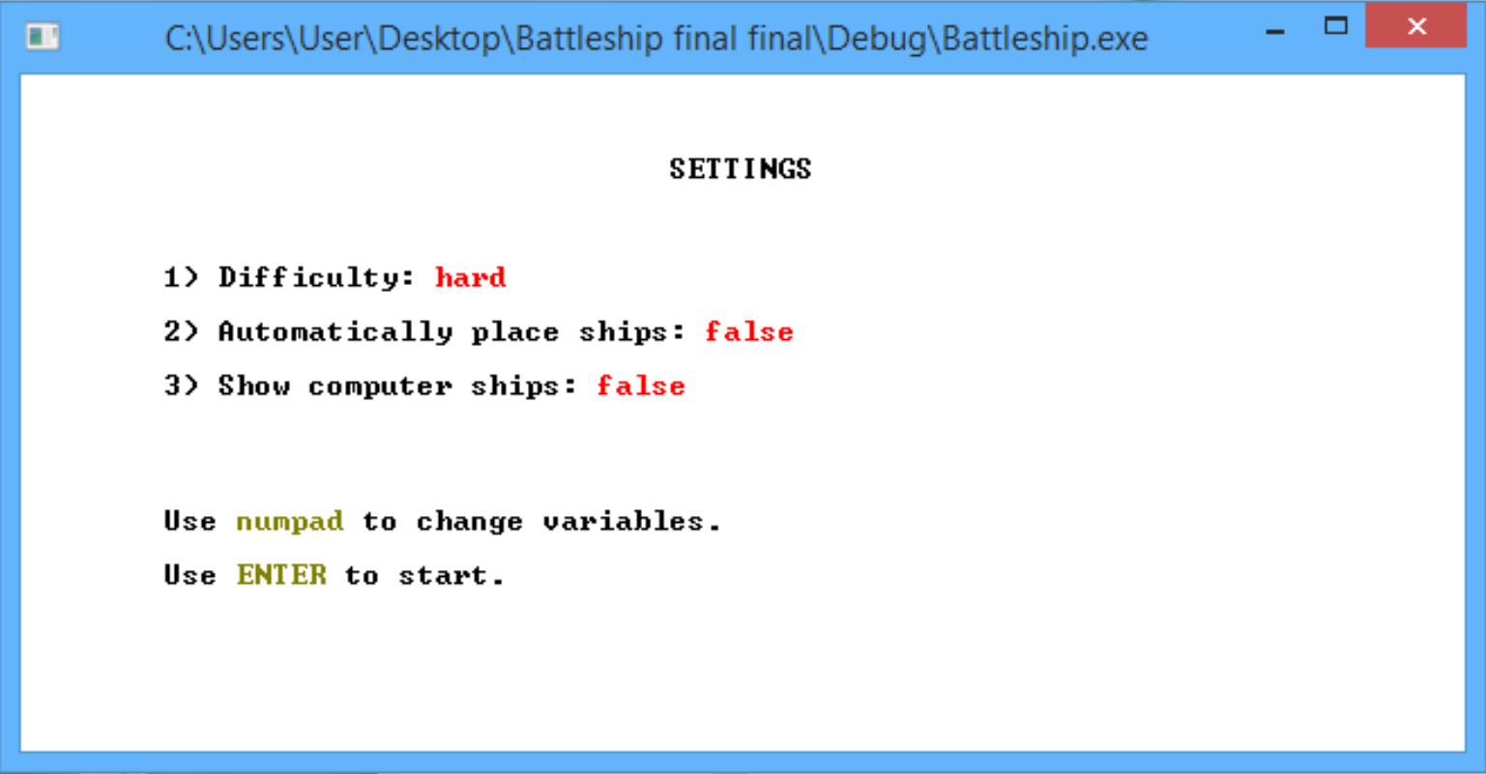
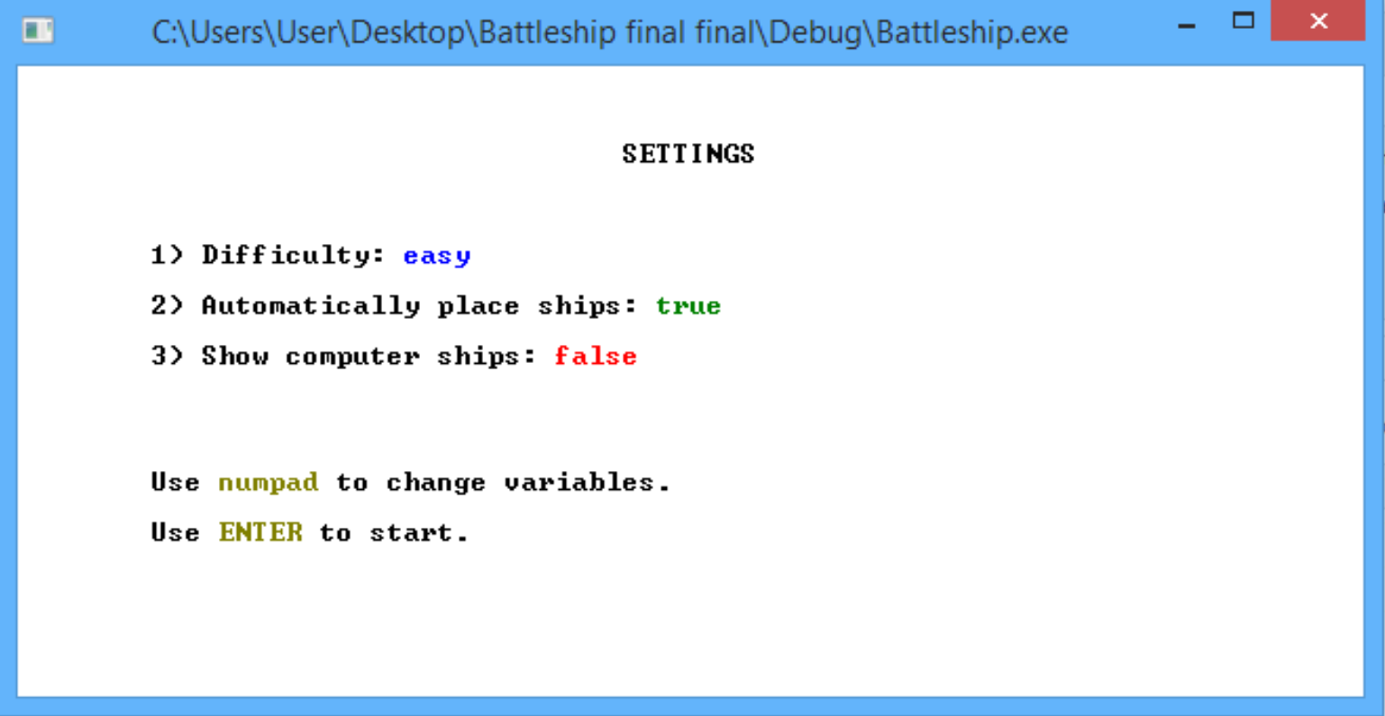
Settings window
Game difficulty
Automatic ship placement
Display opponents ships
Use buttons 1 – 3 to change settings

Slide 4
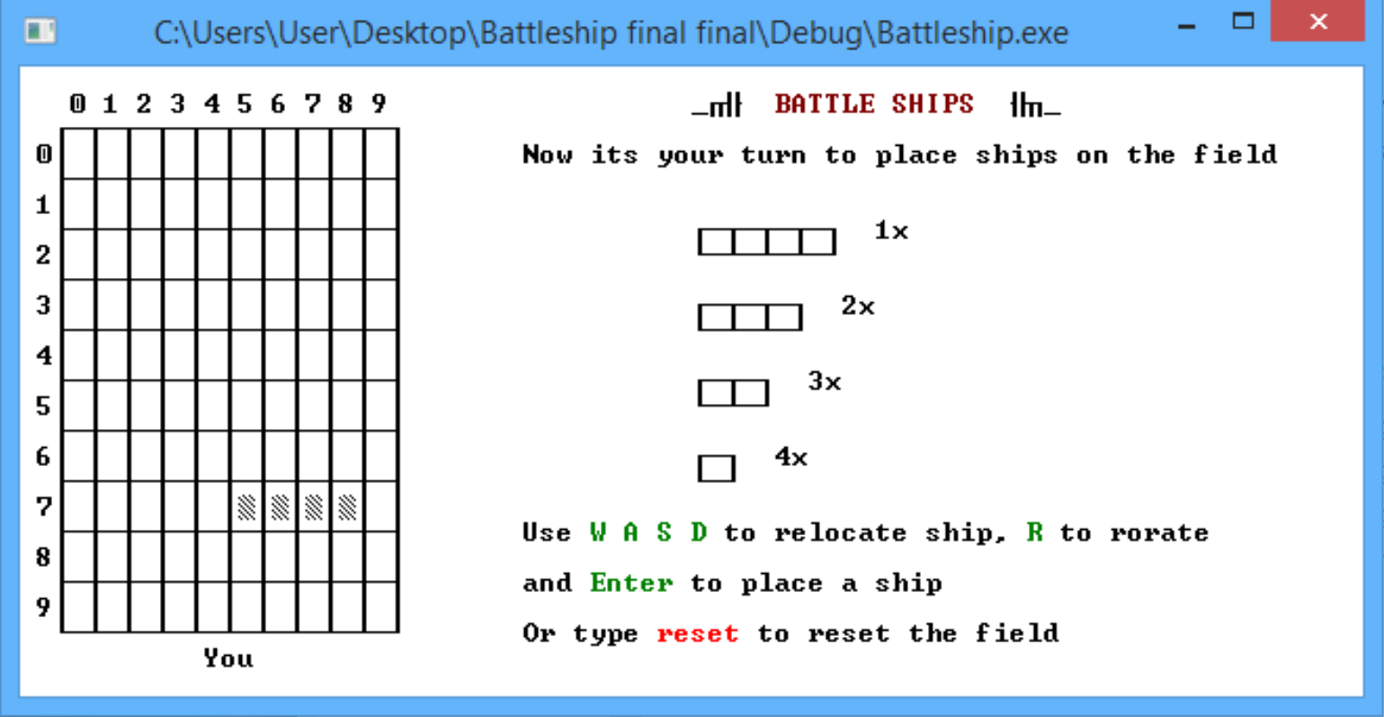
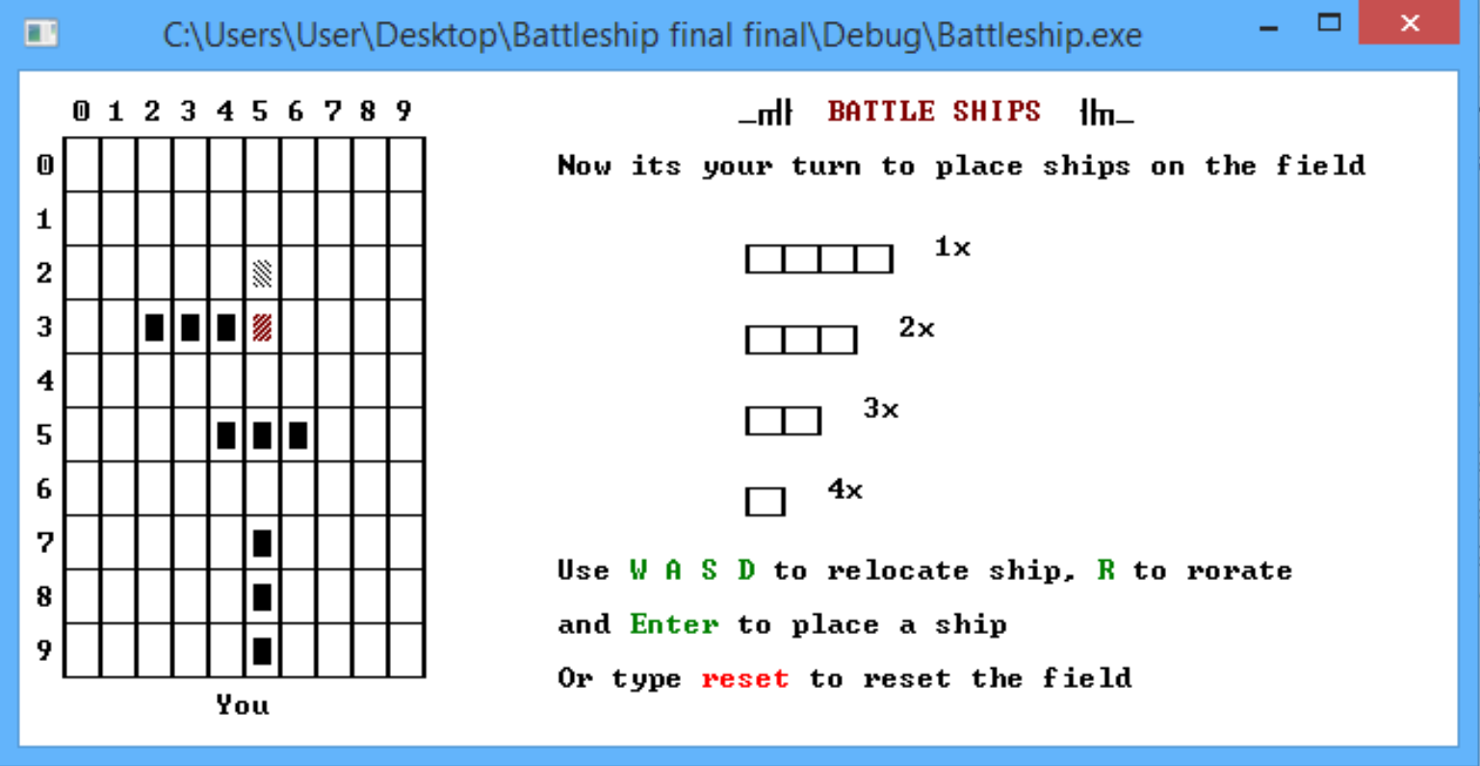
Ships placement
Features:
Algoritm automatically places new ship in allowed position. To change ships coordinates use buttons W A S D and R to rotate.
You can't place a ship in prohibited area (on place of other ship or in 1-cell radius around)

Slide 5
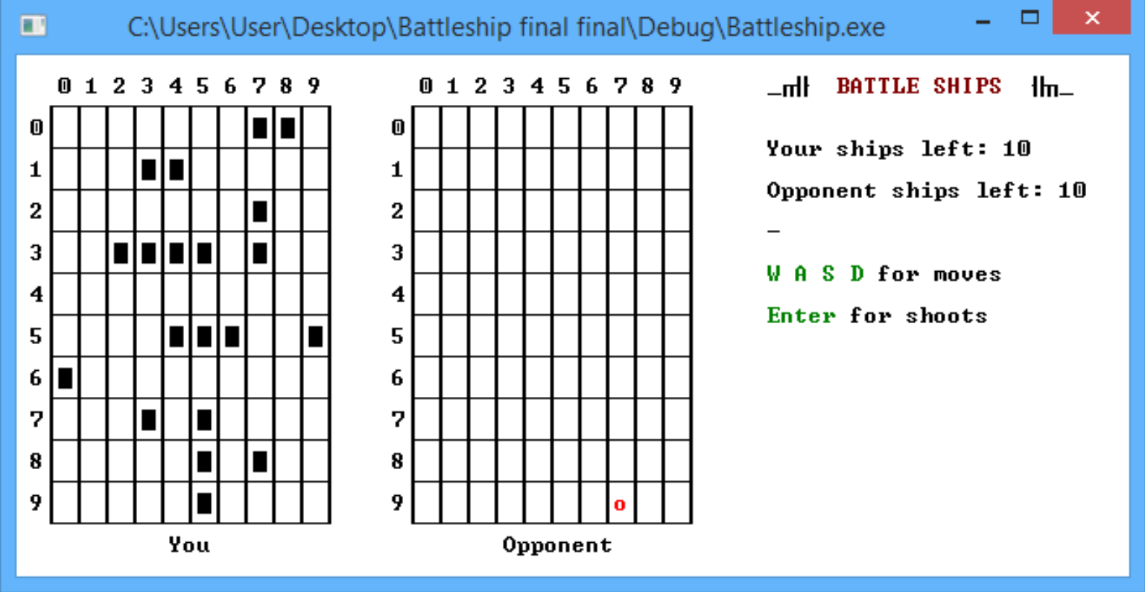
Game process
The game starts after ships placement. You moves first.
Red dot is your aim. You can change it's cell with W A S D and press ENTER to shoot.

Slide 6
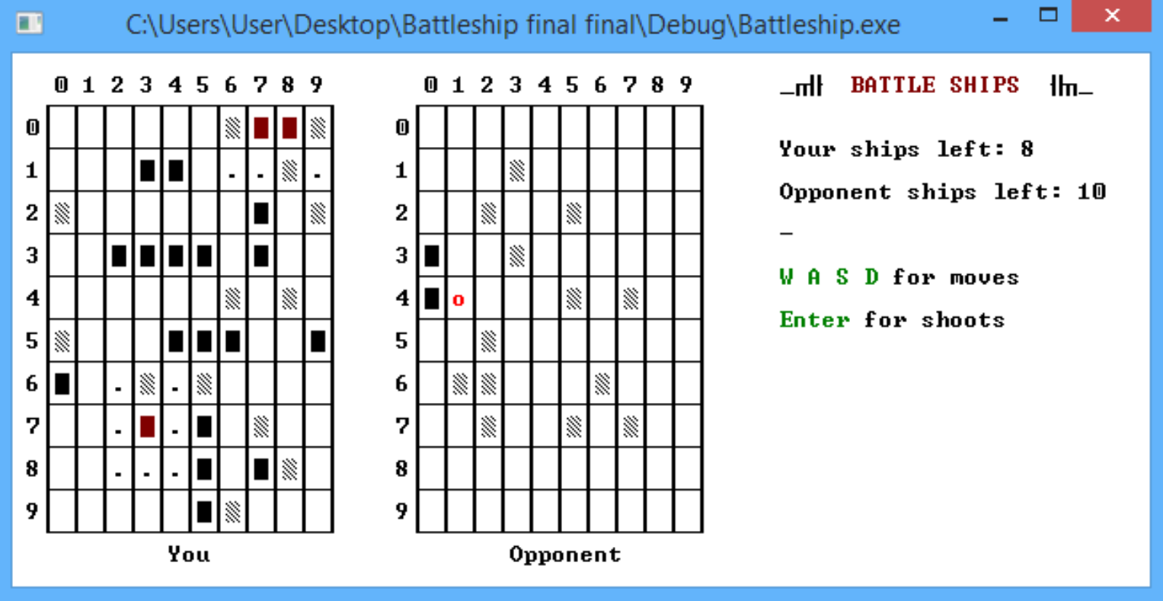
Definitions
Shoot was missed
Hitting the ship
Ship was destroyed
«Dots», mean that there aren't other ships in a radius of destoryed one

Slide 7
Computer's logic
All initial computer's shots are random.
3
Х
After hitting a ship computer begins to shout in adjacent cells.
2
1
3
Х
Х
If computer hits the ship second time it defines the ship as vertical or horisontal and shoots in one of the directions.
2
1
4

Slide 8
Computer's logic
2
Х
Х
Х
Х
If one of the next shots was missed – computer starts to fire in opposite direction and finally destroys the ship.
6
1
3
4
5
After destroying the ship, it becomes red and dots appears around it.

Slide 9
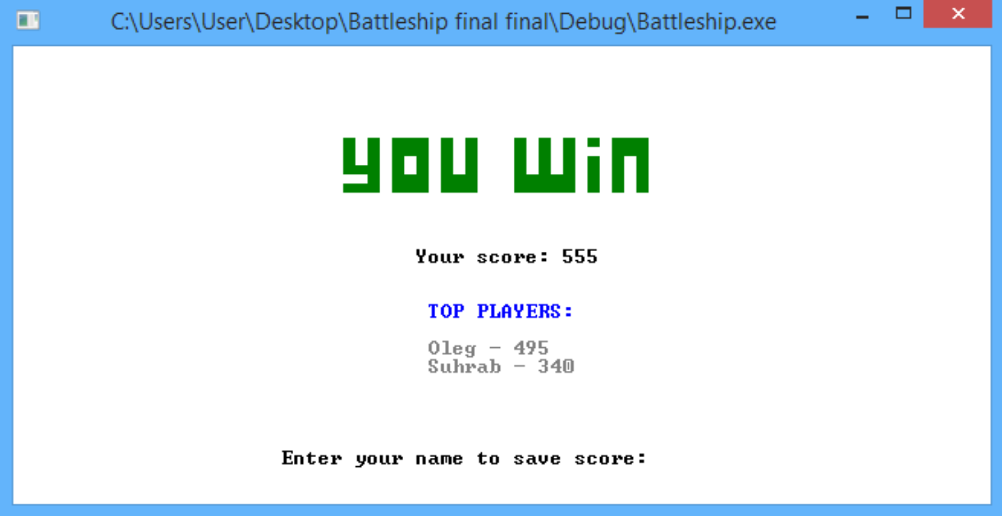
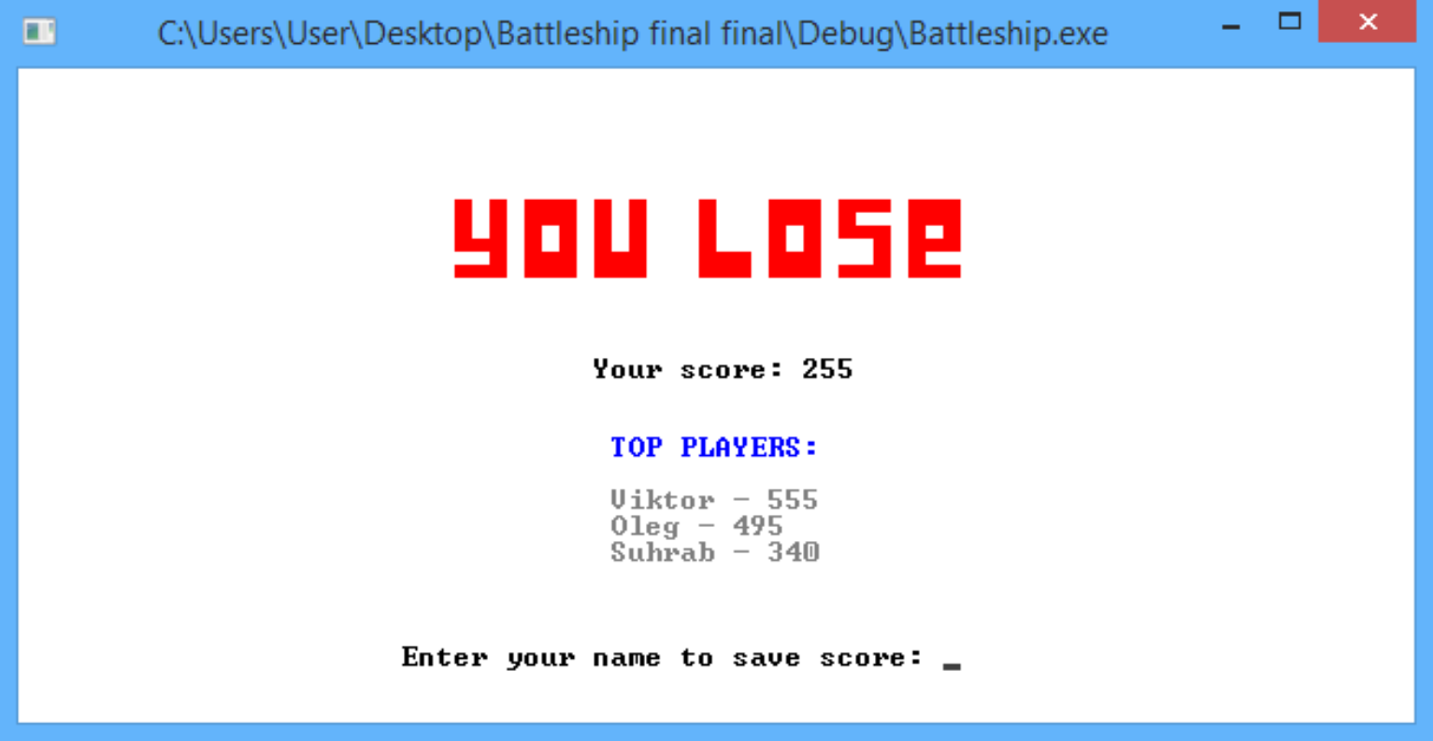
End of the game
At the end of the game there will be information about the game, your score and top-5 players with their score.
Also, if you get on the top-5, you will be asked to input your name to save your result.

Slide 10
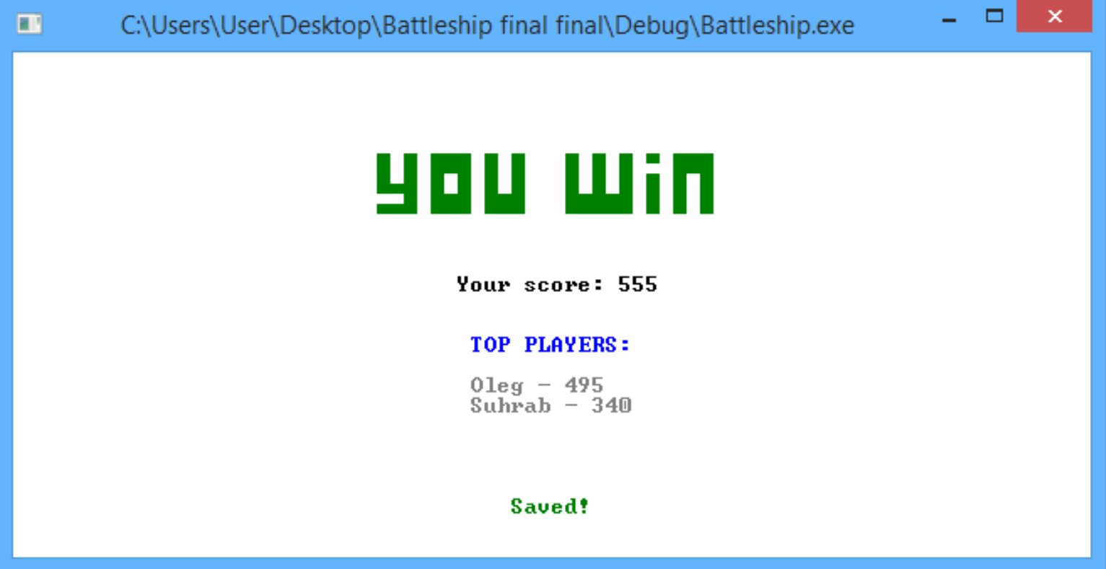
End of the game
After name input you will be notified about successfull saving.
Stats are saved in the Stats.txt file in the project directory.

Slide 11
Thanks for your time!
Viktor Kirillov

