Slide 1
Exception Handling
Lecture 02

Slide 2

Introduction
High expectations from the customers
Customers sometimes have unexpected behavior
Due to design or code issues our system could stop working or fail
Have to prevent such situation and handle them properly

Slide 3
Errors and Error Handling
Error is every unexpected result received during the execution of a program
The unhandled errors could appear like wrong results or behavior or like unexpected interruption of the system
Memory errors - memory incorrectly allocated, memory leaks, “null pointer”
File system errors - disk is full, disk has been removed
Network errors - network is down, URL does not exist
Calculation errors, Array errors, Conversion errors

Slide 4
Traditional Error Handling
Approach: Every method returns a flag indicating success, failure or a wrong state
Cons: The developers have to check the returned result every time and to take actions based on it. More line of code and hard to read
Usage: Traditional languages like C are using this approach for most of the library functions

Slide 5
Exceptions
Better approach for handling exceptional situations
An exception is generally a notification of an event that disrupts the normal operation of a program.
Exceptions allow this unusual event to be processed and the program to respond in some way.
When an exception occurs, the specific state of the program is saved and an exception handler is searched for.

Slide 6
Exceptions in Java
They have a hierarchical nature - they are classes and as such can form hierarchies by inheritance.
It recommends that exceptions be used to manage any state of error or unexpected behavior that occurs during the execution of a program.
The method in which the error occurred throws a special object containing information about the type of error, the location in the program where it occurred, and the state of the program at the time the error occurred.

Slide 7
How the exceptions work?
main()
Method 2
Method N
Method 1
Method 3

Slide 8
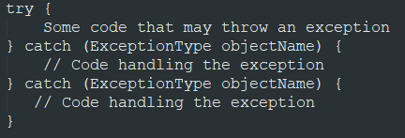
Try-Catch Statement
Child class access
Super class access
Code extension
Super class modifiers
Contains one try block with valid java statements that can throw exceptions
One or more catch blocks that are handling different type of exceptions
ExceptionType should be a class that extends java.lang.Throwable class

Slide 9
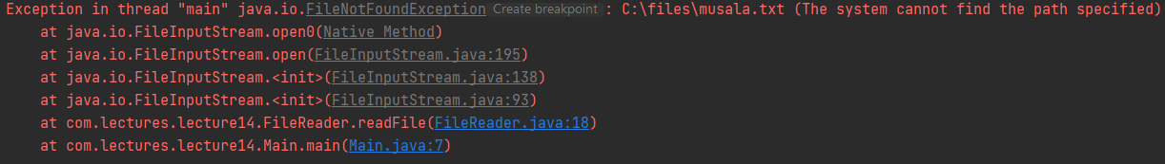
Stack Trace
Child class access
Super class access
Code extension
Super class modifiers
Contains a detailed description about the exception reason and the place in the program where it appeared.
Used for analyses and debugging from the engineers. Should not be visible for the end customers

Slide 10

Catch or Throw Principle
Applicable for exceptions that have to be mandatory handled. They either have to be caught or thrown by the method where they appeared.
Catch - the exception is handled - standart try-catch
Throw - Transfer the responsibility for the handling further to another method in the stack
Child class access
Super class access
Code extension
Super class modifiers

Slide 11
Exception types in Java
Checked
Unchecked
Errors
Notes:
© Copyright Showeet.com – Creative & Free PowerPoint and Google Slides Templates

Slide 12
Checked Exceptions
Mandatory to follow Catch or Throw approach. Compiler reminds for this.
These exceptions are extending java.lang.Exception class but do not extends java.lang.RuntimeException
A good written program should expect such exceptions and should be able to recover when they appear.
Child class access
Super class access
Code extension
Super class modifiers

Slide 13
Errors
Critical situations (fatal errors) where usually the program is not able to recover and the execution is interrupted.
They follow the catch or throw approach. It is not expected from us to handle them.
Example - java.lang.OutOfMemoryError
Child class access
Super class access
Code extension
Super class modifiers

Slide 14
Unchecked Exceptions
Not mandatory to follow catch or throw approach
They extends java.lang.RuntimeException
Such error usually means bug in the application or some library is not used properly
Example - NullPointerException
Child class access
Super class access
Code extension
Super class modifiers

Slide 15
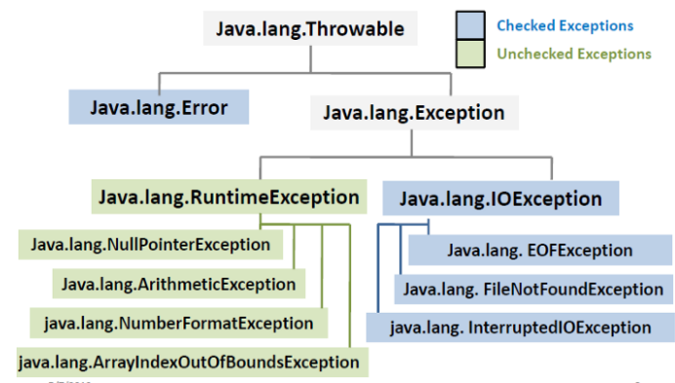
Exceptions Hierarchy
Child class access
Super class access
Code extension
Super class modifiers

Slide 16
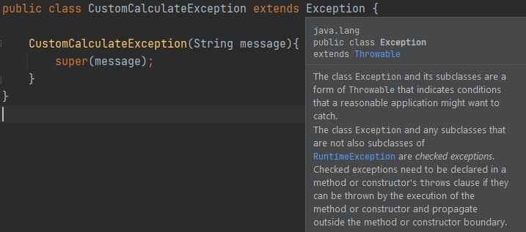
Custom Exceptions
Child class access
Super class access
Code extension
Super class modifiers
Usually used to personalize the exception according to the customer needs.

Slide 17
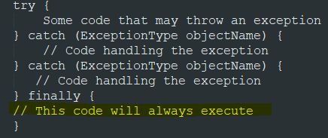
Try-Finally Statement
Every try block could have finally block.
Finally is executed always.
Only one finally block allowed per try statement.
Combination with try-catch-finally is also possible.
Child class access
Super class access
Code extension
Super class modifiers

Slide 18
Good advices when using Exceptions
The exceptions have to be used only for exceptional cases. It is a bad practice to rely always on exceptions for potential cases that you can predict (performance issues). Throwing an exception is a slow operation.
Exceptions that are not handled from anyone (runtime or errors) to be handled from general/common handler that stores the exception and showing user friendly message to the end customers
Child class access
Super class access
Code extension
Super class modifiers

Slide 19
Good advices when using Exceptions
Throw the exceptions on the corresponding level of abstraction.
If the exception has a cause, save it.
Provide detailed message when throwing an exception.
Do not ignore caught exceptions.
Avoid printStackTrace in the console.
Do not catch all exceptions.
Catch only exception you know how to handle.
Child class access
Super class access
Code extension
Super class modifiers

Slide 20


