Slide 1
Introduction to Selenium & TestNG
Lecture 04

Slide 2

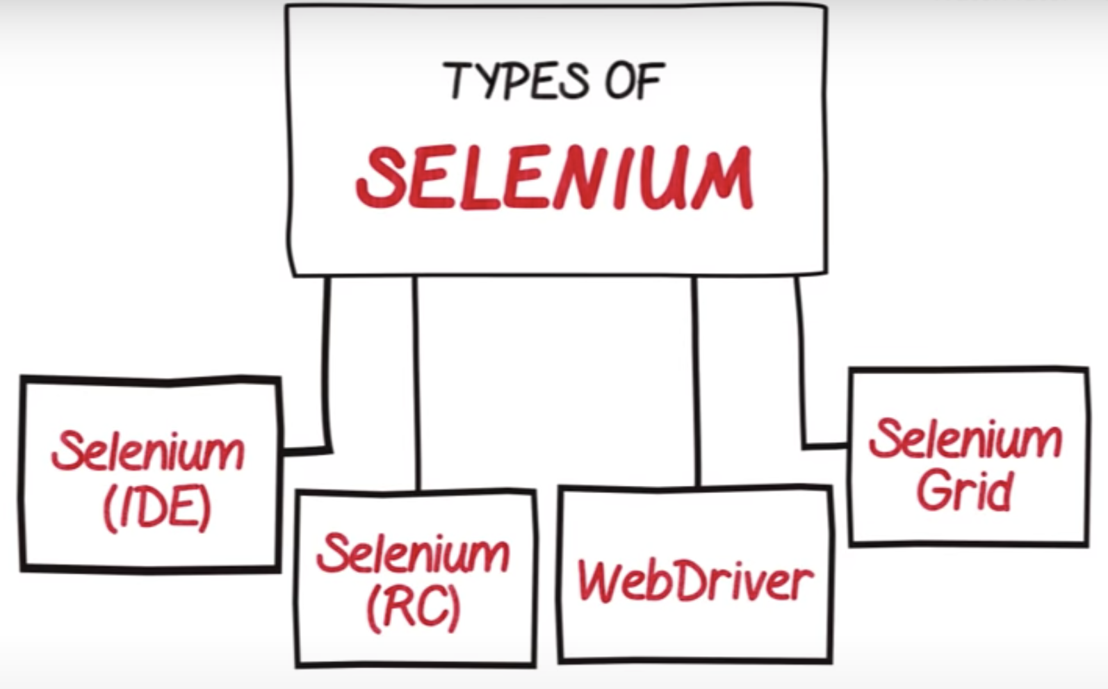
Selenium types

Slide 3
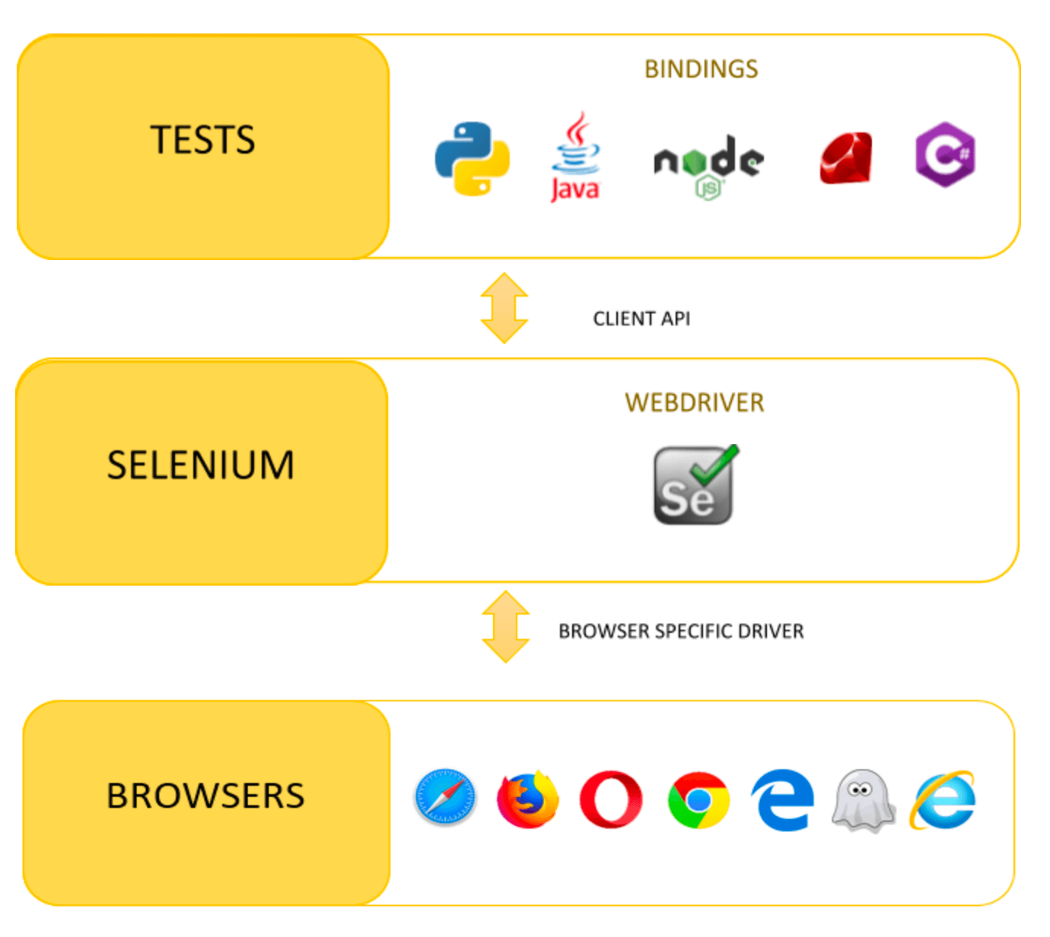
WebDriver Architecture
Implementing tests using API client on different languages.
API communicates with the Selenium server forwarding the user commands to a browser-specific driver.
The browser driver launches the browser to perform the actions and then returns a response.

Slide 4
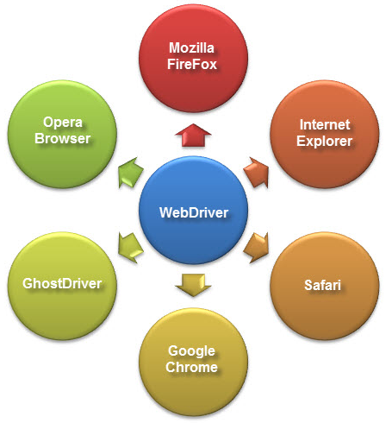
WebDriver Browser Support
Firefox - GeckoDriver
Chrome - ChromeDriver
IE - driver supports only 11
Edge - EdgeDriver
Safari - SafariDriver
Opera - OperaDriver
All drivers could be found here: https://www.selenium.dev/downloads/

Slide 5
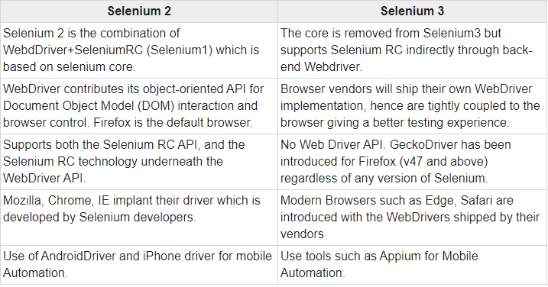
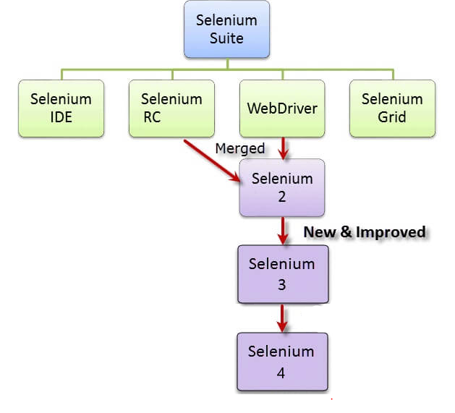
Selenium - version 3 & 4
Selenium 4 changes:
https://applitools.com/blog/selenium-4-migration/

Slide 6
TestNG Framework
TestNG is a testing framework inspired from JUnit and NUnit but introducing some new functionalities that make it more powerful and easier to use, such as:
Annotations.
Run your tests in arbitrarily big thread pools with various policies available (all methods in their own thread, one thread per test class, etc...).
Test that your code is multithread safe.
Flexible test configuration.
Support for data-driven testing (with @DataProvider).
Support for parameters.
Powerful execution model (no more TestSuite).
Supported by a variety of tools and plug-ins (Eclipse, IDEA, Maven, etc...).
Embeds BeanShell for further flexibility.
Default JDK functions for runtime and logging (no dependencies).
Dependent methods for application server testing.

Slide 7
TestNG Annotations
@BeforeSuite, @BeforeTest, @BeforeGroups, @BeforeClass, @BeforeMethod
@AfterSuite ,@AfterTest, @AfterGroups, @AfterClass,@AfterMethod
@Test
@DataProvider
@Factory
@Listeners

Slide 8
TestNG Annotations
@BeforeSuite - runs before all tests in this suite have run. @BeforeTest - runs before any test method belonging to the classes inside the tag is run.
@BeforeGroups - runs shortly before the first test method that belongs to any of these groups is invoked. @BeforeClass - runs before the first test method in the current class is invoked.
@BeforeMethod - run before each test method.
@AfterSuite, @AfterTest, @AfterGroups, @AfterClass, @AfterMethod - the same, but after

Slide 9
TestNG Annotations
@Test annotation attributes
dataProvider - The name of the data provider for test method.
groups - The list of groups this class/method belongs to.
expectedExceptions - The list of exceptions that a test method is expected to throw.
timeOut - The maximum number of milliseconds this test should take.
priority - the order of the test execution

Slide 10
WebDriver API
Selenium WebDriver API here:
https://www.selenium.dev/selenium/docs/api/java/

Slide 11
How to add Selenium and TestNG in project?
Maven dependencies from maven central
Selenium: https://mvnrepository.com/artifact/org.seleniumhq.selenium/selenium-java
TestNG: https://mvnrepository.com/artifact/org.testng/testng
Download browser drivers and add them in the project
Chrome driver: https://chromedriver.chromium.org/downloads
Firefox driver: https://github.com/mozilla/geckodriver/releases

Slide 12

@Find Elements
Install browser extension
Chrome: XPath Helper
Firefox: Try Xpath
Analyze the DOM (Document Object Model) structure of the application
Find stable attributes and locators for the WebElements

Slide 13
WebDriver API
By class
By.className(String)
By.cssSelector(String)
By.id(String)
By.linkText(String)
By.name(String)
By.partialLinkText(String)
By.tagName(String)
By.xpath(String)

Slide 14
WebDriver API
WebDriver class
get(String url) - Loads a new web page in the current browser window.
findElement(By by) - Finds the first WebElement using the given method.
findElements(By by) - Finds all elements within the current page.
getCurrentUrl() - Gets a string representing the current URL in the browser
getPageSource() - Gets the source of the last loaded page.
getTitle() - The title of the current page.
getWindowHandles() - Returns a set of window handles which can be used to iterate over all open windows of this WebDriver instance by passing them to switchTo()
switchTo() - Sends future commands to a different frame or window.
close() - Closes the current window, quitting the browser if it's the last window currently open.
quit () - Quits this driver, closing every associated window.

Slide 15
WebDriver API
WebElement class
clear() - If this element is a text entry element, this will clear the value.
click() - Click this element.
sendKeys(String text) - Use this method to simulate typing into an element, which set its value.
getAttribute(String) - Get the value of the given attribute of the element.
getTagName() - Get the tag name of this element.
getText() - Get the visible text of this element.
isDisplayed() - Whether this element is displayed or not.
isEnabled() - Whether this element is enabled or not.
isSelected() - Whether this element is selected or not. Usually for checkboxes.
submit() - If this current element is a form, or an element within a form, then this will be submitted to the remote server.

Slide 16
WebDriver API
Actions class
clickAndHold() - Clicks (without releasing) at the current mouse location.
click() - Clicks at the current mouse location.
sendKeys(String text) - Send keys to the active element.
doubleClick() - Performs a double-click at the current mouse location.
dragAndDrop() - A convenience method that performs click-and-hold at the location of the source element, moves to the location of the target element, then releases the mouse.
moveToElement(WebElement element) - Moves the mouse to the middle of the element.
pause(long pause) - Performs a pause.
build() - Generates a composite action containing all actions so far, ready to be performed
Actions actions = new Actions(driver);
Action mouseOverElement = actions.moveToElement(element).build().perform();

Slide 17


