Slide 1
Unit Testing - Concepts and Tools
Lecture 14

Slide 2

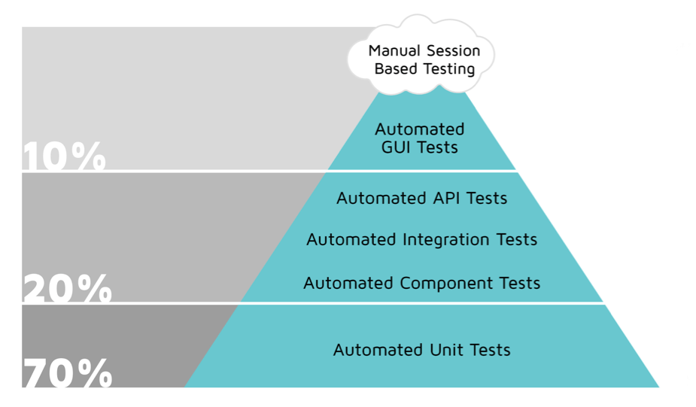
Test Automation Pyramid

Slide 3
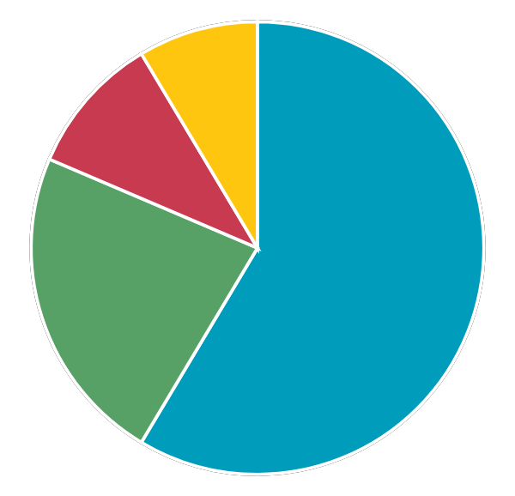
Unit Testing
Must be completely automated and executed every time when there are code changes.
Code Reliability
The code is more reliable when the code coverage is higher
Code Reusability
The code is more reusable. Easy to reuse a code implemented with modular approach
Cost Efficient
Bug fixing cost is much lower
Team Confidence
Increase the team confidence when doing refactoring or more complex changes.

Slide 4
TDD in Unit Testing
Test-driven development (TDD) - process for software development where the tests are written based on the requirements before the code implementation.
All tests are failing at the beginning.
The code implementation is as minimal as possible, so that the tests are passing. After that the code is optimised.
The goal is to have tests covering all requirements.
The TDD leads to code modularity easier for maintainability.

Slide 5
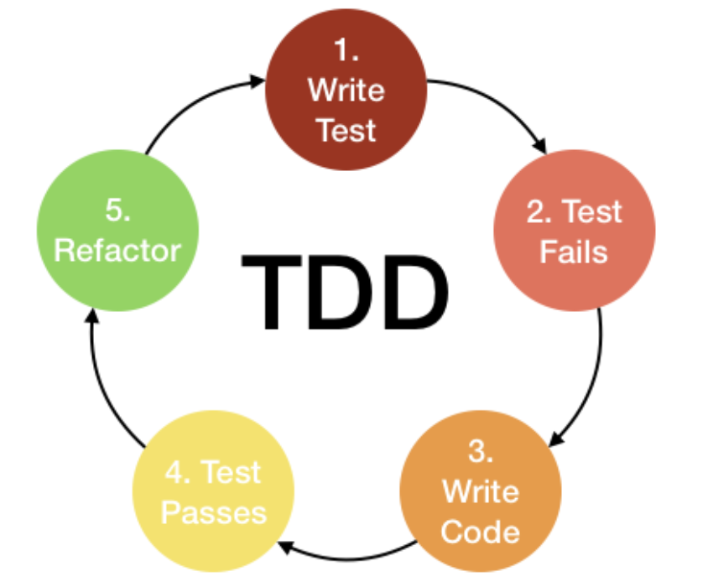
TDD - Concept

Slide 6
TDD Drawbacks
More time and effort at the beginning.
Not suitable for projects with complex design - could lead to big changes in the code.
The tests must be modified if the code or design are changing often.

Slide 7
Code Coverage
Measures what part of the code is executable when the unit tests are started. Higher percent of code coverage reduces the undetected defects.
Using a code analysis tools - Clover, Corbetura, JaCoCo, Sonar etc. Such tools can improve the testing quality showing us areas where we have less coverage.
Include unit tests in the DoD of a feature.
Levels between 70 and 90 percent suggest reliable software

Slide 8
Code Coverage - Techniques and Metrics
Method Coverage (Function Coverage)
Method or function coverage measures code by counting the number of functions called by a test suite.

Slide 9
Code Coverage - Techniques and Metrics
Statement Coverage
Measures the percentage of code statements executed during a test suite. Statements are instructions in the code (a line of program source code) expressing some action that the program should carry out.
To achieve 100% Statement coverage we have to make sure that every statement in the code is executed at least once.
Statement coverage is only useful as a measure of physical code — it says nothing about the quality of tests used to execute the code.

Slide 10
Code Coverage - Techniques and Metrics
Branch Coverage
Branch coverage measures whether a test suite executes the branches from decision points written into the code.
Such decision points arise from if and case statements, with two possible outcomes: true and false.
A Branch coverage is the percentage of branches that have been exercised by a test suite.

Slide 11
Code Coverage - Techniques and Metrics
Decision Coverage
Decision coverage measures whether tests execute statements using each of the Boolean expressions contained in the code.
100% decision coverage implies both 100% branch coverage and 100% statement coverage.
Test coverage criteria requires enough test cases such that each condition in a decision takes on all possible outcomes at least once.
Decision coverage measures the coverage of conditional branches; branch coverage measures the coverage of both conditional and unconditional branches.

Slide 12
Code Coverage - Techniques and Metrics
Path Coverage
The percentage of paths that have been exercised by a test suite.
The test case is executed in such a way that every path is executed at least once.
All possible control paths taken, including all loop paths taken zero, once, and multiple (ideally, maximum) items in path coverage technique, the test cases are prepared based on the logical complexity measure of a procedural design.

Slide 13
Code Coverage - Techniques and Metrics
Cyclomatic Complexity
Cyclomatic complexity measures the total number of linearly dependent paths in a program’s source code. For example, source code containing no conditional statements or decision points has a cyclomatic complexity of 1.
Cyclomatic complexity is useful in planning test cases to determine coverage for particular code modules. For example, testing teams can use the cyclomatic complexity value as an upper bound for the number of required test cases to achieve full branch coverage.

Slide 14
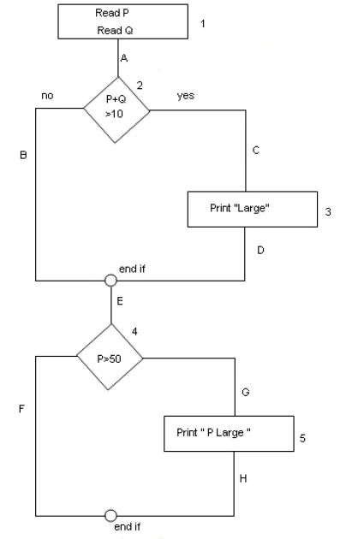
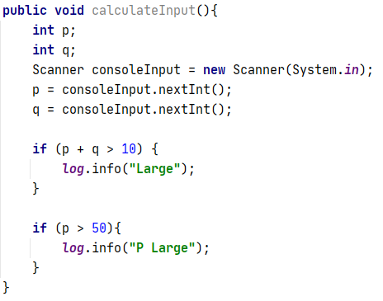
Code Coverage - Techniques and Metrics Exercise
Define the Statement, Branch, Decision, Path Coverage.

Slide 15
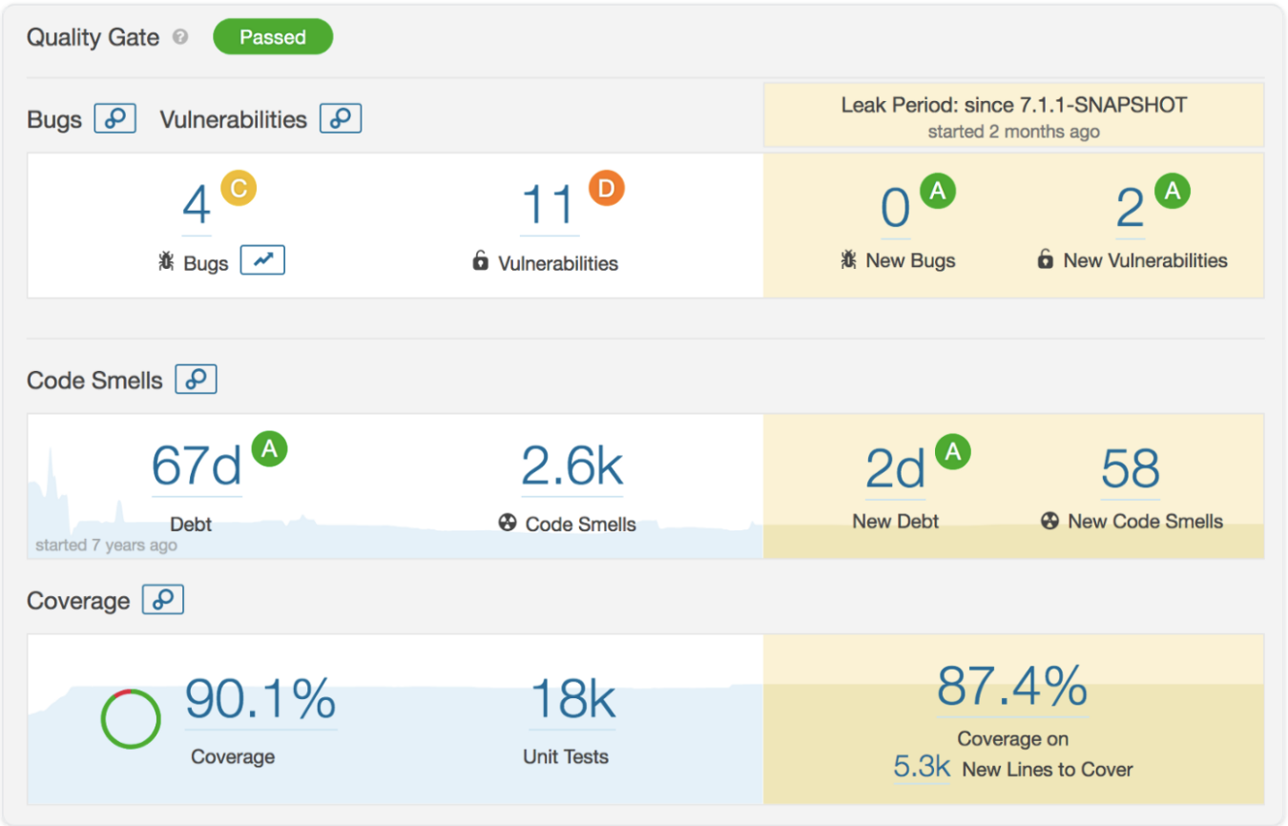
SonarQube - Example Report

Slide 16
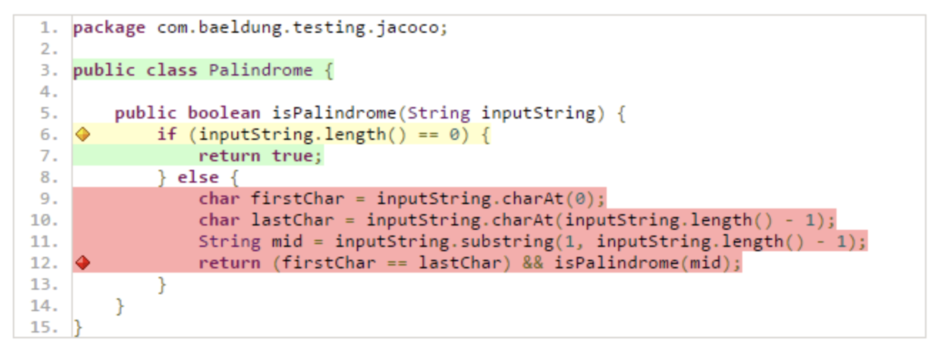
JaCoCo - Example Report

Slide 17
The Need of Mocking & Stubing
Mocking is the act of removing external dependencies from a unit test in order to create a controlled environment around it.
Common targets for mocking are:
Database connections
Web services
Classes that are slow
Classes with side effects
Classes with non-deterministic behavior
Notes:
For example, think of a Java class that communicates with an external payment provider, e.g. Paypal. There is no need to actually connect to the payment provider each time the unit test runs. It would be dangerous to test code that charges credit cards using a live payment environment. It would also make the unit test non-deterministic, e.g. if the payment provider is down for some reason.

Slide 18
Mocking Frameworks - Java
Mockito
EasyMock
PowerMock - testing static methods
JMockit

Slide 19


