Slide 1
Rules
Inspectors give penalty points for violations.
More points earned signifies more problems.
Points are at the discretion of the inspector, based on severity.
# of Critical violations per category:
15 Food contamination during prep
10 Food temperature problem
9 Inadequate sanitization
7 Milk/Water/Eggs/Fish/Shellfish
7 Facility not suitable for food handling
1 Obstructing inspector
A total of 65 violations to watch out for
2015 in Numbers:
Restaurants inspected: 21,271
Violations recorded: 127,347
10 Poor Facility Maintenance
3 Dented Cans/Thawing/Contact Surface
3 Pesticide & Garbage
# of General violations per category:

Slide 2
Grade
A
Initial Inspection
or 6-month Cycle Inspection
Is score
< 14?
Yes
84% of all inspections
No
Score
Grade
0-13
A
Score only;
Remains Ungraded
Second (surprise) inspection
14-27
B
Within
1 month
C
28-100+
Other Inspections:
Pre-permit, Administrative/Miscellaneous, Smoke-free Air, Trans fat, Calorie posting, Inter-agency

Slide 3
First Inspection for 2015 for all restaurants
Start
Inspection
Follow-up
21,271
(100%)
7,806
(37%)
UNGRADED
C
674 (9%)
1,516 (19%)
B
5,616 (72%)
13,465
(63%)
A
Grade
A

Slide 4
Where is the problem here?

Slide 5
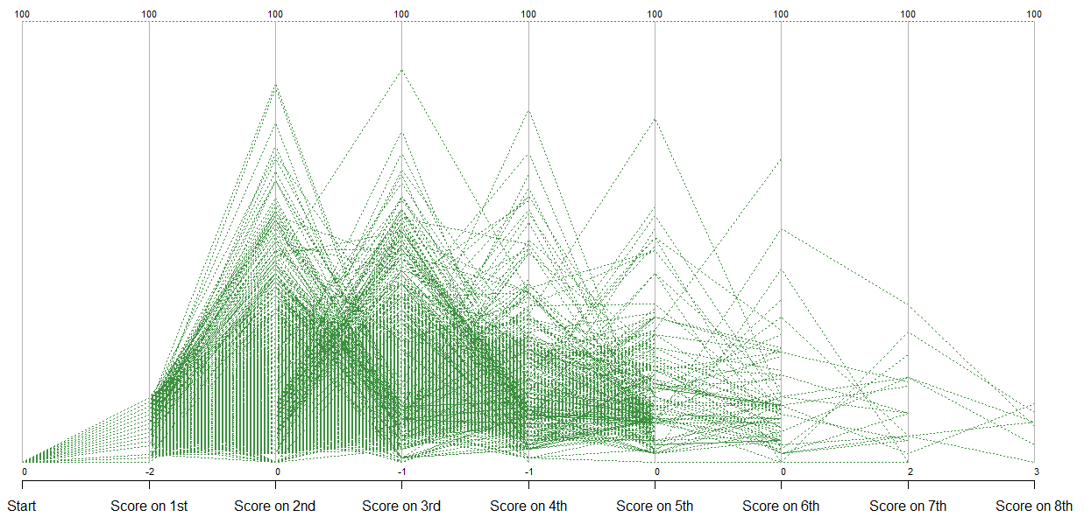
Restaurants that get an A on first inspection continue on a yo-yo trajectory in terms of staying compliant
Source: Inspection for 2015, NYC Open Data, Department of Health and Mental Hygiene

Slide 6
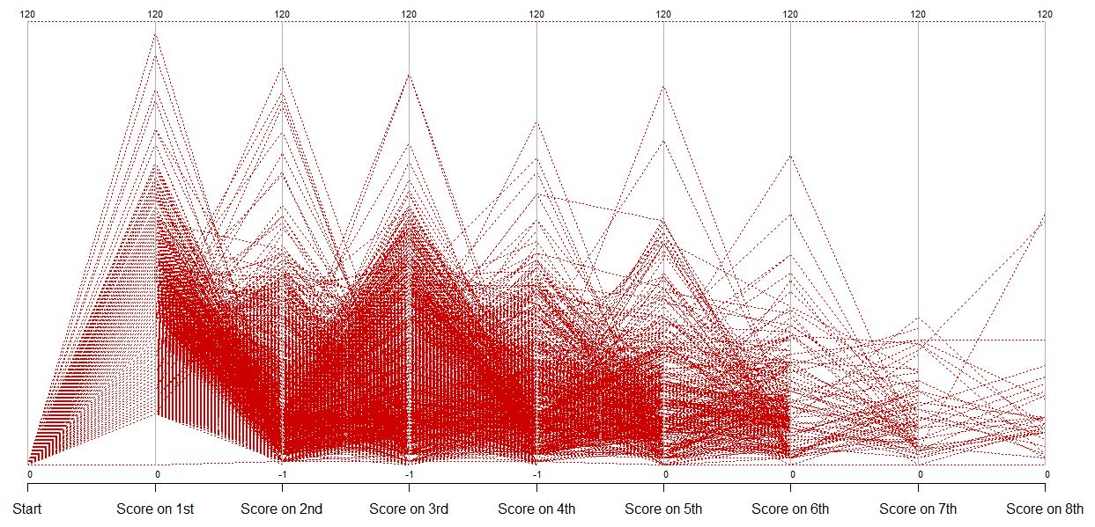
The non-compliant restaurants on first inspection also go up and down in performance on subsequent inspections
Source: Inspection for 2015, NYC Open Data, Department of Health and Mental Hygiene

