Slide 1
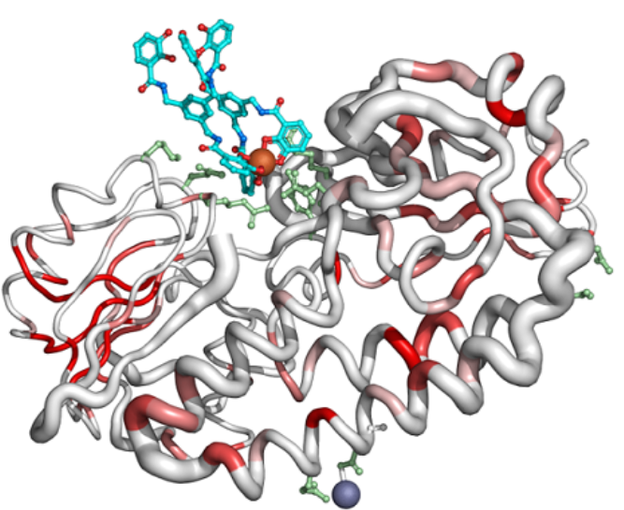
Protein Sequence
Evoformer
Embedding
Row
Attn
T
Col
Attn
T
Feed-
Forward
4×ExtraEvoformer
MSA representation
(Ns, Nr, H)
MSA representation
(Ns, Nr, H)
Outer
Product
4 iter
NoExtra
Evoformer
48×
8×Structure
Triangle
Update
T’
Triangle
Update
Triangle
Attn
T
Triangle
Attn
T
Feed-
Forward
Pair representation
(Nr, Nr, H)
Pair representation
(Nr, Nr, H)

Slide 2
Protein Sequence
Evoformer
Embedding
Row
Attn
T
Col
Attn
T
Feed-
Forward
4×ExtraEvoformer
MSA representation
(Ns, Nr, H)
Outer
Product
MSA representation
(Ns, Nr, H)
4 iter
NoExtra
Evoformer
48×
Triangle
Update
T’
Triangle
Update
Triangle
Attn
T
Triangle
Attn
T
Feed-
Forward
8×Structure
Pair representation
(Nr, Nr, H)
Pair representation
(Nr, Nr, H)

