Slide 1
第10章 Manipulating Databases with JDBC
Connect to a database
Query the database
Display the results of the query in JTable
javafx连MySQL样例：
https://blog.csdn.net/2201_75692232/article/details/134212955

Slide 2
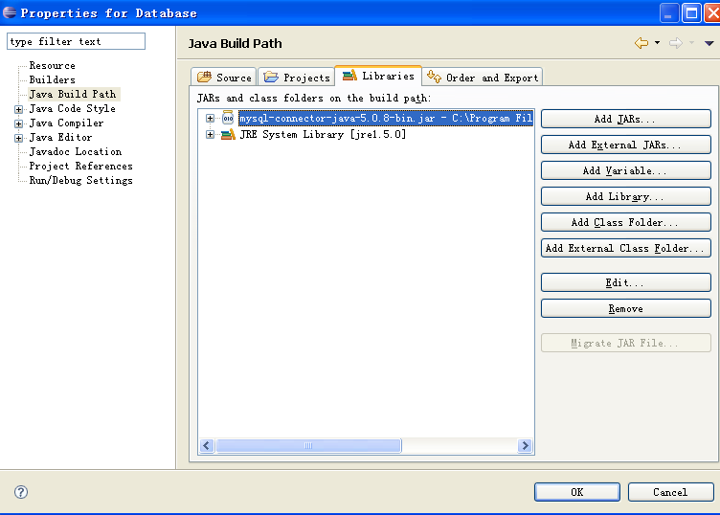
1 Connecting to and Querying a Database
DisplayAuthors
Retrieves the entire authors table
Displays the data in the standard output stream
Example illustrates
Connect to the database
Query the database
Process the result

Slide 3
import java.sql.SQLException;
public class DisplayAuthors {
public static void main(String args[]) {
final String DATABASE_URL = "jdbc:derby:books";
final String SELECT_QUERY =
"SELECT authorID, firstName, lastName FROM authors";

Slide 4
// use try-with-resources to connect to and query the database
try (
Connection connection = DriverManager.getConnection(
DATABASE_URL, "deitel", "deitel");
Statement statement = connection.createStatement();
ResultSet resultSet = statement.executeQuery(SELECT_QUERY)) {
// get ResultSet's meta data
ResultSetMetaData metaData = resultSet.getMetaData();
int numberOfColumns = metaData.getColumnCount();
System.out.printf("Authors Table of Books Database:%n%n");
// display the names of the columns in the ResultSet
for (int i = 1; i <= numberOfColumns; i++) {
System.out.printf("%-8s\t", metaData.getColumnName(i));
}
System.out.println();

Slide 5
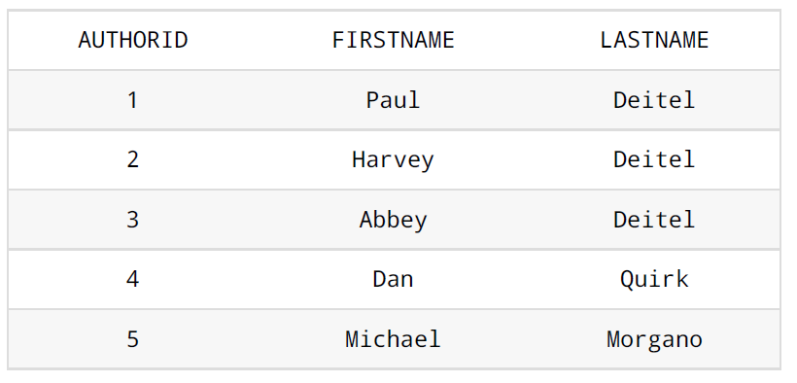
// display query results
while (resultSet.next()) {
for (int i = 1; i <= numberOfColumns; i++) {
System.out.printf("%-8s\t", resultSet.getObject(i));
}
System.out.println();
}
}
catch (SQLException sqlException) {
sqlException.printStackTrace();
}
}
}

Slide 6
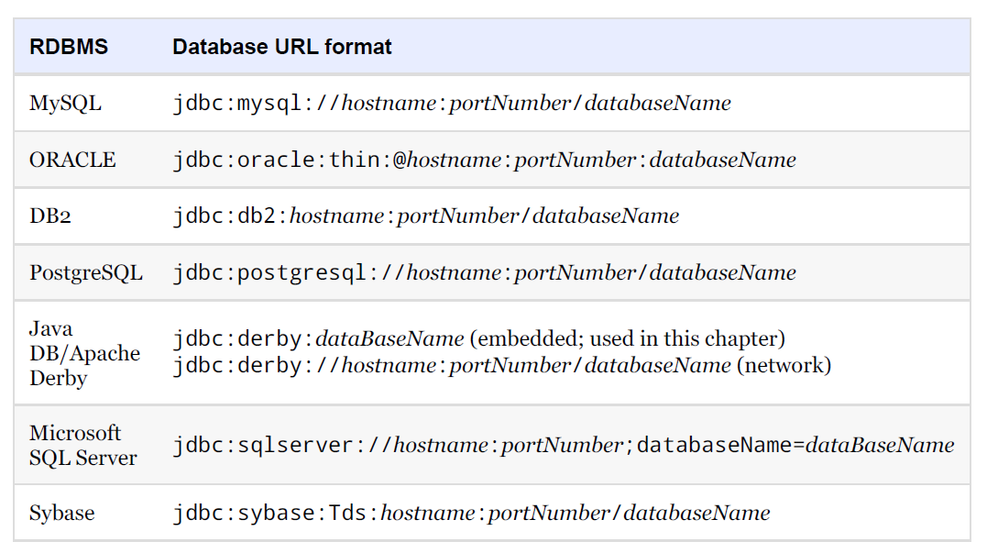
Popular JDBC database URL formats.

Slide 7
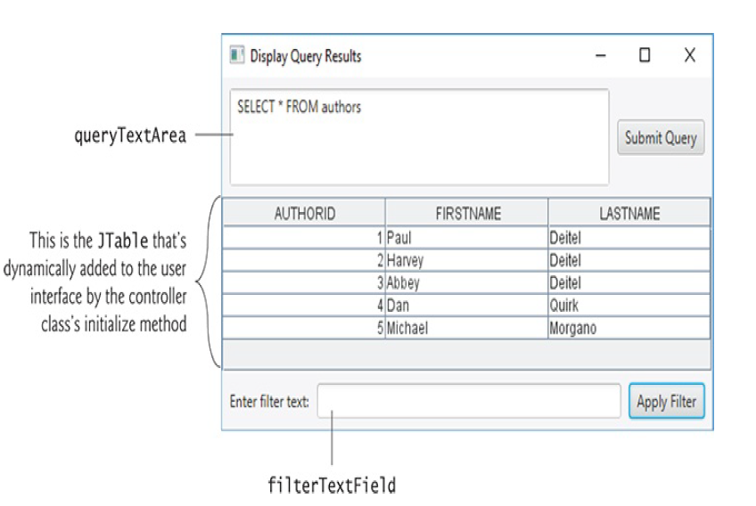
https://openjfx.cn/javadoc/18/javafx.controls/javafx/scene/control/TableView.html

Slide 8
// Fig. 24.29: DisplayQueryResultsController.java
// Controller for the DisplayQueryResults app
import java.sql.SQLException;
import java.util.regex.PatternSyntaxException;
import javafx.embed.swing.SwingNode;
import javafx.event.ActionEvent;
import javafx.fxml.FXML;
import javafx.scene.control.Alert;
import javafx.scene.control.Alert.AlertType;
import javafx.scene.control.TextArea;
import javafx.scene.control.TextField;
import javafx.scene.layout.BorderPane;
import javax.swing.JScrollPane;
import javax.swing.JTable;
import javax.swing.RowFilter;
import javax.swing.table.TableModel;
import javax.swing.table.TableRowSorter;

Slide 9
public class DisplayQueryResultsController {
@FXML private BorderPane borderPane;
@FXML private TextArea queryTextArea;
@FXML private TextField filterTextField;
// database URL, username and password
private static final String DATABASE_URL = "jdbc:derby:books";
private static final String USERNAME = "deitel";
private static final String PASSWORD = "deitel";
// default query retrieves all data from Authors table
private static final String DEFAULT_QUERY = "SELECT * FROM authors";
// used for configuring JTable to display and sort data
private ResultSetTableModel tableModel;
private TableRowSorter<TableModel> sorter;

Slide 10
public void initialize() {
queryTextArea.setText(DEFAULT_QUERY);
// create ResultSetTableModel and display database table
try {
// create TableModel for results of DEFAULT_QUERY
tableModel = new ResultSetTableModel(DATABASE_URL,
USERNAME, PASSWORD, DEFAULT_QUERY);
// create JTable based on the tableModel
JTable resultTable = new JTable(tableModel);
// set up row sorting for JTable
sorter = new TableRowSorter<TableModel>(tableModel);
resultTable.setRowSorter(sorter);
// configure SwingNode to display JTable, then add to borderPane
SwingNode swingNode = new SwingNode();
swingNode.setContent(new JScrollPane(resultTable));
borderPane.setCenter(swingNode);
}

Slide 11
catch (SQLException sqlException) {
displayAlert(AlertType.ERROR, "Database Error",
sqlException.getMessage());
tableModel.disconnectFromDatabase(); // close connection
System.exit(1); // terminate application
}
}

Slide 12
// query the database and display results in JTable
@FXML
void submitQueryButtonPressed(ActionEvent event) {
// perform a new query
try {
tableModel.setQuery(queryTextArea.getText());
}
catch (SQLException sqlException) {
displayAlert(AlertType.ERROR, "Database Error",
sqlException.getMessage());
// try to recover from invalid user query
// by executing default query
try {
tableModel.setQuery(DEFAULT_QUERY);
queryTextArea.setText(DEFAULT_QUERY);
}
catch (SQLException sqlException2) {
displayAlert(AlertType.ERROR, "Database Error",
sqlException2.getMessage());
tableModel.disconnectFromDatabase(); // close connection
System.exit(1); // terminate application
}
}
}

Slide 13
// apply specified filter to results
@FXML
void applyFilterButtonPressed(ActionEvent event) {
String text = filterTextField.getText();
if (text.length() == 0) {
sorter.setRowFilter(null);
}
else {
try {
sorter.setRowFilter(RowFilter.regexFilter(text));
}
catch (PatternSyntaxException pse) {
displayAlert(AlertType.ERROR, "Regex Error",
"Bad regex pattern");
}
}
}

Slide 14
// display an Alert dialog
private void displayAlert(
AlertType type, String title, String message) {
Alert alert = new Alert(type);
alert.setTitle(title);
alert.setContentText(message);
alert.showAndWait();
}
}

Slide 15
// Fig. 24.25: ResultSetTableModel.java
// A TableModel that supplies ResultSet data to a JTable.
import java.sql.Connection;
import java.sql.Statement;
import java.sql.DriverManager;
import java.sql.ResultSet;
import java.sql.ResultSetMetaData;
import java.sql.SQLException;
import javax.swing.table.AbstractTableModel;
// ResultSet rows and columns are counted from 1 and JTable
// rows and columns are counted from 0. When processing
// ResultSet rows or columns for use in a JTable, it is
// necessary to add 1 to the row or column number to manipulate
// the appropriate ResultSet column (i.e., JTable column 0 is
// ResultSet column 1 and JTable row 0 is ResultSet row 1).

Slide 16
public class ResultSetTableModel extends AbstractTableModel {
private final Connection connection;
private final Statement statement;
private ResultSet resultSet;
private ResultSetMetaData metaData;
private int numberOfRows;
// keep track of database connection status
private boolean connectedToDatabase = false;
// constructor initializes resultSet and obtains its metadata object;
// determines number of rows
public ResultSetTableModel(String url, String username,
String password, String query) throws SQLException {
// connect to database
connection = DriverManager.getConnection(url, username, password);
// create Statement to query database
statement = connection.createStatement(
ResultSet.TYPE_SCROLL_INSENSITIVE, ResultSet.CONCUR_READ_ONLY);
// update database connection status
connectedToDatabase = true;
// set query and execute it
setQuery(query);
}

Slide 17
// get class that represents column type
public Class getColumnClass(int column) throws IllegalStateException {
// ensure database connection is available
if (!connectedToDatabase) {
throw new IllegalStateException("Not Connected to Database");
}
// determine Java class of column
try {
String className = metaData.getColumnClassName(column + 1);
// return Class object that represents className
return Class.forName(className);
}
catch (Exception exception) {
exception.printStackTrace();
}
return Object.class; // if problems occur above, assume type Object
}

Slide 18
// get number of columns in ResultSet
public int getColumnCount() throws IllegalStateException {
// ensure database connection is available
if (!connectedToDatabase) {
throw new IllegalStateException("Not Connected to Database");
}
// determine number of columns
try {
return metaData.getColumnCount();
}
catch (SQLException sqlException) {
sqlException.printStackTrace();
}
return 0; // if problems occur above, return 0 for number of columns
}

Slide 19
// get name of a particular column in ResultSet
public String getColumnName(int column) throws IllegalStateException {
// ensure database connection is available
if (!connectedToDatabase) {
throw new IllegalStateException("Not Connected to Database");
}
// determine column name
try {
return metaData.getColumnName(column + 1);
}
catch (SQLException sqlException) {
sqlException.printStackTrace();
}
return ""; // if problems, return empty string for column name
}

Slide 20
// return number of rows in ResultSet
public int getRowCount() throws IllegalStateException {
// ensure database connection is available
if (!connectedToDatabase) {
throw new IllegalStateException("Not Connected to Database");
}
return numberOfRows;
}

Slide 21
// obtain value in particular row and column
public Object getValueAt(int row, int column)
throws IllegalStateException {
// ensure database connection is available
if (!connectedToDatabase) {
throw new IllegalStateException("Not Connected to Database");
}
// obtain a value at specified ResultSet row and column
try {
resultSet.absolute(row + 1);
return resultSet.getObject(column + 1);
}
catch (SQLException sqlException) {
sqlException.printStackTrace();
}
return ""; // if problems, return empty string object
}

Slide 22
// set new database query string
public void setQuery(String query)
throws SQLException, IllegalStateException {
// ensure database connection is available
if (!connectedToDatabase) {
throw new IllegalStateException("Not Connected to Database");
}
// specify query and execute it
resultSet = statement.executeQuery(query);
// obtain metadata for ResultSet
metaData = resultSet.getMetaData();
// determine number of rows in ResultSet
resultSet.last(); // move to last row
numberOfRows = resultSet.getRow(); // get row number
fireTableStructureChanged(); // notify JTable that model has changed
}

Slide 23
// close Statement and Connection
public void disconnectFromDatabase() {
if (connectedToDatabase) {
// close Statement and Connection
try {
resultSet.close();
statement.close();
connection.close();
}
catch (SQLException sqlException) {
sqlException.printStackTrace();
}
finally { // update database connection status
connectedToDatabase = false;
}
}
}
}

Slide 24
// Fig. 24.29: JdbcRowSetTest.java
// Displaying the contents of the Authors table using JdbcRowSet.
import java.sql.ResultSetMetaData;
import java.sql.SQLException;
import javax.sql.rowset.JdbcRowSet;
import javax.sql.rowset.RowSetProvider;
public class JdbcRowSetTest {
// JDBC driver name and database URL
private static final String DATABASE_URL = "jdbc:derby:books";
private static final String USERNAME = "deitel";
private static final String PASSWORD = "deitel";

Slide 25
// display each row
while (rowSet.next()) {
for (int i = 1; i <= numberOfColumns; i++) {
System.out.printf("%-8s\t", rowSet.getObject(i));
}
System.out.println();
}
}
catch (SQLException sqlException) {
sqlException.printStackTrace();
System.exit(1);
}
}
}

Slide 26
public static void main(String args[]) {
// connect to database books and query database
try (JdbcRowSet rowSet =
RowSetProvider.newFactory().createJdbcRowSet()) {
// specify JdbcRowSet properties
rowSet.setUrl(DATABASE_URL);
rowSet.setUsername(USERNAME);
rowSet.setPassword(PASSWORD);
rowSet.setCommand("SELECT * FROM Authors"); // set query
rowSet.execute(); // execute query
// process query results
ResultSetMetaData metaData = rowSet.getMetaData();
int numberOfColumns = metaData.getColumnCount();
System.out.printf("Authors Table of Books Database:%n%n");
// display rowset header
for (int i = 1; i <= numberOfColumns; i++) {
System.out.printf("%-8s\t", metaData.getColumnName(i));
}
System.out.println();

