Slide 1
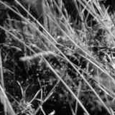
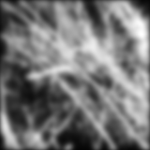
Linear filtering

Slide 2
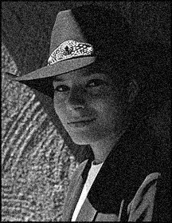
Motivation: Image denoising
How can we reduce noise in a photograph?
Notes:
Answer: take lots of images, average them

Slide 3

Moving average
Let’s replace each pixel with a weighted average of its neighborhood
The weights are called the filter kernel
What are the weights for the average of a 3x3 neighborhood?
1
1
1
1
1
1
1
1
1
“box filter”
Source: D. Lowe

Slide 4


Defining convolution
Let f be the image and g be the kernel. The output of convolving f with g is denoted f * g.
f
Convention: kernel is “flipped”
MATLAB functions: conv2, filter2, imfilter
Source: F. Durand
Notes:
If we want to know the value of the filtered image at any location, we overlay the filter kernel over the image centered at that location, multiply the image values by the corresponding kernel values, and sum the result. To produce the entire filtered output image, we slide the filter kernel over every location and perform this operation.

Slide 5
Key properties
Linearity: filter(f₁ + f₂) = filter(f₁) + filter(f₂)
Shift invariance: same behavior regardless of pixel location: filter(shift(f)) = shift(filter(f))
Theoretical result: any linear shift-invariant operator can be represented as a convolution

Slide 6
Properties in more detail
Commutative: a * b = b * a
Conceptually no difference between filter and signal
Associative: a * (b * c) = (a * b) * c
Often apply several filters one after another: (((a * b₁) * b₂) * b₃)
This is equivalent to applying one filter: a * (b₁ * b₂ * b₃)
Distributes over addition: a * (b + c) = (a * b) + (a * c)
Scalars factor out: ka * b = a * kb = k (a * b)
Identity: unit impulse e = […, 0, 0, 1, 0, 0, …], a * e = a

Slide 7
Dealing with edges
What is the size of the output?
MATLAB: filter2(g, f, shape)
shape = ‘full’: output size is sum of sizes of f and g
shape = ‘same’: output size is same as f
shape = ‘valid’: output size is difference of sizes of f and g
full
same
valid
g
g
g
g
f
f
f
g
g
g
g
g
g
g
g

Slide 8
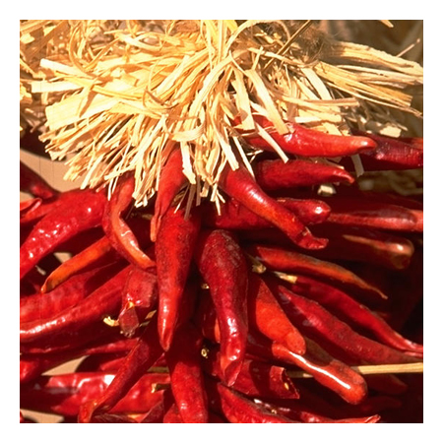


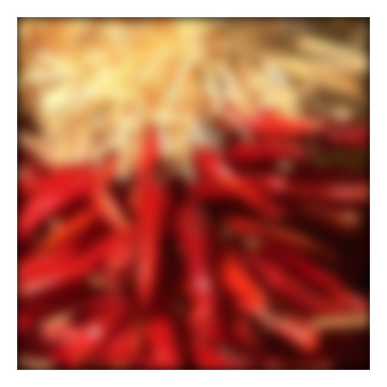


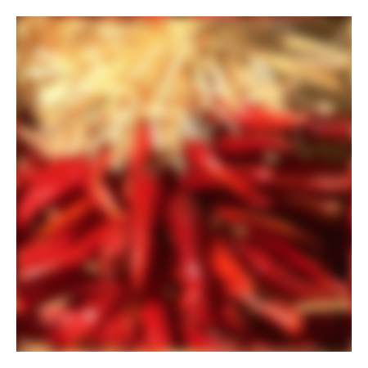






Dealing with edges
What about missing pixel values?
the filter window falls off the edge of the image
need to extrapolate
methods:
clip filter (black)
wrap around
copy edge
reflect across edge
Source: S. Marschner

Slide 9
Dealing with edges
What about missing pixel values?
the filter window falls off the edge of the image
need to extrapolate
methods (MATLAB):
clip filter (black): imfilter(f, g, 0)
wrap around: imfilter(f, g, ‘circular’)
copy edge: imfilter(f, g, ‘replicate’)
reflect across edge: imfilter(f, g, ‘symmetric’)
Source: S. Marschner

Slide 10
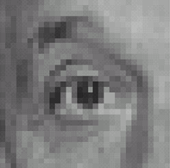
Practice with linear filters
0
0
0
?
0
1
0
0
0
0
Original
Source: D. Lowe

Slide 11
Practice with linear filters
0
0
0
0
1
0
0
0
0
Original
Filtered
(no change)
Source: D. Lowe

Slide 12
Practice with linear filters
0
0
0
?
0
0
1
0
0
0
Original
Source: D. Lowe

Slide 13
Practice with linear filters
0
0
0
0
0
1
0
0
0
Original
Shifted left
By 1 pixel
Source: D. Lowe

Slide 14
Practice with linear filters
1
1
1
?
1
1
1
1
1
1
Original
Source: D. Lowe

Slide 15
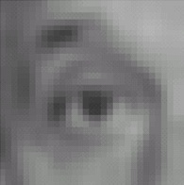
Practice with linear filters
1
1
1
1
1
1
1
1
1
Original
Blur (with a
box filter)
Source: D. Lowe

Slide 16

Practice with linear filters
0
0
0
-
1
1
1
?
0
2
0
1
1
1
0
0
0
1
1
1
(Note that filter sums to 1)
Original
Source: D. Lowe

Slide 17
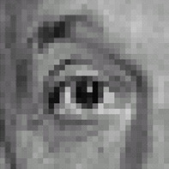
Practice with linear filters
0
0
0
-
1
1
1
0
2
0
1
1
1
0
0
0
1
1
1
Original
Sharpening filter
Accentuates differences with local average
Source: D. Lowe

Slide 18
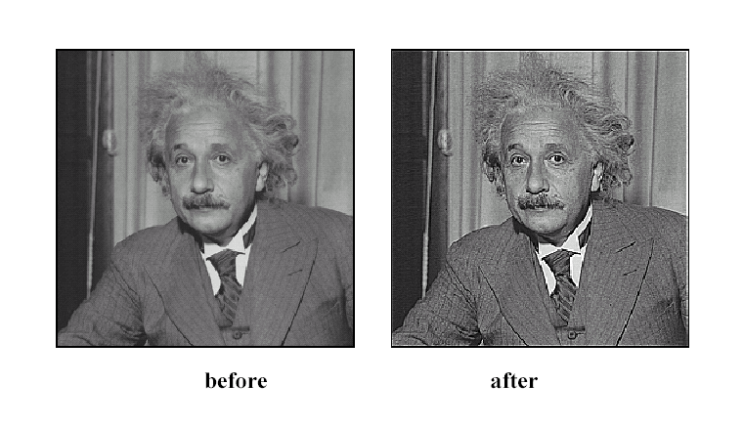
Sharpening
Source: D. Lowe

Slide 19

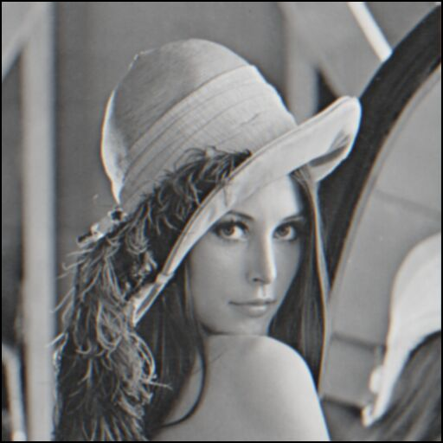
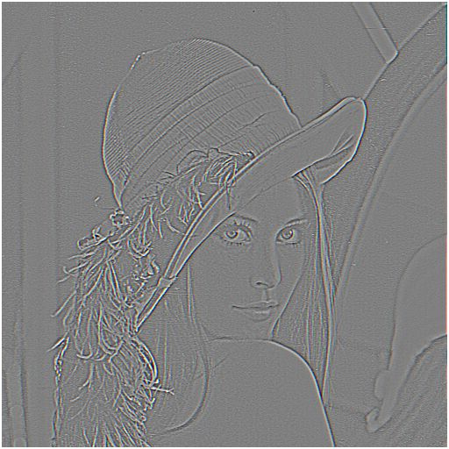

Sharpening
What does blurring take away?
–
=
original
smoothed (5x5)
detail
Let’s add it back:
+
=
original
detail
sharpened

Slide 20

Smoothing with box filter revisited
What’s wrong with this picture?
What’s the solution?
Source: D. Forsyth

Slide 21
Smoothing with box filter revisited
What’s wrong with this picture?
What’s the solution?
To eliminate edge effects, weight contribution of neighborhood pixels according to their closeness to the center
“fuzzy blob”

Slide 22
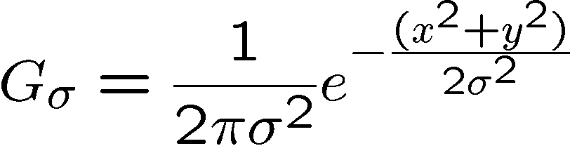
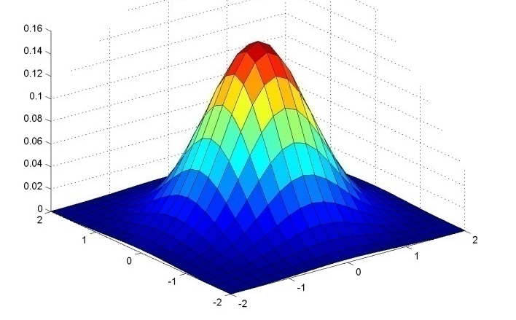
Gaussian Kernel
0.003 0.013 0.022 0.013 0.003
0.013 0.059 0.097 0.059 0.013
0.022 0.097 0.159 0.097 0.022
0.013 0.059 0.097 0.059 0.013
0.003 0.013 0.022 0.013 0.003
5 x 5, σ = 1
Constant factor at front makes volume sum to 1 (can be ignored when computing the filter values, as we should renormalize weights to sum to 1 in any case)
Source: C. Rasmussen

Slide 23
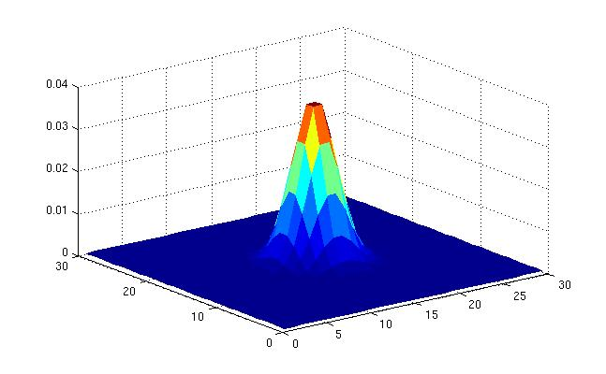
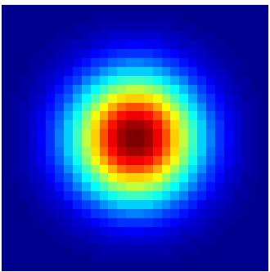
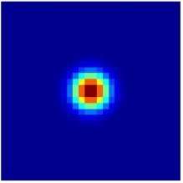
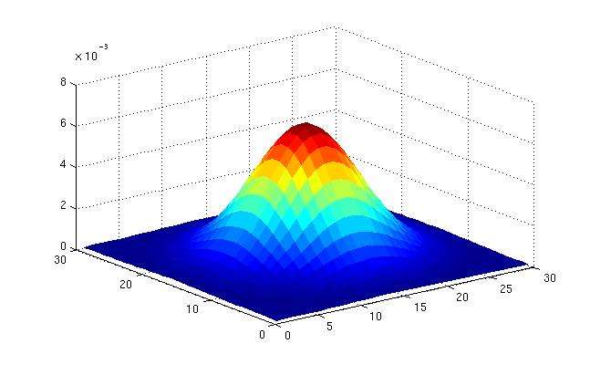
Gaussian Kernel
σ = 2 with 30 x 30 kernel
σ = 5 with 30 x 30 kernel
Standard deviation σ: determines extent of smoothing
Source: K. Grauman

Slide 24
Choosing kernel width
The Gaussian function has infinite support, but discrete filters use finite kernels
Source: K. Grauman

Slide 25
Choosing kernel width
Rule of thumb: set filter half-width to about 3σ

Slide 26
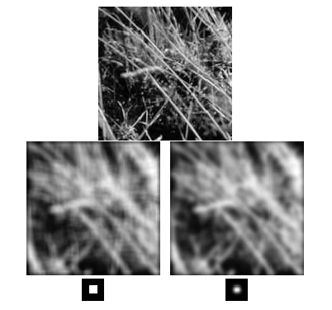
Gaussian vs. box filtering

Slide 27
Gaussian filters
Remove high-frequency components from the image (low-pass filter)
Convolution with self is another Gaussian
So can smooth with small-σ kernel, repeat, and get same result as larger-σ kernel would have
Convolving two times with Gaussian kernel with std. dev. σ is same as convolving once with kernel with std. dev.
Separable kernel
Factors into product of two 1D Gaussians
Discrete example:
Source: K. Grauman
Notes:
Linear vs. quadratic in mask size

Slide 28
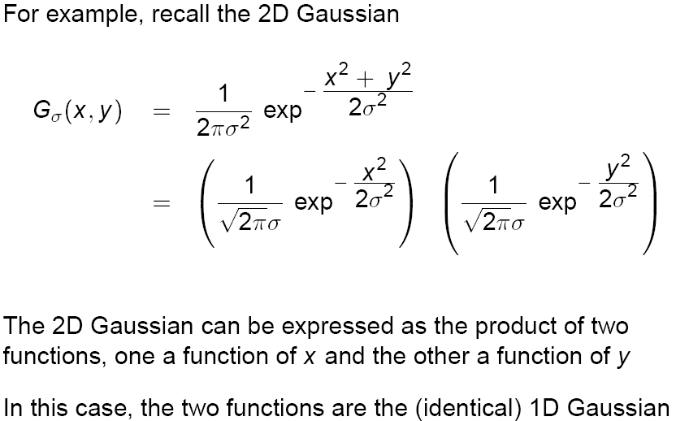
Separability of the Gaussian filter
Source: D. Lowe

Slide 29
Why is separability useful?
Separability means that a 2D convolution can be reduced to two 1D convolutions (one among rows and one among columns)
What is the complexity of filtering an n×n image with an m×m kernel?
O(n² m²)
What if the kernel is separable?
O(n² m)

Slide 30
Noise
Salt and pepper noise: contains random occurrences of black and white pixels
Impulse noise: contains random occurrences of white pixels
Gaussian noise: variations in intensity drawn from a Gaussian normal distribution
Source: S. Seitz
Notes:
Salt and pepper and impulse noise can be due to transmission errors (e.g., from deep space probe), dead CCD pixels, specks on lens

Slide 31
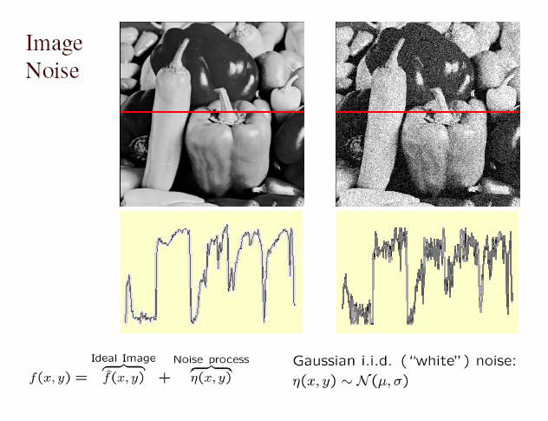
Gaussian noise
Mathematical model: sum of many independent factors
Good for small standard deviations
Assumption: independent, zero-mean noise
Source: M. Hebert

Slide 32
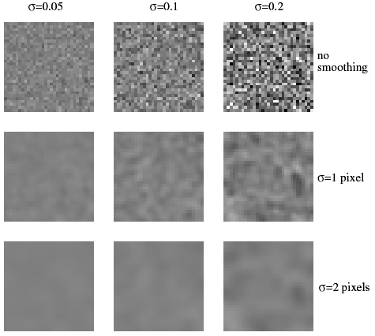
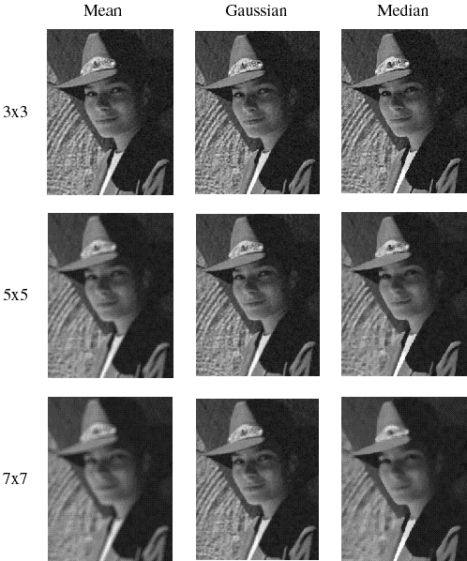
Reducing Gaussian noise
Smoothing with larger standard deviations suppresses noise, but also blurs the image

Slide 33
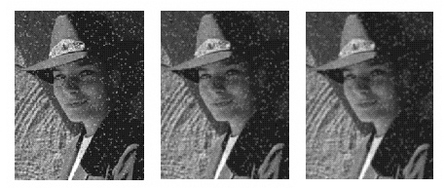
Reducing salt-and-pepper noise
3x3
5x5
7x7
What’s wrong with the results?

Slide 34
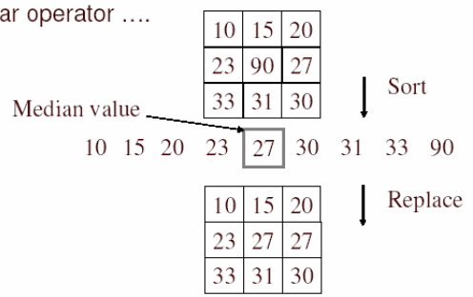
Alternative idea: Median filtering
A median filter operates over a window by selecting the median intensity in the window
Is median filtering linear?
Source: K. Grauman
Notes:
Linearity of median filter: try filter([0 0 0; 0 1 0; 0 0 0] + [1 1 1; 1 1 2; 2 2 2])

Slide 35
Median filter
Is median filtering linear?
Let’s try filtering

Slide 36
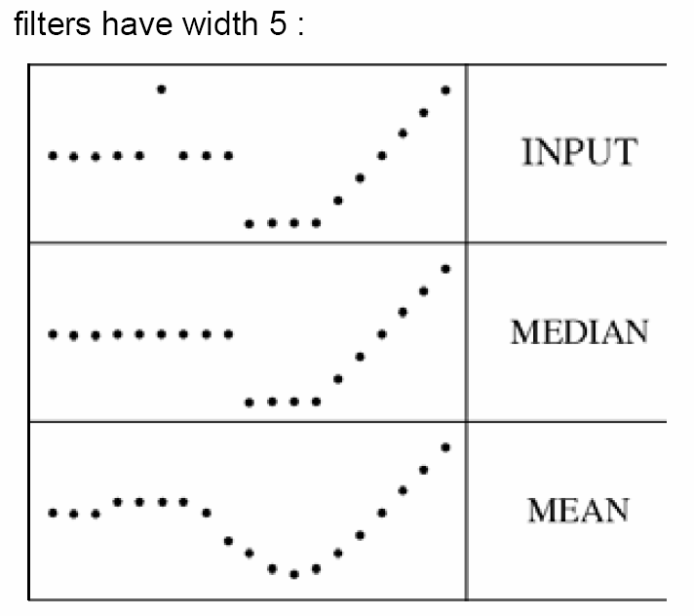
Median filter
What advantage does median filtering have over Gaussian filtering?
Robustness to outliers
Source: K. Grauman

Slide 37
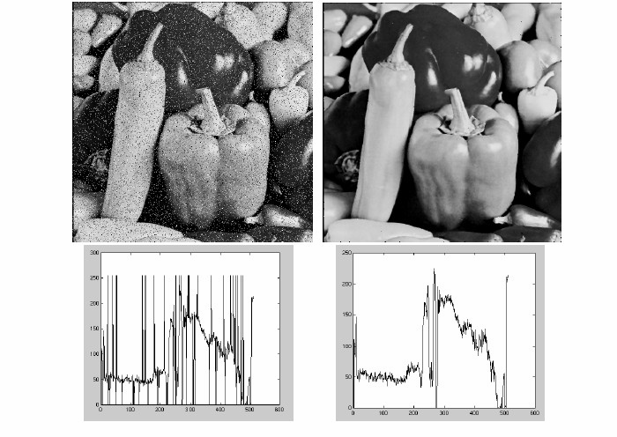
Median filter
Salt-and-pepper noise
Median filtered
MATLAB: medfilt2(image, [h w])
Source: M. Hebert

Slide 38
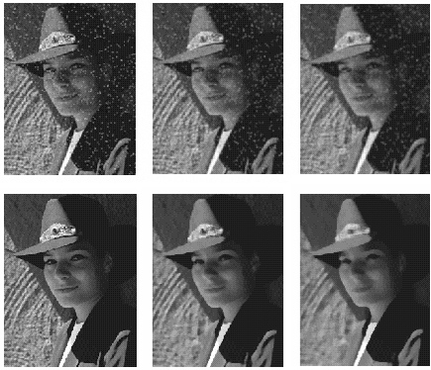
Gaussian vs. median filtering
3x3
5x5
7x7
Gaussian
Median

Slide 39
Review: Image filtering
Convolution
Image smoothing
Gaussian filter
Nonlinear filtering

