Slide 1
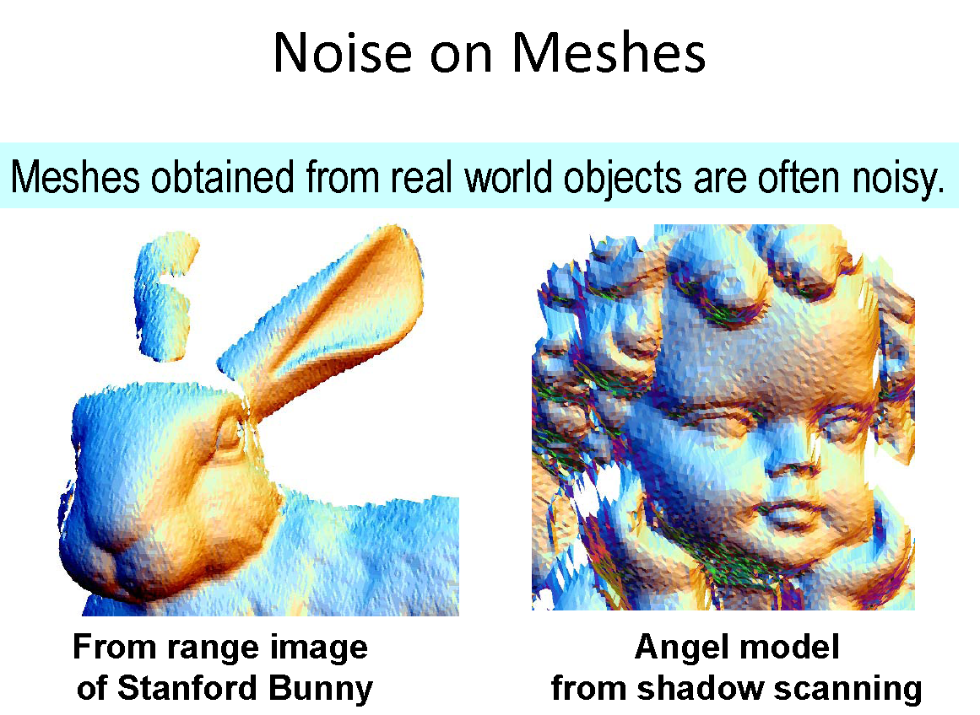
Mesh Smoothing/Denoising
Notes:
Why do we need to do mesh smoothing/denoising.
The main reason is that the meshes obtained from the real world are often noisy.
For instance, triangle meshes are produced from optically scanned point clouds.
Scanning is measurement, and any measurement is subject to noise.
Here we show two noisy meshes, the left one is from the range image of Stanford Bunny,
And the right one is the angel model from shadow scanning.
Both the two meshes are scanned, and their surface are not smooth enough due to noises.
Apart from detracting from the visual quality of the model, noise can also be a problem for other
geometric algorithms.

Slide 2
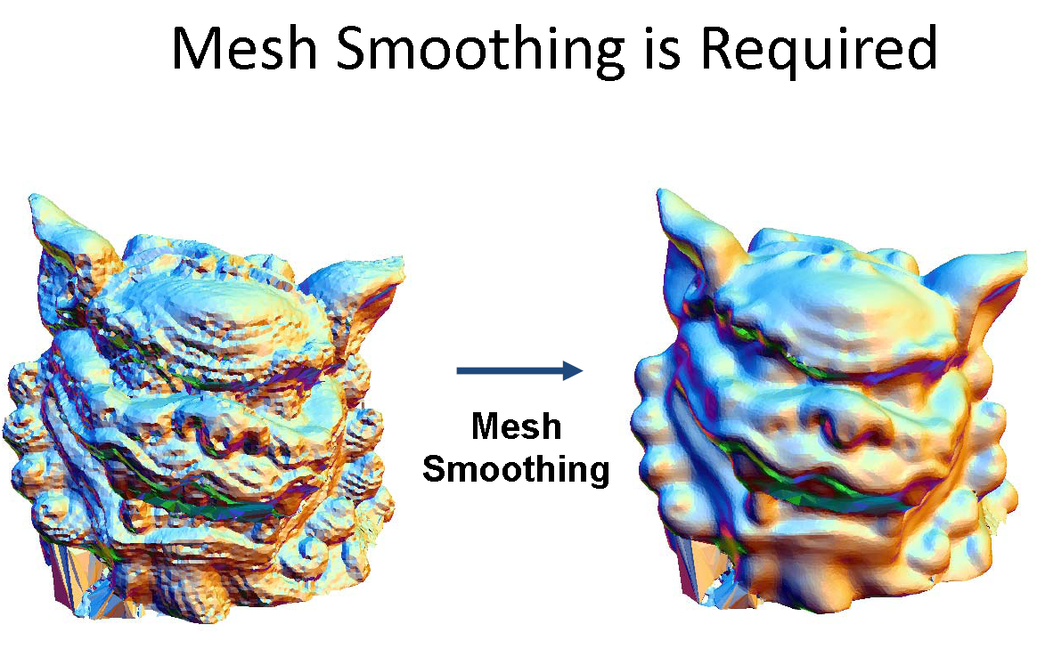
Mesh Smoothing/Denoising
Notes:
Therefore, removing noise from the “signal” in a triangle mesh is an important concern.
We can view the vertex positions of a triangle mesh as a discrete signal on an irregular grid.
The left figure shows the input mesh, and the right figure shows the output mesh after mesh smoothing.
It’s evident that output mesh is more smooth than the input.

Slide 3
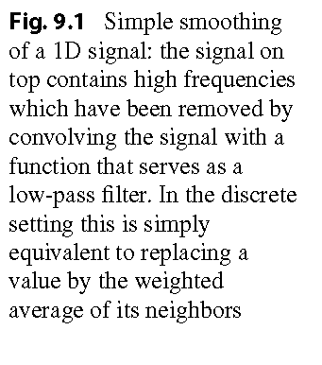
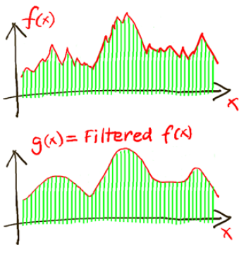
1D Signal Smoothing/Denoising
Notes:
Before introducing mesh smoothing in details, we firstly study a simple case, the 1D signal smoothing.
The signal or the curve on top contains high frequencies which have been removed by convolving the signal with a function that serves as a low-pass filter.
In the discrete setting, this is simply equivalent to replacing a value by the weighted average of its neighbors.

Slide 4
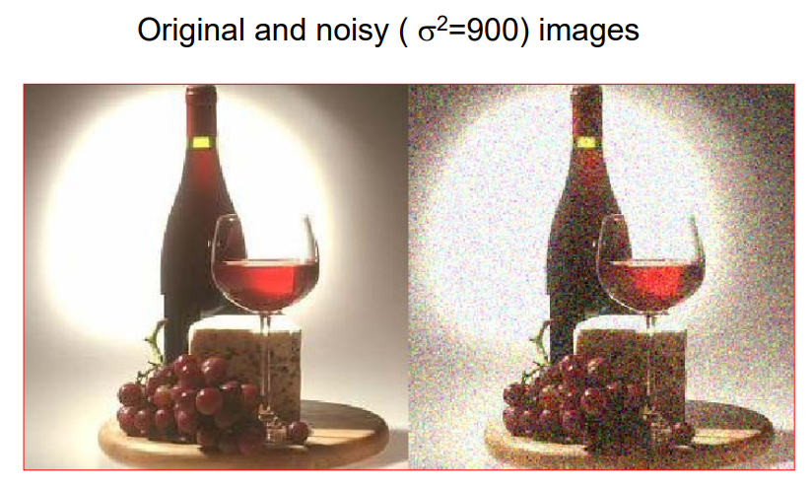
Image Smoothing/Denoising
Notes:
Now we extend the 1D signal to 2D image.
The left figure shows the original image, and the right show the noisy image which is generated by adding Gaussian noises to the original image.

Slide 5
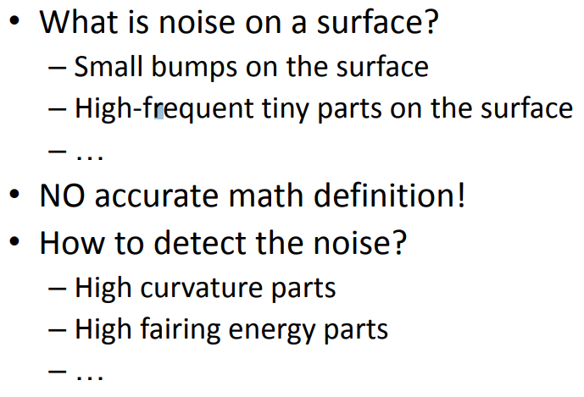
Mesh Smoothing
Notes:
Now we arrive at the mesh smoothing. It could be viewed as a 3d signal denoising.
The first question is what’s the noise on a surface or a mesh?
They the small bumps on the surface, or the high-frequent tiny parts on the surface and so on.
I have already uploaded a noisy mesh in Assignment 4. And you can observe the noisy mesh in the MeshLab software.
In fact, there is no accurate math definition the noise in a mesh.
The second question is how to detect the noise?
We can detect noise by finding the high curvature parts and the high fairing energy parts.

Slide 6
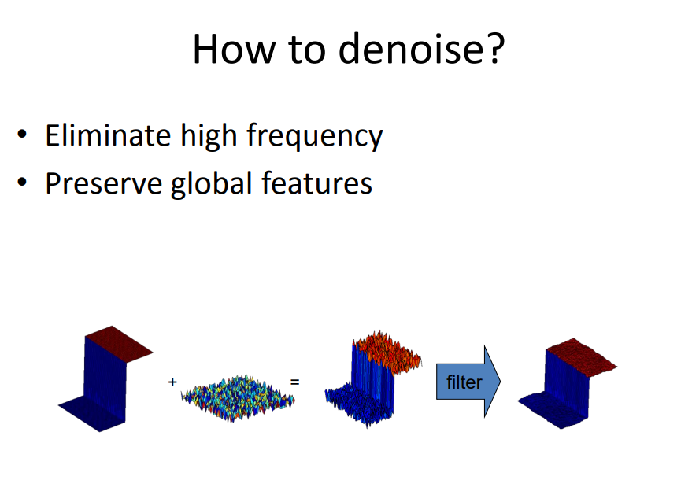
Notes:
The third question is how to denoise? The main task of mesh smoothing or mesh denoising.
We should eliminate the high frequency noise and preserve the global features simultaneously.
The noisy mesh is the combination of the shape with global features (three segments) and the high frequency noises.
After denoising or filtering, only global features are preserved and the high frequency noises are removed.

Slide 7
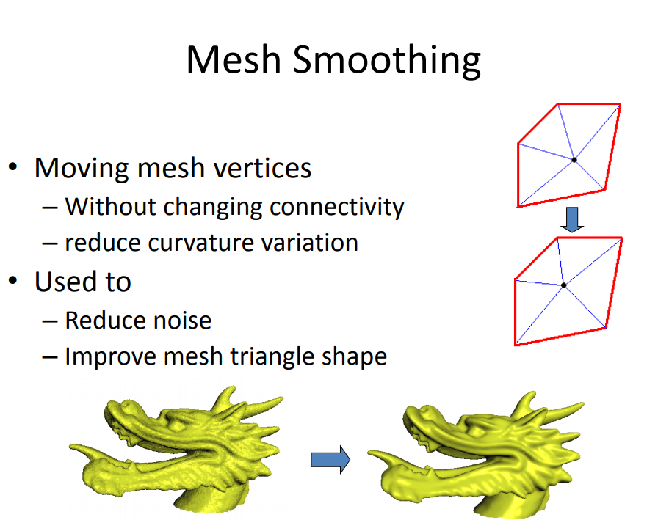
Notes:
In the process of mesh smoothing, we move the vertices without changing the connectivity and reduce the curvature variation.
For example, in this figure, we move the blue point from one position to another position and the topology is not changed.
Mesh smoothing can be used to reduce noise and improve mesh triangle shape.

Slide 8
Laplacian Mesh Smoothing
Notes:
In the process of mesh smoothing, we move the vertices without changing the connectivity and reduce the curvature variation.
For example, in this figure, we move the blue point from one position to another position and the topology is not changed.
Mesh smoothing can be used to reduce noise and improve mesh triangle shape.

Slide 9
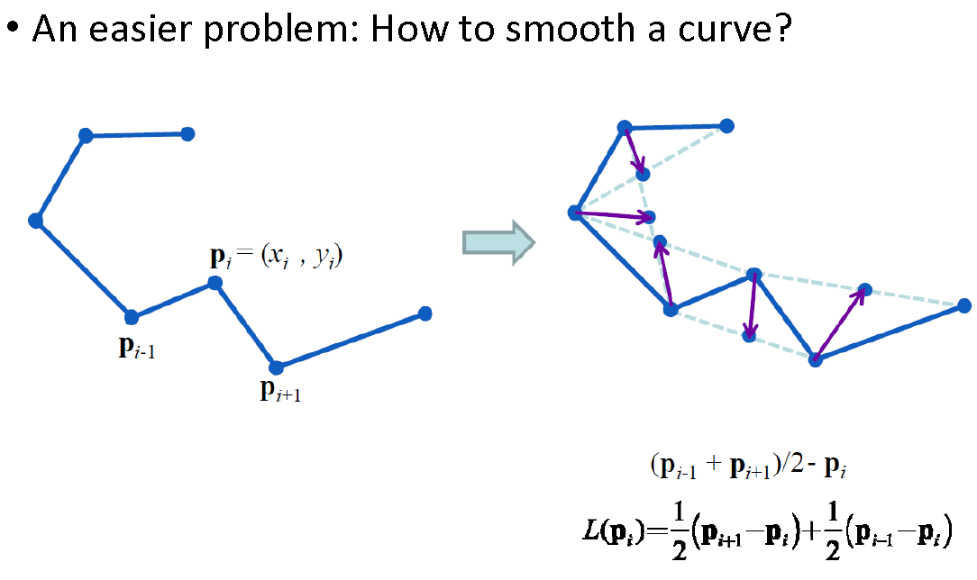
Laplacian Smoothing
Notes:
We introduce a basic and important mesh smoothing algorithm: laplacian [lɑ:'plɑ:siən] mesh smoothing.
Before presenting the process of laplacian mesh smoothing, we firstly show how to smooth a curve using laplacian smoothing.
Suppose that there is a curve with 7 points. We uses pi to denote a point in the curve, and pi-1 and pi+1 to denote the two neighbors of pi.
The point pi has two coordinates, xi and yi.
How to smooth the curve?
A simple but effective method is to move each point to the midpoint of its two neighbors. The midpoint is calculated by adding pi-1 with pi+1 and divide it by 2.
Comparing each new point with its corresponding old point, we can find a vector described by this formulation.
We can rewrite the formulation as L(p_i),
We use the arrow to represent the vector.

Slide 10
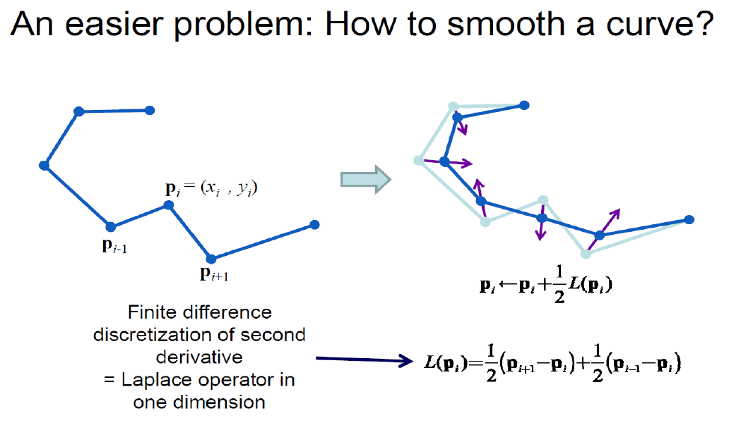
Laplacian Smoothing
Notes:
We have presented the definition of L(pi).
Now we don’t move each point to the mid-point of its two neighbors,
But move each point in the direction of L(pi) with only half distance.
We use this formulation to represent such process. The new position of pi is calculated by adding the original position of pi with half the L(pi).
The definition of L(pi) is the same with the previous slide.
We call L(pi) in this formulation as the finite difference discretization of second derivative, or the Laplace operator in one dimension.

Slide 11
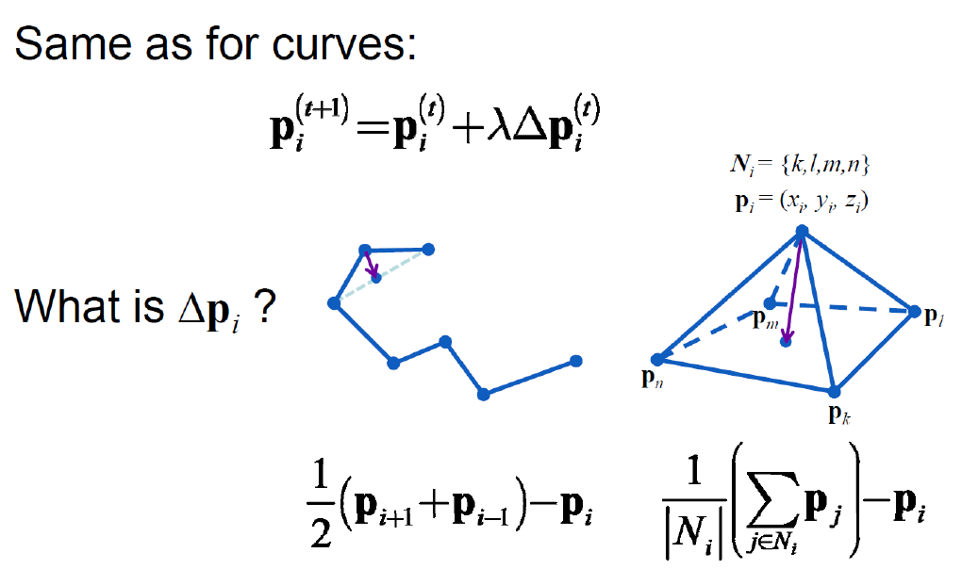
Laplacian Smoothing
Notes:
Hence, in the laplacian smoothing of 1D curve, we update the position of each point by adding it with the product of lambda and epsilon pi in each iteration.
Lambda is a weight, t denotes the current iteration, and t+1 denotes the next iteration. Laplacian smoothing is a iterative process, which repeats the updating of vertex position using this formulation until convergence.
What’s the epsilon pi? What does the mathematical symbol epsilon mean? Epsilon represent the second derivative operator for vector. Do you remember it?
You have learned the first and second derivative operator in your Calculus course. Right?
And the second derivative of pi is actually the L(pi). The derivation of discrete signal is actually the subtraction between the neighbors. Right?
Now we extend laplacian smoothing from 1D signal to 3D mesh.
Similarly, to construct the Laplace operator L(pi), we calculate the subtraction between pi and the average of pi’s neighbors.

Slide 12
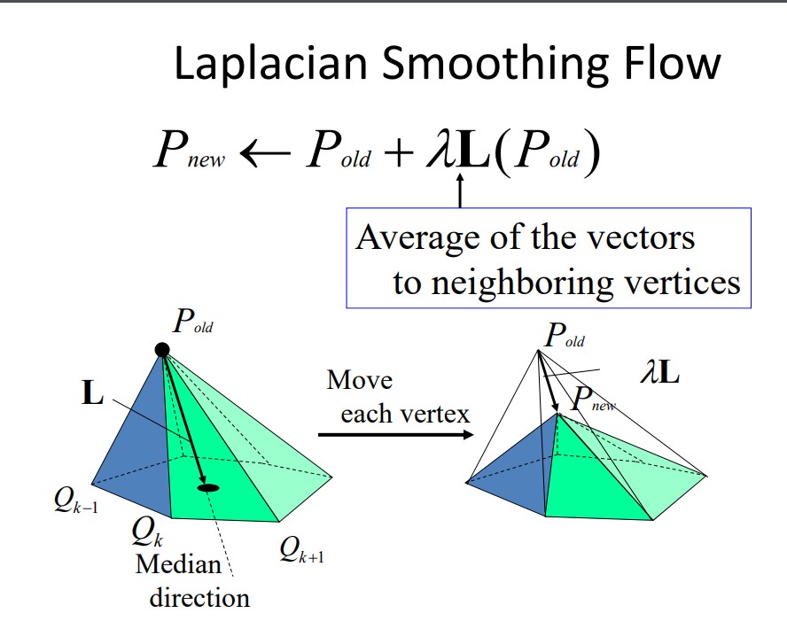
Notes:
In the laplacian mesh smoothing, we update the position of each point by adding it with the product of lambda and the Laplace operator in P_old.
The L operator is indeed the average of the vectors to neighboring vertices.
In each iteration, we move the vertex to the new position using this formulation.
The direction of L is also the median direction.

Slide 13
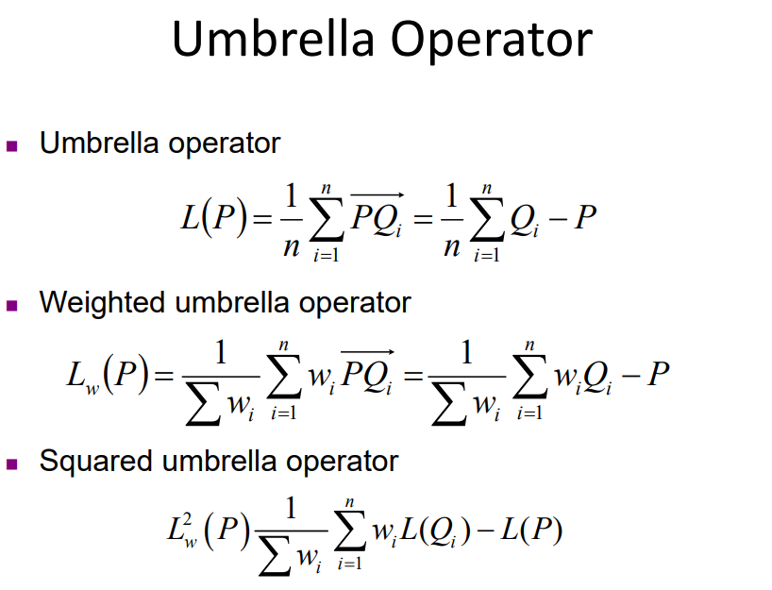
Notes:
We have introduced the basic formulation of L(p), which is also called the umbrella operator since the L operator looks like a umbrella.
The weighted umbrella operator and squared umbrella operator are the two variations of umbrella operator.

Slide 14
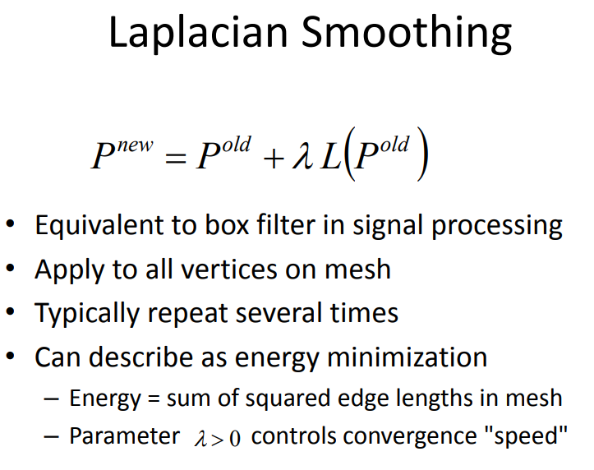
Notes:
The updating of a vertex by adding it with its Laplace operator is very similar to the box filter in signal processing,
as only the old vertex and the neighbors of the old vertex determines the new position.
The vertex updating using this formulation is applied to all vertices on the mesh, and is typically repeated several times until convergence.
The laplacian smoothing can be also described as energy minimization
where the energy equals the sum of the squared edge lengths in mesh, and the parameter lambda controls convergence speed.

