Slide 1
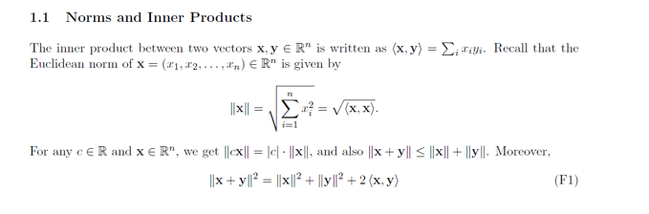
Gradient Descent

Slide 2
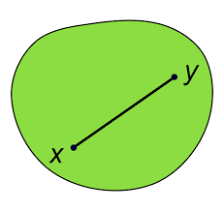
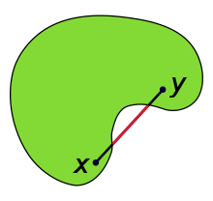
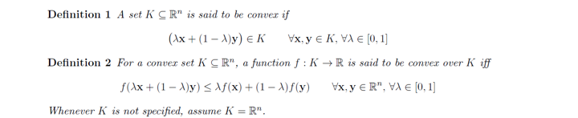
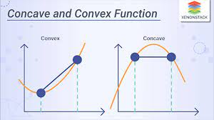
Convexity

Slide 3
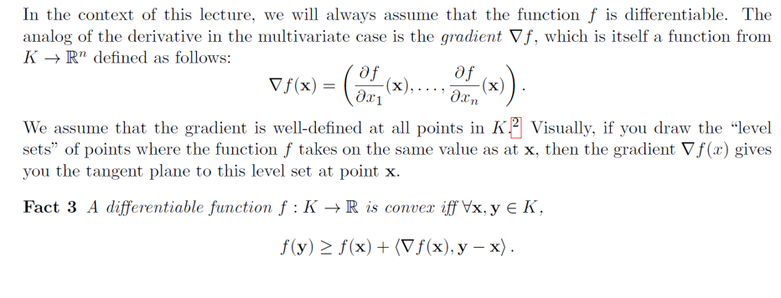
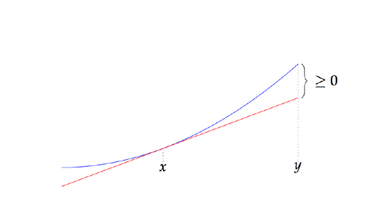
Gradients

Slide 4
Minimizing a Function
To minimize a function, set its gradient to equal 0
Finds global minimum if f is a convex function
For non-convex function, still often finds a good solution, i.e., a local minimum
Gradient is a very complicated expression, can’t solve by setting to 0
Instead, update iteratively. This is called gradient descent

Slide 5
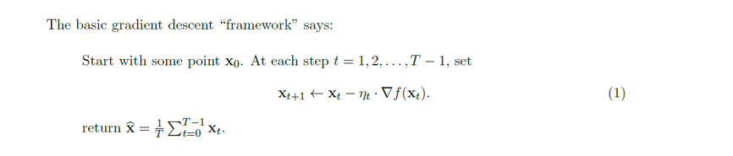
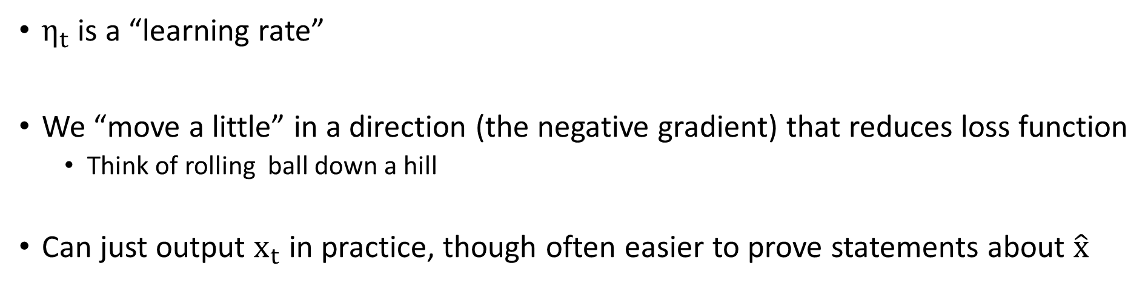
Gradient Descent
$η_{t}$ is a “learning rate”
We “move a little” in a direction (the negative gradient) that reduces loss function
Think of rolling ball down a hill
Can just output $x_{t}$ in practice, though often easier to prove statements about $\hat{x}$

Slide 6
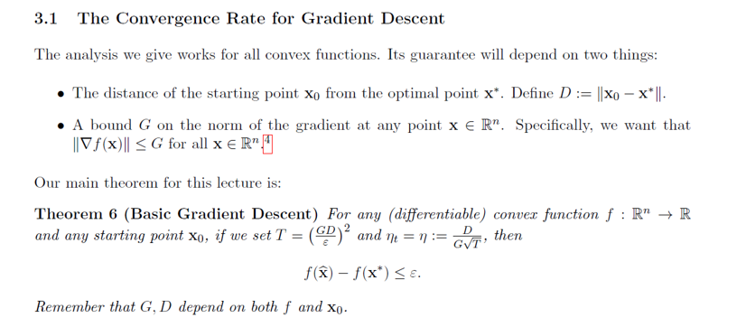
Gradient Descent Convergence

Slide 7
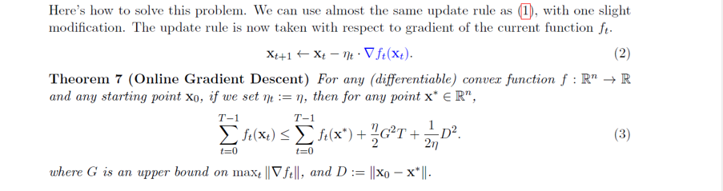
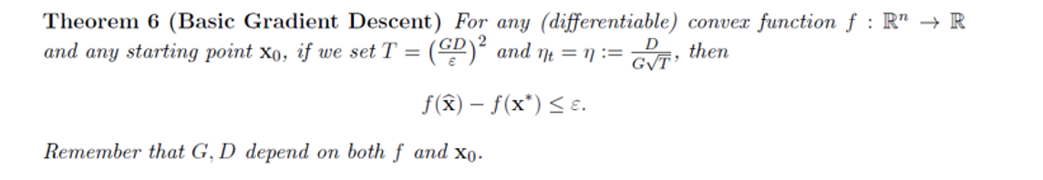

A Stronger Statement – Online Gradient Descent
Suppose we even allow the function $f_{t}$ to change at each time step

Slide 8
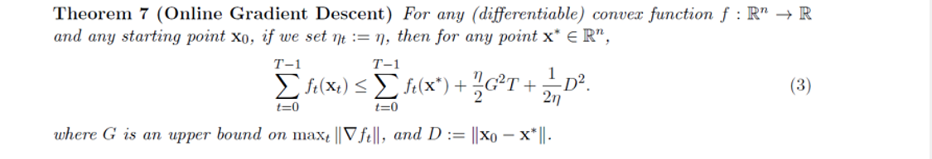
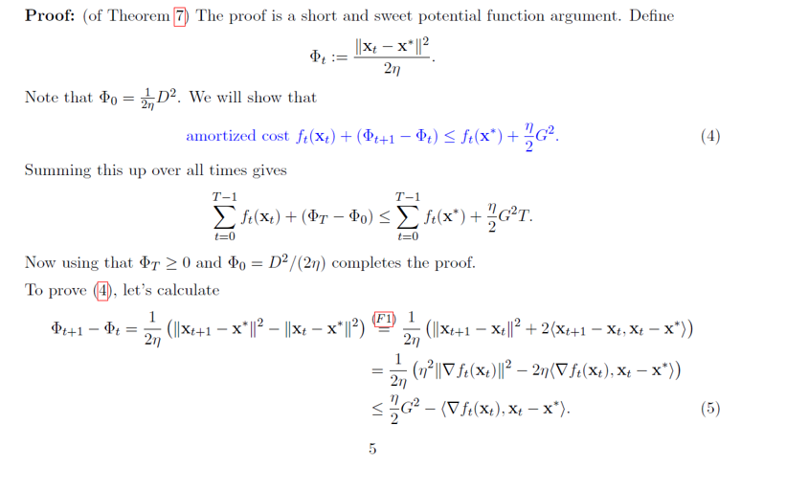

Slide 9
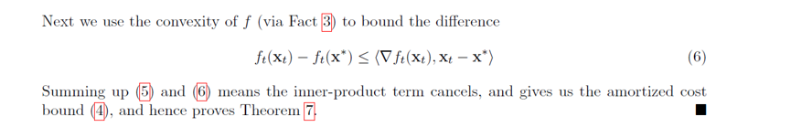

Slide 10
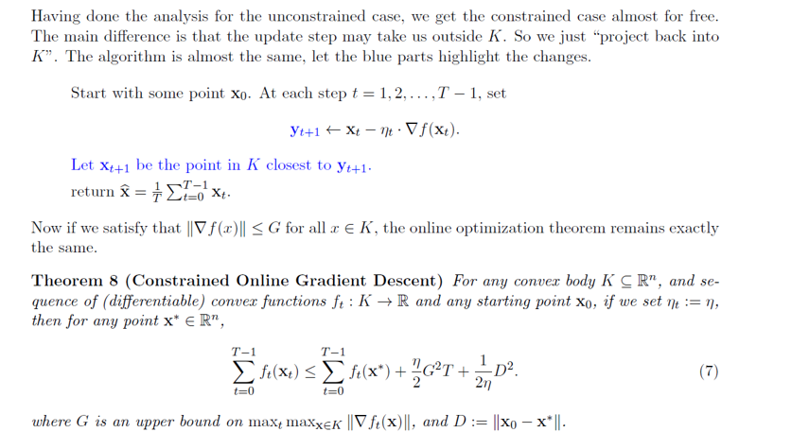
Constrained Minimization

Slide 11
