Slide 1


Slide 1
Loan Application Assessment
A Machine Learning Business Proposal
by William Andrian

Slide 2


Slide 6
Introduction
Loans are a way for people to gather capital and finance their current need or goals. Banks and other financial institutions act as lenders and lend out money in a certain amount of time with interest.
To acquire a loan, an applicant’s loan application must be assessed and approved by the lender. A usual key metric is the credit score, which is a credit track record of an individual.
Unfortunately, some individuals lack the credit histories to accumulate credit score, especially unbanked people. Which makes lenders reluctant to approve their loan application. This dataset here aims to represent those people to give a fair assessment and extend financial inclusion to them
2

Slide 3
Slide 6
MARKET ANALYSIS
Trust
Rejection
Defaulting
Rejected loan applications could make individuals “scarred” and less likely to try again
Cowling, M., Liu, W. & Calabrese, R. Has previous loan rejection scarred firms from applying for loans during Covid-19?. Small Bus Econ 59, 1327–1350 (2022). https://doi.org/10.1007/s11187-021-00586-2
A defaulted individual could get deterred into loaning again in the future. Lenders could also accumulate losses and lose trust
A key factor in the financial industry
UNBANKED PERCENTAGE
Indonesia has 97.74 million or 48% of the country’s adult population being unbanked
source:
https://digitalfinance.worldbank.org/country/indonesia#
48%
3

Slide 4
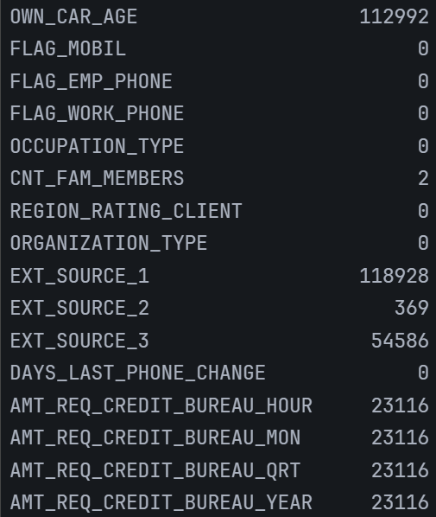
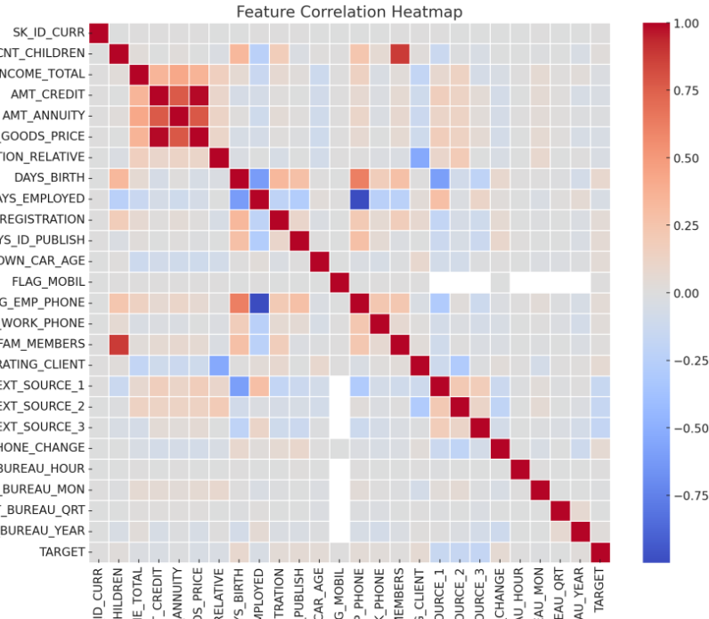
Slide 4
DATA ANALYSIS
Default
Rate
8.07%
Missing
Entries
Low Correlation with Target
We have an extremely imbalanced dataset with the Default class only comprising 8.07% of the total applications
Lots of missing values are present in the dataset. Various techniques will need to be implemented
No obvious correlation can be drawn to the target variable. Complex relationships need to be discovered
4

Slide 5

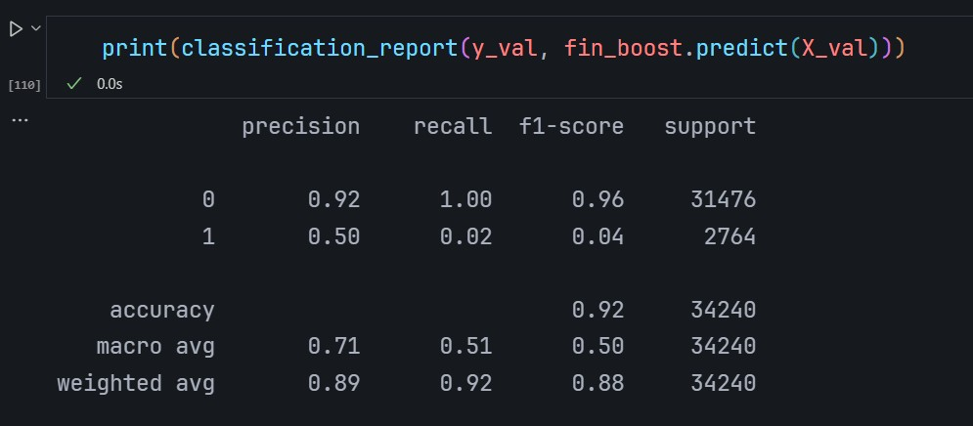
Slide 6
PROBLEM STATEMENT
This is a severely imbalanced problem where both classes are equally important to us, because denying an application would lose the company customers and approving a likely-to-default application would also lose customers and external trust. So choosing a metric to evaluate our model would be important.
In order to meet those requirements, I’ve selected PR-AUC and F1 score because they are more sensitive to the minority class. This prevents getting a high score only because the model predicts the majority class. [1]
Example of modelling not sensitive to the minority class. An accuracy of 0.92 seems high but when we remember the majority class was 92%, we can achieve that score by guessing everything as the non-default.
[1] Saito, Takaya, and Marc Rehmsmeier. “The precision-recall plot is more informative than the ROC plot when evaluating binary classifiers on imbalanced datasets.” PloS one vol. 10,3 e0118432. 4 Mar. 2015, doi:10.1371/journal.pone.0118432
5

Slide 6
Slide 6
WHY MACHINE LEARNING?
As found with the Data Analysis, no obvious relations to the target variable can be determined. That means the underlying relationships are complex and not easy to figure out. That makes the perfect case for machine learning, which are great for discovering deep and hidden relationships between variables that are not obvious to the human eye.
Also, the speed and volume a machine learning model is capable to train and test on makes formulating and validating a solution extremely fast compared to slower human based analysis
5

Slide 7
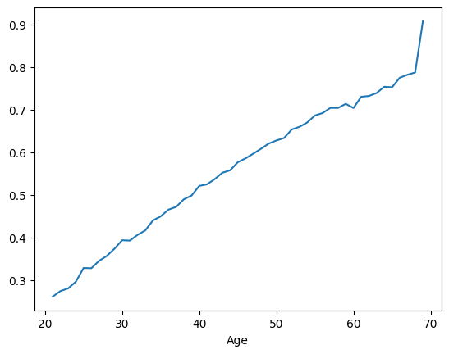
Slide 9
FEATURE ENGINEERING
※EXT_SOURCE
Imputing EXT_SOURCE_1
Imputing EXT_SOURCE_2 & EXT_SOURCE_3
EXT_SOURCE_1 is strongly correlated with age so I’ve imputed them based on average values on age
Since they are not strongly correlated to anything, I imputed them based on their mean
Chart->
RATIOS
Since they’re weakly correlated, ratio features could extract more information
6

Slide 8

Slide 9
FEATURE ENGINEERING
※To Years
Original form
Age
The dataset saves time values as negative days, so we transform it into years by dividing by -365
No troublesome values are encountered so the formula works well
Employed_Years
Some of them are positive, but they almost match the pensioner + unemployed values, so I’ve interpreted them as not employed
7

Slide 9
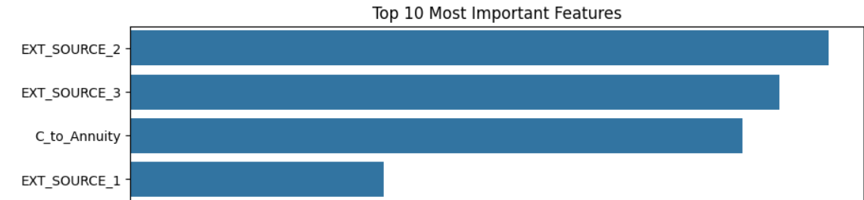
Slide 9
FEATURE ENGINEERING
※Neighboring_Mean
Original Idea
Columns Considered
Get the target mean of the nearest k-rows of a row using nearest neighbors. Considered columns are normalized.
The considered columns are EXT_SOURCE 1 to 3, and Credit to Annuity Ratio since they were found to be important features
Original idea from https://www.kaggle.com/competitions/home-credit-default-risk/discussion/64821
Validation
To validate this method, the preprocessing is “trained” on the train split to ensure no data leakages happen during training and validation
8

Slide 10

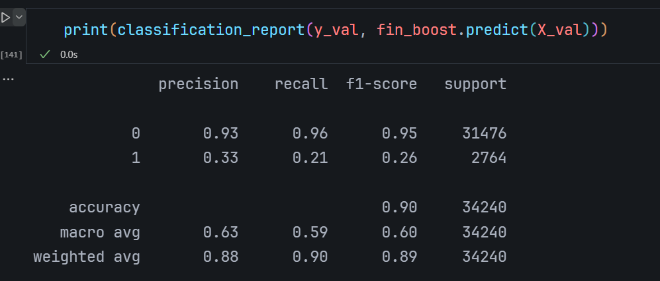
Slide 6
MODELLING
The model first tried out was Catboost and LightGBM since they are both renowned for their performance and speed especially for LightGBM. Both are gradient boosting models which can also reduce overfitting
But after trials, Catboost was the higher performing model and the LightGBM model was dropped
The results were quite well, with me trading off accuracy for a higher F1 macro to more accurately predict the minority class
9

Slide 11
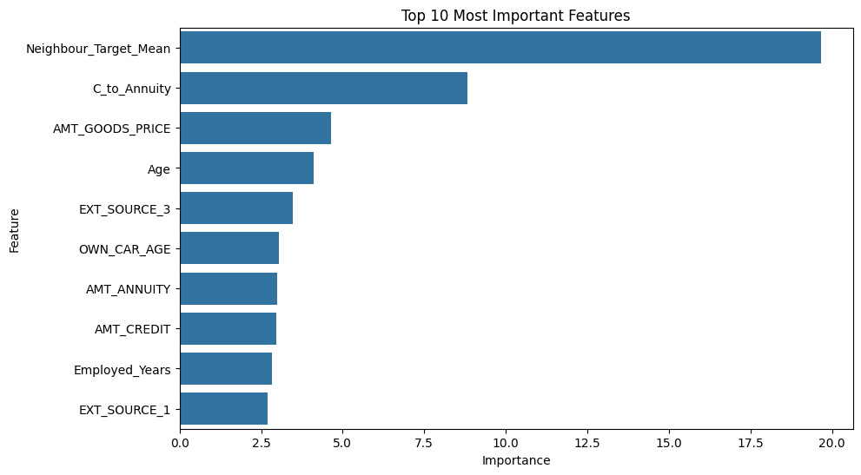
Slide 6
FEATURE IMPORTANCE
10

Slide 12
Slide 6
FEATURE IMPORTANCE
The feature engineering proved to work with the Neighbour_Target_Mean feature discussed before being the most important feature, followed by C_to_Annuity, another ratio feature engineered, AMT_GOODS_PRICE was untouched, Age was derived from the formula, and EXT_SOURCE_3 was imputed. With Neighbour_Target_Mean being calculated by EXT_SOURCEs and normalized C_to_Annuity, I think that if EXT_SOURCEs contain less missing data which I had to impute, the model would have an improvement.
10

Slide 13
Slide 6
BUSINESS PROPOSAL
The model is very performant in predicting, taking less than a second to predict 35,000 rows
Preprocessing 136,000 rows of data for training takes 5 minutes on a single laptop but a parallelized distributed system could speed up the process significantly.
The model could be deployed to an app or website to ensure constant availability anywhere and anytime
Adding these facts to the prediction performance of the model means that using such model could replace the need of human assessment especially for early screenings, and speed up the process since it doesn’t have to wait for a human to assess. This means less waiting time for an application and the applicant can be reached out faster to discuss the results.
11

Slide 14
Slide 6
CONCLUSION
The model trained would likely help a lender company to assess default risks of applicants. This model is the proposed solution to a company since it will give additional assessments besides from human assessors. A model will be faster and readily available than a human so integrating it as an early checker could be beneficial for the company. Also, a suggestion to improve this model is gathering more information especially EXT_SOURCE because they are very important to this model and reducing the number of missing data of those features would improve this model.
12

Slide 15
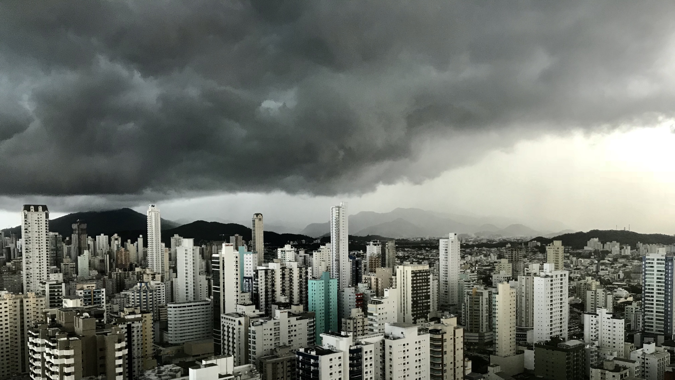
Slide 11
THANK YOU

