Slide 1
Final Project
Presentation
CS-UY 4563 11:00AM
Prof Linda M. Sellie
Claire Huang, Alan Wu

Slide 2
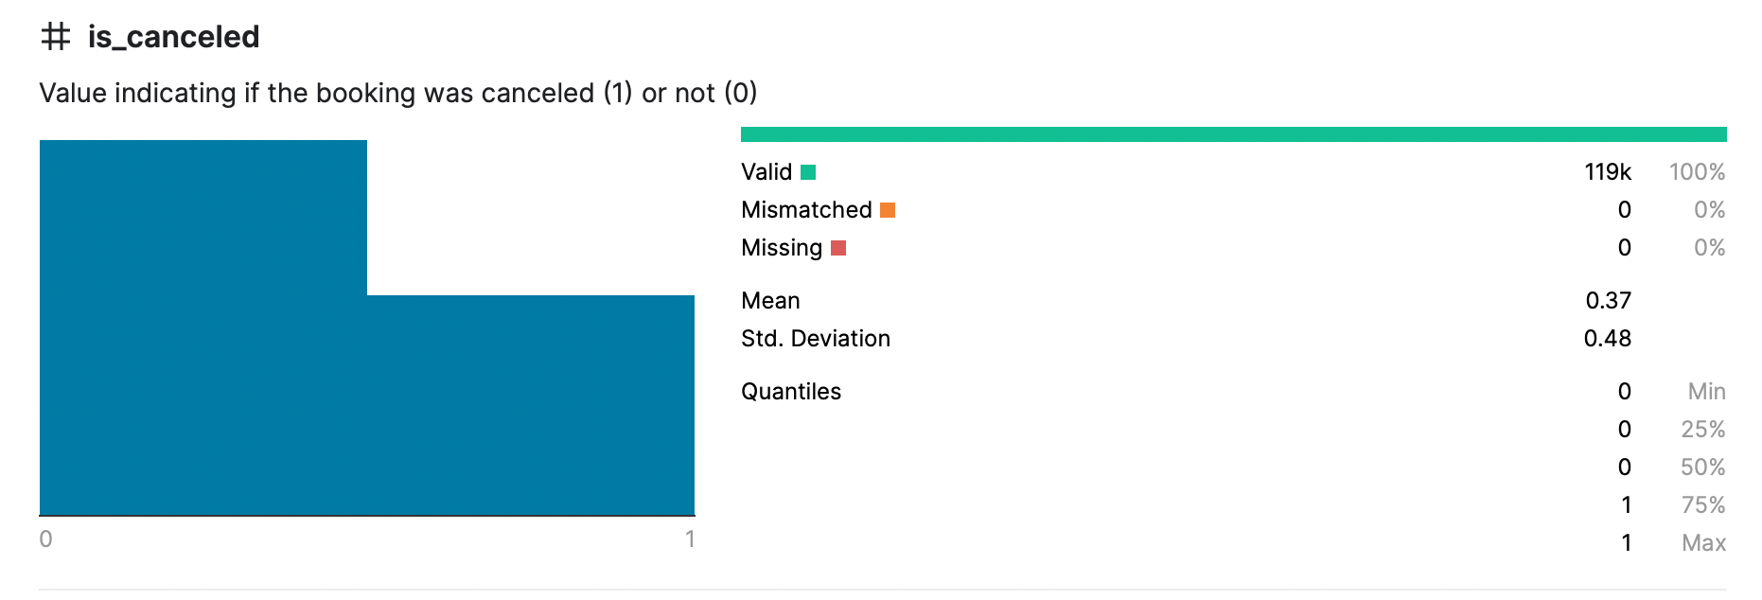
Introduction
We used hotel booking demand data
from the article Hotel Booking Demand Datasets, written by Nuno Antonio, Ana Almeida, and Luis Nunes for Data in Brief, Volume 22, February 2019
Contains 13930 booking information
32 features including the target in the original dataset
Preprocessing
one-hot encoding
did not use the date information
combine some features to a bool type

Slide 3
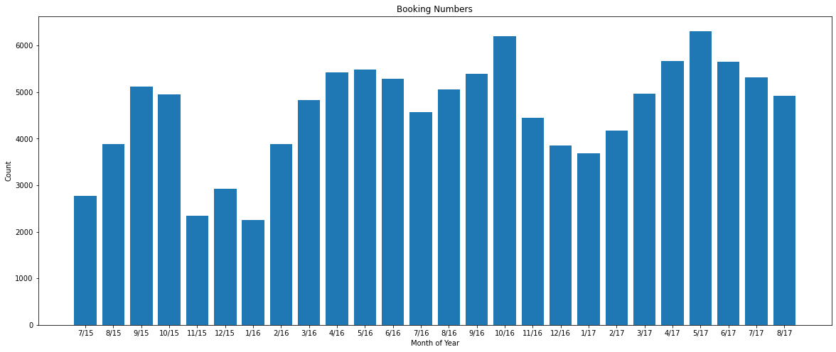
Unsupervised Analysis
Booking Distribution with Respect to Months of Years

Slide 4
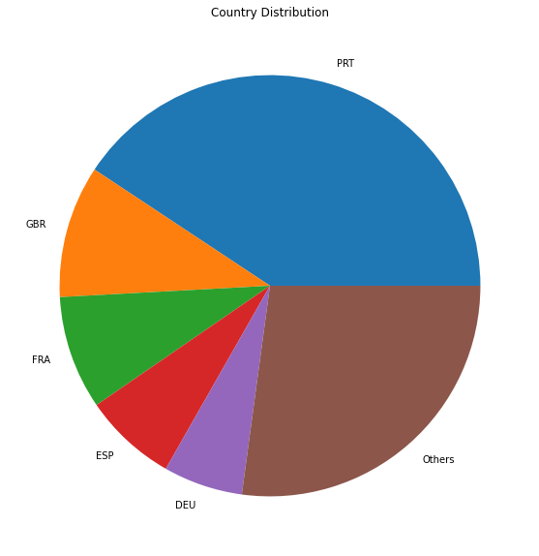
Unsupervised Analysis
Booking Distribution with Respect to Countries

Slide 5
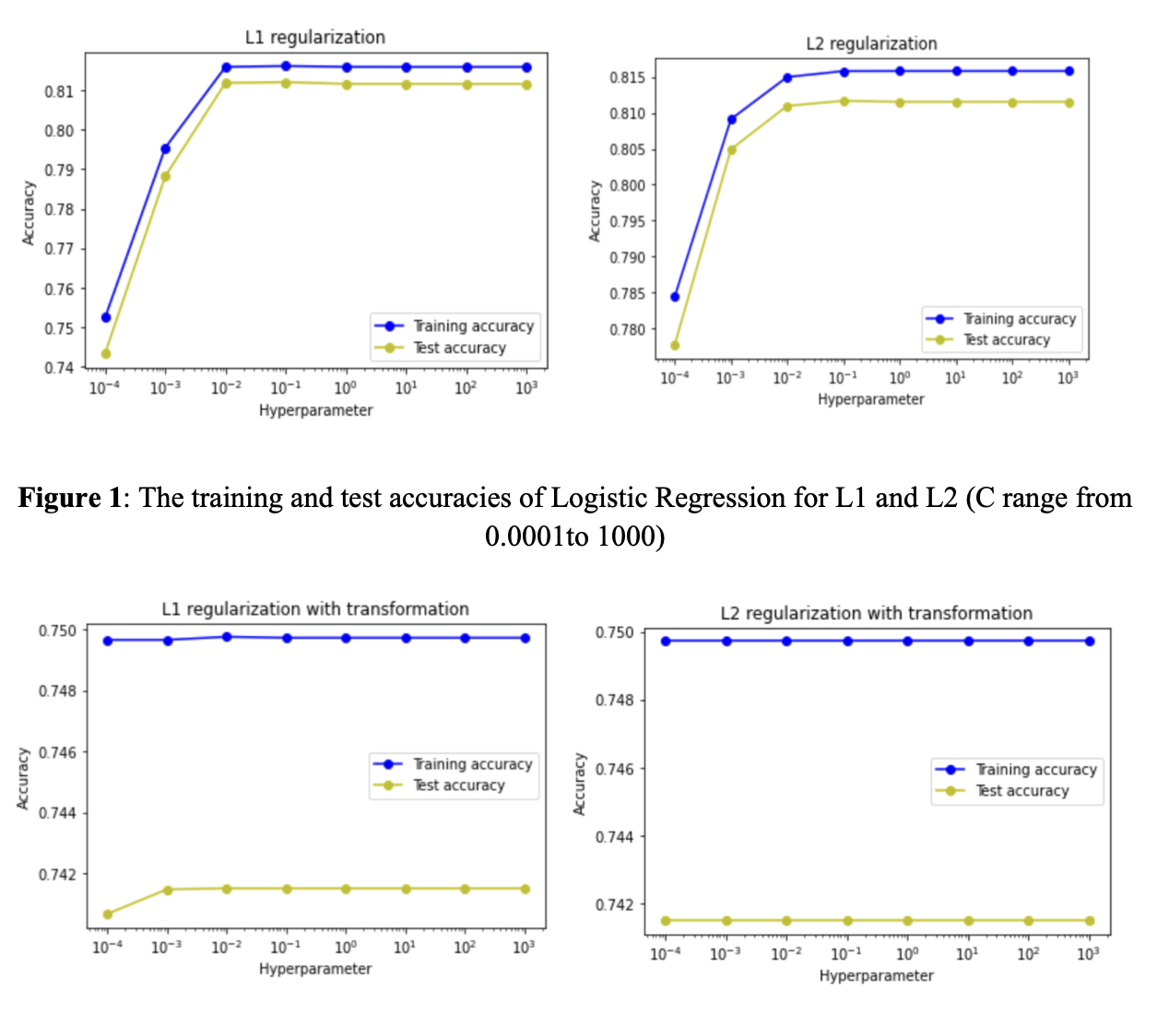
Logistic Regression
L1 lasso regularization and L2 ridge regularization
C-value : [0.0001, 0.001, 0.01, 0.1, 1, 10, 100, 1000]
polynomial feature transformation
No existed problem of overfitting or underfitting
Best accuracy was about 81.1974% which belongs to the L1 lasso regularization with no transformation for a c-value that is equal to 0.1.

Slide 6
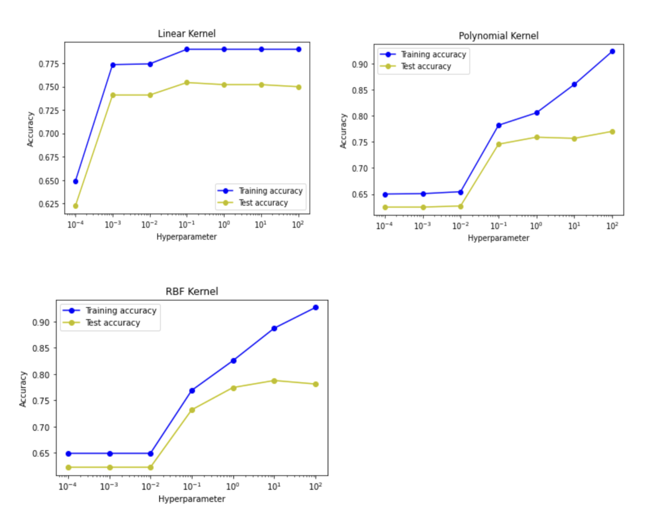
SVM
Linear, polynomial, radial-basis-function kernels
2000 samples
C-values: [0.0001, 0.001, 0.01, 0.1, 1, 10, 100]
Problem of overfitting
the highest test accuracy is 0.787946 for the radial–basis function kernel with the hyperparameter equal to 10

Slide 7
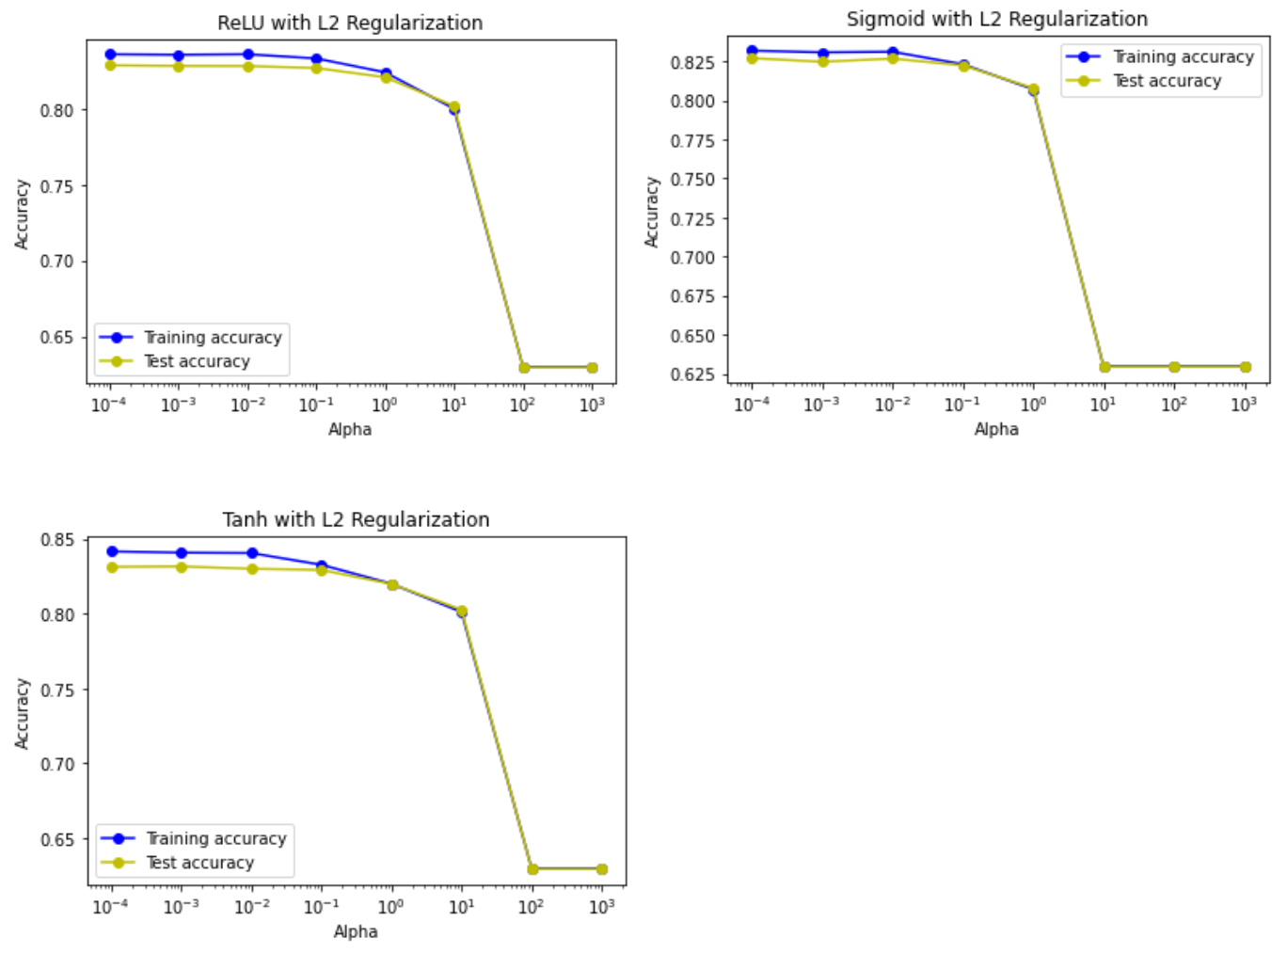
Neural Network
Different activation functions (ReLU, sigmoid, tanh)
40% training, 60% test
Alpha-values: [0.0001, 0.001, 0.01, 0.1, 1, 10, 100, 1000]
Results
Highest test accuracy of 0.831681 with tanh and alpha value 0.001
Good results for alpha in [0.0001, 0.01]
In general, tanh > ReLU > sigmoid

Slide 8
Conclusion
Highest accuracy was 83.1681% with neural network
Possible improvement including larger sample size for training
Overall good fitting and prediction

Slide 9
Work Cited
https://www.kaggle.com/datasets/jessemostipak/hotel-booking-demand?resource=download
https://www.tutorialspoint.com/how-to-label-a-line-in-matplotlib-python
https://scikit-learn.org/stable/modules/svm.html
https://scikit-learn.org/stable/modules/generated/sklearn.model_selection.train_test_split.html
https://scikit-learn.org/stable/modules/generated/sklearn.linear_model.LogisticRegression.html

