Slide 1
Solar Panel Detection
Detecting solar panels from aerial imagery data using convolutional neural networks.
Amandeep Rathee
March 13, 2020.

Slide 2
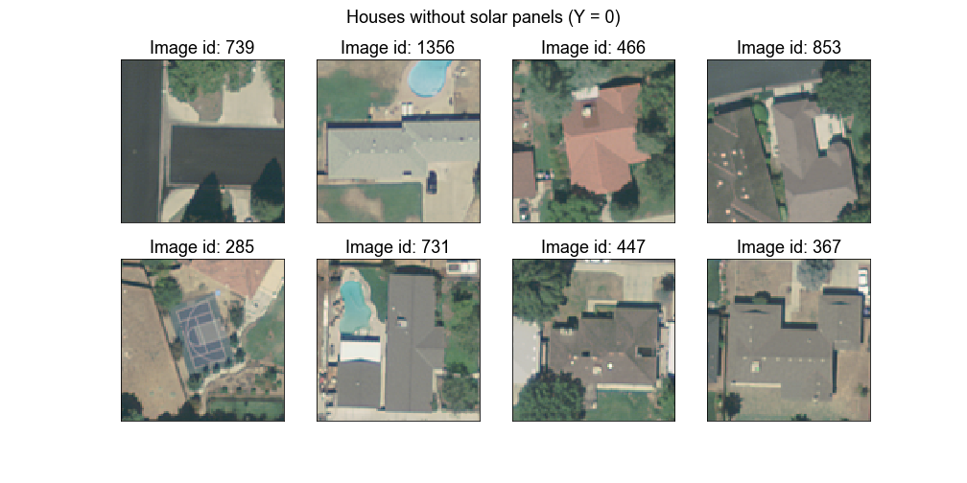
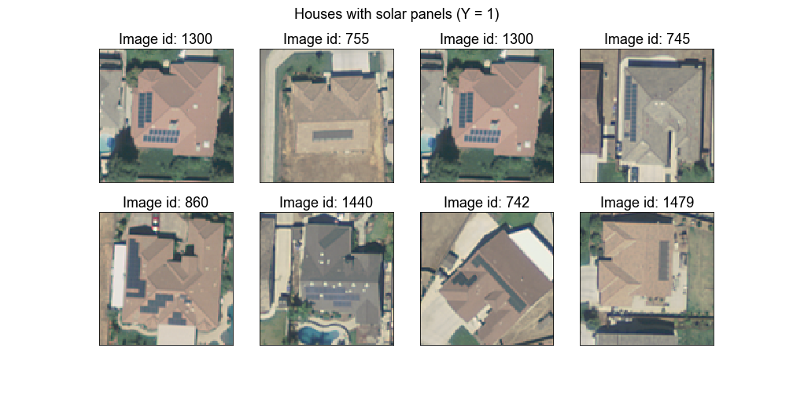
Data
1500 cropped images from aerial satellite photographic data collected in 2013 from Fresno, California. (Malof et al., 2016).
Some class imbalance: only 500 images have solar panels in them.
Sample images:
Figure 1: Sample images from aerial imagery data

Slide 3
Background
Numerous studies for object detection using Histogram of Oriented Gradients (Dalal et al., 2005) approach. A classifier on top of HOG features seem to do well on image detection.
Since 2012, computer vision moved to deep learning when AlexNet (Krizhevsky et al., 2012) won the ImageNet competition.

Slide 4
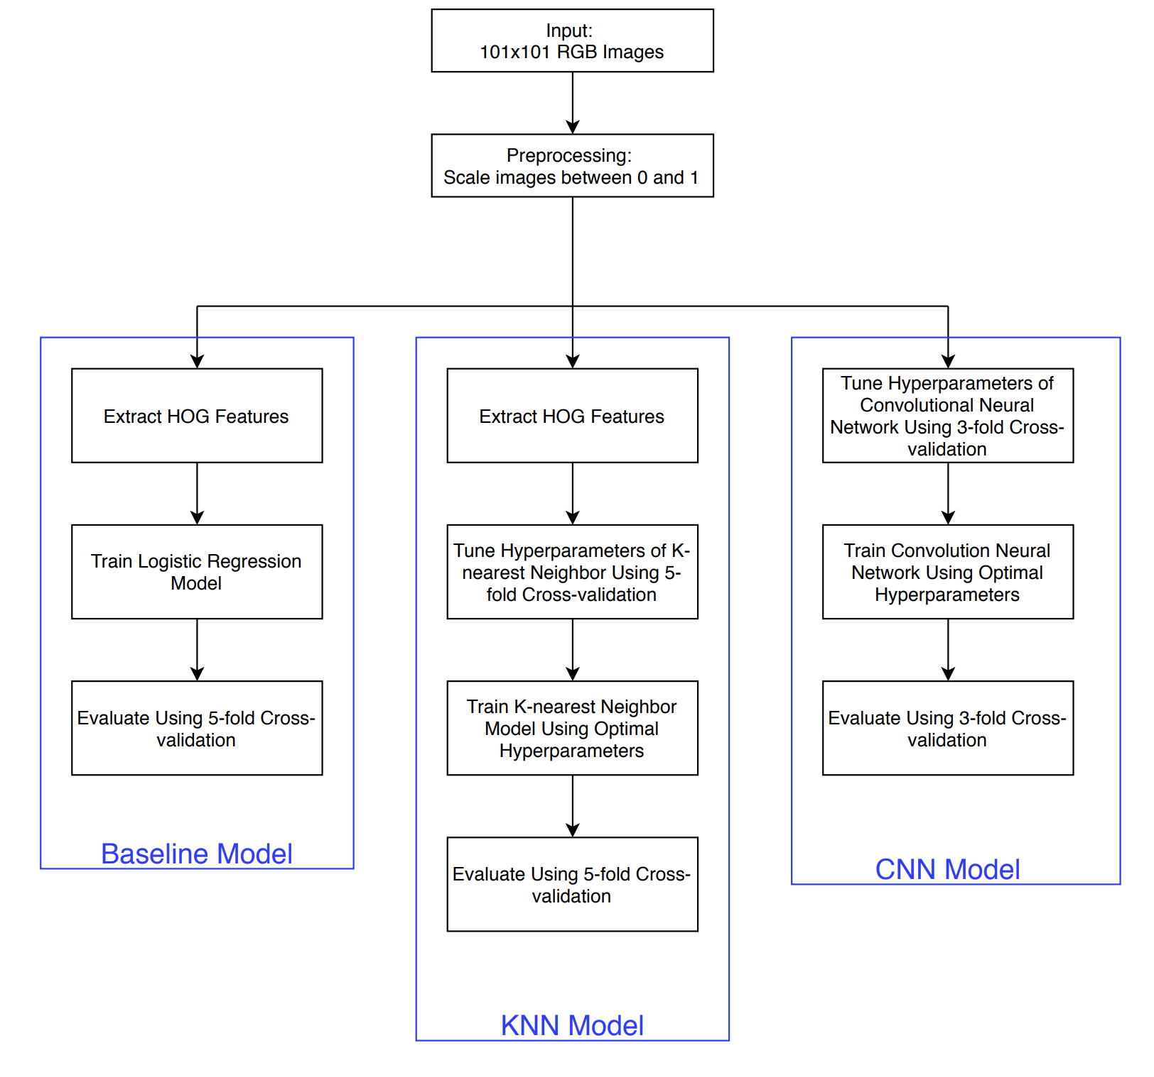
Methods
Figure 2: Flowchart of the methods used to detect solar panels in aerial imagery

Slide 5
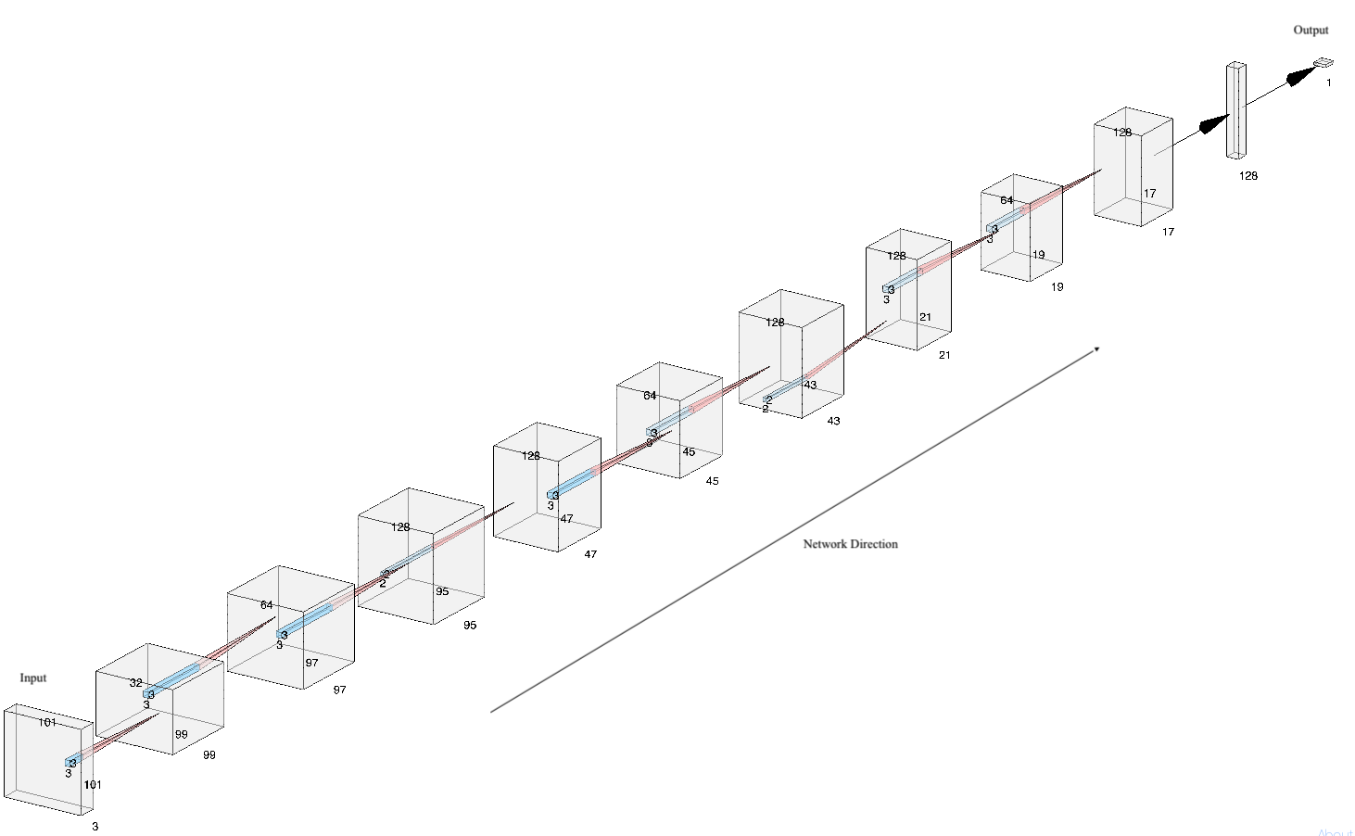
CNN
Figure 3: Architecture of CNN used to detect solar panels in aerial imagery.

Slide 6
CNN Architecture
Used ReLu (Li et al., 2017) as the activation function.
Used batch normalization (Ioffe et al., 2015).
Used global max pooling instead of fully-connected layer at the end of the network.
Weighed the samples from the minority class higher.

Slide 7
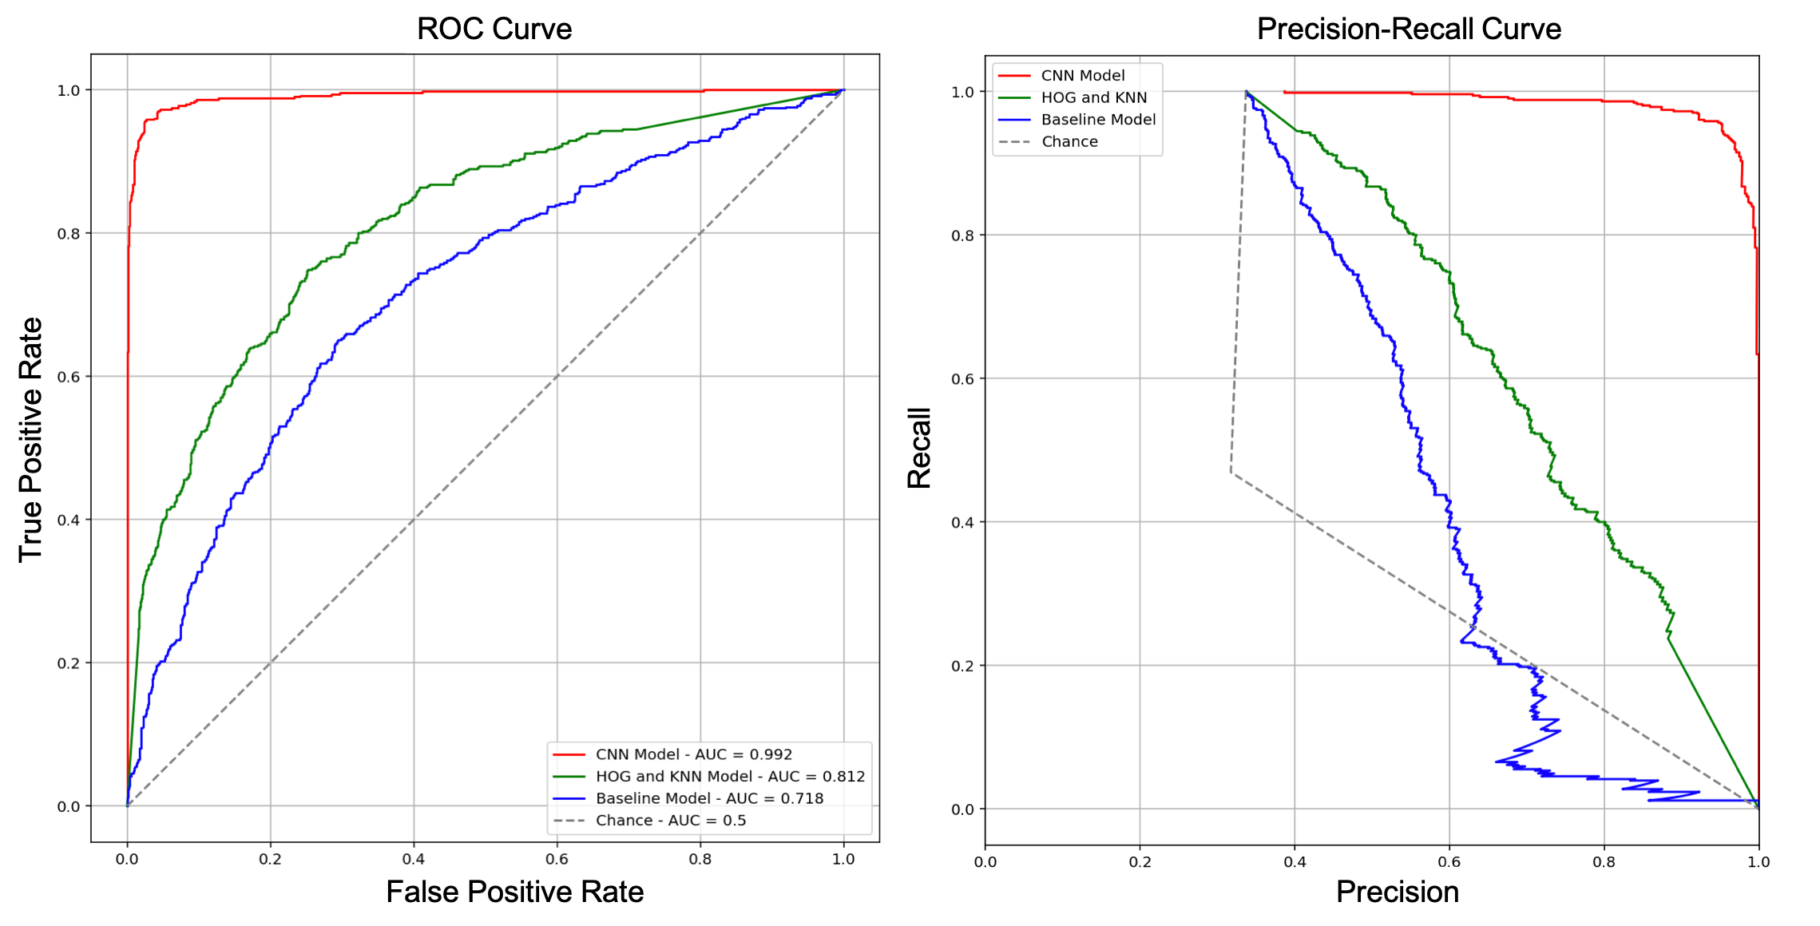
Results
Figure 4: ROC and PR curves from the solar detection task

Slide 8
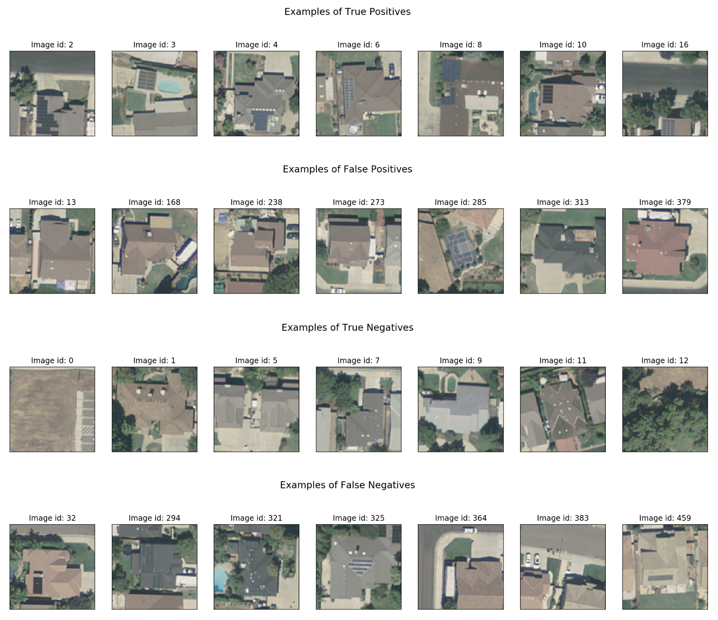
Predictions from the CNN
In false positive cases, the model mistakes shadows and dark colors for panels.
In false negative cases, colors of solar panel is almost indistinguishable from the surrounding objects.
Figure 5: TP, TN, FP and FN images from the CNN model

Slide 9
Conclusion
Need more data to minimize false positives and false negatives, and to perform validation with more confidence.
Two approaches that worked well in boosting the AUC:
Global max pooling at the end of the network instead of fully connected layer.
Weighing the sample from the minority class higher than the samples from the majority class.

Slide 10
References
Malof, J. M., Bradbury, K., Collins, L. M., & Newell, R. G. (2016). Automatic Detection of Solar Photovoltaic Arrays in High Resolution Aerial Imagery. Applied Energy, 183, 229–240. https://doi.org/10.1016/j.apenergy.2016.08.191
Dalal, N., & Triggs, B. (2005). Histograms of oriented gradients for human detection. 2005 IEEE Computer Society Conference on Computer Vision and Pattern Recognition (CVPR’05), 1, 886–893 vol. 1. https://doi.org/10.1109/CVPR.2005.177
Krizhevsky, A., Sutskever, I., & Hinton, G. E. (2012). Imagenet classification with deep convolutional neural networks. In Advances in neural information processing systems (pp. 1097-1105).
Ioffe, S., & Szegedy, C. (2015). Batch normalization: Accelerating deep network training by reducing internal covariate shift. arXiv preprint arXiv:1502.03167.
Li, Y., & Yuan, Y. (2017). Convergence analysis of two-layer neural networks with relu activation. In Advances in neural information processing systems (pp. 597-607).

