Slide 1
Insights presentation
Made by Kyrylo Krocha

Slide 2
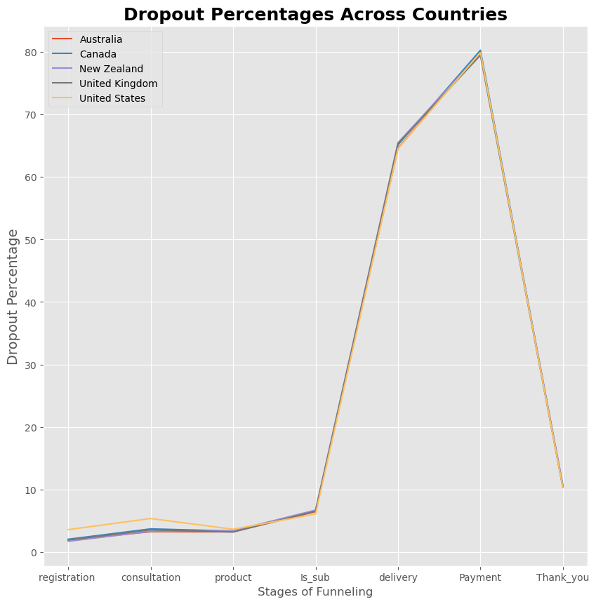
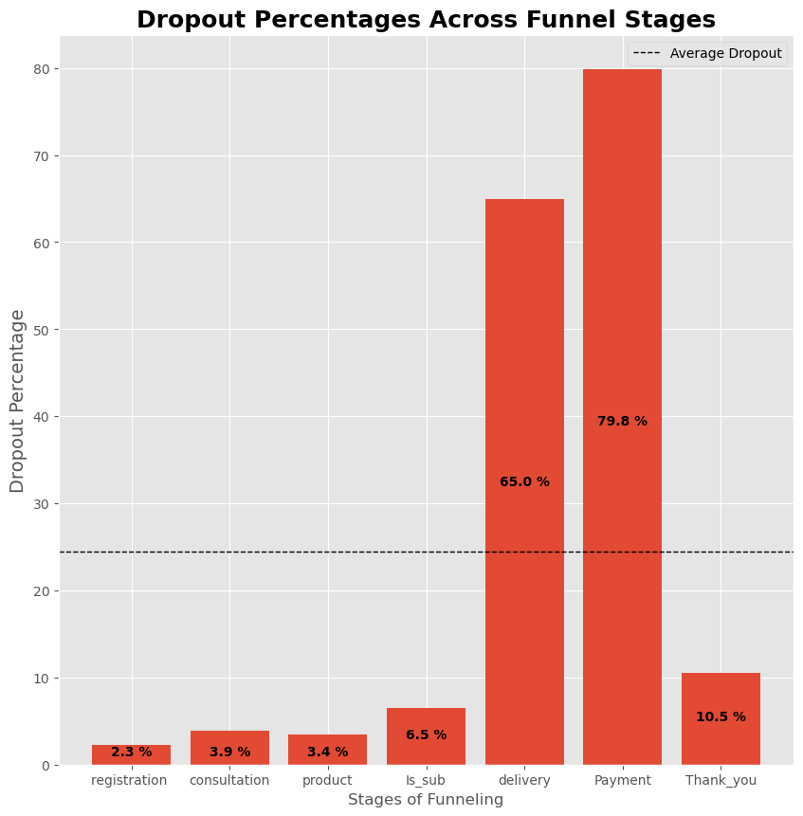
From the plot 1, which represents dropout percentages for each stage of funnel, we can see that the highest dropout rates are on stages of entering delivery information and payment details, which suggests that user interface on this stages are not understandable, or users are too overwhelmed with the number of questions, so maybe simplifying UI is a good idea. Also, the problem could be lying in the lack of delivery locations and payment methods – customers just quit the process when they can`t pay for product, or get it delivered to specific location.
As we can see from the second plot, dropout percentages are almost identical across all countries. That means, that significant increase of dropouts on delivery and payment stages is not caused by any sort of language or cultural barrier, but rather just universal problems with UI and delivery/payment options.
Plot 1
Plot 2

Slide 3
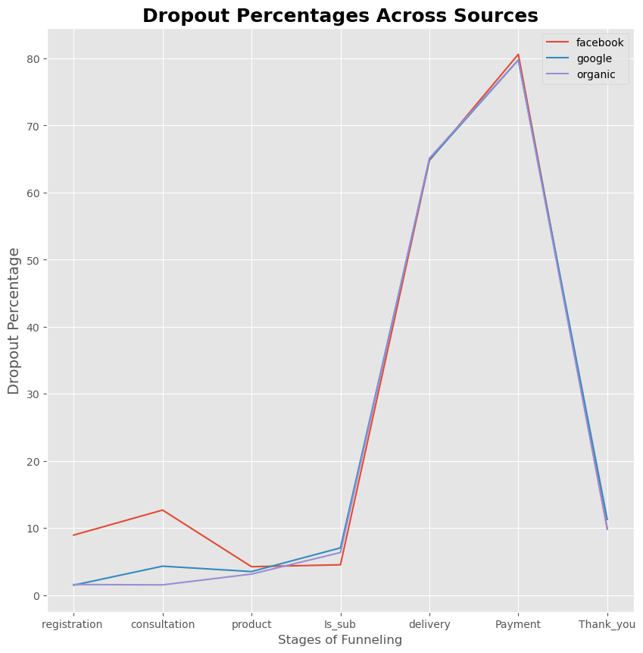
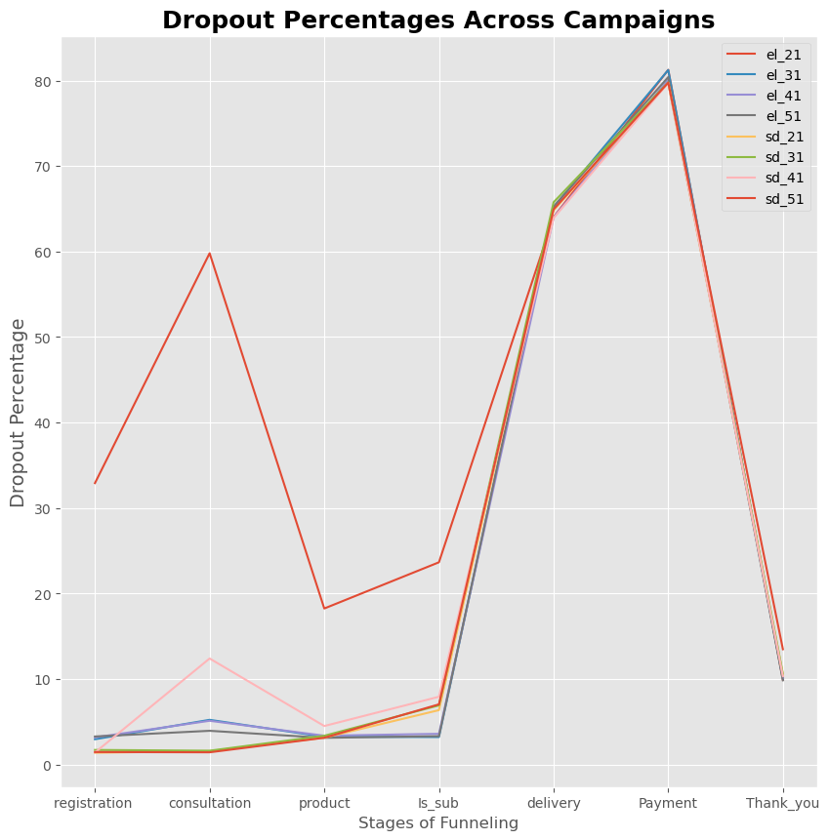
Campaigns/Source effectiveness analysis
There is significant increase of dropout on early stages from Facebook(plot 3), specifically on el_21 campaign(plot 4), indicating a misalignment in targeting. So changing targeting preferences for el_21 campaign should improve funnel conversion. Alternatively, el_21 can be removed entirely, saving company money that would be otherwise spent on campaign that doesn`t provide a lot of customers that are really interested in product.
Plot 3
Plot 4

Slide 4
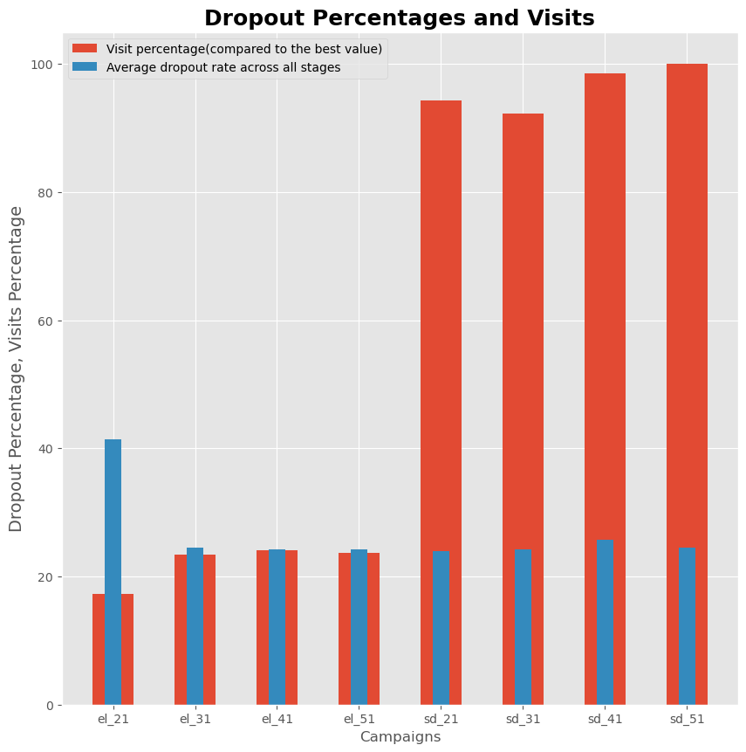
Campaigns with the greatest user appeal
Plot 5 illustrates the percentage of visits to the homepage attributed to each campaign, alongside the average dropout rate for each. The visit percentage is normalized by setting the average number of visits for the most popular campaign, sd_51, as 100%.
From the visualization, it is evident that campaign sd_51 was the most effective, attracting an average of 4,291 visits per day during its active period. Notably, this campaign also exhibited a relatively low dropout rate, making it a standout performer for the company. These results suggest that campaign sd_51 was not only highly engaging in terms of driving traffic to the homepage but also successful in guiding users deeper into the funnel. This implies that company should analyze the specific elements of sd_51 (e.g., ad creative, target demographics, and platform) to replicate its success in future campaigns.
Plot 5

Slide 5
Conclusion
As a result of analysis, key recommendations are:
1.Simplify UI and improve delivery/payment options:
  Streamline the delivery and payment stages to reduce user friction.
  Expand delivery coverage and offer diverse payment methods to accommodate a broader audience.
2. Refine Facebook campaigns:
  Adjust targeting preferences for el_21 or discontinue it if user interest remains low.
  Reinvest resources into campaigns with proven effectiveness.
3. Replicate success of sd_51:
  Dive deep into sd_51 winning formula and apply similar strategies in future campaigns.

