Slide 1
IoT Using
OpenHAB and MQTT
Kirk Carlson
Kirk.Carlson@att.net
https://github.com/kirkcarlson

Slide 2
Personal Objective
Integrate information from various sources on single page
Platform for storage and retrieval of data
Re-use existing sensors
Learn about One-Wire devices and MQTT
Enforce the “Castle Doctrine”
“Control” is obviously missing – Not first rodeo

Slide 3
Desired Data
Local weather conditions
Local weather forecast
‘Esoteric’ weather conditions and water level data
Sunrise/sunset times
Moon phase and rise time
Door sensors, especially garage door
Motion sensors

Slide 4
IoT Integrator Alternatives
NodeRED
IFTTT – If this, then that
FHEM
Cayenne
OpenHAB
Maybe 20 others not considered

Slide 5
What is OpenHAB?
Home Automation Bus / Information integrator
  Abstracts data to number, string, datetime, contact (open/closed), switch (on, off), dimmer (%), rollerblind(%)
  Technology agnostic
  Open, non-proprietary
Interfaces to many (most?) Internet of Things things
Data can be accessed with RESTful interface
Actively developed
Built on Eclipse Smarthome framework with Java

Slide 6


OpenHAB Works With Many
IoT Things

Slide 7
Version
This talk is about version 1.8.3
Run under Ubuntu
Dependent on Java 1.8 (the proprietary Oracle version)
Version 2.0 was released late January
OpenHABian is easy way to install Version 2 on a Raspberry Pi

Slide 8
OpenHAB Basics
Driven by configuration files and add-ons
Main configuration file (for add-ons)
Items
Sitemaps
Persistence
Rules
Apps

Slide 9
Add-ons
JVM interface to services and devices
This talk used:
  Astro – astronomical information
  Weather – conditions and forecasts from several providers
  MQTT – simple information messaging technique
  OWFS – one-wire devices

Slide 10
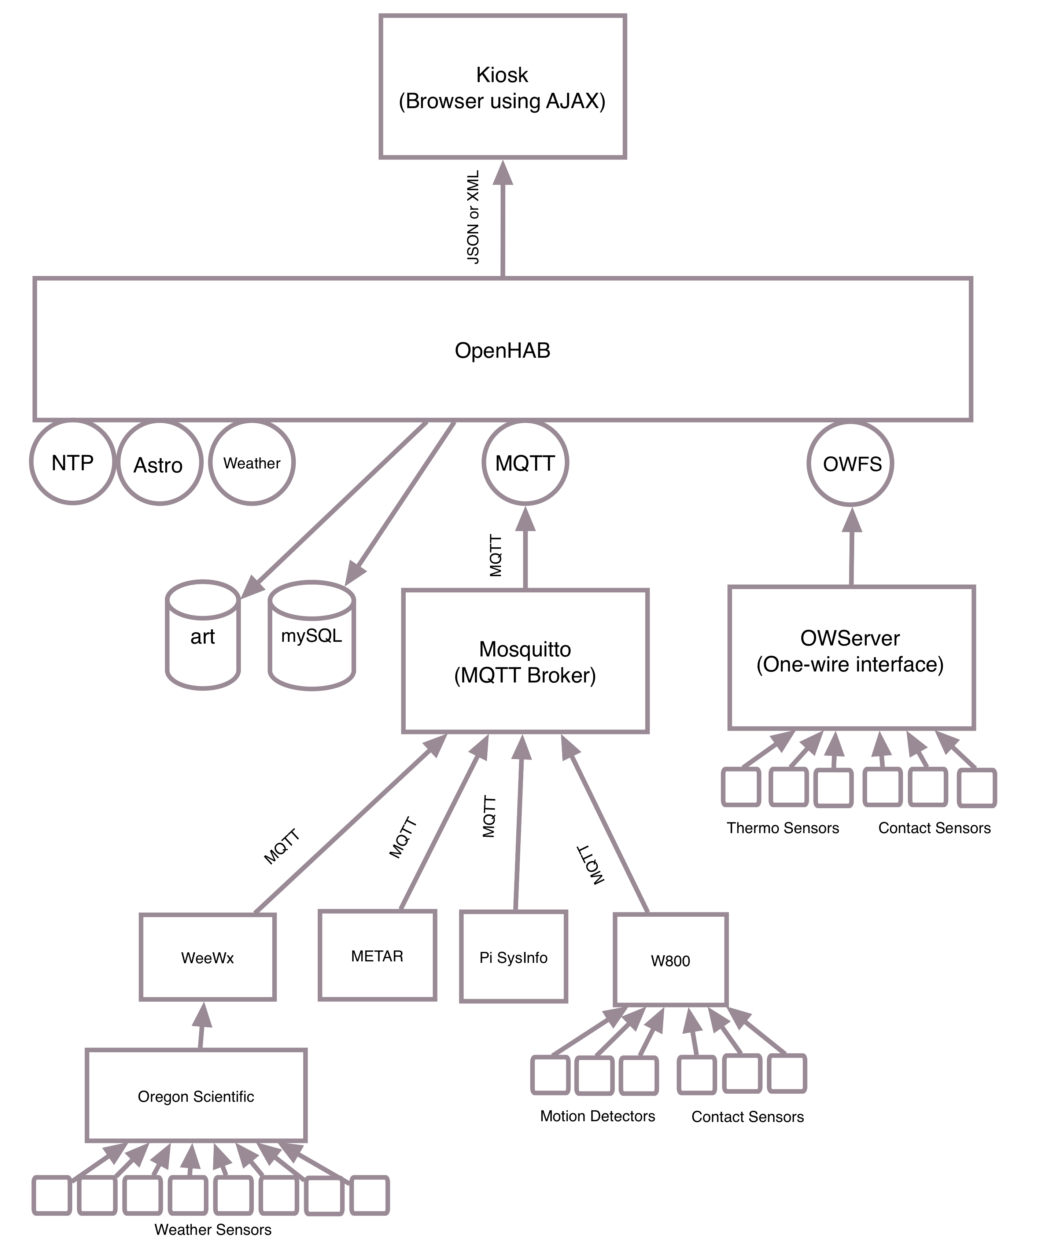
My Experience with OpenHAB

Slide 11
Main configuration file
Configure the add-ons
Examples...

Slide 12
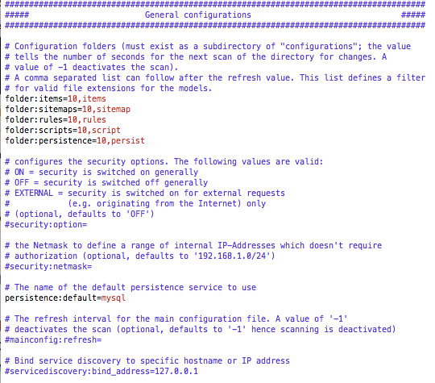
OpenHAB General Configuration

Slide 13
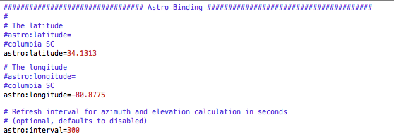
Astro Binding Configuration

Slide 14
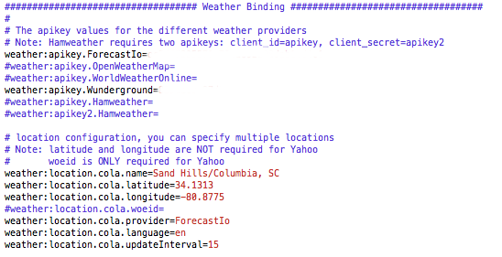
Weather Add-on Configuration

Slide 15
Items
Type (number, string, datetime, switch, contact, etc.)
Unique name
Text to display when item is used
Value associated with text
Icon used with text
Binding of item to input
Group(s) that item belongs to
Each item is essentially a “variable”
Use freely for conversions: °F, °C, “x °F (y °C)”
Or derivatives: motion at times implies “At home”

Slide 16
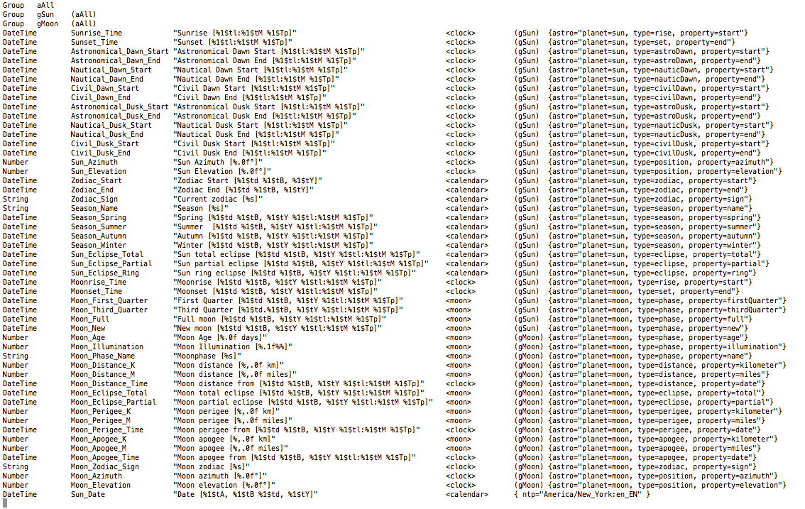
Astronomical Items

Slide 17
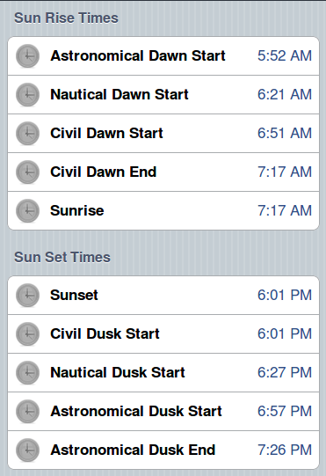
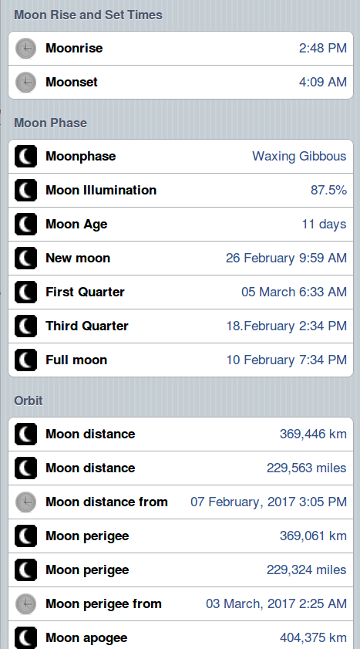
Astro Control Page

Slide 18
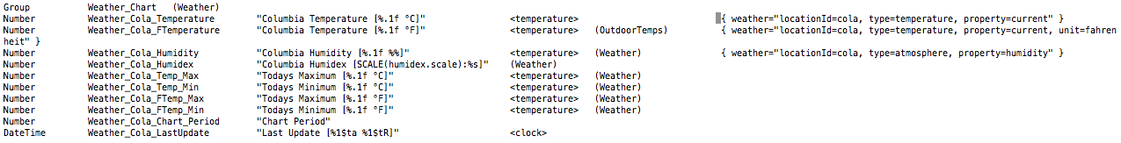
Weather Items

Slide 19
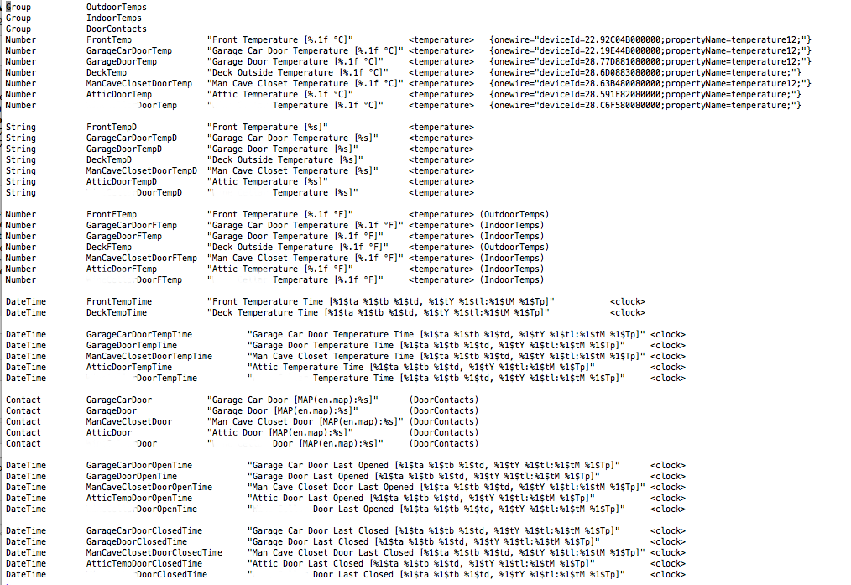
One-Wire Items

Slide 20
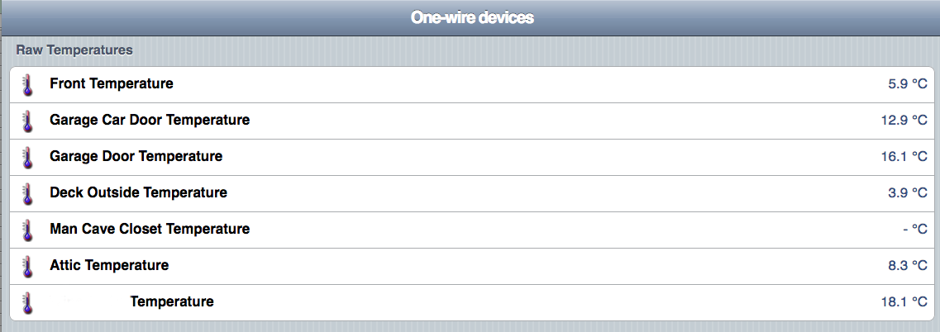
One-Wire Devices Raw Temperatures

Slide 21
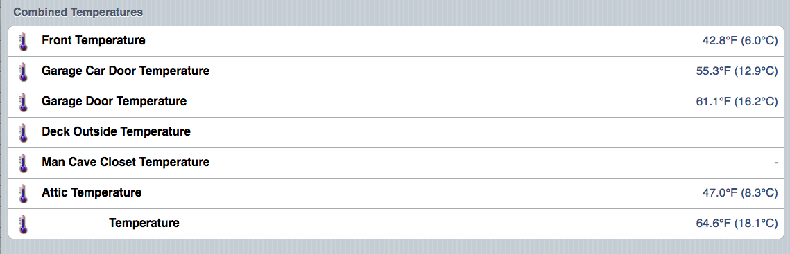
Temperatures as Strings

Slide 22
Sitemaps
Defines which items are displayed and where
Can be hierarchical
Used by default page viewer, smart phone apps, and others
There can be more than one per system
  Debugging sitemap for ALL items
  Specialty maps with only certain items

Slide 23
Persistence
Allows values to be recalled
  Graphing
  High or low temperatures
Defaults to a round robin database
Can use other databases like mySQL
Stores data as time-value pairs

Slide 24
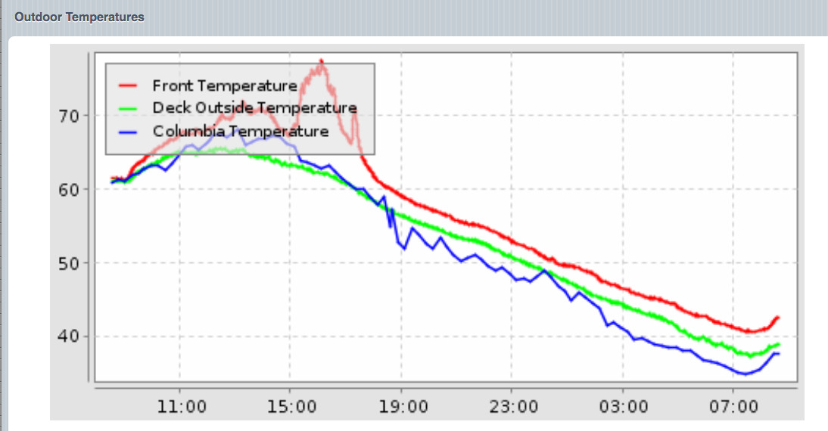
Graph of Outside Temperatures

Slide 25
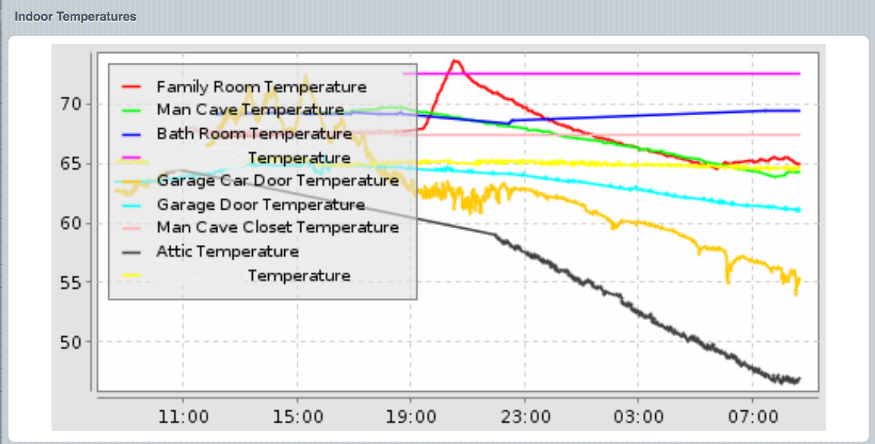
Graph of Inside Temperatures

Slide 26
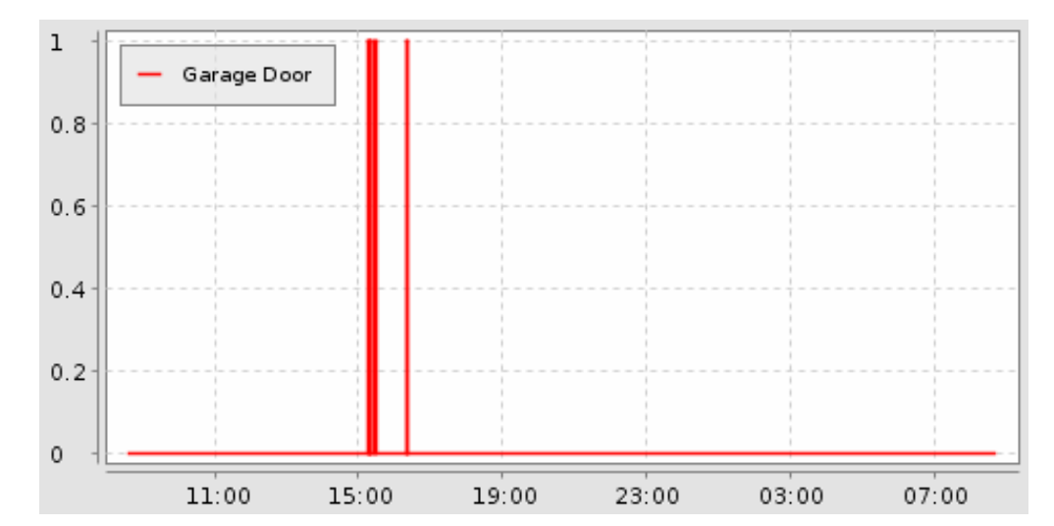
Graph of Garage Door Contact

Slide 27
Rules
Sort of an If This Then That type of interface
Trigger, the when part
  update of a value
  change of value
  specific change in value (off to on)
  periodically (like crontab)
  timer expiry
  start up
  others...
Actions, the then part
  basically a snippet of Jave code
  can convert units of updated values (e.g, °C to °F)
  can start a timer for a reminder (you left the garage door open)

Slide 28
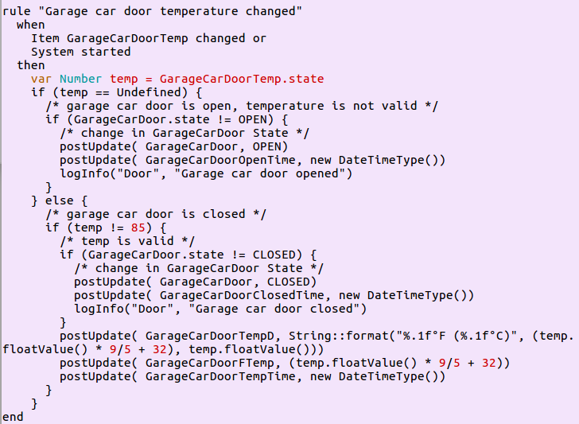
Garage Door Rule

Slide 29
Apps
Generate a web page (default)
Generate a weather page
Access RESTful data
Access graph .png

Slide 30
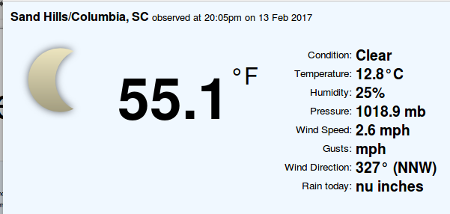
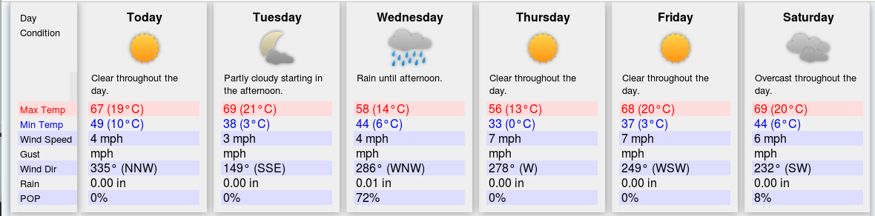
Weather Images

Slide 31
MQTT
Simple messaging protocol
Simple interface:
  Topic string (“major/minor”)
  Payload (value)
  QOS (at most once, at least once, exactly once)
  Retention
Need an MQTT broker
  Publish information to the broker
  Information is subscribed from the broker
  Mosquitto is an open source broker that is easy to use

Slide 32
Paho-MQTT Library for Python
Fairly flexible functions
Single publish that internally connects, publishes and disconnects
Multiple publish by connect, publish items, disconnect
Has callback capabilities for subscribing

Slide 33
Example Uses of MQTT
Interfaced METAR weather records
Interfaced W800 to access X-10 RF and “security” devices
Used MQTT capabilities of weewx to interface Oregon Scientific weather station
(not for non-real-time data like water level data)

Slide 34
RESTful API
access to item info and sitemaps
can speak different protocols: xml, JSON,
http://bc.local:8081/rest
http://bc.local:8081/rest/items
http://bc.local:8081/rest/sitemaps
http://bc.local:8081/rest/items/X10_Test_A1/state
http://bc.local:8081/rest/sitemaps/kiosk
access historical data with HABmin

Slide 35
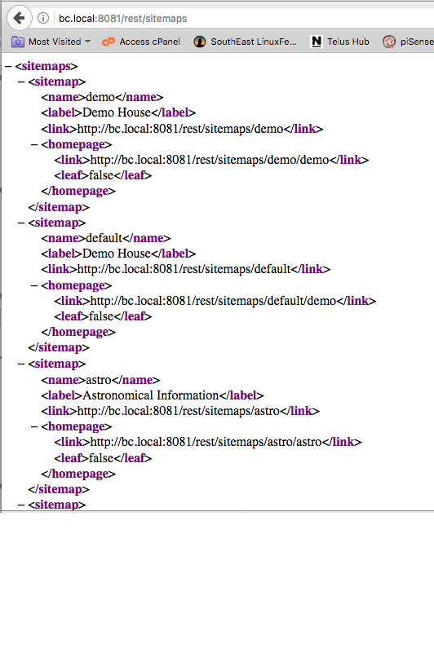
RESTful interface: rest/sitemaps

Slide 36
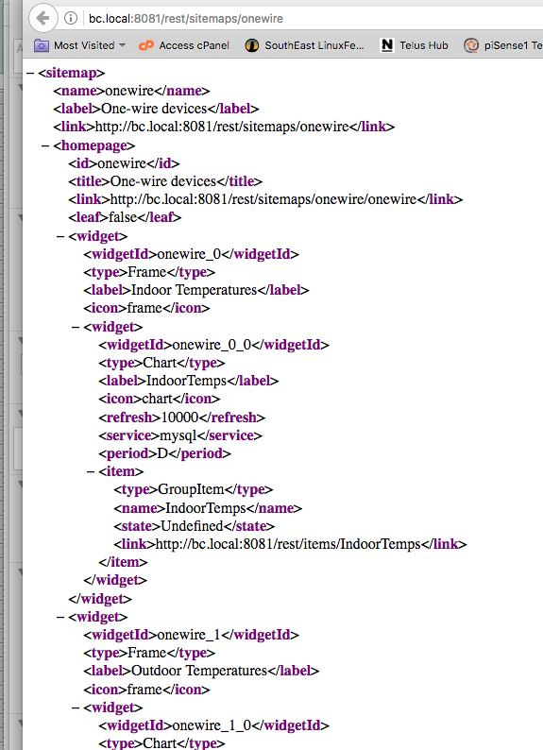
RESTful interface: rest/sitemaps/onewire

Slide 37
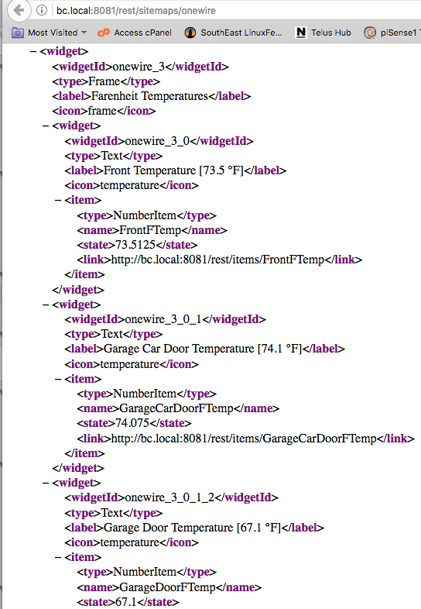
RESTful Interface: rest/sitemaps/onewire

Slide 38
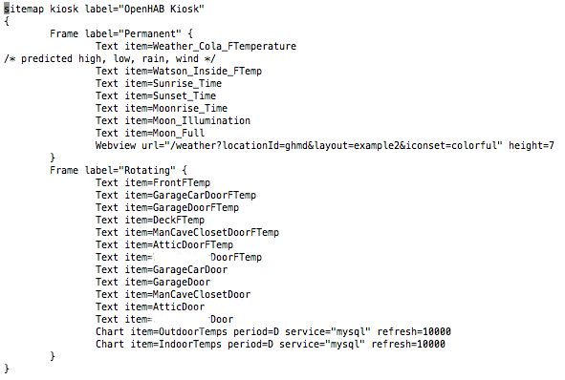
Sitemap for Simple Kiosk

Slide 39
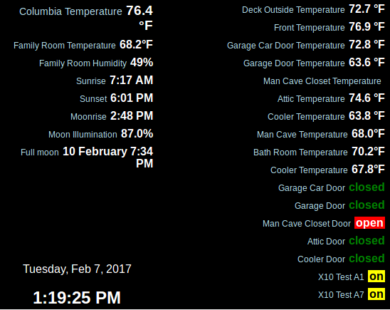
Kiosk

Slide 40
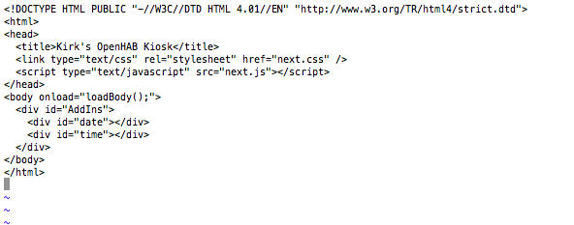
Kiosk.html

Slide 41
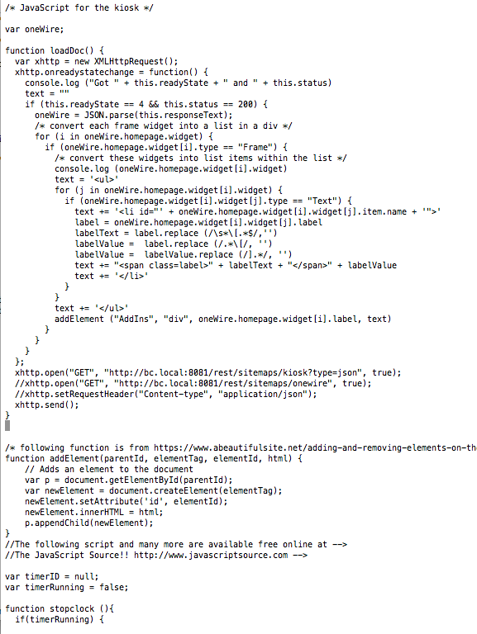
Kiosk.js
(partial)

Slide 42
One-Wire Devices
Mature technology
Uses one cable: power, ground, signal
Easiest use to measure temperatures
An analog to digital chip is available
Can monitor or control single bits:
  Door contact
  Door bell?
  Garage door opener??
Can interface with Raspberry Pi boards or USB dongle
Interfaces managed by OWFS
OWFS can be integrated into OpenHAB

Slide 43
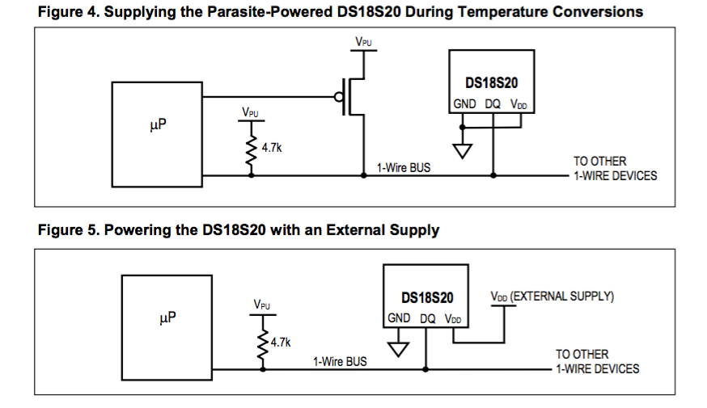
Powering One-Wire Devices

Slide 44
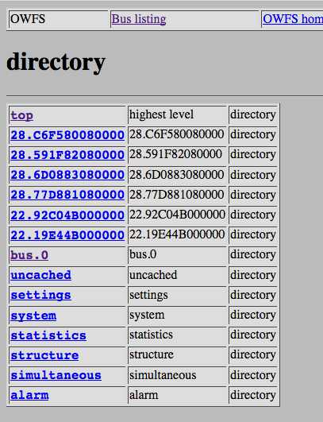
OWFS Top Directory Listing

Slide 45
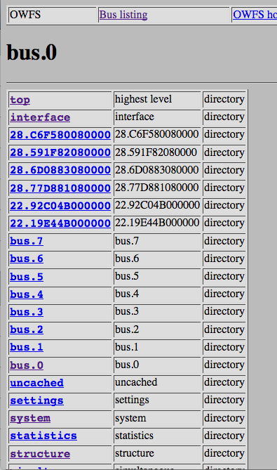
OWFS Listing of
Top Level Busses

Slide 46
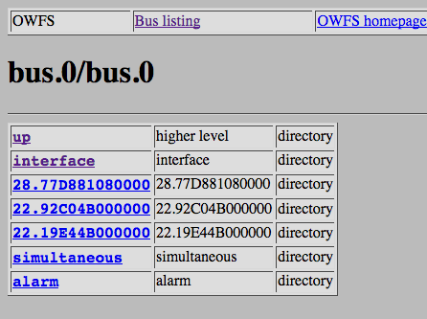
OWFS Subbus 0/0

Slide 47
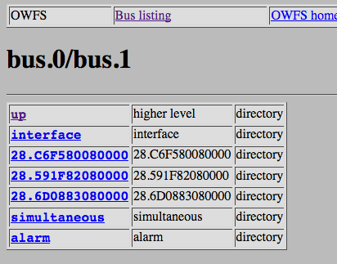
OWFS Subbus 0/1

Slide 48
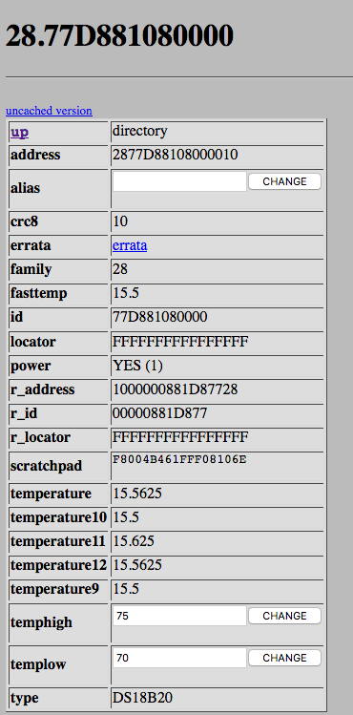
OWFS Device
Listing for
DS18B20

Slide 49
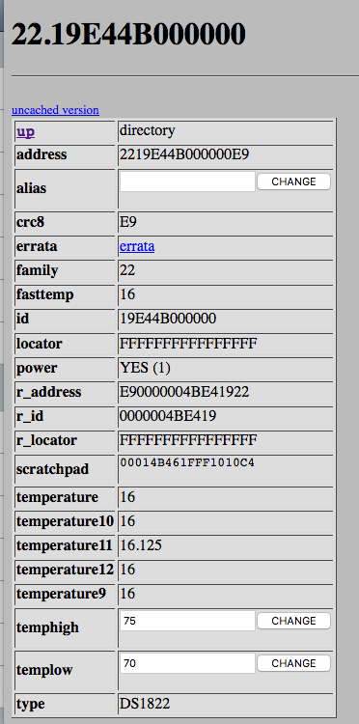
OWFS Device Listing for
DS1822

Slide 50
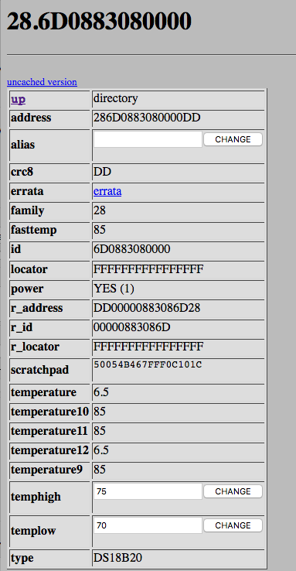
OWFS Device
Listing with
Errors
85 indicates a
communication
error

Slide 51
Next Steps
Make kiosk and sitemaps more attractive
Add sensor check logic
  Are the batteries dead or dying? not heard from unit for a while
  Is a radio or radio link down? not heard from group of units
  Concurrence between redundant sensors? vote before acting
Add reminders
  Garage door left open too long after dark
  Open and close window to manage indoor temperature
Add more sensors (WARNING: addictive)
Clean up persistence
Play with scraping of web data
Play with integrating Nagios
Push notifications
Explore one-wire more

