Slide 1
Introduction to
OpenHAB
Kirk Carlson
Kirk.Carlson@att.net
https://github.com/kirkcarlson

Slide 2
Motivation
Envisioned a kiosk with diverse information
  Current local weather conditions
  Weather forecast
  Door and window closures
  Sunrise and sunset times
High enough SAF to continue

Slide 3
Personal Requirements
Integrate information from various sources
Re-use existing sensors
Scrape specialized information from websites
Enforce the “Castle Doctrine”
Learn about One-Wire devices and MQTT
“Control” could come later – Not first rodeo

Slide 4
Desired Data
Local weather conditions
Local weather forecast
‘Esoteric’ weather conditions
Water level/wave/wake data
Astronomical data: sunrise/sunset times, etc
Door sensors, especially garage door
Motion sensors

Slide 5
What is Internet of Things (IoT)
Sensors
  Temperature, motion, closures, flow, power, etc.
Actuators
  Thermostats, lights, valves, sprinkler, locks
Communication
  Sensor to hub
  Hub to actuators
  Hub to other users... web page, kiosk, etc.

Slide 6
IoT Integrator Alternatives
NodeRED
IFTTT – If This, Then That
FHEM
Cayenne
Maybe 20 others not considered
OpenHAB

Slide 7
What is OpenHAB?
Home Automation Bus / Information integrator
  Abstracts data to number, string, datetime, contact (open/closed), switch (on, off), dimmer (%), rollerblind(%), etc.
  Technology agnostic
  Open, (mostly) non-proprietary
Interfaces to many (most?) Internet of Things things
Uses a open-source Java-based server

Slide 8
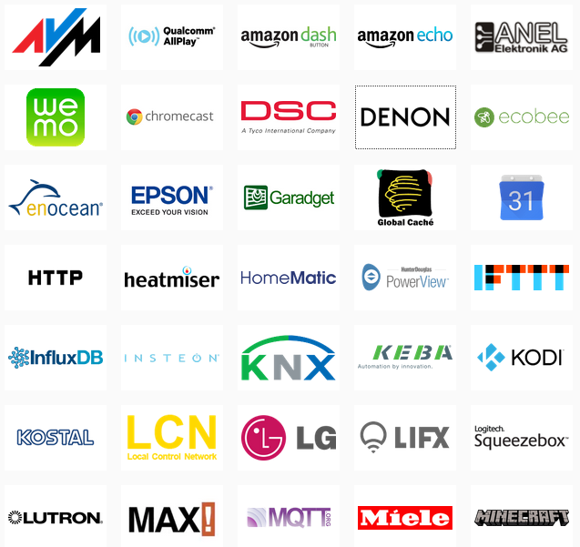
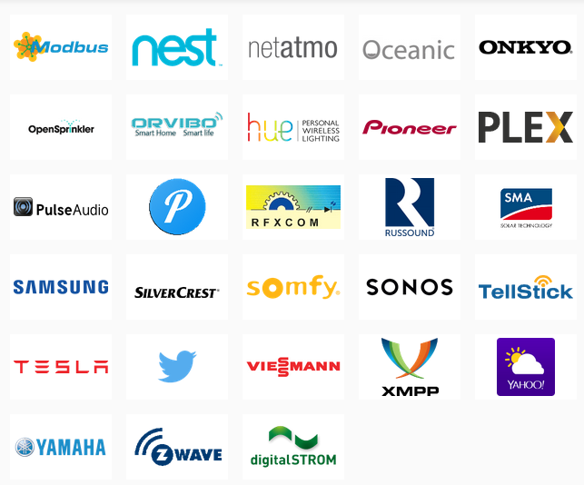
OpenHAB Works With Many
IoT Things

Slide 9
Software
Uses Java 1.8 (the proprietary Oracle version)
Built on Eclipse SmartHome
Version 1.8.3 is mature, but now dated
Version 2.0 was released late January
  Improved architecture for multiple “things”
  OpenHABian is a minimal install for Raspberry Pi
  Recommended... this talk is about 2.0

Slide 10
User Interfaces
Sort of backward, but this is more motivating
Look ahead to see what OpenHAB can do
Then see how it works

Slide 11
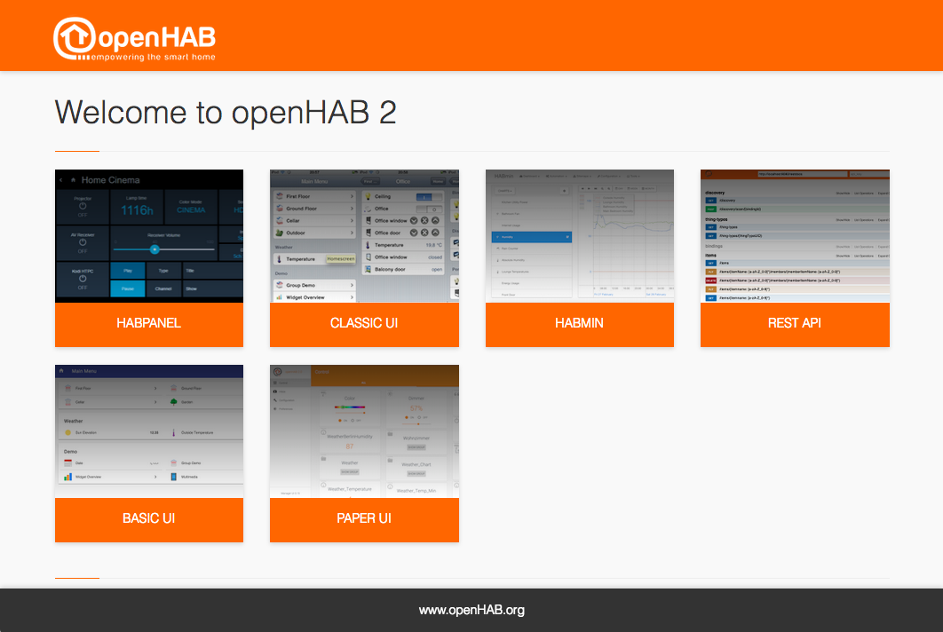
OpenHabian Apps

Slide 12
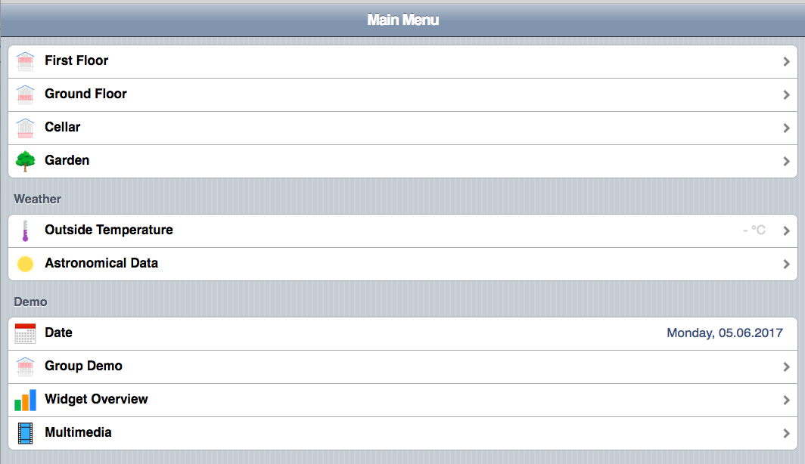
Classic User Interface

Slide 13
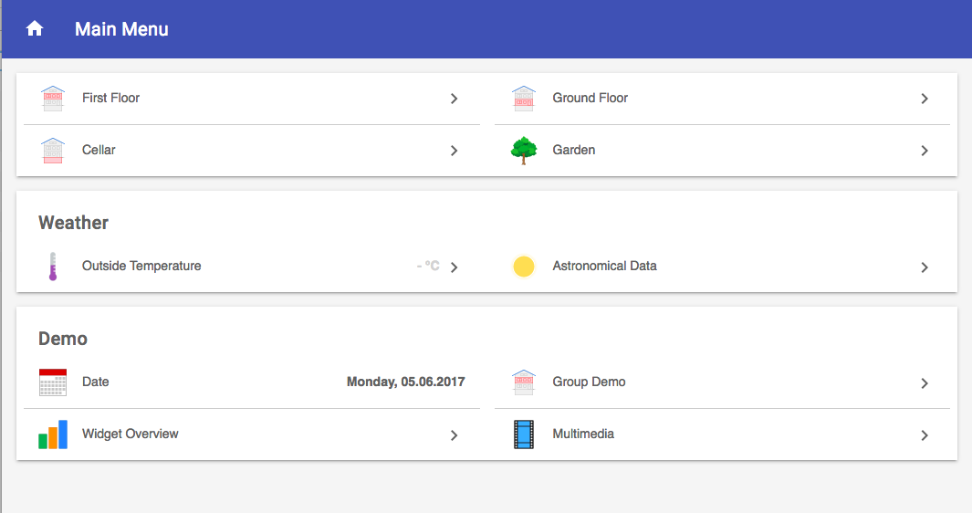
Basic User Interface

Slide 14
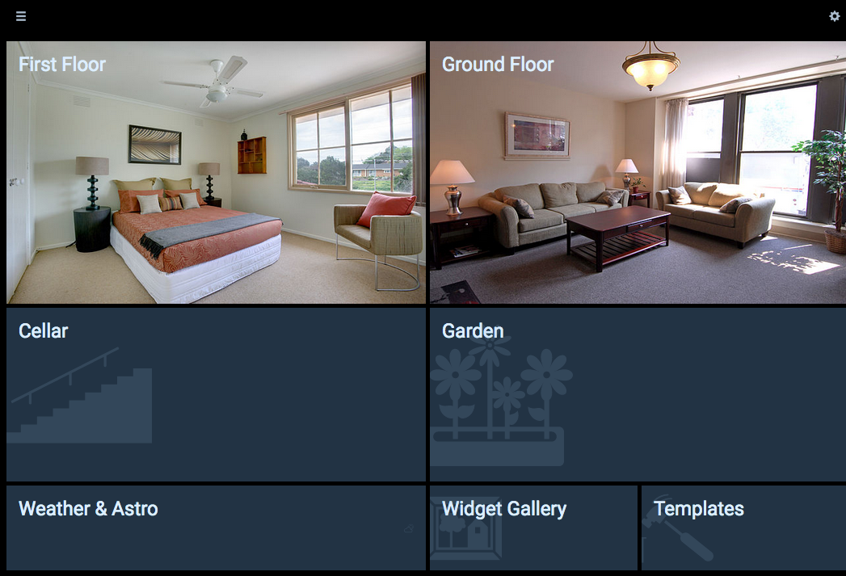
HABPanel User Experience

Slide 15
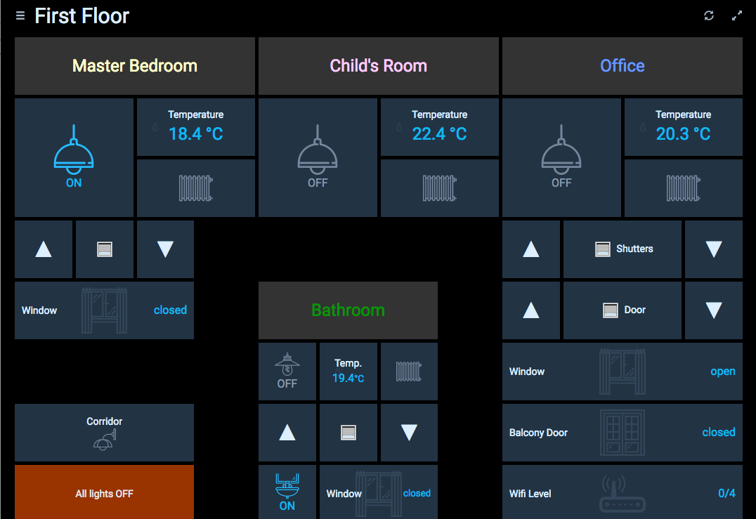
HABPanel (continued)

Slide 16
OpenHAB Basics
Everything is configured
Functionality is extended with add-ons

Slide 17
OpenHAB Configuration
Services – inclusion of add-ons
Items – e.g. temperature
Sitemaps – list of items
Persistence – what to save, where and how
Rules – IFTTT functionality
Apps – to access data
Things – provide sensor or actuator items
Channel – selector within a thing

Slide 18
Add-ons
Bindings abstract sensors
  Astro – astronomical information for a lat/long
  Weather – conditions and forecast for a lat/long from a specific provider
  MQTT – simple information messaging technique
  OWFS – one-wire devices
Actions abstract actuators
  Mail
  pushover

Slide 19
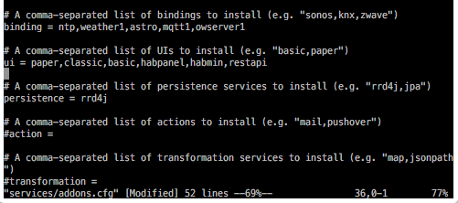
Service configuration

Slide 20
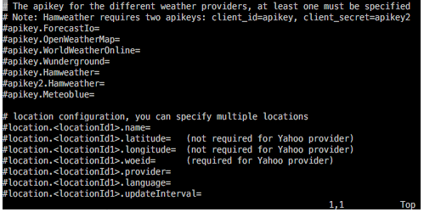
Weather service configuration

Slide 21
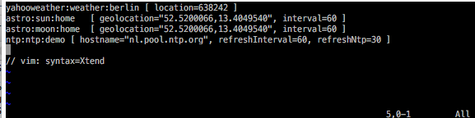
Thing configuration

Slide 22
Items
Holds one sensor value or control element
May be for alternate units (°F (°C))
May be for derivative information
  Accumulation
  Time of last activity
  Battery Failure (no activity in a certain time)

Slide 23
Item Configuration
Type (number, string, datetime, contact, etc.)
Unique name
Text to display when item is used
Formatted value associated with text
Icon used with text
Binding of item to input thing
Group(s) that item belongs to

Slide 24
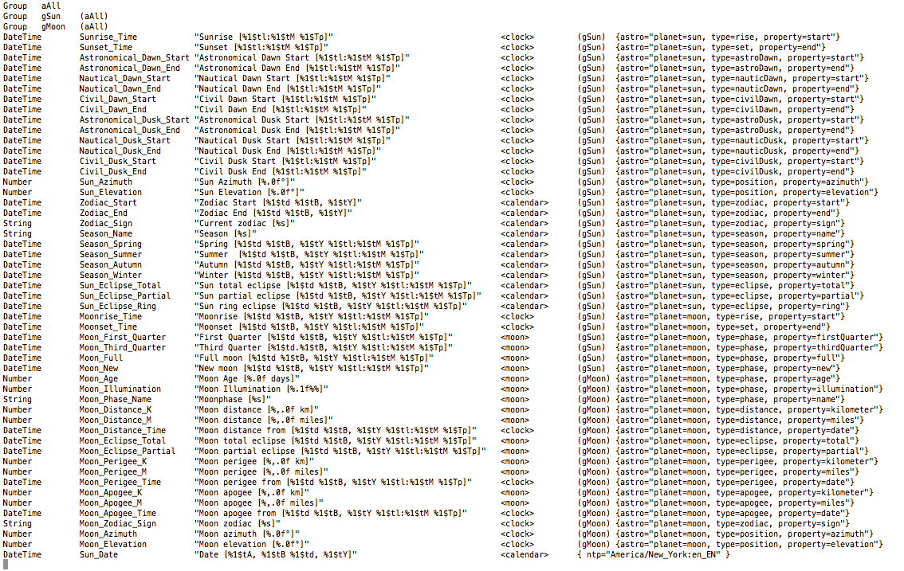
Astronomical Items

Slide 25
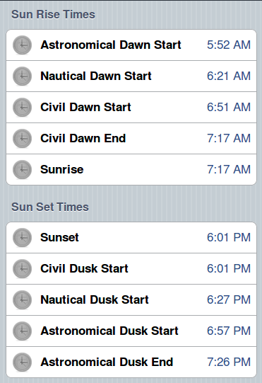
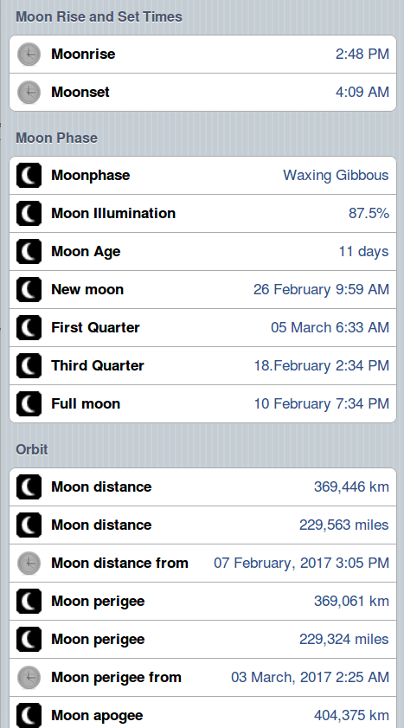
Astronomy User Interface

Slide 26
Sitemaps
Defines which items are displayed and where
Used by user interface programs
Can make items optional based on value
Can an color item based on its value
Define grouping on a page
Define sub-pages
As many as you want
  Debugging sitemap for ALL items
  Specialty maps with select items

Slide 27
Groups
Show the status of a group of items
  How many lights are on:
  Are all outside doors closed?
  Are all batteries OK?
Code defines how to combine item status
Can control a group of items
  Turn all lights off
  Set all thermostats to 40°

Slide 28
Transformations
Aids for converting values
Invoked by item text description
Unit conversion (°F—>°C)
Range conversion (wind Beaufort scale)
Language translations

Slide 29
Things
New concept for 2.0
Allow multiple instances of an interface
e.g., allows doing astronomical calculations for two locations

Slide 30
Channels
Pathway through a thing
For the weather thing
  place latitude and longitude
  provider
For astronomical
  place

Slide 31
Persistence
Allows values to be recalled
  Graphing
  High-low values over a particular period
  Yesterday's weather
Defaults to a round robin database
  Fixed sized database
  Consolidates values through averages
Can use other databases like mySQL
Stores data as time-value pairs

Slide 32
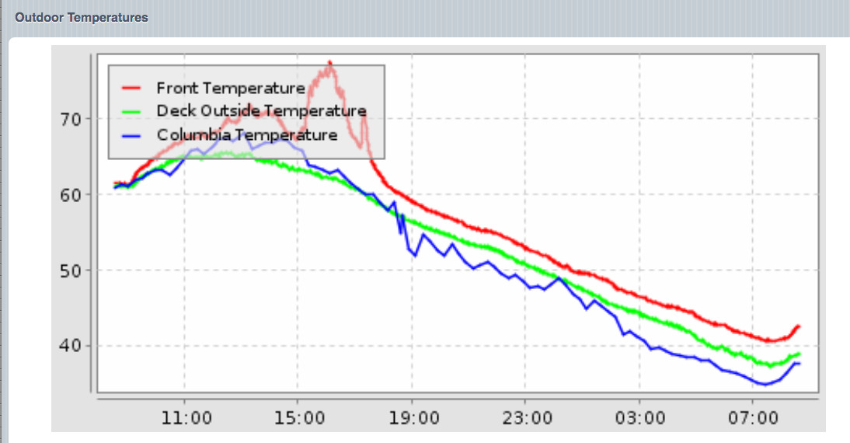
Graph of Outside Temperatures

Slide 33
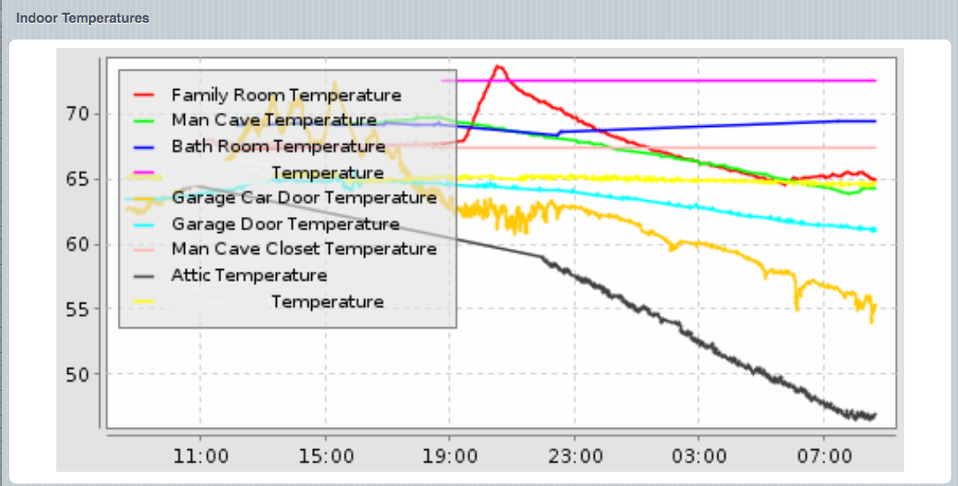
Graph of Inside Temperatures

Slide 34
Rules
Real power of home automation
  Prevents stupidity of dumb timer
    Why is he sprinkling when it is raining?
    Why does that light come on before dark?
Provides “If This, Then That” functionality

Slide 35
Rule Trigger or “when” clause
update of a value
change of value
specific change to value (off to on, sunset start)
periodically (like crontab with seconds)
timer expiry
start up
others...

Slide 36
Rule action or “then” clause
A snippet of Java Extend code
  set new values
  convert units of updated values (e.g, °C to °F)
  start a timer for some other action
Should use the Eclipse SmartHome Designer
Using vi sucks for this
  no syntax highlighting
  have to know Java object models (epoch≠epoch, datetime≠datetime, Number is an object, not a type)

Slide 37
Rule action or “then” clause
A snippet of Java Extend code
  set new values
  convert units of updated values (e.g, °C to °F)
  start a timer for some other action
Should use the Eclipse SmartHome Designer
Using vi sucks for this
  no syntax highlighting
  have to know Java object models (epoch≠epoch, datetime≠datetime, Number is an object, not a type)

Slide 38
Rules for Data Derivatives
Example: PIR motion sensor has 2 channels
  Motion: on for motion, off some time after motion
  Darkness: on, off
  (programming can limit motion to dark periods)
Darkness can be feedback for a controlled light
Darkness can be used to infer battery status

Slide 39
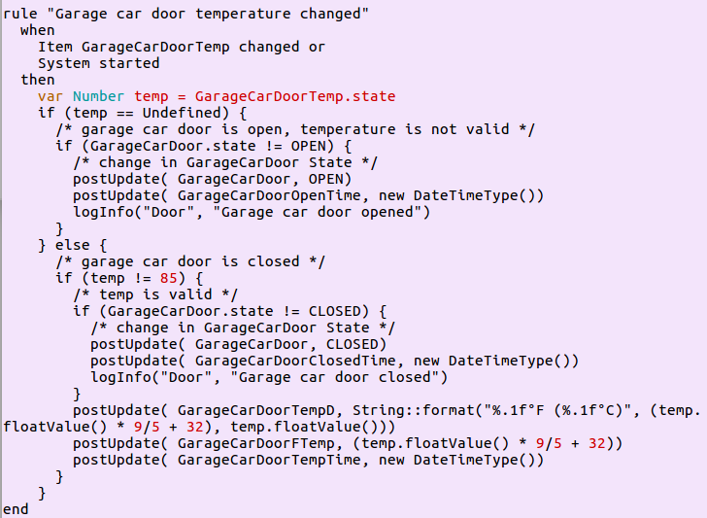
Garage Door Rule

Slide 40
Apps
Basic UI – generate a web page for mobiles
Classic UI – generate a basic web page
HABPanel – tile-based UI for dashboards
Paper UI – system administration, item access
HABMin – administration program (Z-wave)

Slide 41
Apps (continued)
weather – generate image with embedded data
rest – access RESTful data
graph – access graph .png images
Roll your own

Slide 42
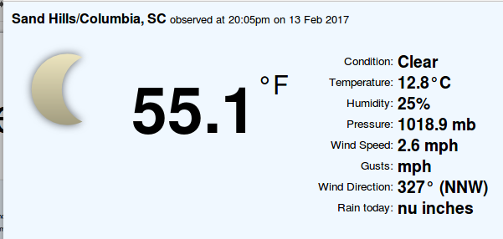
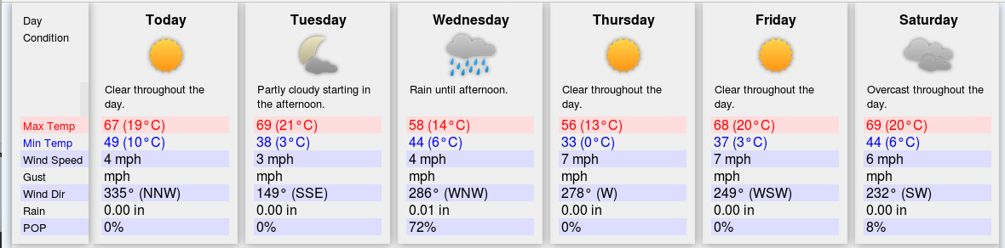
Weather Images

Slide 43
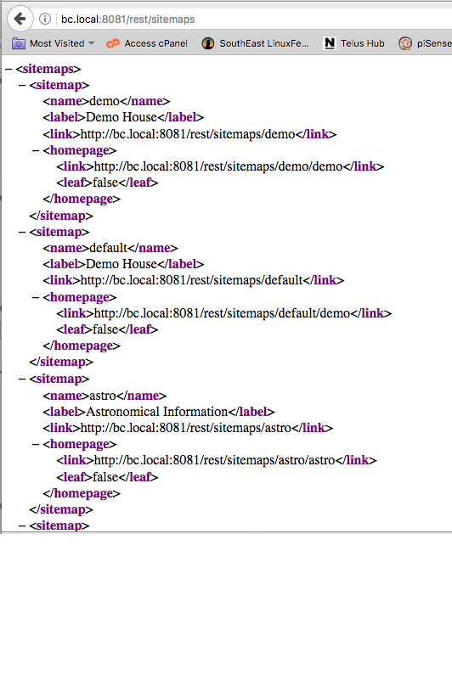
RESTful interface: rest/sitemaps

Slide 44
RESTful API
access to item info and sitemaps
  Individually or all defined
  Verging on being too powerful
uses JSON or xml, so great for AJAX
Points outs need for securing the HTML port
  No authentication out of the box
  Openhabian has a procedure to use NGINX as reverse proxy to provide authentication

Slide 45
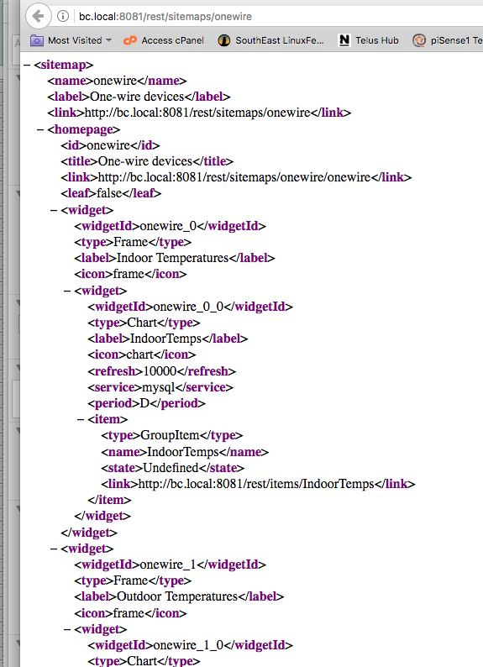
RESTful interface: rest/sitemaps/onewire

Slide 46
HABMin
Administrative program
Can access historical data

Slide 47
PaperUI
Intended as a GUI for administering add-ons
Easy to use
Lists the add-ons and their status
Not quite fully functional (so somewhat frustrating)

Slide 48
MyOpenHAB
Online openHAB server
For those who want access everywhere
For those who aren't rationally paranoid
  Violates “castle doctrine”

Slide 49
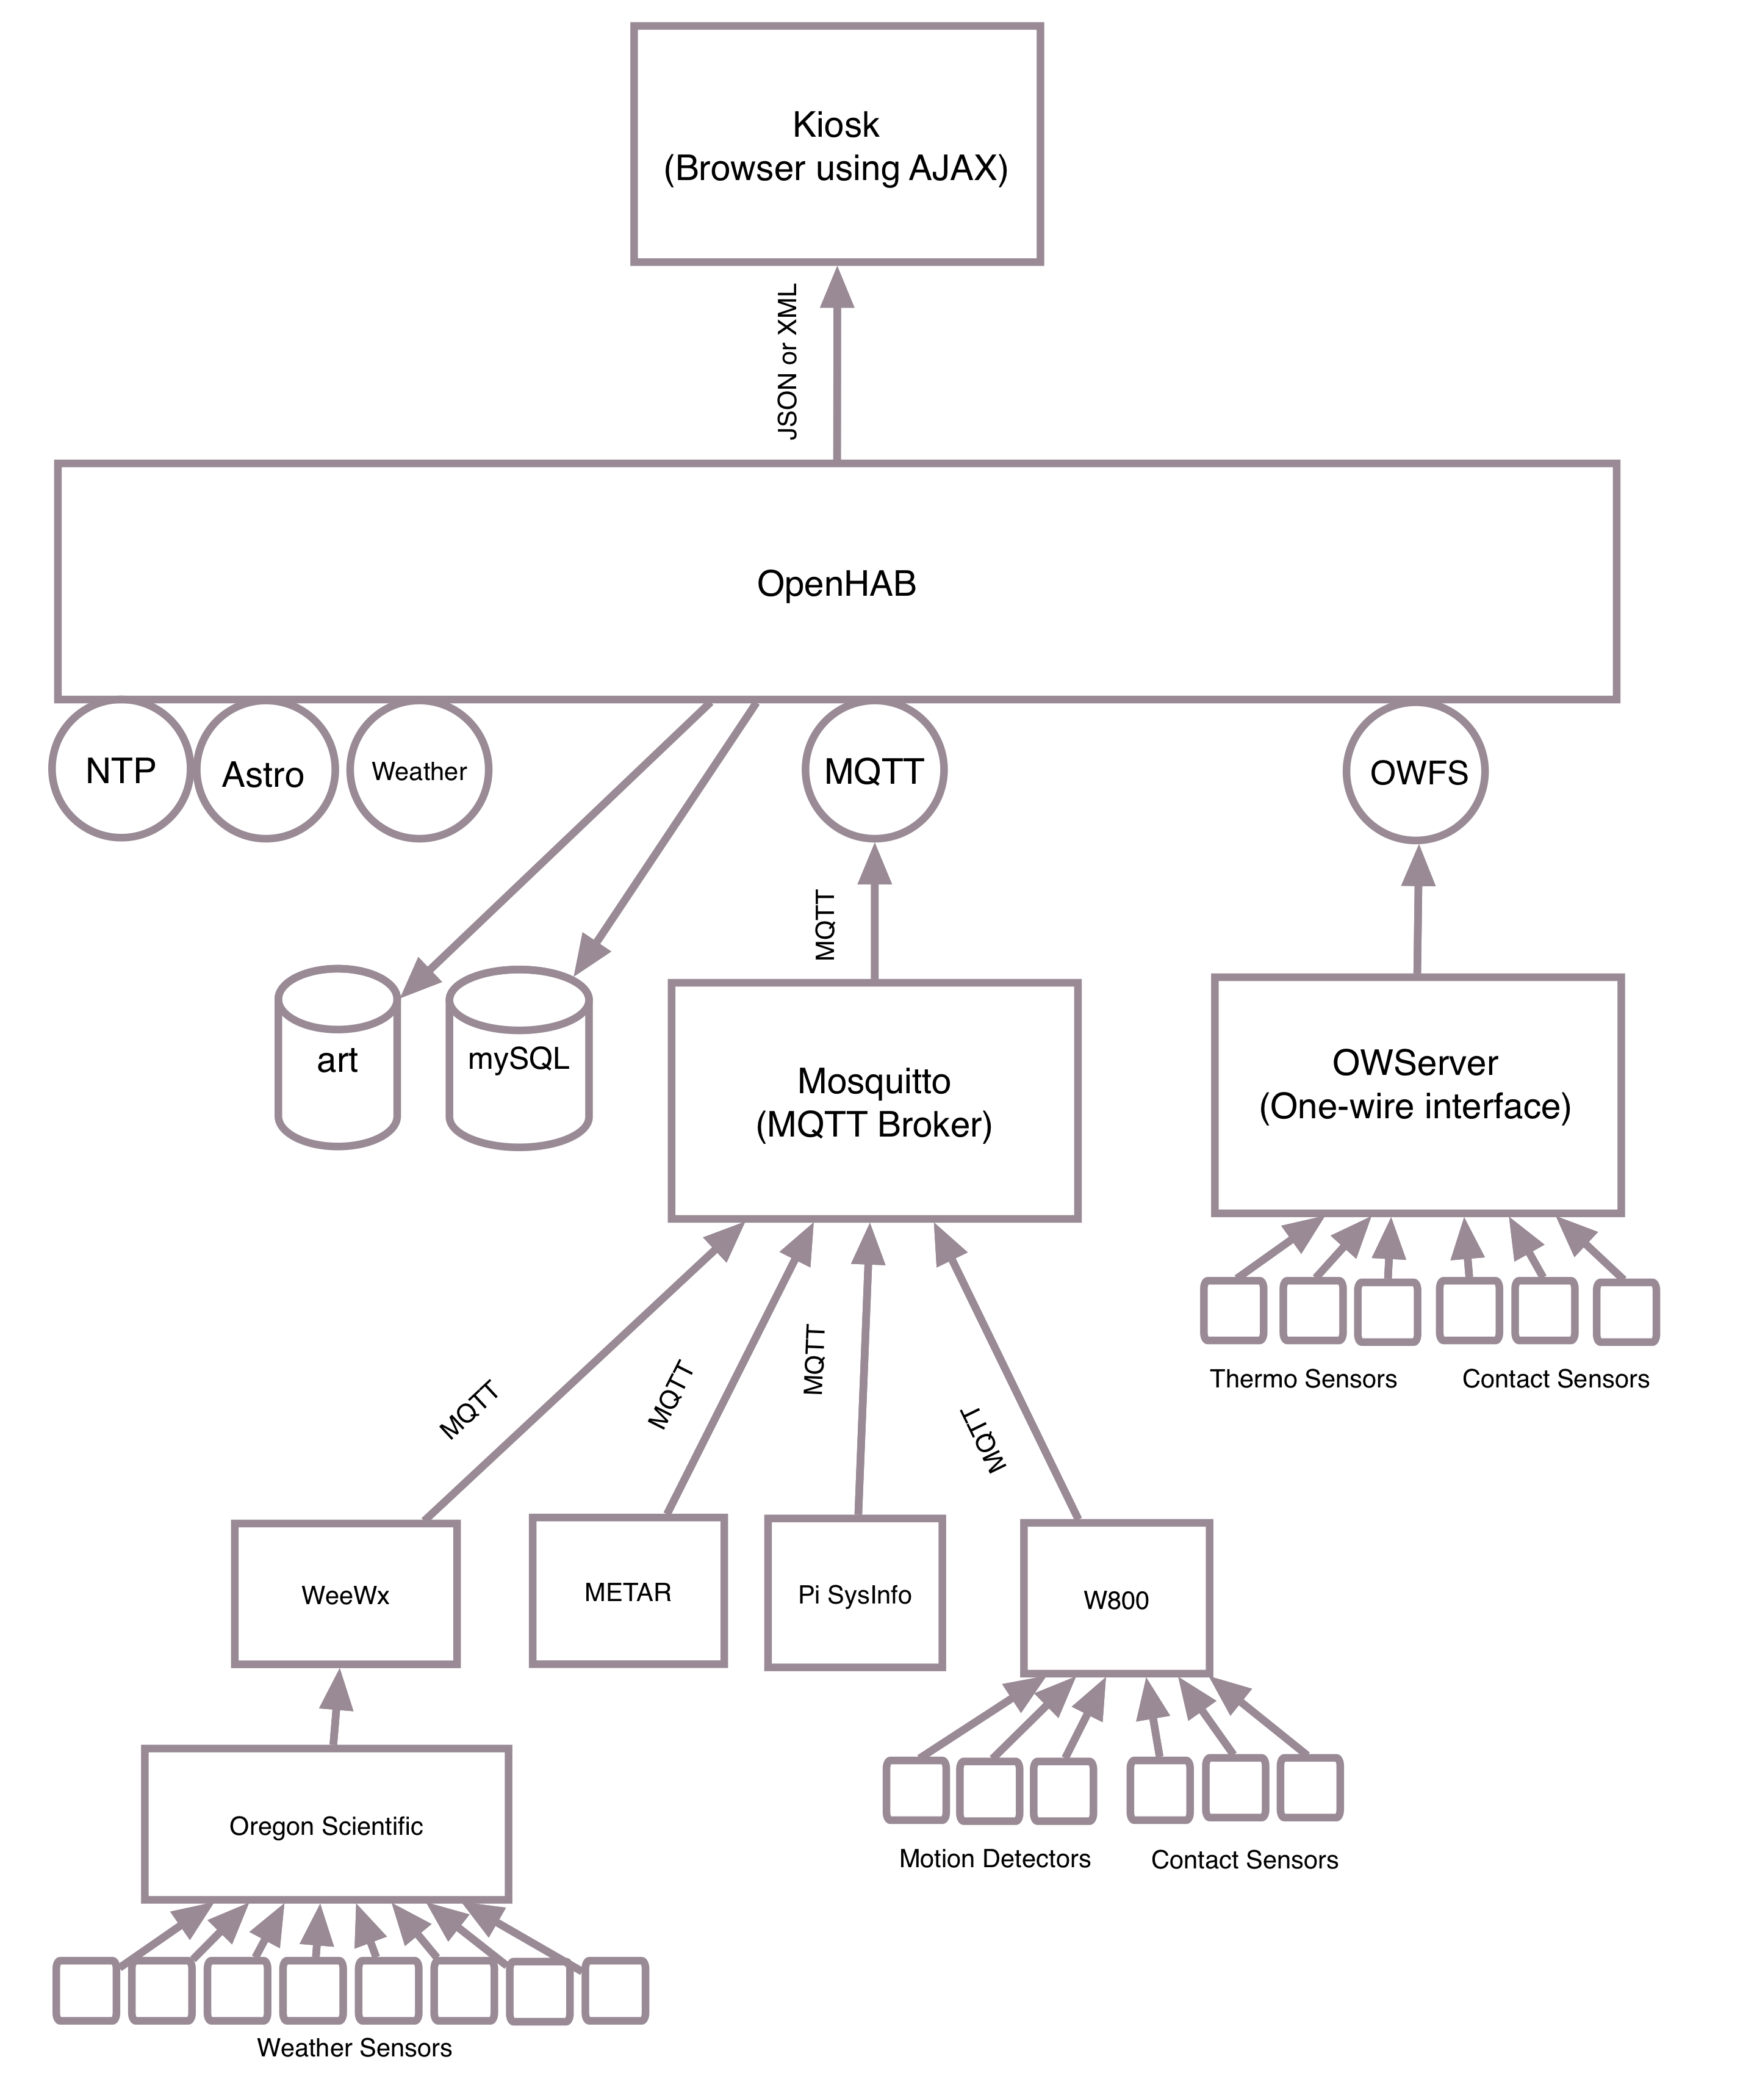
My Experience with OpenHAB

Slide 50
MQTT
Simple messaging protocol
Simple interface:
  Topic string (“major/minor”)
  Payload (value)
  QOS (at most once, at least once, exactly once)
  Retention
Great for ad hoc data

Slide 51
MQTT Broker
Information is published to the broker
Information is subscribed from the broker
Mosquitto is an open source broker that is easy to use

Slide 52
Paho-MQTT Library for Python
Fairly flexible functions
Single publish that internally connects, publishes and disconnects
Multiple publish by connect, publish items, disconnect
Has callback capabilities for subscribing

Slide 53
Example Uses of MQTT
Interfaced METAR weather records
Interfaced W800 to access X-10 RF and “security” devices
Used MQTT capabilities of weewx to interface Oregon Scientific weather station
Scraped web for exchange rates
Scraped web for fire hazard status
Scraped web for marine forecast

Slide 54
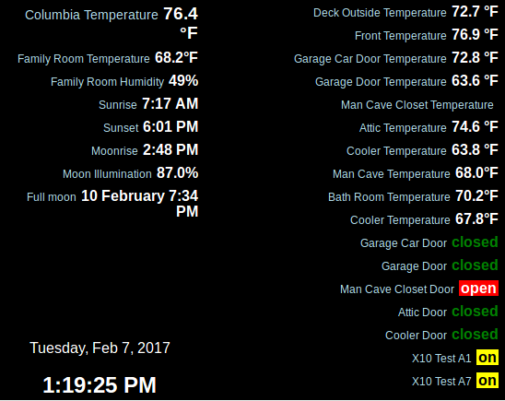
Kiosk

Slide 55
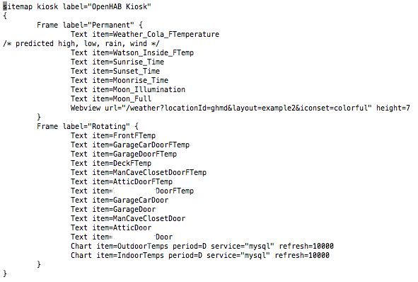
Sitemap for Simple Kiosk

Slide 56
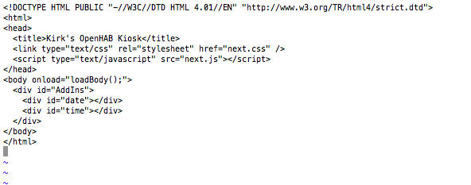
Kiosk.html

Slide 57
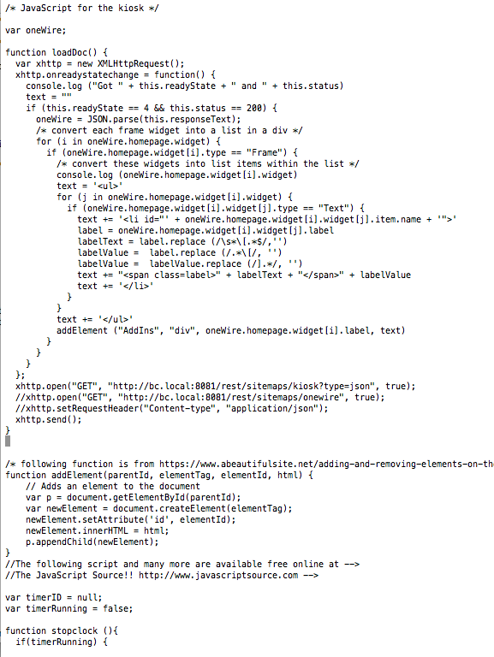
Kiosk.js
(partial)

