Slide 1
CSE 881 · Data Mining
Quantifying Health, Fitness,
and Progress Using Wearable Devices
An end-to-end prototype: PhysioNet ingestion · EM imputation · ML for VO₂max, body-fat %, activity · Flask dashboard
Team · Atharva · Spring 2026

Slide 2
Motivation & Problem Statement
The gap. Wearable devices continuously log heart rate, EDA, temperature, accelerometry — but users rarely get actionable fitness metrics back. The challenge. Extracting reliable indicators (VO₂max, body-fat %, session intensity) from noisy, missing, multi-rate time series and presenting them in context against clinical baselines.
46
subjects in the PhysioNet cohort
3
activity protocols: aerobic · anaerobic · stress
21M+
raw sensor rows ingested into SQLite
Quantifying Health, Fitness & Progress · CSE 881
2

Slide 3
Dataset · PhysioNet Wearable Device
Hongn et al., 2025 — Wearable Device Dataset from Induced Stress and Structured Exercise Sessions.
Demographics
Sensor streams
Subject ID · Age · Gender · Height · Weight · Activity history · Protocol version (V1/V2)
HR @ 1 Hz · TEMP @ 4 Hz · EDA @ 4 Hz · BVP @ 64 Hz · ACC (x,y,z) @ 32 Hz · IBI (event-based)
Segments
Clinical reference (scraped)
Three sessions per subject: AEROBIC · ANAEROBIC · STRESS — stored hierarchically in CSVs
VO₂max norms by age / sex / sport from fitness-science repositories (inscyd.com)
Quantifying Health, Fitness & Progress · CSE 881
3

Slide 4
End-to-End Pipeline
1
2
3
4
5
6
PhysioNet
CSVs
ETL
SQLite
EM
Imputation
Feature
Engineering
ML
Models
Flask
Dashboard
›
›
›
›
›
Raw files
per subject
wearable_data.db
7 tables
Multivariate-
Gaussian fill
HR, HRV, EDA,
ACC stats
Linear, Ridge,
RF, LogReg
Explore · Models
Predict
Every stage is a standalone Python module — reproducible, testable, re-runnable.
Quantifying Health, Fitness & Progress · CSE 881
4

Slide 5
Preprocessing · EM Imputation
Why EM? Mean imputation zeroes out correlations between sensor streams. Dropping rows deletes valid demographics. How it works • Assume multivariate Gaussian (μ, Σ). • E-step: fill missing cells with conditional means given observed cells. • M-step: re-estimate (μ, Σ) using filled data plus covariance correction. • Iterate until ‖Δμ‖ + ‖ΔΣ‖ < 10⁻⁴.
Synthetic MCAR Benchmark
500 samples · 3-D multivariate normal · 15% MCAR Convergence in 6 iterations
0.76
MAE on held-out cells
(lower = better)
Also replaces sensor-stream spikes (|z|>5) with forward-filled rolling medians.
Quantifying Health, Fitness & Progress · CSE 881
5

Slide 6
Feature Engineering
One feature row per (subject, activity) · 51 columns · 94 rows total.
HR statistics
Thermoregulation
Skin conductance (EDA)
mean · std · min · max · P25 · P75 · range · linear slope · HR reserve used
temperature mean · std · drift · P25 / P75 over session
mean / std / peaks · captures stress response
Motion intensity
Heart-rate variability
Demographics + encoded
accelerometer magnitude √(x²+y²+z²) — mean · std · range
SDNN · RMSSD · mean IBI — parasympathetic proxies
age · height · weight · gender_m · active_bin · activity one-hots
Quantifying Health, Fitness & Progress · CSE 881
6

Slide 7
Models & Target Construction
VO₂max
Body-fat %
Activity class
Target formula
Target formula
Target formula
15 · HR_max / HR_rest
1.20·BMI + 0.23·age − 10.8·sex − 5.4
AEROBIC / ANAEROBIC / STRESS
Source
Source
Source
Uth-Sorensen field estimate (mL/kg/min).
Deurenberg BMI-based equation.
Protocol label from the dataset.
Models evaluated
Models evaluated
Models evaluated
Linear · Ridge · RandomForest
Linear · Ridge · RandomForest
LogReg · RandomForest
75/25 train/test split · scikit-learn · StandardScaler for linear models.
Quantifying Health, Fitness & Progress · CSE 881
7

Slide 8
Results · Regression Tasks
VO₂max
Body-fat %
sorted by RMSE (lower is better)
sorted by R² (higher is better)
RandomForest wins both — captures non-linear HR-rest/HR-max and demographic interactions that linear models miss.
Quantifying Health, Fitness & Progress · CSE 881
8

Slide 9
Results · Activity Classification
3-way classification — AEROBIC · ANAEROBIC · STRESS (94 sessions)
0.750
Best accuracy
0.718
Best F1 (macro)
0.863
Best ROC-AUC
Quantifying Health, Fitness & Progress · CSE 881
9

Slide 10
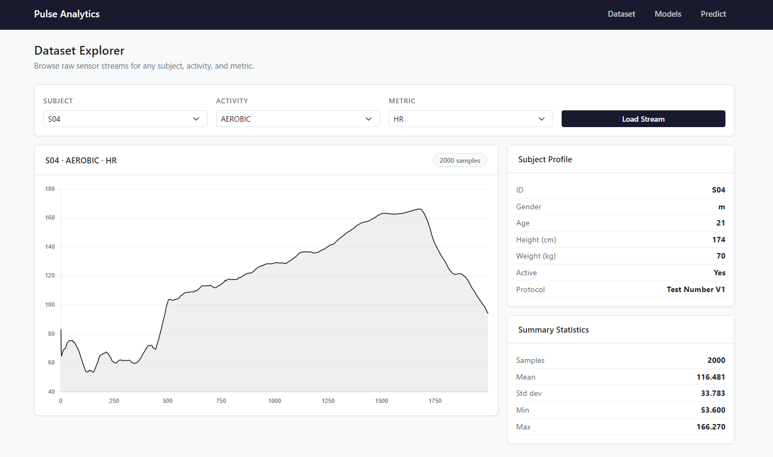
Prototype · Dataset Explorer
Live per-subject, per-activity sensor stream viewer — HR, EDA, TEMP, BVP, ACC channels, with summary statistics (mean, std, min, max) computed on the fly.
Quantifying Health, Fitness & Progress · CSE 881
10

Slide 11
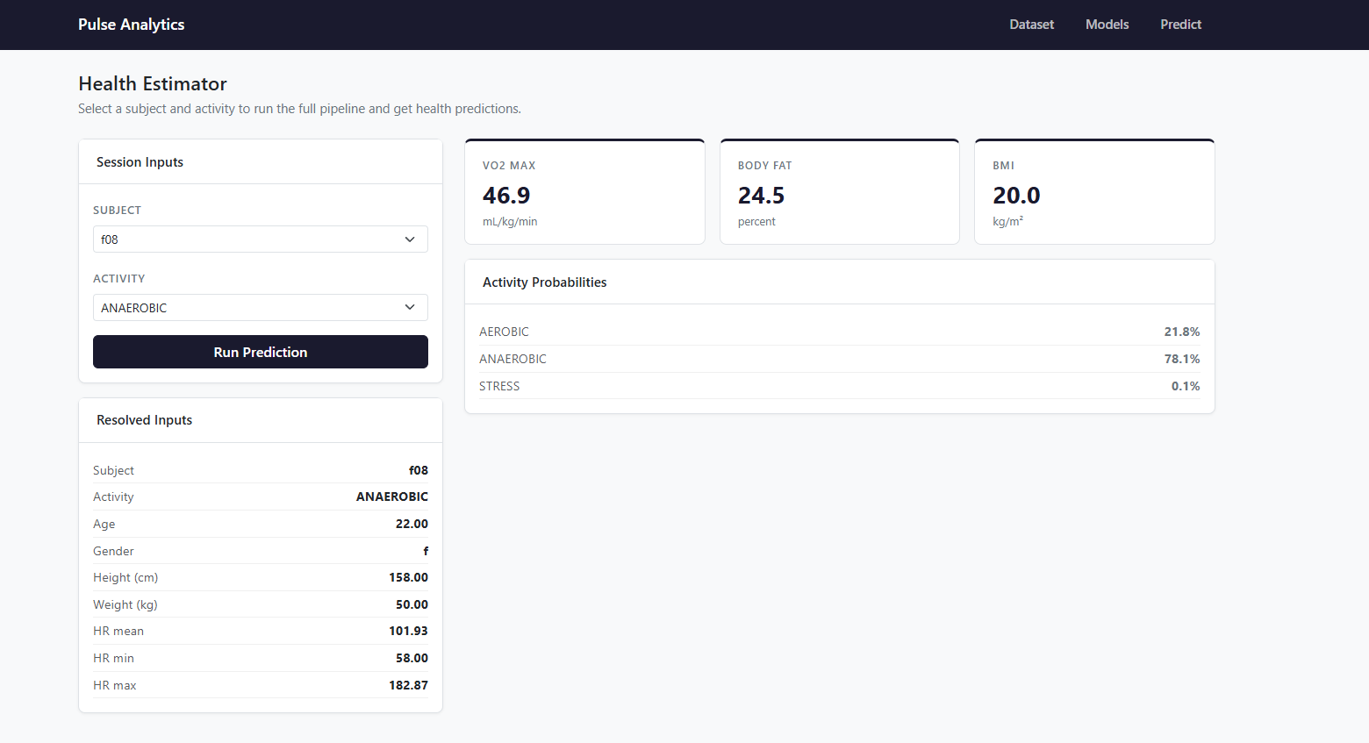
Prototype · Health Estimator
Runs the full trained pipeline on user-entered demographics + HR inputs and returns VO₂max, body-fat %, BMI, and activity-class probabilities.
Quantifying Health, Fitness & Progress · CSE 881
11

Slide 12
Conclusion & Future Work
What we delivered
Limitations & next steps
· Reproducible ETL into SQLite (21M+ rows).· Hand-rolled multivariate-Gaussian EM imputer + sklearn sanity check.· 51-feature session table driving 3 ML tasks.· Best: VO₂max RMSE 1.13 · Body-fat R² 0.87 · Activity F1 0.72.· Flask dashboard with explore / models / predict views.
· Only 46 subjects — small N limits generalisation.· Targets are physiology proxies, not gold-standard lab values.· Add subject-level cross-validation and calibration curves.· Bring in external clinical datasets for real VO₂max labels.· Deploy as a lightweight PWA with live wearable sync.
Thank you — questions?

