Slide 1


Final Project
Kevin Kirkpatrick

Slide 2


Final Project
A Problem Worth Solving, Analysing and Visualising
The Data
The Preparation
The Visualisation
The Forecasting
The Assumptions & Unknowns

Slide 3
A Problem Worth Solving, Analysing and Visualising

Slide 4
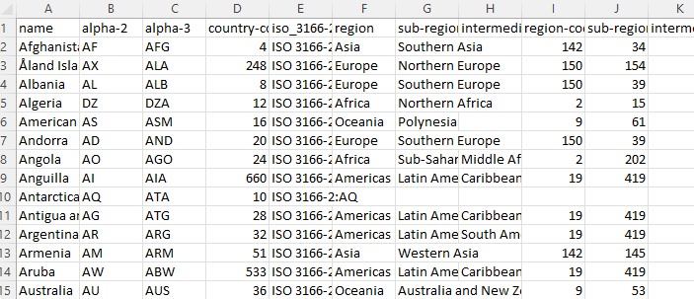
The Data
The data utilised for this project represents all daily COVID-19 cases and related deaths recorded from 23/01/2020 to 30/04/2022
A ‘continents’ data file representing all countries and the continent (region) and sub-region along with 2 and 3 character short name lists (“ Australia” – “AU or “AUS”)

Slide 5
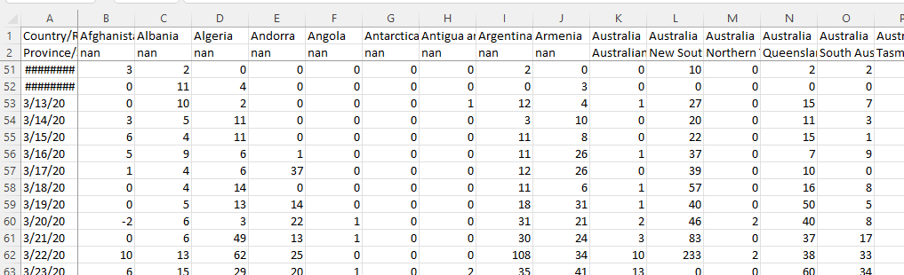
The Data
The second and third datasets represent by date and by country and province all:
Cases; and
Deaths

Slide 6
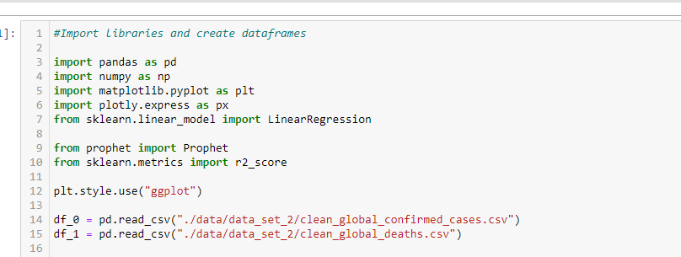
The Preparation

Slide 7
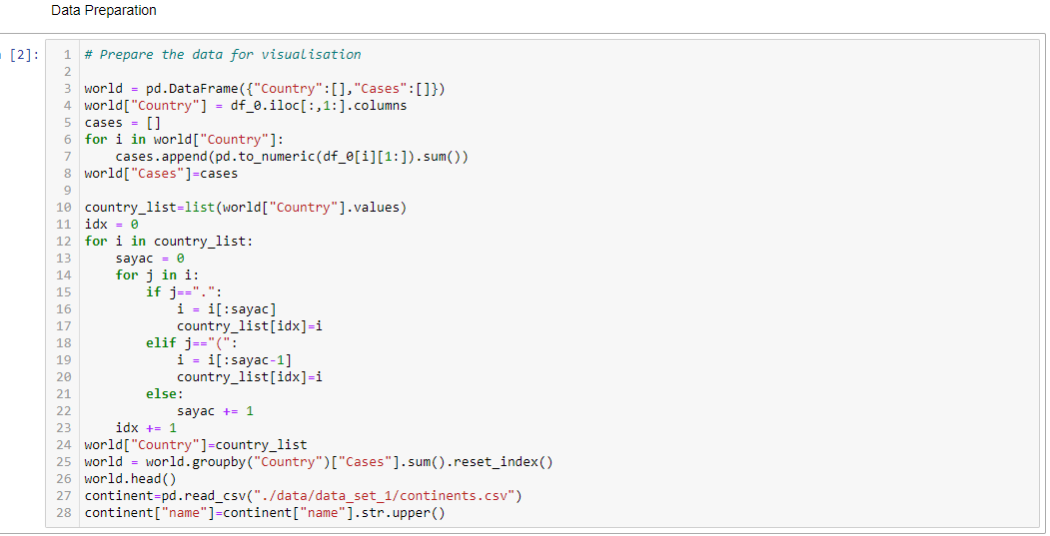
The Preparation

Slide 8
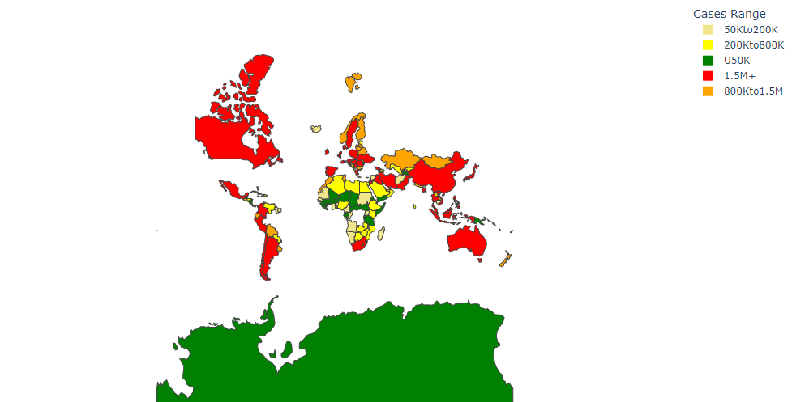
The Visualisation

Slide 9
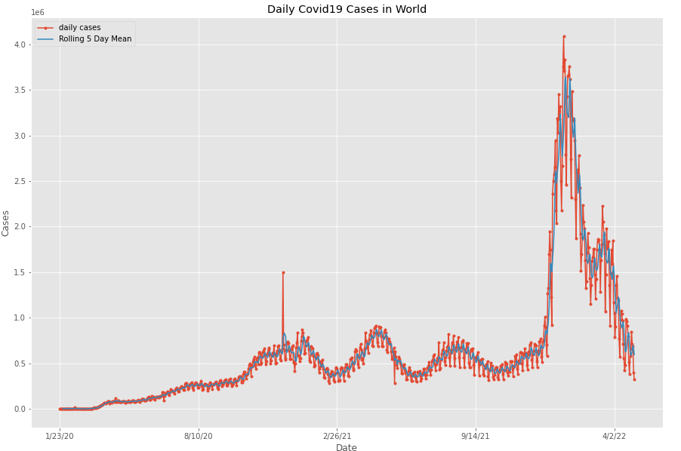
The Visualisation

Slide 10
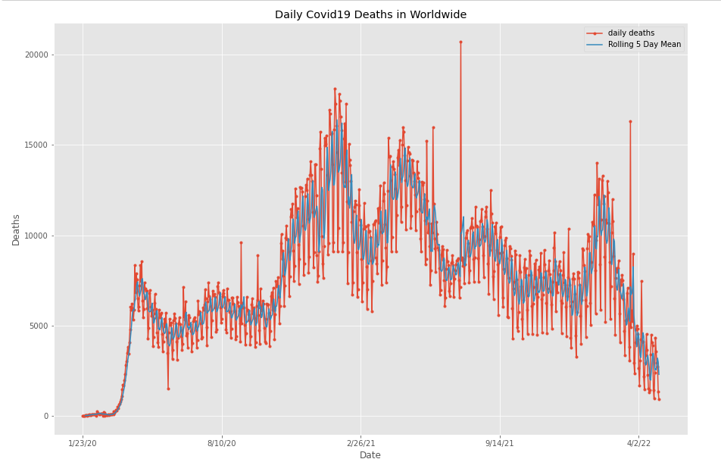
The Visualisation

Slide 11
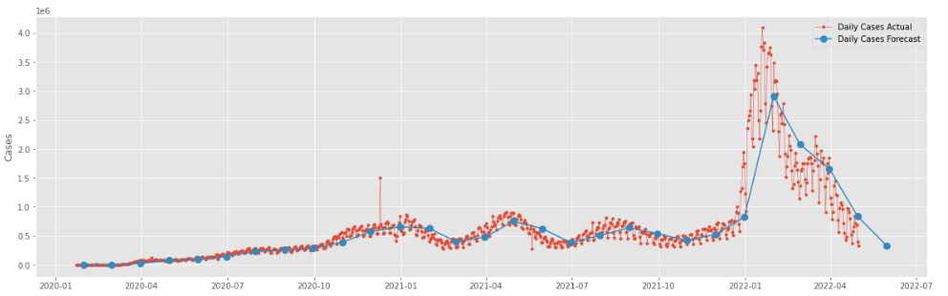
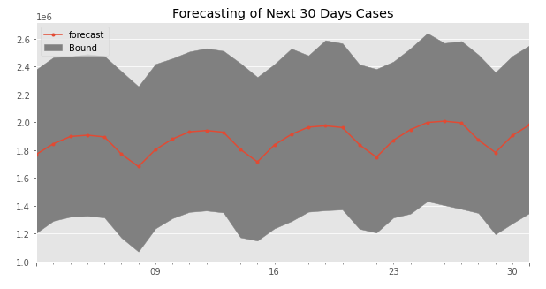
The Forecasting

Slide 12
The Assumptions & Unknowns

Slide 13
Sources & References

Slide 14
Thank You

