Slide 2

Topics
Introduction to Repetition Structures
The while Loop: a Condition-Controlled Loop
The for Loop: a Count-Controlled Loop
Calculating a Running Total
Sentinels
Input Validation Loops
Nested Loops

Slide 3
Introduction to Repetition Structures
Often have to write code that performs the same task multiple times
  Disadvantages to duplicating code
    Makes program large
    Time consuming
    May need to be corrected in many places
Repetition structure: makes computer repeat included code as necessary
  Includes condition-controlled loops and count-controlled loops

Slide 4
The while Loop: a Condition-Controlled Loop
while loop: while condition is true, do something
  Two parts:
    Condition tested for true or false value
    Statements repeated as long as condition is true
  In flow chart, line goes back to previous part
  General format:
    while condition:
    statements

Slide 5
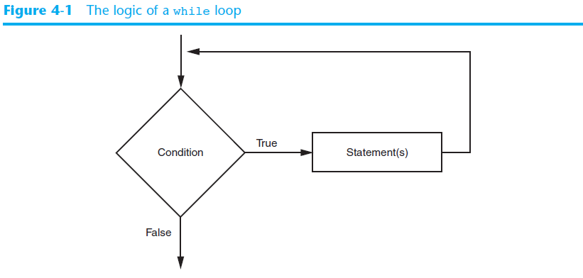
The while Loop: a Condition-Controlled Loop (cont’d.)

Slide 6
The while Loop: a Condition-Controlled Loop (cont’d.)
In order for a loop to stop executing, something has to happen inside the loop to make the condition false
Iteration: one execution of the body of a loop
while loop is known as a pretest loop
  Tests condition before performing an iteration
    Will never execute if condition is false to start with
    Requires performing some steps prior to the loop

Slide 7
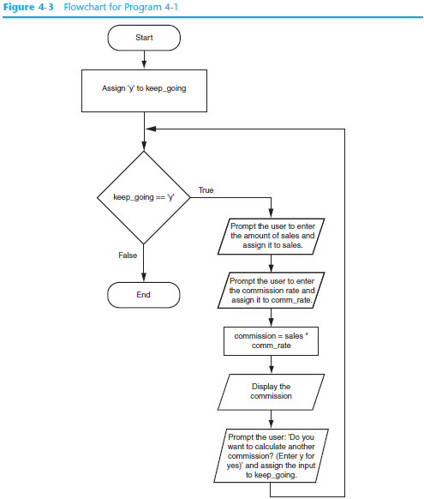

Slide 8
Infinite Loops
Loops must contain within themselves a way to terminate
  Something inside a while loop must eventually make the condition false
Infinite loop: loop that does not have a way of stopping
  Repeats until program is interrupted
  Occurs when programmer forgets to include stopping code in the loop

Slide 9
The for Loop: a Count-Controlled Loop
Count-Controlled loop: iterates a specific number of times
  Use a for statement to write count-controlled loop
    Designed to work with sequence of data items
      Iterates once for each item in the sequence
    General format:
    for variable in [val1, val2, etc]:
    statements
    Target variable: the variable which is the target of the assignment at the beginning of each iteration

Slide 10
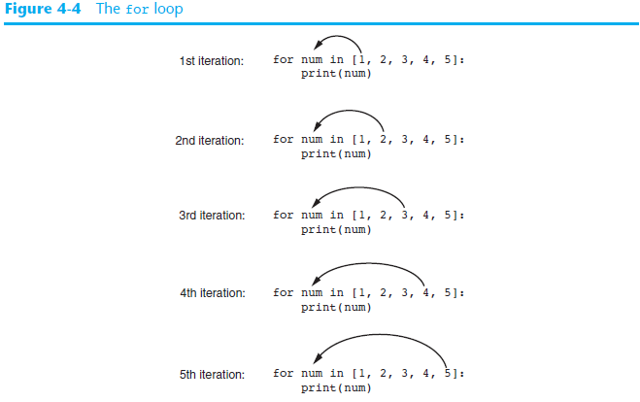

Slide 11
Using the range Function with the for Loop
The range function simplifies the process of writing a for loop
  range returns an iterable object
    Iterable: contains a sequence of values that can be iterated over
range characteristics:
  One argument: used as ending limit
  Two arguments: starting value and ending limit
  Three arguments: third argument is step value

Slide 12
Using the Target Variable Inside the Loop
Purpose of target variable is to reference each item in a sequence as the loop iterates
Target variable can be used in calculations or tasks in the body of the loop
  Example: calculate square root of each number in a range

Slide 13
Letting the User Control the Loop Iterations
Sometimes the programmer does not know exactly how many times the loop will execute
Can receive range inputs from the user, place them in variables, and call the range function in the for clause using these variables
  Be sure to consider the end cases: range does not include the ending limit

Slide 14
Generating an Iterable Sequence that Ranges from Highest to Lowest
The range function can be used to generate a sequence with numbers in descending order
  Make sure starting number is larger than end limit, and step value is negative
  Example: range (10, 0, -1)

Slide 15
Calculating a Running Total
Programs often need to calculate a total of a series of numbers
  Typically include two elements:
    A loop that reads each number in series
    An accumulator variable
  Known as program that keeps a running total: accumulates total and reads in series
  At end of loop, accumulator will reference the total

Slide 16
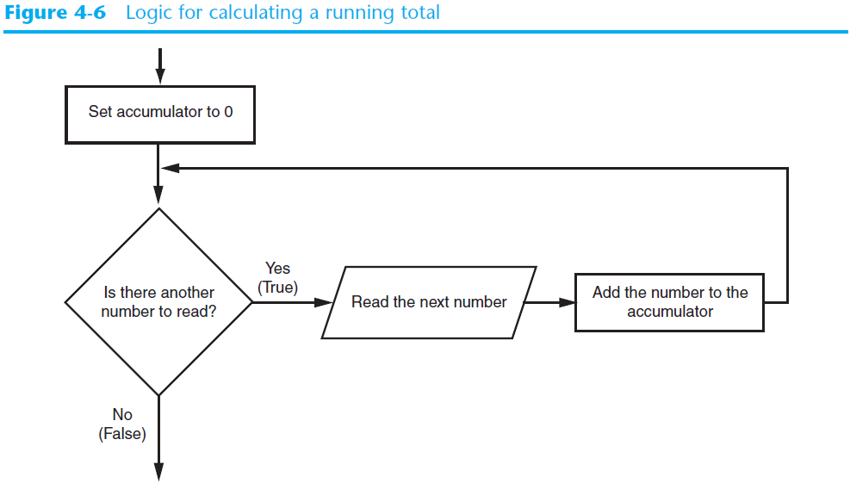
Calculating a Running Total (cont’d.)

Slide 17
The Augmented Assignment Operators
In many assignment statements, the variable on the left side of the = operator also appears on the right side of the = operator
Augmented assignment operators: special set of operators designed for this type of job
  Shorthand operators

Slide 18
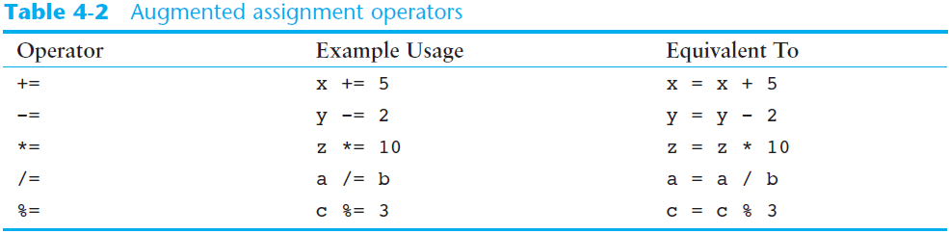
The Augmented Assignment Operators (cont’d.)

Slide 19
Sentinels
Sentinel: special value that marks the end of a sequence of items
  When program reaches a sentinel, it knows that the end of the sequence of items was reached, and the loop terminates
  Must be distinctive enough so as not to be mistaken for a regular value in the sequence
  Example: when reading an input file, empty line can be used as a sentinel

Slide 20
Input Validation Loops
Computer cannot tell the difference between good data and bad data
  If user provides bad input, program will produce bad output
  GIGO: garbage in, garbage out
  It is important to design program such that bad input is never accepted

Slide 21
Input Validation Loops (cont’d.)
Input validation: inspecting input before it is processed by the program
  If input is invalid, prompt user to enter correct data
  Commonly accomplished using a while loop which repeats as long as the input is bad
    If input is bad, display error message and receive another set of data
    If input is good, continue to process the input

Slide 22
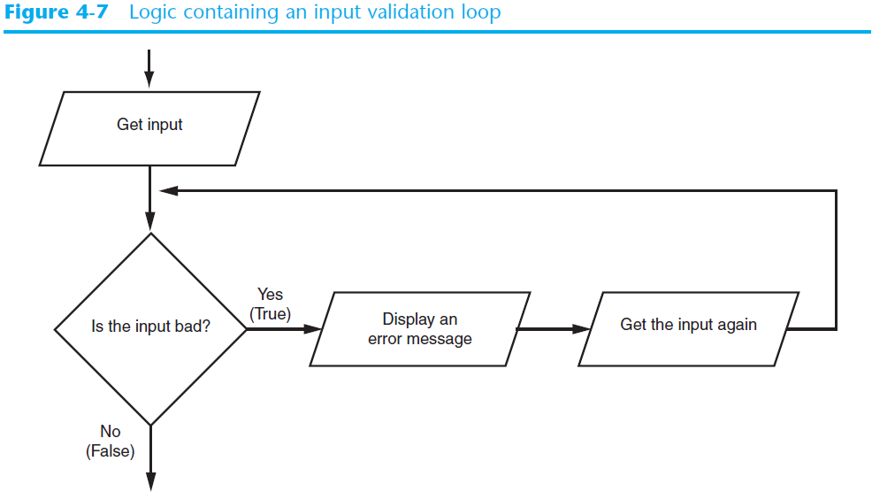
Input Validation Loops (cont’d.)

Slide 23
Nested Loops
Nested loop: loop that is contained inside another loop
  Example: analog clock works like a nested loop
    Hours hand moves once for every twelve movements of the minutes hand: for each iteration of the “hours,” do twelve iterations of “minutes”
    Seconds hand moves 60 times for each movement of the minutes hand: for each iteration of “minutes,” do 60 iterations of “seconds”

Slide 24
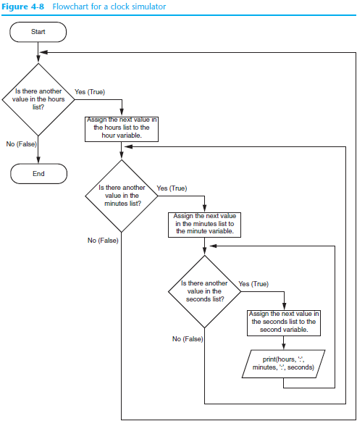

Slide 25
Nested Loops (cont’d.)
Key points about nested loops:
  Inner loop goes through all of its iterations for each iteration of outer loop
  Inner loops complete their iterations faster than outer loops
  Total number of iterations in nested loop: number_iterations_inner x
  number_iterations_outer

Slide 26
Summary
This chapter covered:
  Repetition structures, including:
    Condition-controlled loops
    Count-controlled loops
    Nested loops
  Infinite loops and how they can be avoided
  range function as used in for loops
  Calculating a running total and augmented assignment operators
  Use of sentinels to terminate loops

Slide 27
Interactive Mode
When you start Python in interactive mode, you will see a prompt
  Indicates the interpreter is waiting for a Python statement to be typed
  Prompt reappears after previous statement is executed
  Error message displayed If you incorrectly type a statement
Good way to learn new parts of Python

Slide 28
Writing Python Programs and Running Them in Script Mode
Statements entered in interactive mode are not saved as a program
To have a program use script mode
  Save a set of Python statements in a file
  The filename should have the .py extension
  To run the file, or script, type
  python filename
  at the operating system command line

Slide 29
The IDLE Programming Environment
IDLE (Integrated Development Program): single program that provides tools to write, execute and test a program
  Automatically installed when Python language is installed
  Runs in interactive mode
  Has built-in text editor with features designed to help write Python programs

Slide 30
Summary
This chapter covered:
  Main hardware components of the computer
  Types of software
  How data is stored in a computer
  Basic CPU operations and machine language
  Fetch-decode-execute cycle
  Complex languages and their translation to machine code
  Installing Python and the Python interpreter modes

