Slide 1
Empirical Analysis of the German Caselaw on SEP Injunctions after Huawei v ZTE
Dr. Justus A. Baron
Northwestern University & BRELA Bureau d’Etudes

Slide 2
Introduction
Important technology standards such as 5G, WiFi 6, and HEVC are governed by numerous Standard-Essential Patents (SEPs) owned by various firms.
Disputes over SEP licenses often lead to litigation in different national court systems worldwide.
Two global approaches have emerged: determining Fair, Reasonable, and Non-Discriminatory (FRAND) royalty rates and handling injunctive relief differently.
Differences in court approaches create friction and parallel litigations.
In some countries like the US, Japan, and Korea, obtaining injunctive relief for SEP owners is challenging.
However, SEP injunctions still occur in jurisdictions like Germany, the Netherlands, and China, with Germany being a prominent venue.

Slide 3
Injunctions issued by German courts can have worldwide effects, influencing negotiations.
Concerns about German jurisprudence on SEP litigation have prompted actions such as seeking anti-suit injunctions in foreign jurisdictions.
Criticisms of German courts overlook recent changes in SEP injunction jurisprudence.
The European Court of Justice's (ECJ) Huawei v ZTE decision introduced a framework for negotiating SEP licenses.
German courts have referenced and applied this framework, though interpretations vary.
Recent attention to SEP litigation in Germany has influenced EU policy, leading to proposed regulations aiming to increase consistency and reduce litigation.
The establishment of the Unified Patent Court (UPC) adds complexity to SEP injunction matters.

Slide 4
Our study focuses on the empirical analysis of German caselaw on SEP injunctions, aiming to describe outcomes rather than contribute to legal interpretation.
We examine the success of FRAND defenses in German courts, reasons for SEP holders or implementers prevailing, and factors influencing litigation outcomes.
Our dataset includes 71 regional court decisions involving FRAND defenses and injunction requests.
Through our analysis, we provide insights into the policy-relevant issue of SEP litigation outcomes in German courts.
Our findings highlight a balanced caselaw but also underscore concerns such as bifurcation and limited reviews of FRAND compliance.

Slide 5
Literature
Gniadek (2016): Reviewed post-Huawei v ZTE decisions, indicating a patentee-friendly approach by German courts.
Pentheroudakis and Baron (2017): Analyzed SEP litigation decisions globally, highlighting divergences in German courts' approaches.
Nolte and Rosenblum (2017): Focused on German caselaw on injunctions in SEP cases, reviewing 22 post-Huawei decisions.
Tapia and Markis (2018): Examined German court decisions to elucidate Huawei v ZTE requirements for patent owners and licensees.
Picht (2019): Discussed German law on patent injunctions, including competition law considerations and impacts of Huawei v ZTE.
Colangelo and Aguggia (2023): Reviewed recent German caselaw, emphasizing the alignment with Huawei v ZTE standards.

Slide 6
Habich (2022): Provided a comprehensive overview in German on FRAND defenses in SEP injunction cases, focusing on regional and appellate court decisions from 2017 to 2019.
Contreras et al. (2017): Analyzed litigations involving declared SEPs in Germany and the UK, highlighting an increase in assertions driven by NPEs and settlement trends.
Baron et al. (2023): Identified the significant role of German courts in SEP litigation in Europe and analyzed the timing and frequency of disputes.
Cremers et al. (2016): Investigated patent litigation cases in Europe, noting the occurrence of "parallel litigations" and "injunction gaps."
Literature Gap: Despite numerous reviews, there's a lack of comprehensive empirical studies on German court decisions regarding SEP injunctions. Existing studies focus on earlier periods or specific aspects, leaving a gap in analyzing FRAND defenses under Huawei v ZTE.
Empirical Studies in the US: Contrasts with the growing body of empirical studies in the US, providing statistical evidence on outcomes and procedural events in SEP disputes.

Slide 7
Existing German Studies: Primarily focus on pre-Huawei v ZTE decisions and provide limited analysis beyond infringement and invalidity findings.
Research Gap: Lack of comprehensive data analysis on the success of FRAND defenses, parties' likelihood of success, and the decisive factors in injunction decisions post-Huawei v ZTE.
Our Contribution: Aiming to fill this gap by providing a quantitative overview of German court decisions on SEP injunctions, focusing on the effectiveness of FRAND defenses under the Huawei v ZTE framework.

Slide 8
Methodology
Sample Selection
Defined criteria: Included first instance (Landgericht) court decisions post-Huawei v ZTE ruling (after July 16, 2015).
Transition cases: Decided after Huawei v ZTE ruling but initiated before, treated separately for analysis.
Inclusion criteria: Cases with infringed patents essential to a standard, subject to FRAND commitment, and plaintiff's injunction request.
Exclusion: Cases involving anti-suit or anti-anti-suit injunctions.
Data sources: Leveraged court websites, law firm databases, and prior studies, expanding through a snowball approach.
Dataset: Comprised 71 decisions spanning from August 2015 to August 2023.

Slide 9
Coding of Decisions
Extracted immediate information: Case number, court, decision on injunction, dates of relevant events, and amount in dispute.
Identified key dates in dispute through case descriptions: First contact, patent holder's licensing offer, complaint dates, and request for injunction dates.
Created variables for patent holder's licensing offers: Pool licensing and worldwide portfolio license offers.
Coded court decisions following Huawei v ZTE framework:
Dominant position
Abuse of dominant position
Notice of infringement,
Willingness to license
FRAND offer (formally and substantively).
Searched darts-ip database for further legal proceedings: Identified appeals to Higher Regional Court and Federal Court of Justice.
Extracted variables describing outcomes of appeals: Result of appeal, first instance, and judicial review.
Identified patent numbers and searched for validity proceedings: Found 44 parallel validity proceedings related to 64 of the cases.

Slide 10
Descriptive analysis

Slide 12
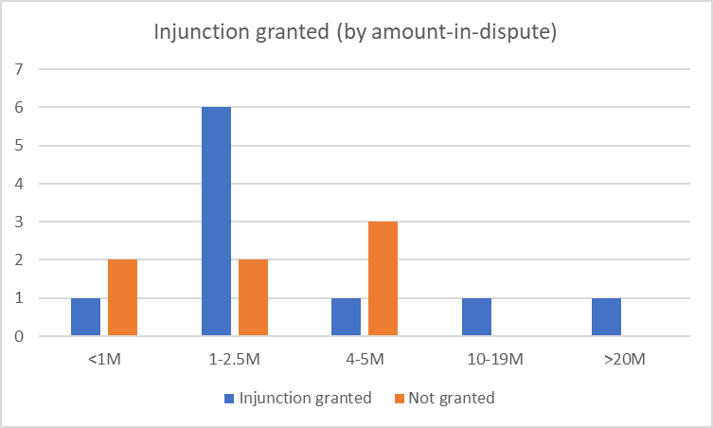

Slide 19
Discussion and takeaways
Balanced Reality:
Post-Huawei v ZTE, German courts exhibit balanced approach in SEP litigation.
Both SEP holders and implementers have similar success rates in FRAND defenses.
No indication of injunction likelihood correlating with the amount in dispute.
Valid Concerns:
Courts engage superficially with substance of FRAND offers.
Bifurcation of proceedings between validity and infringement raises concerns; many injunctions issued for later invalidated patents.
Areas for Improvement:
Disproportionate focus on individual patent validity over substantive FRAND character of offers.
Need for efficient, comprehensive resolution of disputes beyond narrow patent validity focus.

