Slide 1


Basic Selenium
By Khanh Tran, Thanh Tran
Dec, 2016
Better
Better

Slide 2
Course Goals and Objectives
By the end of this course you will
Have a good knowledge of Selenium
Understand advantages and disadvantages of Selenium
Know how to use the Selenium IDE
Understand some locator strategies and know how to use both CSS and XPath selectors
Know how to develop automation scripts using Selenium Webdriver technology

Slide 3
Outline
Introduction
Selenium IDE
Web Elements Identification
Selenium Web Driver
Test Frameworks used for Selenium Scripts
Notes:
1. Introduction (1h)
+ What is Selenium?
+ Overview of Selenium Framework
+ How Selenium work?
+ What Selenium can do?
+ What Selenium can not do?
2. Selenium IDE
Theory (2h)
+ Install Selenium IDE
+ Record and playback your test with Selenium IDE
+ Create test suite
+ Create test case
+ Execute test case
+ Others
+ Demo (1h)
3. Locators & Object Identification
Theory (3h)
+ Firebug
+ IE Developer tools
+ Google Chrome Developer tools
+ Finding web elements
- By ID, name, linktext
- By Xpath, CSS, DOM
Demo (3h)
+ All common Objects
+ Some special objects (third party…)
+ Some actions
4. Selenium WebDriver
+ Why WebDriver?
+ Architecture of selenium webdriver
+ Selenium webdriver language basics (Some useful commands)
+ Write a selenium webdriver test script
+ Running a selenium webdriver test script
5. Selenium test Frameworks
+ JUnit
+ TestNG
(Reference:
+ MS Unit
+ NUnit
)

Slide 4


Slide 5
1. Introduction
What is Selenium?
What Selenium can do?
Advantages and Disadvantages of Selenium
Selenium Components
How Selenium Work?
Overview of Selenium Framework?

Slide 6

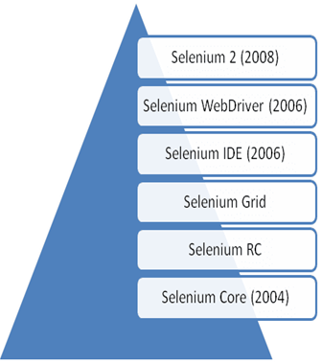
What is Selenium?
* A open-source functional testing framework for web applications * Developed Jason Huggins in 2004 for testing internal application at ThroughtWorks
* In 2006 Jason moved to Selenium team (a part of google) to develop Selenium WebDriver

Slide 7
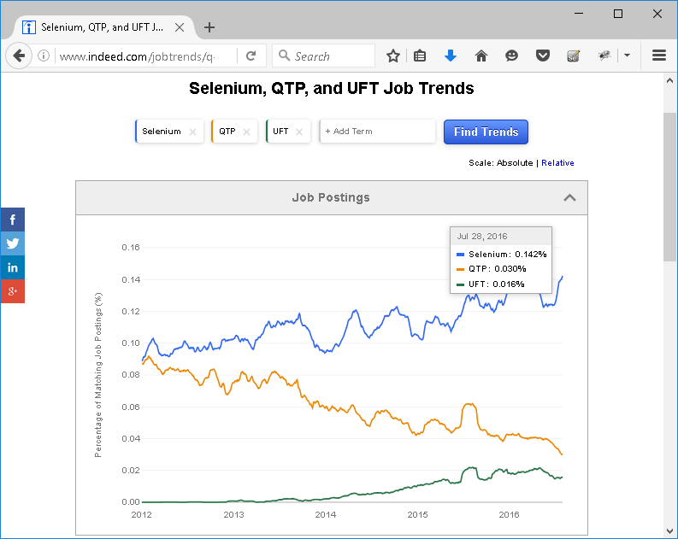
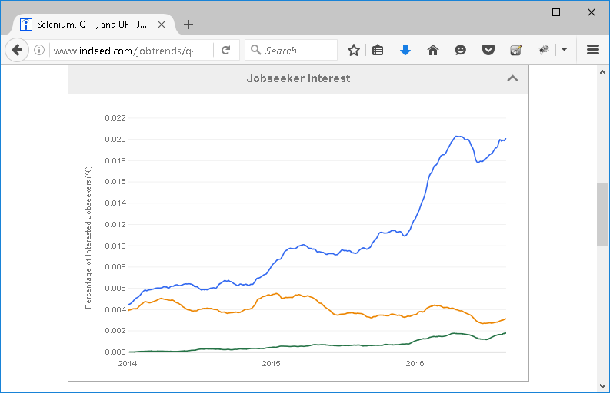
What is Selenium?
Job Trends

Slide 8
What Selenium can do?
Support capabilities
Cross Browser Testing (Chrome, Firefox, IE, Safari, Opera)
Multiple Operating System (Windows, Linux, Mac, Android, iOS)
Different Language Scripting (Java, C#, Python, Ruby, PHP, Perl, JavaScript, HTML)
Easy Framework Development (Keyword Driver, Data driven, etc)
Parallel Testing (Multiple browser in same time)

Slide 9
What Selenium can do?
Automation capabilities
Record and Play back
Full actions on all web elements
Verify check points
Reporting (need improvement)
Logging (need improvement)
Object identifier (HTML5, AngularJS, jQuery, JsRender)

Slide 10
Advantages and Disadvantages of Selenium
# | Advantages | # | Disadvantages
1 | Strong in web-based applications testing | 1 | Not support non web-based applications
2 | Option to choose programming language such as Java, C#, ruby, python | 2 | Expertise required in a particular programming language and Selenium framework
3 | It does not require license and is free | 3 | It has no official support, so technical issues need to rely on the selenium community forums
4 | Easily to integrated into CI + Easy to integrate with Visual Studio, TFS, MTM + Easy to integrate with Eclipse, Maven, SVN, Jenkins, Jira | 4 | Script requires more time to develop
5 | It is more suited for the Agile methodology of coding and testing + Daily builds + Scripting by QC/ Dev + Run tests everywhere / everyone

Slide 11
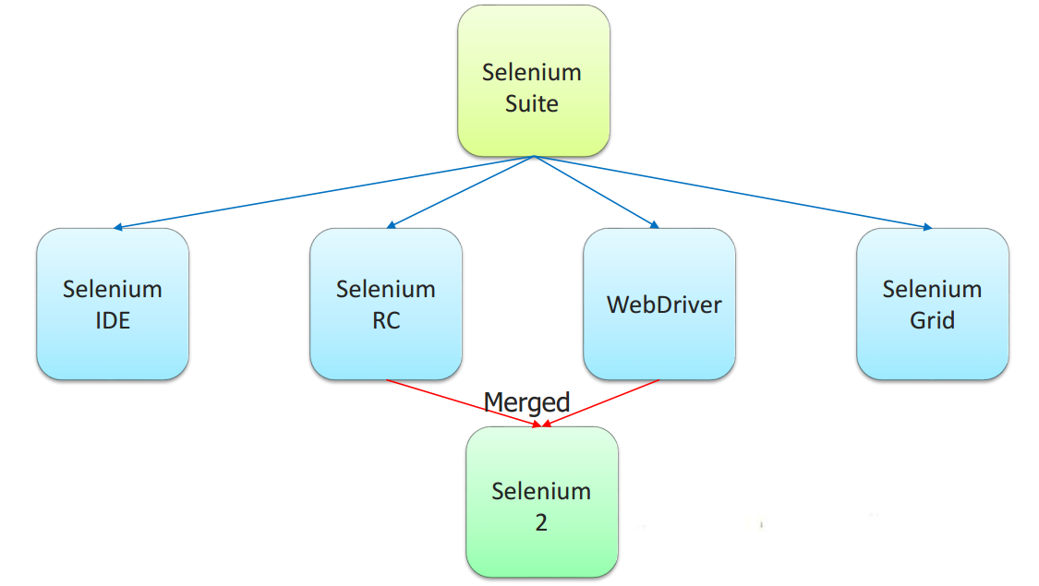
Selenium Components
Selenium Integrated Development Environment (IDE)
Selenium Remote Control (RC)
WebDriver
Selenium Grid

Slide 12
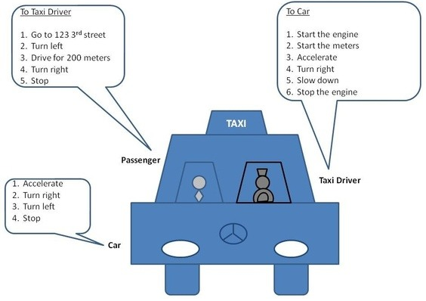
How Selenium work
The Client (Passenger) tells the Taxi Driver where he wants to go and how to get there
The Taxi Driver executes the client's requests. The taxi driver sends his own requests to the Car
The Car executes the taxi driver's requests

Slide 13
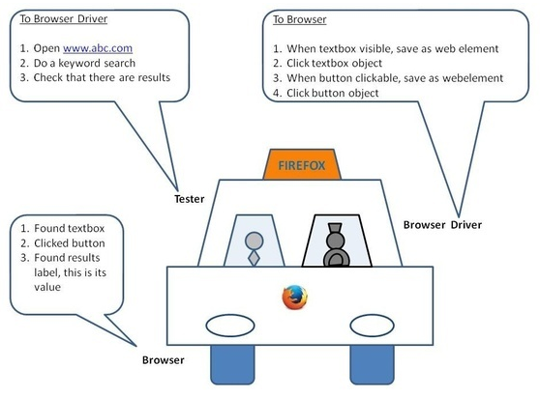
How Selenium work
Tester (Automation Engineer) writes the automation code. The automation code sends requests to the Browser Driver component
The Browser Driver component executes the test engineer requests. It sends its own request to the Browser
The Browser executes the browser driver requests

Slide 14
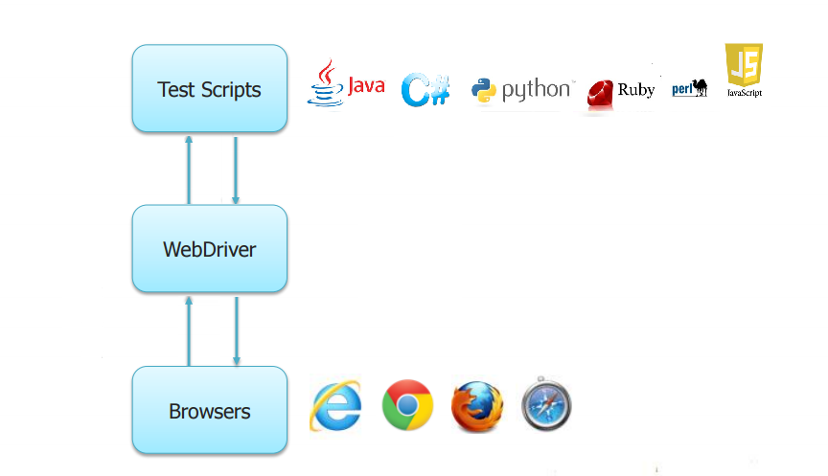
How Selenium work
Response
Request
Response
Request

Slide 15
How Selenium work
Selenium Client
Selenium Agent
Webdriver
Reference
http://docs.seleniumhq.org/download/
https://sites.google.com/a/chromium.org/chromedriver/downloads

Slide 16
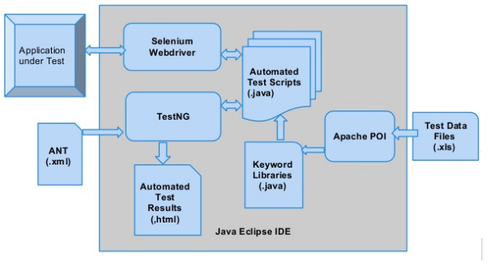
Overview of Selenium Framework

Slide 17


Slide 18
2. Selenium IDE
What is Selenium IDE?
What Selenium IDE can do?
Advantages and Disadvantages of Selenium
Install Selenium IDE
Main features
Some normal IDE commands
Practice 2.1: Record and Playback your tests
Practice 2.2: Create test suites / test cases
Practice 2.3: Execute test suites / test cases

Slide 19
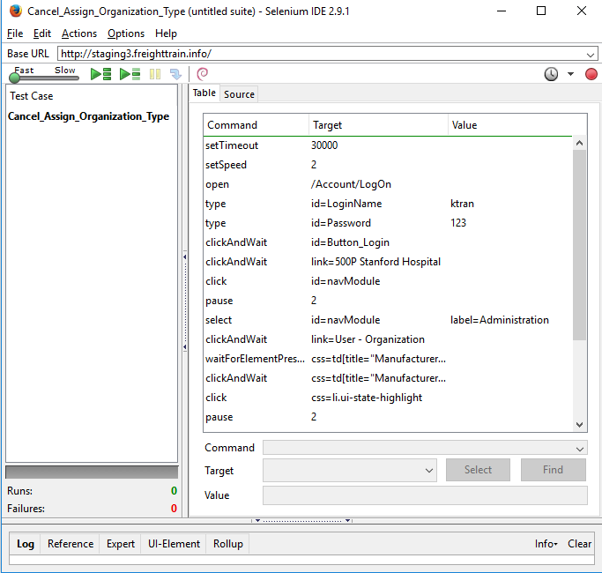
What is Selenium IDE
Firefox plug-in
Integrated Development Environment for Selenium tests

Slide 20
What Selenium IDE can do?
Provides record and play back functionality
Provides the ability to debug test scripts
Auto complete common selenium commands
Export tests in different formats like HTML, C#, Java, Python, Ruby
Support user extensions
Create test suites, test cases (scripts)
Execute scripts and reports
Create quick bug reproduction scripts

Slide 21
Advantages and Disadvantages of Selenium IDE
# | Advantages | # | Disadvantages
1 | No programming skills required | 1 | Based on Selenium Core
2 | Simple to develop | 2 | No code reuse
3 | Simple to use | 3 | No iterations and conditional statements
4 | Step by step debugger | 4 | Available for the Firefox only
5 | Extensible (plugins, JavaScript libs) | 5 | Difficult for checking complex test cases involving dynamic contents

Slide 22
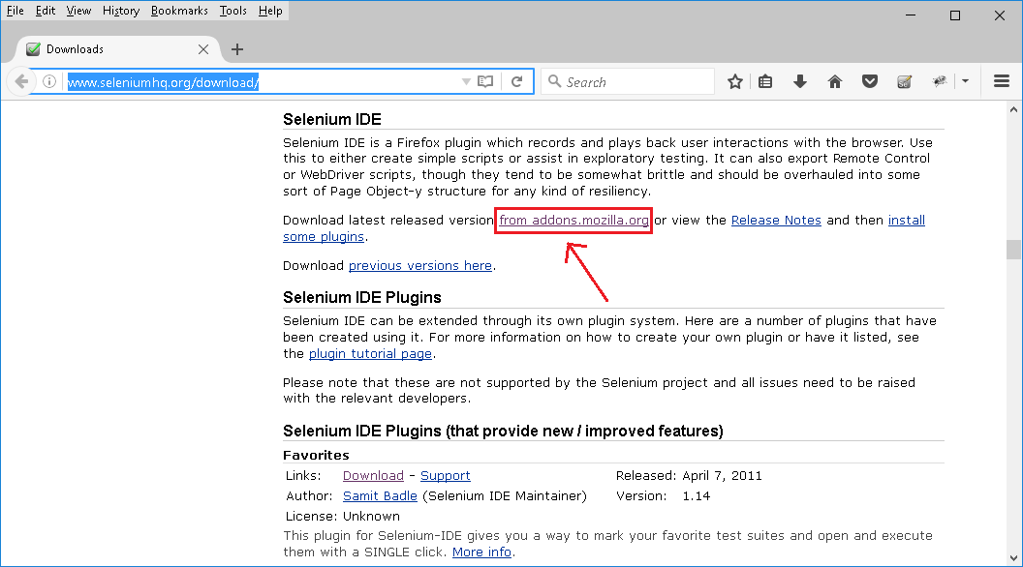
Install Selenium IDE
http://www.seleniumhq.org/download/

Slide 23
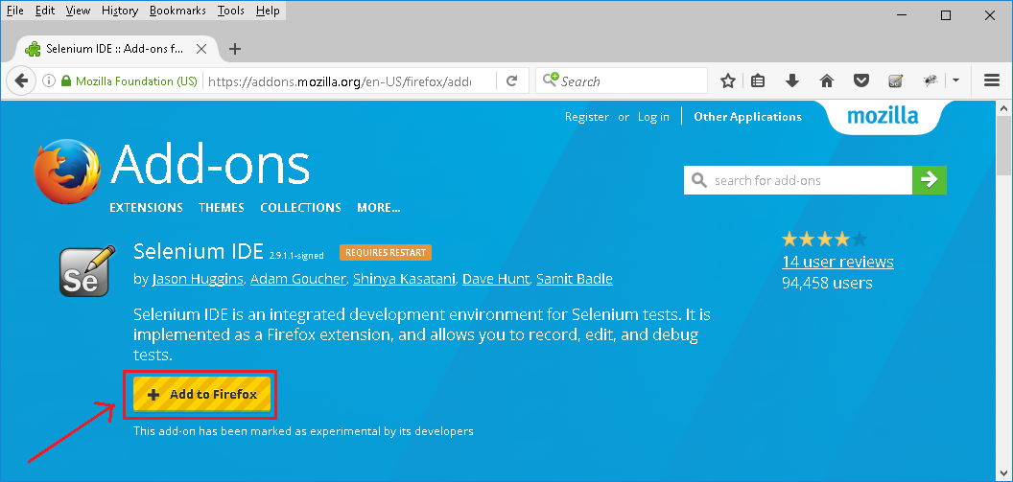
Install Selenium IDE
https://addons.mozilla.org/en-US/firefox/addon/selenium-ide/

Slide 24
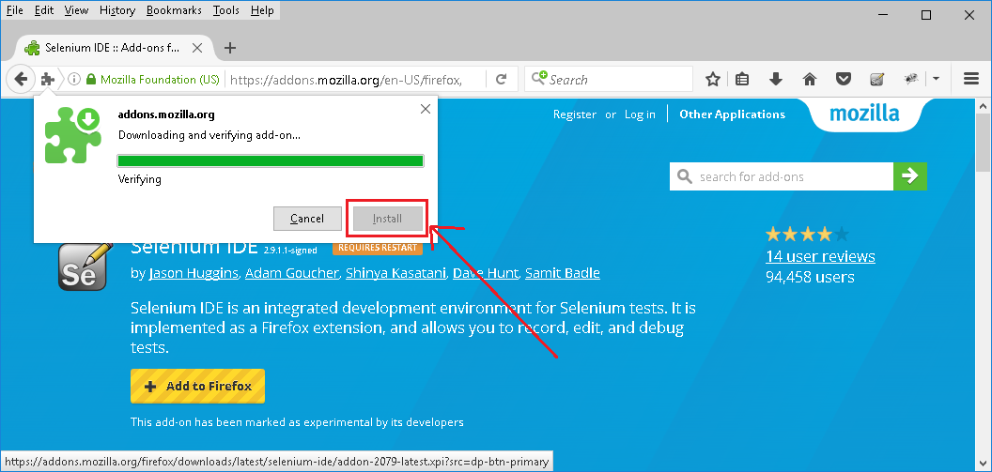
Install Selenium IDE
https://addons.mozilla.org/en-US/firefox/addon/selenium-ide/

Slide 25
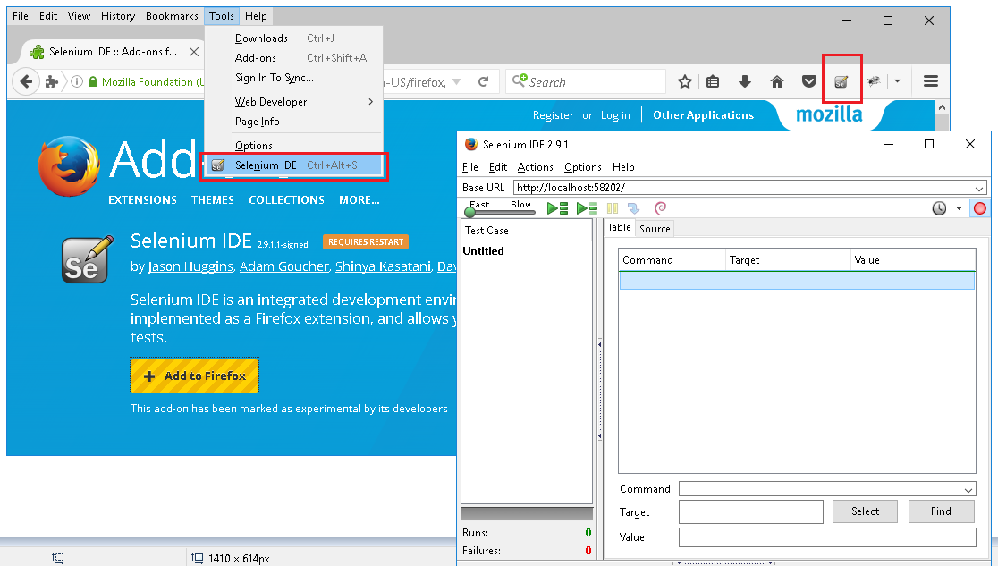
Install Selenium IDE
https://addons.mozilla.org/en-US/firefox/addon/selenium-ide/

Slide 26
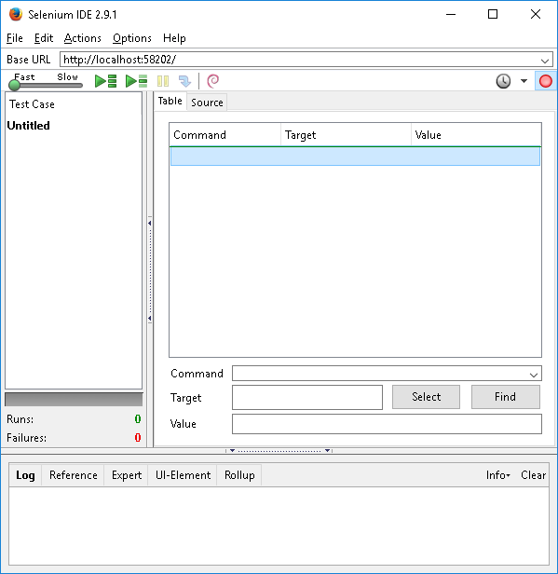
Main features
http://www.seleniumhq.org/docs/02_selenium_ide.jsp#ide-features
The root of web application you want to test
The list of actions in the actual test case to execute
Category of tests
The log of the events that were executed, including any errors or warning that may have occurred

Slide 27
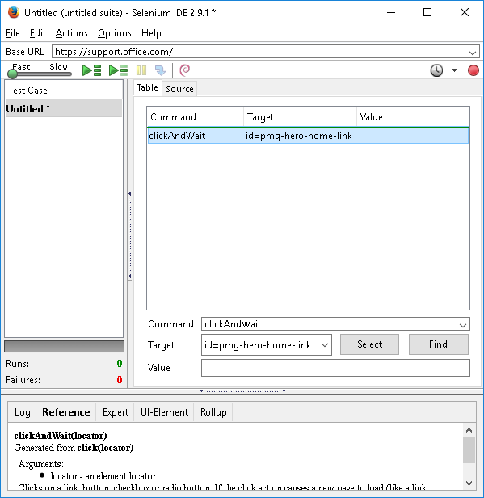
Main features
Execution Commands
Record test actions
Results of tests
Reference of the currently selected command
Specify commands, including asserts

Slide 28
Some normal IDE commands
http://www.frontendtest.org/blog/selenium-ide-commands/
Actions | Accessors | Assertions
open | store | verifyTitle/assertTitle
click/clickAndWait | storeTitle | verifyTextPresent
doubleClick/doubleClickAndWait | storeAlert | verifyElementPresent
check/checkAndWait | storeAttribute | verifyText
 | echo | waitForPageToLoad
 |  | waitForElementPresent
Reference
http://www.seleniumhq.org/docs/02_selenium_ide.jsp#selenium-commands-selenese

Slide 29
Record and Playback your tests
Practice 1
1: Start Firefox
2: Start Selenium IDE
3: Enable Recording
4: Open "http://www.seleniumhq.org/"
5: Click on "Projects" tab
6: Click on "Selenium IDE" textlink
7: Stop Recording
8: Insert two commands
setSpeed (2000)
assertTitle (Selenium IDE Plugins)
9: Playback the script
10: Verify the result

Slide 30
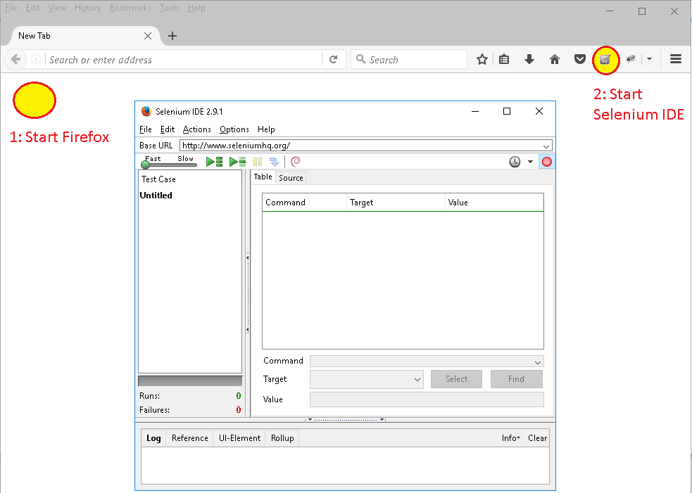
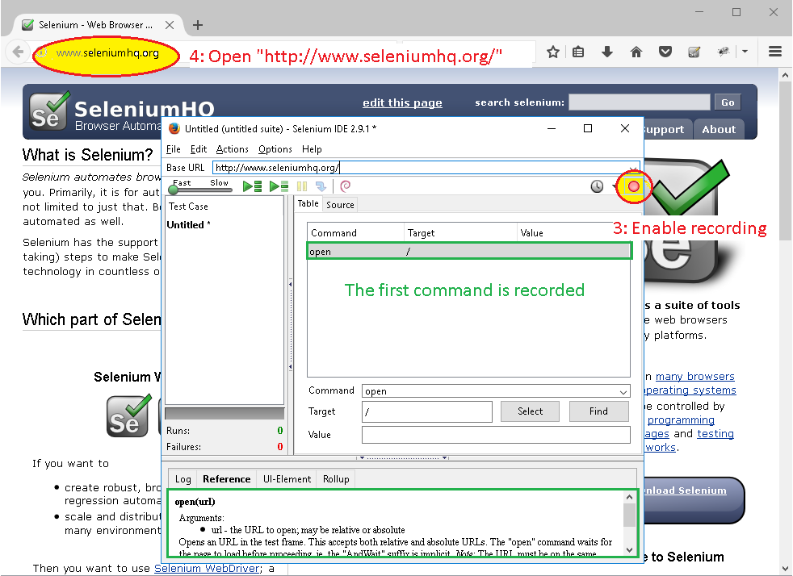
Record and Playback your tests
Practice 2.1

Slide 31
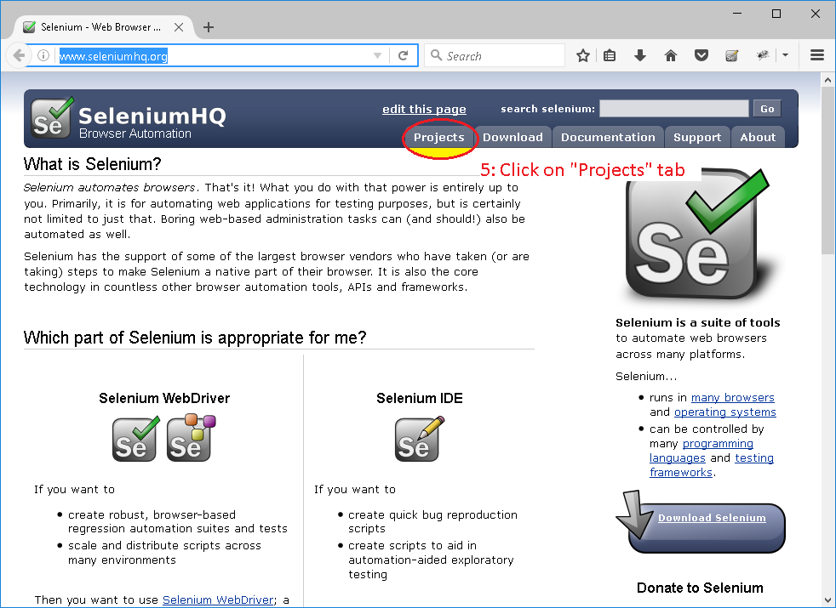
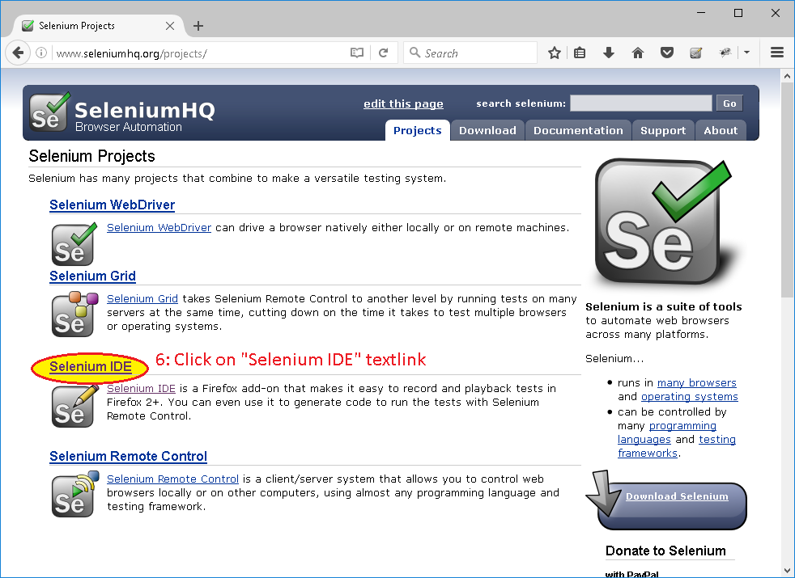
Record and Playback your tests
Practice 2.1

Slide 32
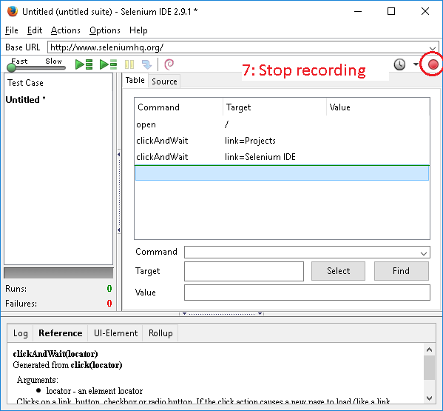
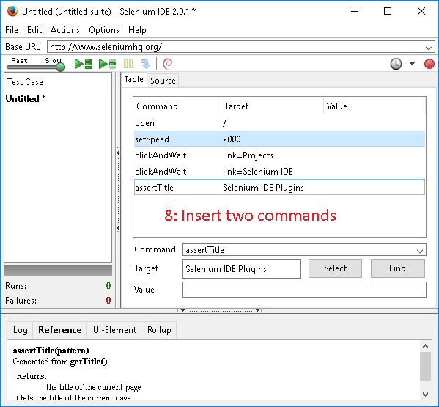
Record and Playback your tests
Practice 2.1

Slide 33
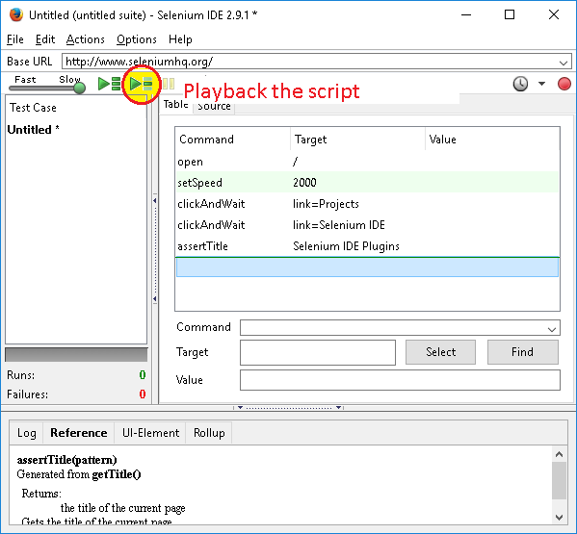
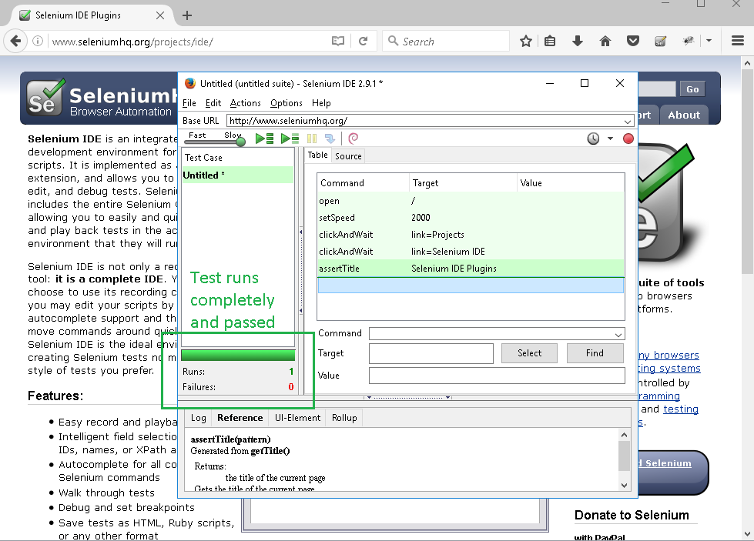
Record and Playback your tests
Practice 2.1

Slide 34
Create test suites / test cases
Practice 2.2
1: Start Firefox
2: Start Selenium IDE
3: Save Test Case (Ctrl + S) → TC_0001.html
4: New Test Case (Ctrl + N)
5: Save Test Case (Ctrl + S) → TC_0002.html
6: Save Test Suite → TS_0001
7: Click on TC_0001, insert some commands, Save (Ctrl + S)
8: Click on TC_0002, insert some commands, Save (Ctrl + S)

Slide 35
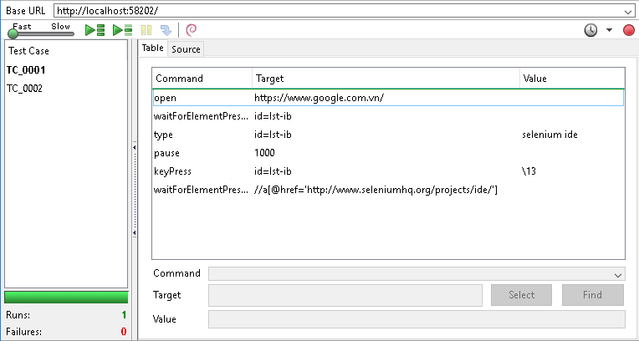
Create test suites / test cases
Practice 2.2

Slide 36
Execute test suites / test cases
Practice 2.3
1: Start Firefox
2: Start Selenium IDE
3: Open TS_0001
4: Click on TC_0001, click on “Play current test case” button
5: Wait for the TC_0001 running to finish
6: Click on “Play entire test suite” button
7: Wait for all test cases running to finish

Slide 38
3. Web Elements Identification
Web Elements
Locators
By ID, Name, LinkText
By XPath, CSS
Browser Tools for Web Elements Identification
Practice 3.1: Locate web elements by CSS/XPath
Practice 3.2: Make sure data is sorted properly

Slide 39
Web Elements
Button
Text Box
Link
Drop Down
Radio Button
List Box
Etc

Slide 40
Locators
http://docs.seleniumhq.org/docs/02_selenium_ide.jsp#locating-elements
Locators are used to identify the web elements
ID
Name
Link Text
XPath
CSS
Etc

Slide 41
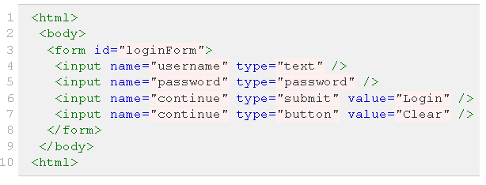
Locating by Id
id=loginForm (3)
driver.FindElement(By.Id("loginForm"))

Slide 42
Locating by Name
name=username (4)
name=password (5)
name=continue (6)
name=continue (7)
driver.FindElement(By.Name("username"))

Slide 43
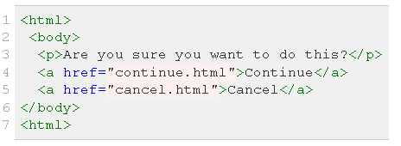
Locating by LinkText
link=Continue(4)
link=Cancel(5)
driver.FindElement(By.LinkText("Continue"))

Slide 44
Locating by XPath
Xpath is query language for selecting nodes from an XML document
Xpath is based on a tree representation of the XML document and provides the ability to navigate around the tree
http://docs.seleniumhq.org/docs/02_selenium_ide.jsp#locating-elements

Slide 45
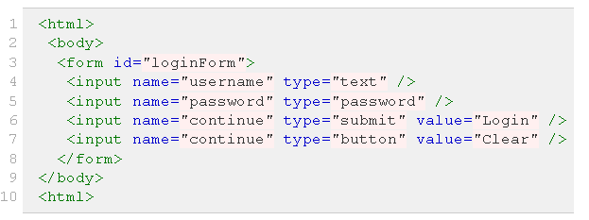
Locating by XPath
*Absolute path
xpath=/html/body/form[1] (3)
driver.FindElement(By.Xpath("html/body/form[1]"))
*Relative path
xpath=//form[1] (3)
driver.FindElement(By.Xpath(“//form[1]"))
*Tag with attribute value
xpath=//input[@name='username'] (4)
driver.FindElement(By.Xpath("//input[@name='username']”)

Slide 46
Locating by XPath
*Any tag with id
xpath=//*[@id='loginForm'] (4)
driver.FindElement(By.Xpath(“//*[@id='loginForm']”)
*Operator ‘and’
xpath=//input[@type='submit'][@value='Login'] (6)
xpath=//input[@type='submit' and @value='Login'] (6)
driver.FindElement(By.XPath("//input[@type='submit'][@value='Login']"))
driver.FindElement(By.XPath("//input[@type='submit‘ and @value='Login']"))
*Operator ‘or’
xpath=//input[@type='submit' or @value='Login'] (6)
driver.FindElement(By.XPath("//input[@type='submit' or @value='Login']"))

Slide 47
Locating by XPath
*Any contains text
xpath=//input[contains(@name,'username')] (4)
driver.FindElement(By.XPath("//input[contains(@name,'username')]"))
*Match value to any attribute
xpath=//input[contains(@*,'username')] (4) driver.FindElement(By.XPath("//input[contains(@*,'username')]"))
*Use parent to get to same-hierarchy object
xpath=//input[@name='username']/..//input[@name='password'] (5)
driver.FindElement(By.XPath("//input[@name='username']/..//input[@name='password']"))

Slide 48
Locating by XPath
XPath Axes
ancestor
ancestor-or-self
child
descendant
descendant-or-self
following
following-sibling
parent
preceding
preceding-sibling
self
Reference
http://www.xmlplease.com/axis

Slide 49
Locating by CSS
CSS (Cascading Style Sheets) is a language for describing the rendering of HTML and XML documents
CSS uses Selectors for binding style properties to elements in the document
http://docs.seleniumhq.org/docs/02_selenium_ide.jsp#locating-elements

Slide 50
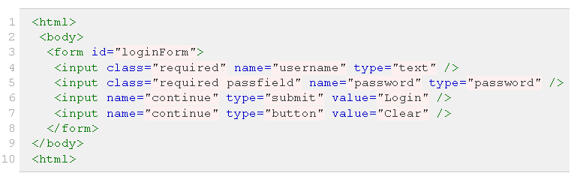
Locating by CSS
css=form#loginForm (3)
css=input[name="username"] (4)
css=input.required[type="text"] (4)
css=input.passfield (5)
css=#loginForm input[type="button"] (7)
css=#loginForm input:nth-child(2) (5)
xpath=//form[@id='loginForm'](3)
xpath=//input[@name='username'](4)
xpath=//input[contains(@class,'required')][@type='text'](4)
xpath=//input[contains(@class,'passfield')](5)
xpath=//*[@id='loginForm']//input[@type="button"] (7)
xpath=//*[@id='loginForm']//input[2] (5)

Slide 51
Locating by CSS
Mapping between CSS and XPath
CSS Pattern | Xpath equivalent | Meaning
* | * | Matches any element
E | E | Matches any E element
E F | E//F | Matches any F element that is a descendant of an E element
E > F | E/F | Matches any F element that is a child of an element E
E:first-child | E[1] | Matches element E when E is the first child of its parent
E:nth-of-type(n) | E[n] | Matches element E when E is the n-th child of its parent
E:last-child | E[last()] | Matches element E when E is the last child of its parent
E#myid | E[ @id = ‘myid’ ] | Matches any E element ID equal to ‘myid’
E[name=email] | E[@name=‘email’] | Matches any E that has name equal to “email"
E:contains(‘Some Text’) | E[contains(text(),’Some Text’)] | Matches any E that contains ‘Some Text’

Slide 52
Browser Tools for Web Elements Identification
Firefox
Firebug
https://addons.mozilla.org/en-US/firefox/addon/firebug/
FirePath (optional)
https://addons.mozilla.org/en-US/firefox/addon/firepath/
IE
IE Developer tools
Chrome
Google Chrome Developer tools

Slide 53
Execute test suites / test cases
Practice 3.1
Please locate all web elements (1 → 5) as below page by both XPath and CSS methods.
<html>
<body>
<form id="loginForm"> (1)
<input class="required" name="username" type="text" /> (2)
<input class="required passfield" name="password" type="password" /> (3)
<input name="continue" type="submit" value="Login" /> (4)
<input name="continue" type="button" value="Clear" /> (5)
</form>
</body>
<html>

Slide 54
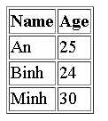
Execute test suites / test cases
Practice 3.2
Make sure that below table is sorted by name
<table border="1">
<tr>
<th>Name</th>
<th>Age</th>
</tr>
<tr>
<td>An</td>
<td>25</td>
</tr>
<tr>
<td>Binh</td>
<td>24</td>
</tr>
<tr>
<td>Minh</td>
<td>30</td>
</tr>
</table>

Slide 55


