Slide 1

Basic HPLoadRunner
Draft version
By Anh Tran
14 October 2013

Slide 2

Change Log
Revision | Date | Change | Author
Draft | 28 Oct 2013 | Initial version | Anh Tran
0.01 | 1 Nov 2013 | Update as review's comments | Anh Tran

Slide 3
Content
Introduction about Load Test
Introduction about Load Runner
Example
Reference

Slide 4
1. Introduction about Load Test
Why do we need load test for an application?
What is load test?
What are problems with manual test?
What is the good solution?

Slide 5
1. Introduction about Load Test
Why do we need load test for an application?
  Is it stable under expected and unexpected user loads?
  Does it respond quickly enough for the intended number of users?
  Does it handle the expected user load and beyond?
  Does it handle the number of business transactions required?

Slide 6
1. Introduction about Load Test
What is load test?
  Stability: Stability under expected and unexpected user loads
  Performance: System response time as expectation under load
  Functionality under load: Business process functionality properly under heavy load
  For example: Verify the response time of booking room transaction of a web page with 20 concurrent users throughout 24 hours

Slide 7

1. Introduction about Load Test
What are problems with manual test?
Hey,
All of You Click
Submit button
3, 2, 1...!
Do you have testing resources enough?
How do you synchronize users?
How do you achieve test repeatability?
Hey,
All Click again
Please!
How do you achieve endurance testing?
How do you collect and analyze result?
Coordinator
How do you make a summary report to effect?
Web server
Database server
Testers
System Under Test

Slide 8
1. Introduction about Load Test
What is the good solution?
  A load testing tool can resolve all above problems properly
  ALL PROBLEMS SOLVED IN ONE SOLUTION
A tool is able to simulate multiple of users
A tool is able to simulate concurrent users
A tool is able to organize the test throughout a duration
A tool is able to generate results automatically
A tool is able to collect results automatically
A tool is able to summarize results automatically
A tool is able to generate report fast and correctly
HP
LOAD RUNNER
Controller
Analysis
Vuser host
Web server
Database server
Load Generation
System Under Test

Slide 9
2. Introduction about Load Runner
Load Runner Overview
Load Runner Components
Load Runner Terminology
Load Runner Load Testing Process

Slide 10
2. Introduction about Load Runner
Load Runner Overview
  What is Load Runner?
  Which protocols does Load Runner support?
  Which platforms does Load Runner support?

Slide 11
2. Introduction about Load Runner
Load Runner Overview
  What is Load Runner?
    Load Runner is a Mercury Interactive Tool that predicts performance and behaviour of the system
    By creating lots of load, you can see how the system reacts at peak levels or with simultaneous Users
    Load Runner emulates an environment where multiple users work concurrently. Load Runner accurately measures and analyses the system performance, and its functionality while the application is under load,

Slide 12
2. Introduction about Load Runner
Load Runner Overview
  Which protocols does Load Runner support?
    FTP
    DNS
    RDP
    SAP
    CRM
    MMS
    Web
    SMTP
    Java application
    Mobile application
    Mailing services

Slide 13
2. Introduction about Load Runner
Load Runner Overview
  Which platforms does Load Runner support?
    Windows 7, XP, 2000
    HP
    IBM
    Sun Solaris
    Linux

Slide 14
2. Introduction about Load Runner
Load Runner Components
Virtual User Generator
Captures end-user business process & Creates automated script as one single user.
Virtual User Generator
Load Runner Controller
Organize & Monitor load test
Load Runner Analysis
Summarizes - Analyzes performance result & Generates report

Slide 15
2. Introduction about Load Runner
Load Runner Terminology
  Vuser: Load Runner replaces human users with virtual users called Vusers. Vusers emulate the actions of human users working on your system
  Vuser script: The actions that a Vuser performs during a scenario are described in a Vuser script
  Scenario: A scenario defines the events that occur during a testing session, based on performance requirements
  Protocol: A method communication between a client and the server
  Controller: The Controller manages and maintain Vusers and scenarios
  Load Generator: The host that executes the Vuser script, enabling the Vuser to emulate the actions of a human user
  Performance Analysis: The Analysis tool that summarizes result and create graphs for analysis, and generate reports

Slide 16
2. Introduction about Load Runner
Load Runner load testing process
Plan
Load Test
Create
Vuser Script
Create
Scenarios
Run
Scenarios
Analyze
Report
LoadRunner
V U G E N
LoadRunner
ANALYSIS
LoadRunner
CONTROLLER

Slide 17
2. Introduction about Load Runner
Load Runner load testing process
  A. Plan load test
    Analyze performance requirements:
      Typical business processes (critical manual work flow)
      Application and database transaction processing time
      Network bandwidth limitations
      Number of concurrent users
      Required response times
      Failover operations
      System reliability
      Work load

Slide 18
2. Introduction about Load Runner
Load Runner load testing process
  A. Plan load test
    Analyze environment
      OS
      Network speed
      Protocol
      Browser
      Proxy
    Environment setup
      SUT environment
      Load Generator environment
    Design test plan

Slide 19
2. Introduction about Load Runner
Load Runner load testing process
  B. Create Vuser script
    Record a basic Vuser script
    Enhance the Vuser script
    Replay and debug

Slide 20
2. Introduction about Load Runner
Load Runner load testing process
  B. Create Vuser script
    Record a basic Vuser script
      Activate Virtual User Generator Tool
      Create a blank Vuser script
      Record really business activities to the script

Slide 21
2. Introduction about Load Runner
Load Runner load testing process
  B. Create Vuser script
    Enhance the Vuser script
      Configure Run Time settings
      Insert Start and End transaction
      Perform Correlation
      Add comments for description
      Add check point
      Add C programming statement whenever required
      Insert Load Runner function if required
      Do Parameterization

Slide 22
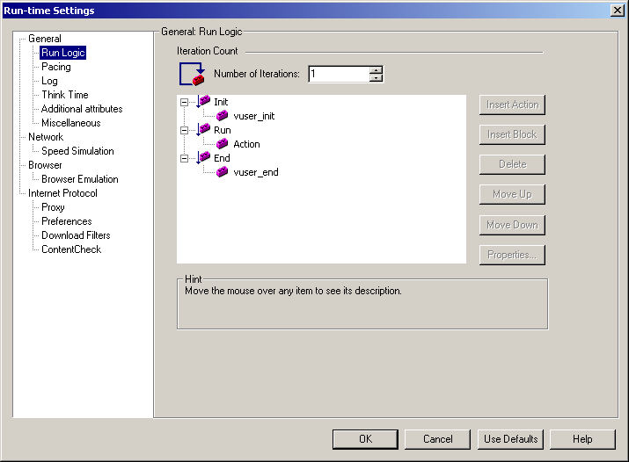
2. Introduction about Load Runner
Load Runner load testing process
  B. Create Vuser script
    Enhance the Vuser script
      Configure Run Time settings
        Run Logic: The number of times that a Vuser repeats various sections of the Vuser script.

Slide 23
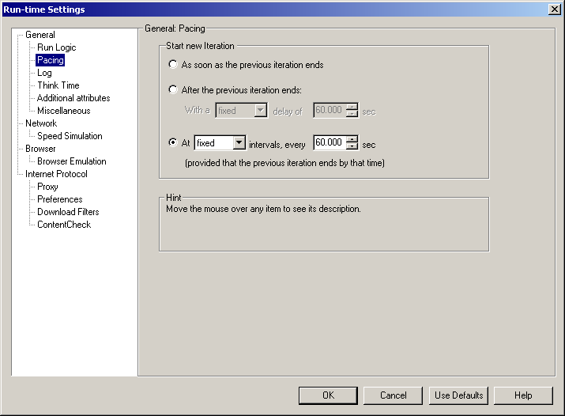
2. Introduction about Load Runner
Load Runner load testing process
  B. Create Vuser script
    Enhance the Vuser script
      Configure Run Time settings
        Pacing: The time to wait between repetitions

Slide 24
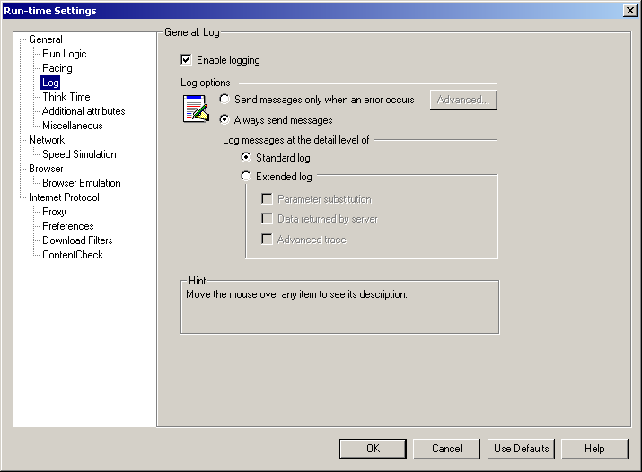
2. Introduction about Load Runner
Load Runner load testing process
  B. Create Vuser script
    Enhance the Vuser script
      Configure Run Time settings
        Log Settings: The level of information that you want to gather during playback

Slide 25
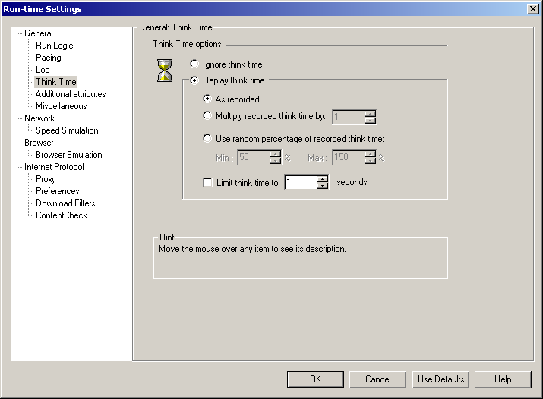
2. Introduction about Load Runner
Load Runner load testing process
  B. Create Vuser script
    Enhance the Vuser script
      Configure Run Time settings
        Think time: the time that user waits between performing successive action
        Vuser uses lr_think_time function to emulate user think time

Slide 26
2. Introduction about Load Runner
Load Runner load testing process
  B. Create Vuser script
    Enhance the Vuser script
      Configure Run Time settings
            Speed simulation
            Browser
            Internet protocol

Slide 27
2. Introduction about Load Runner
Load Runner load testing process
  B. Create Vuser script
    Replay and debug

Slide 28
2. Introduction about Load Runner
Load Runner load testing process
  C. Create a load test scenario
    Add Vuser script
    Add load generator
    Schedule scenario
    Configure SLA (Service Level Agreement)

Slide 29
2. Introduction about Load Runner
Load Runner load testing process
  C. Create a load test scenario
    Add Vuser script

Slide 30
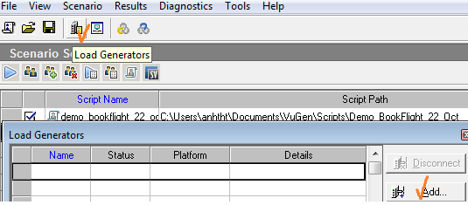
2. Introduction about Load Runner
Load Runner load testing process
  C. Create a load test scenario
    Add load generator

Slide 31
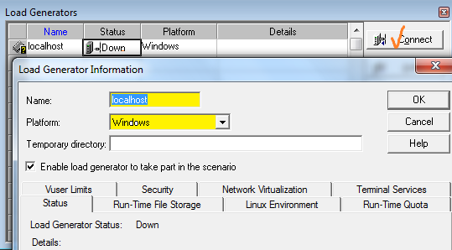
2. Introduction about Load Runner
Load Runner load testing process
  C. Create a load test scenario
    Add load generator

Slide 32
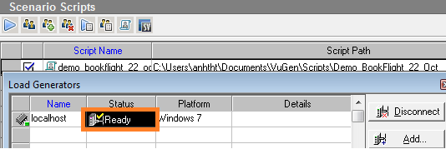
2. Introduction about Load Runner
Load Runner load testing process
  C. Create a load test scenario
    Add load generator

Slide 33
2. Introduction about Load Runner
Load Runner load testing process
  D. Run the load test

Slide 34
2. Introduction about Load Runner
Load Runner load testing process
  E. Analyze report
    Report summary
    Graph

Slide 35
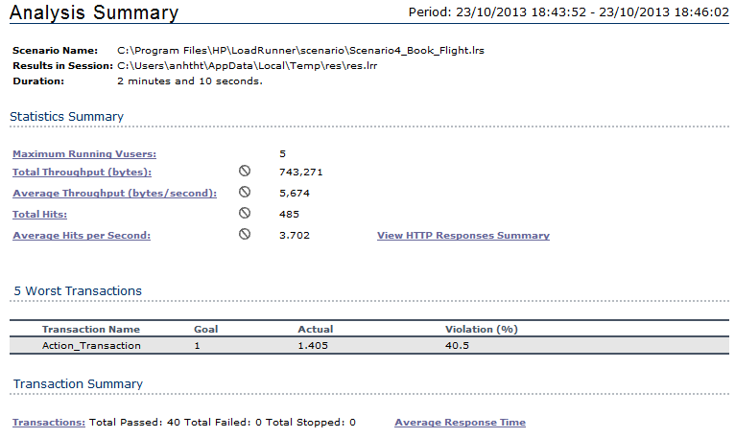
2. Introduction about Load Runner
Load Runner load testing process
  E. Analyze report
    Report summary

Slide 36
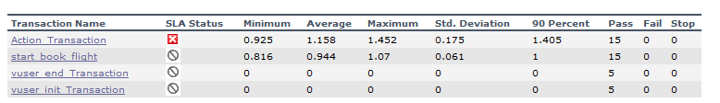
2. Introduction about Load Runner
Load Runner load testing process
  E. Analyze report
    Report summary

Slide 37
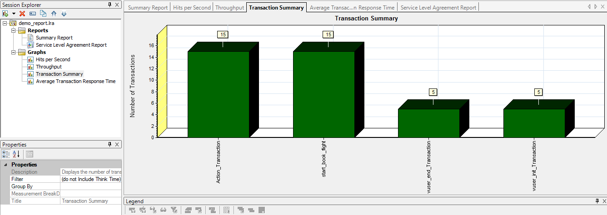
2. Introduction about Load Runner
Load Runner load testing process
  E. Analyze report
    Graph

Slide 38
2. Introduction about Load Runner
Load Runner load testing process
  E. Analyze report
    Graph: Analysis graphs are divided into following common categories
      Vuser Graphs - Provide information about Vuser states and other Vuser statistics
      Error Graphs - Provide information about the errors that occurred during the scenario
      Transaction Graphs - Provide information about transaction performance and response time
      Web Resource Graphs - Provide information about the throughput, hits per second, HTTP responses per second, number of retries per second, and downloaded pages per second for Web Vusers
      Web Page Breakdown Graphs - Provide information about the size and download time of each Web page component.

Slide 39
2. Introduction about Load Runner
Load Runner load testing process
  E. Analyze report
    Graph: Analysis graphs are divided into following common categories
      User-Defined Data Point Graphs - Provide information about the custom data points that were gathered by the online monitor
      System Resource Graphs - Provide statistics relating to the system resources that were monitored during the scenario using the online monitor
      Network Monitor Graphs - Provide information about the network delays
      Firewall Server Monitor Graphs - Provide information about firewall server resource usage.
      Web Server Resource Graphs - Provide information about the resource usage for the Apache, iPlanet/Netscape, iPlanet(SNMP), and MS IIS Web servers.

Slide 40
3. Example
REQUIREMENTS:
Verify the behavior of ParkDiamond's booking room page when there are 20 users
booking rooms concurrently throughout 2 hours
- Response time: maximum 4 minutes (240 seconds)
- Book room transaction:
- Concurrent users: 20 users
- Work load: All users book flight at the same time

Slide 41
3. Example from a real practice
A. Plan Load Test:
  Analyze performance requirements:
    Typical business process?
    Network bandwidth limitations?
    Number of concurrent users?
    Required response times?
    Failover operations ?
    System reliability work load?

Slide 42
3. Example from a real practice
A. Plan Load Test:
  Analyze performance requirements:
    Typical business process: Booking room process on page http://parkdiamondhotel.vn/ as following
    1. Choose Check in date
    2. Choose Check out date
    3. Select Number of adults
    4. Select Number of children
    5. Choose Room
    6. Fill in Personal Information
    7. Confirm and Submit Reservation
    8. Input Credit card detail
    9. Submit

Slide 43
3. Example from a real practice
A. Plan Load Test:
  Analyze performance requirements:
    Network bandwidth limitations: ADSL
    Required response time:
    Number of concurrent users: 20
    Duration: 2 hours
    System work load: all users booking rooms concurrently

Slide 44
3. Example from a real practice
A. Plan Load Test:
  Analyze environment
    SUT environment:
      Target: http://parkdiamondhotel.vn/
      Protocol: WEB-HTTP/HTML
    Load Generator environment
      PC: localhost
      OS: Window 7
      Network speed:
      Browser: IE, Mozilla Firefox, Google Chrome
      Proxy:

Slide 45
3. Example from a real practice
A. Plan Load Test:
  Setup environment
  Design test plan

Slide 46
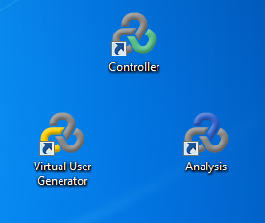

3. Example from a real practice
B. Create Vuser script:
  Record a Vuser script
  Step 1: Activate Virtual User Generator

Slide 47
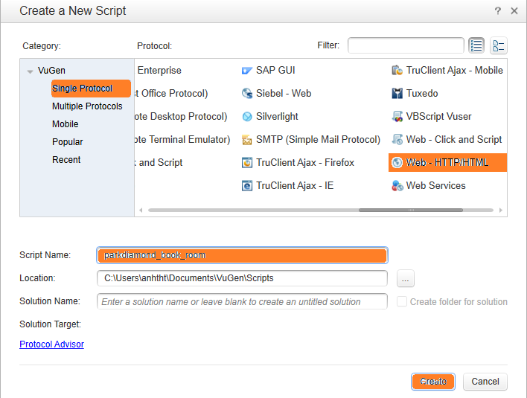
3. Example from a real practice
B. Create Vuser script:
  Record a Vuser script
  Step 2: Create a blank Vuser script

Slide 48
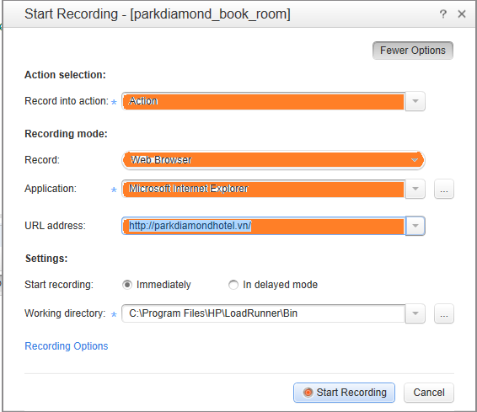
3. Example from a real practice
B. Create Vuser script:
  Record a Vuser script
  Step 3: Record really business activities to the script
    Click Start Record button (CTRL+R)
    Fill in Record Settings

Slide 49
3. Example from a real practice
B. Create Vuser script:
  Record a Vuser script
  Step 3: Record really business activities to the script
Launch Park Diamond page
Perform Booking Room(s)
  Choose Check in Date
  Choose Check out Date
  Choose Number of Adults
  Choose Number of Children
  Check Availability
  Choose room
  Fill in Personal Information
  Submit Reservation
  Fill in Credit Card information
  Final Confirmation

Slide 50
3. Example from a real practice
B. Create Vuser script:
  Enhance the Vuser script
    Configure Run Time Settings

Slide 51
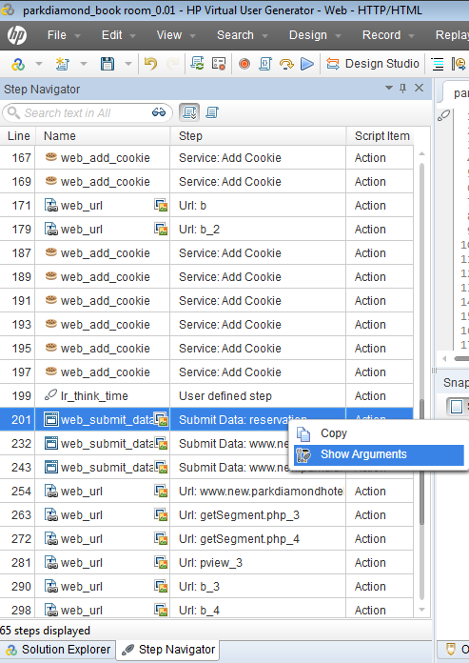
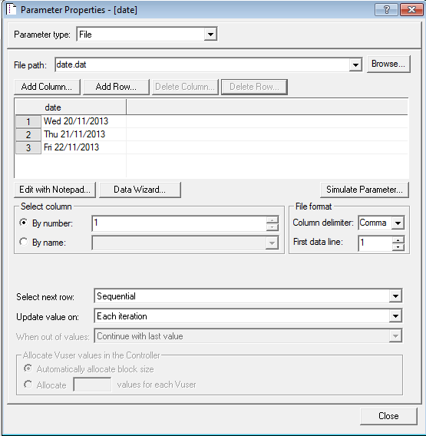
3. Example from a real practice
B. Create Vuser script:
  Enhance the Vuser script
    Set parameters for various values of arrived days

Slide 52
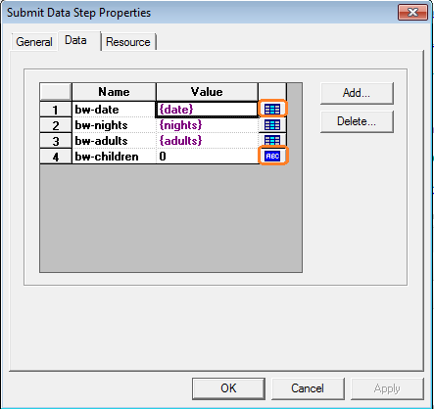
3. Example from a real practice
B. Create Vuser script:
  Enhance the Vuser script
    Create parameters for various values of Arrived Days
This value is parameterized
with 'date' name
This value uses static value

Slide 53
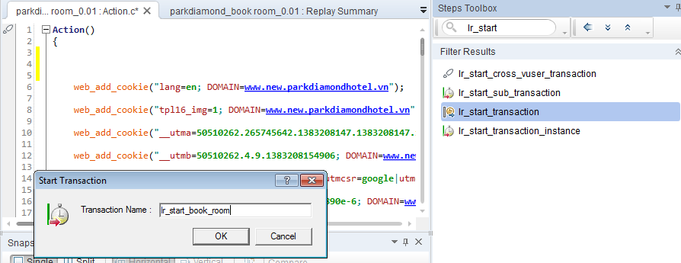
3. Example from a real practice
B. Create Vuser script:
  Enhance the Vuser script
    Add start and end transaction to get the amount of time it takes for transaction performing

Slide 54
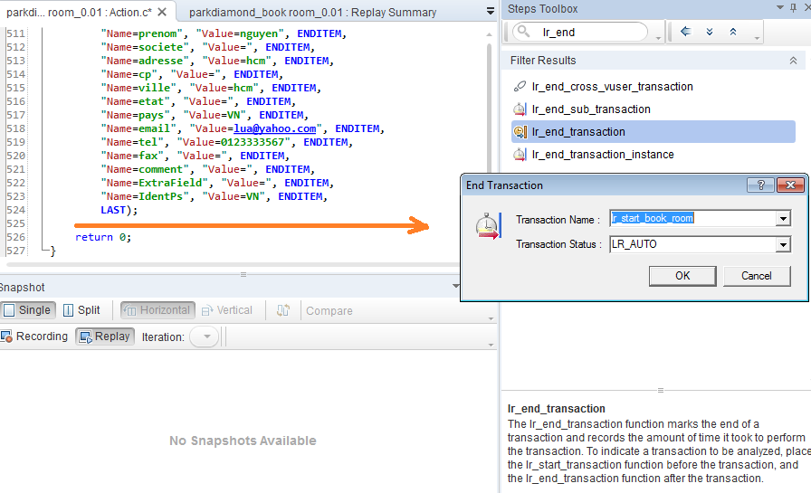
3. Example from a real practice
B. Create Vuser script:
  Enhance the Vuser script
    Add start and end transaction to get the amount of time it takes for transaction performing

Slide 55
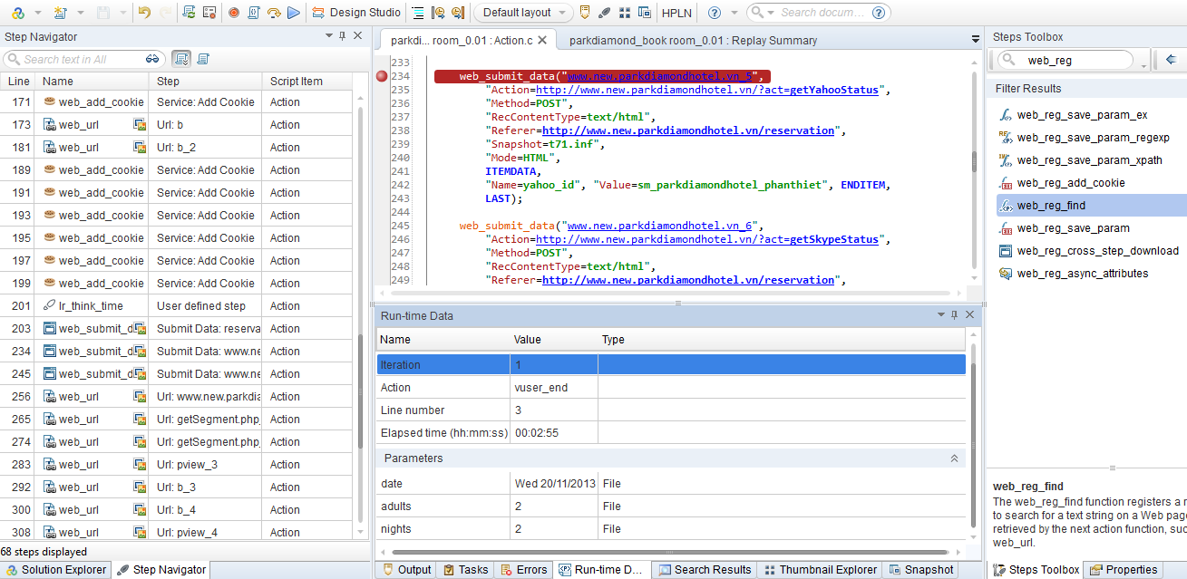
3. Example from a real practice
B. Create Vuser script:
  Enhance the Vuser script
    Insert break point for easier debug

Slide 56
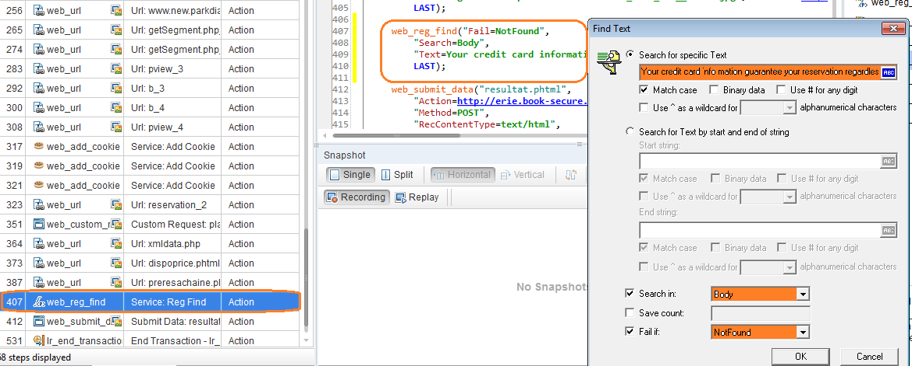
3. Example from a real practice
B. Create Vuser script:
  Enhance the Vuser script
    Add web_reg_find transaction to verify that Reservation is submitted successfully

Slide 57
3. Example from a real practice
B. Create Vuser script:
  Replay and Debug
    Click Replay (F5) to replay the script
    Output: contains the real-time active logs
    Error: contains Information such as messages, warnings, error
    Run-time data: contains the values of established time, and parameters for each iteration
    Thumbnail Explorer: captured picture for each screen
    Snapshot:

Slide 58
3. Example from a real practice
C. Create scenario:
  Add Vuser script
  Add load generator
  Schedule scenario
  Configure SLA (Service Level Agreement)

Slide 59
3. Example from a real practice
C. Create scenario:
  Add Vuser script
  Add load generator
  Schedule scenario
  Configure SLA (Service Level Agreement)

Slide 60

3. Example from a real practice
C. Create scenario:
  Add Vuser script

Slide 61
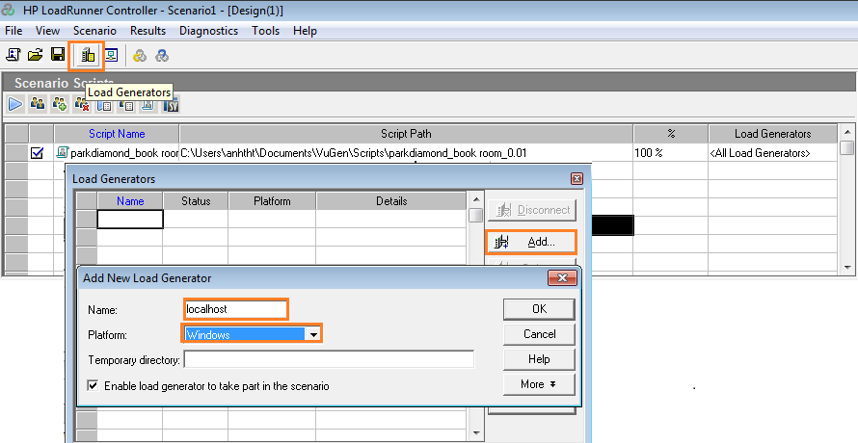
3. Example from a real practice
C. Create scenario:
  Add Load Generator

Slide 62
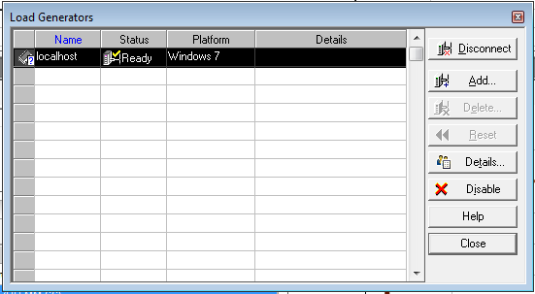
3. Example from a real practice
C. Create scenario:
  Add Load Generator

Slide 63
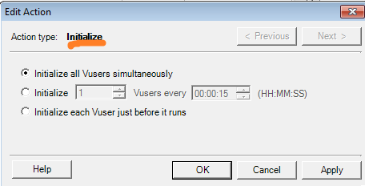
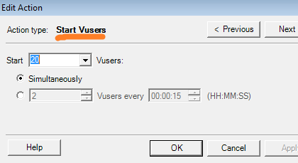
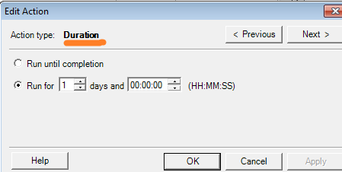
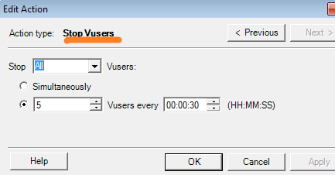
3. Example from a real practice
C. Create scenario:
  Schedule Scenario

Slide 64
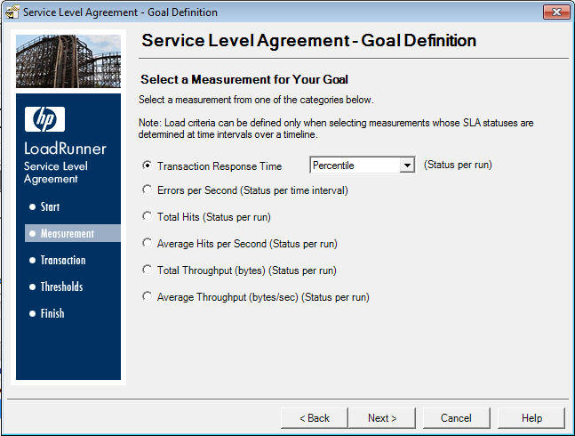
3. Example from a real practice
C. Create scenario:
  Configure SLA

Slide 65
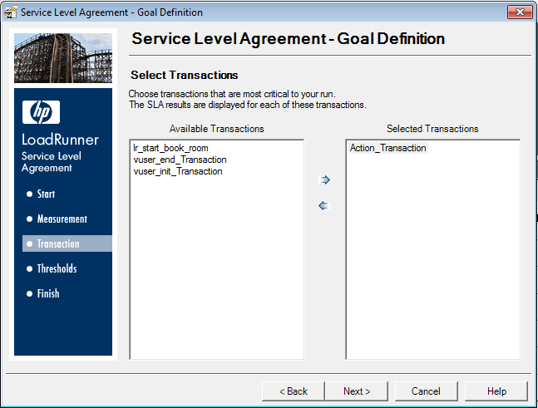
3. Example from a real practice
C. Create scenario:
  Configure SLA

Slide 66
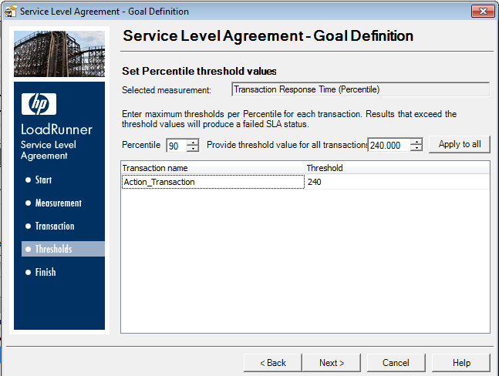
3. Example from a real practice
C. Create scenario:
  Configure SLA

Slide 67
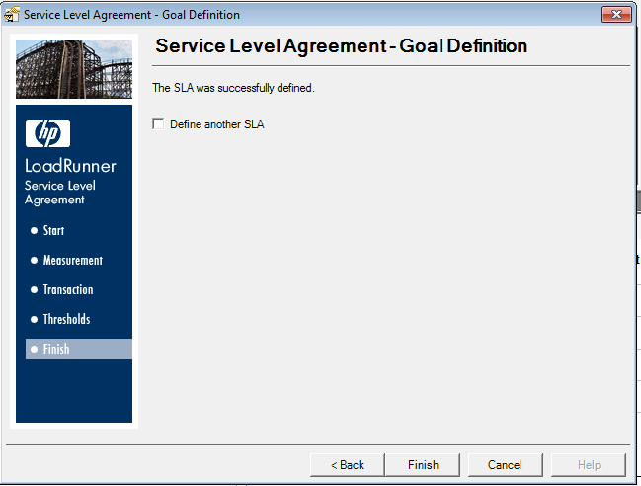
3. Example from a real practice
C. Create scenario:
  Configure SLA

Slide 68
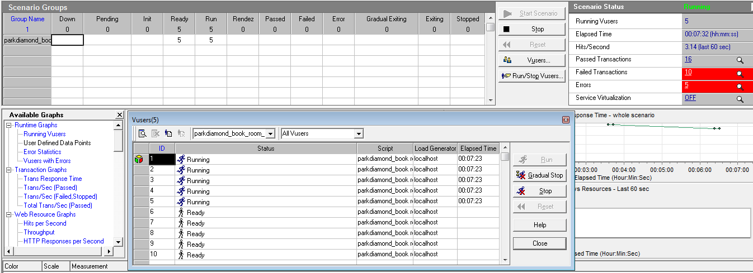
3. Example from a real practice
D. Run Scenario:

Slide 69
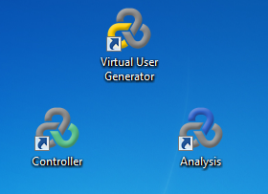

3. Example from a real practice
E. Analyze report:

Slide 70
4. HP ALM (Application Lifecycle Management)

Slide 71
5. Reference
- HP LoadRunner Tutorial:
http://www8.hp.com/us/en/software-solutions/software.html?compURI=1175451
- HP Application Life Cycle:

Slide 72
The End
      THANK YOU

