Slide 1
WIKI
Guide for using Wiki as a normal user

Slide 2
Overview
Getting started with Wiki
Creating Content
Sharing Content
Managing Changes, Notifications, and Tasks
Finding Content
Organising Content
Customising Wiki
Giving People Access to Content

Slide 3
Getting started with Wiki
Wiki Dashboard
Content in Wiki
User Options
User Permissions

Slide 4
Wiki Dashboard
Wiki is a web application where people can share knowledge and information together. The sharing content can be as simple or as rich as you like. It can be just words, or you can add images, diagrams, activity streams, etc.
The Wiki dashboard is devided into three sections:
Welcome message: the information that appears in the top left section of the dashboard.
Spaces, Pages, Network:
Spaces: displays the spaces you have marked as favorites, followed by all the spaces that you have permission to view.
Pages: displays the pages you have marked as favorites.
Network: displays the users that you are following (or who are following you).
Recent activities: displays a few different lists of the most recently updated content.
Popular: displays content that has been recently created, liked or commented on.
All Updates: displays updates from all spaces that you have permission to view.
Favourite Spaces: displays updates from your favorite spaces.
Network: displays updates made by the users in your network.
Space Categories: displays updates from spaces in the category you have selected from the list.
You can go to the dashboard from anywhere in your site by clicking on the DTV logo at the top left of the page.

Slide 5
Content in Wiki – Spaces/Pages/Blog Posts
Spaces: A Space is an area within Wiki, containing your pages, blog posts and other content. You can think of each space as a sub-site, or mini-site, each with its own home page.
In Wiki, content is organised into spaces. There are two types of space:
Site spaces (or global spaces): are areas on your site where you can create content and collaborate with other users.
Personal spaces: belong to specific users. You can keep your personal space private, or open it up for other users to view or edit. Personal spaces are listed in the 'People Directory'.
Each space has its own pages, blog posts, comments, access control settings.
How to create a space?
To create a site space, you need the 'Create Space' global permission. In the scope of this course, we skip this.
To create a personal space you need the 'Personal Space' global permission.
Pages: Pages are the primary means of storing and sharing information in Wiki. Pages are contained within spaces.
Spaces are used to organise content into logical groups. Pages are used to organise content into lower-level groups.
Blog Posts: Blog Posts are another types of content in Wiki. Blog Posts are also contained within spaces.
Blog posts may be announcements, journal entries, status reports, or any other timely information.

Slide 6
User Options
On the dashboard, you can access to your own options by clicking on the user picture at the top right and select 'Profile/ Network/ Favourites/ Watches/ Settings'.
User options includes:
User profile: contains personal details, picture, password. This information is editable.
Network: shows the recent activities of the users in your network. It also allows you to add or remove a person into your connections list.
Favourites: displays a list your favourites pages and spaces.
Watches: displays your watches on pages and spaces.
Settings: contains your settings for password, email, or editor.

Slide 7
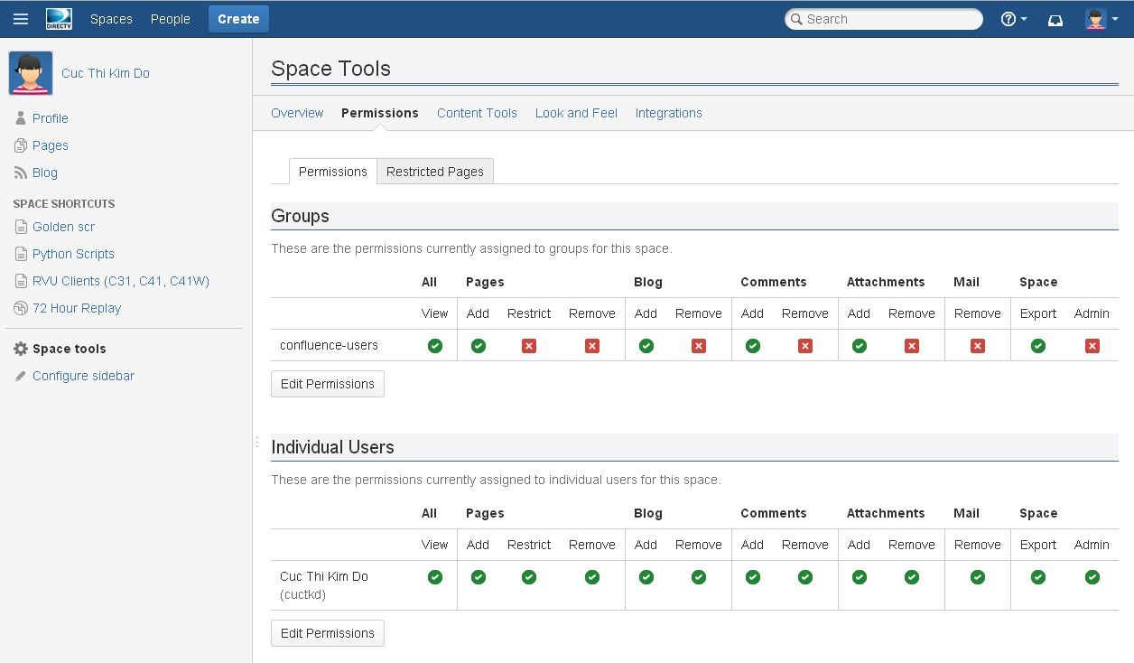
User Permissions
View the user permissions on a space (if you are the space administrator)
Go to the space and choose Space Tools on the sidebar.
Choose "Permissions" tab.

Slide 8
Creating Content
Creating a Content
Wiki Editor
Working with images and links

Slide 9
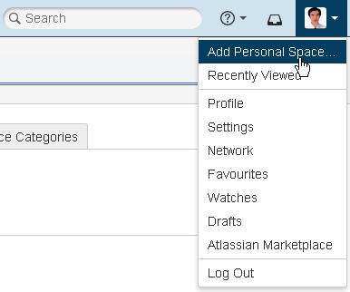
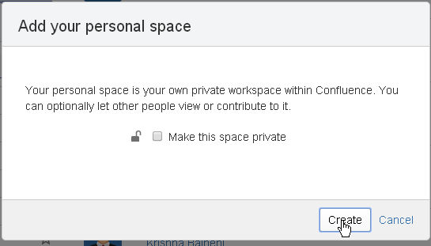
Creating Content – Personal Space
You can quickly create new content on Wiki by steps:
Click on User picture at the most right of Wiki header.
Select 'Add Personal Space…' option from dropdown menu.
On the popup dialog, set the space private or public.
Click on Create.
Note:
- To create a personal space you need the 'Personal Space' global permission.
- 'Add Personal Space' will be replaced by 'Personal Space' if your personal space has already been created.

Slide 10
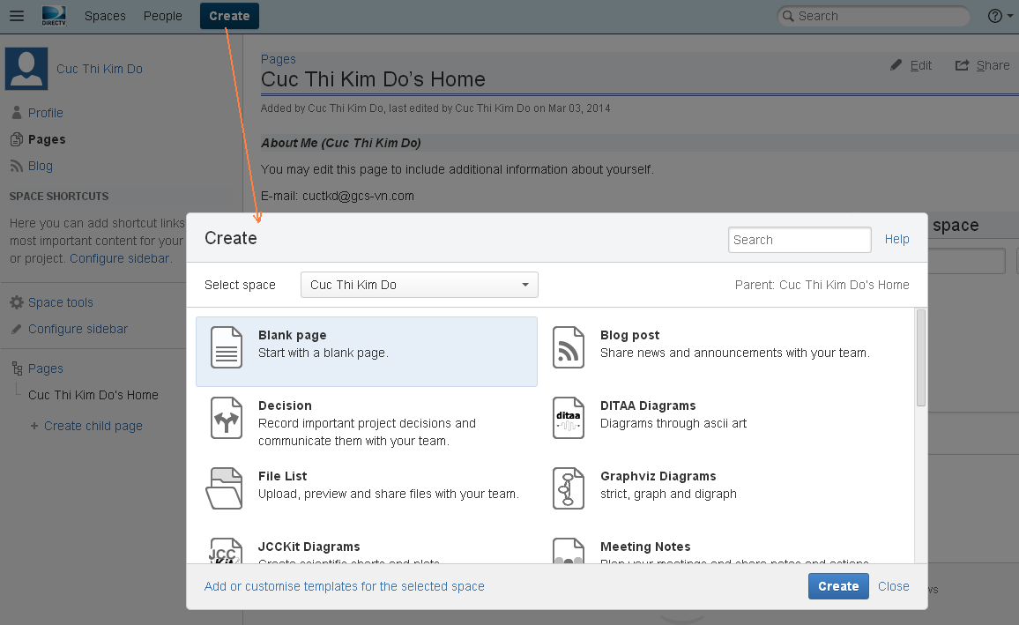
Creating Content – Pages/Blog Posts
You can quickly create new content on Wiki by steps:
Click on Create button on the Wiki header. Select an appropriate Space.
Select the type of content you want to create (e.g. a blank page, a blog post, or a page based on a template).
Select Create.
The Wiki editor will open. Add your content in the editor pane, or update the default content supplied by the template.
Select Save.
Note:
- To create a page, you need
the 'Add Pages' permission for the
space where you will add the page.
- To create a blog post, you need the
'Add Blog' permission for that space.

Slide 11
Wiki Editor
The Wiki editor is the tool that you will use to create and edit Wiki pages, blog posts and comments. You can enter content as you do in a Word document, apply formatting, and embed other content and files into the page.
Working with Text Effects: Wiki editor supports most text effects available in standard text editing applications (displayed on the editor toolbar).
Working with Images:
Insert an image:
1. In the editor, place the cursor where you want to insert the image.
2. Choose Insert > Image and choose the Attached Images tab.
3. Select the required image and choose Insert.
Delete an image:
1. In the editor, select the image.
2. Press Delete key on keyboard.
3. Save the page.

Slide 12
Wiki Editor (cont.)
Wiki Editor (cont.)
Working with Links:
Insert a text link:
1. Select some text or put your cursor where you want to insert the link.
2. Choose Insert > Link.
3. Select a page, blog post or attachment, or enter an external URL.
4. Enter or modify the link text - this is the text that will appear on the page. If this field is blank, the page name or URL will be used as the link text.
5. Choose Insert.
Insert an image link:
1. Select an image on your page.
2. Choose Link on the Image Properties toolbar.
3. Select a page, blog post or attachment, or enter an external URL.
4. Choose Insert.
Modify a link:
1. Select the link text or image .
2. Choose Edit from the link properties toolbar.
3. Modify the link and choose Save.
Remove a link:
1. Select the link text or image.
2. Choose Unlink from the properties toolbar.

Slide 13
Wiki Editor (cont.)
Wiki Editor (cont.)
Working with Links (cont.):
Link to specific types of content:
Type of link | Ways to do this
Link to page | Choose Link > Search then enter part of the page name. Choose Link > Recently viewed and select a page from the list.
Link to a page in another space | Choose Link > Search enter part of the page name and select All Spaces from the drop down. Choose Link > Advanced then enter the space key followed by the page name, ex: spacekey:mypage.
Link to a blog post | Choose Link > Search and enter part of the blog post name.
Link to an attachment or image on current page | Choose Link > Attachment then upload or select an attachment from the list.
Link to an attachment on another page | Choose Link > Search and enter part of the attachment name.
Link to a website | Choose Link > Web Link then enter the website URL.
Link to an email address | Choose Link > Web Link then enter the email address.

Slide 14
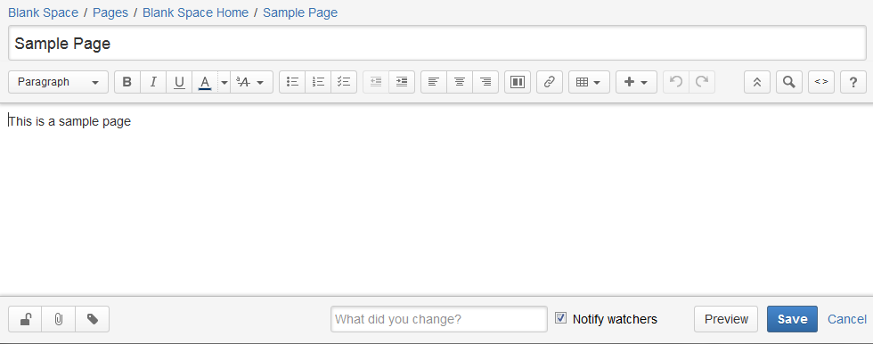
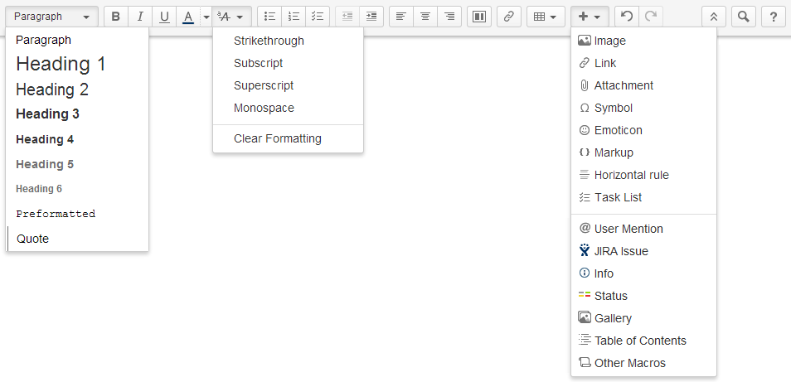
Wiki Editor (cont.)

Slide 15
Sharing Content
Sharing a page link
@user mention
Liking a page

Slide 16
Sharing Content
Wiki provides a number of ways for you to notify other people about content that may be of interest to them, you can:
share a page link with them
mention a user when you write a page, blog post or comment. Mentioning a user automatically emails a notification to them about that content
like a page, blog post or comment. The author will receive a notification. If enough people like the content, it will appear in the list of popular content on the dashboard and in the recommended updates email message
Other users can also find out about changes to content in Wiki by watching pages and spaces.

Slide 17
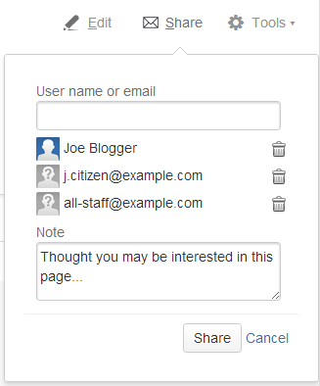
Sharing a page link
You can share a Wiki page or blog post by emailing a link to recipients of your choice. The recipients can be Wiki users or any email addresses.
To email a link to a Wiki page or blog post using the Share button:
1. Go to the page or blog post you wish to share.
2. Choose Share at the top right of the page.
Note: The Share button will only be visible if your Wiki
administrator has configured an outgoing mail server
for your Wiki site.
3. Enter the name or username of a Wiki user or any email
address
4. Select the appropriate user or email address from the
dropdown. You can add multiple recipients to the list.
5. Enter an optional message into the Note box.
6. Choose Share to send the link via email.

Slide 18
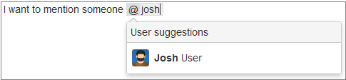
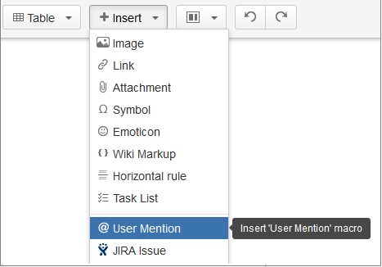
@user mention
You can mention a person in a special way that prompts Wiki to send that person an email message and a workbox notification. This way of mentioning someone is called an @mention. It works on Wiki pages, blog posts and comments.
Using autocomplete to mention someone
1. Edit the page.
2. Click where you want to insert a mention and
type '@' and then the first few characters of the user's full name.
3. Choose the user's name from the list of suggestions.
Accessing a user mention option in editor toolbar
1. Edit the page.
2. Choose Insert > User Mention. Wiki will add an
'@' sign to the page, and display a dropdown list of suggested
users for you to choose from.
3. Start typing the person's name, to refine the list of suggestions.
4. Choose the person from the list of names.

Slide 19
Liking a page
Liking a page, blog post or comment:
Click the Like button to let people know that you agree with or enjoy a page, blog post or comment.
Click Unlike to remove your name from the list of people who like the content.
Effects of liking content - when you like a page, blog post or comment:
The author of the content receives a notification.
People in your network receive a notification (only if they do not already know about the content). Let's assume Arthur is in your network. Arthur will not receive a notification if:
Someone else in his network has already liked the content.
Arthur himself has already liked the content.
Arthur has already commented on it.
In the case of a threaded comment, Arthur has already replied to the comment.
If enough people like the content, it will appear on the 'Popular' tab of the dashboard.
Similarly, if the content is popular enough it will appear in the 'Recommended Updates' summary sent out by email.

Slide 20
Organising Content
Working with Pages
Working with Blog Posts
Working with Spaces
Working with Favourites
Working with Labels
Working with Attachments

Slide 21
Organising Content
Wiki provides a number of ways for organising and structuring content:
Spaces: allow you to group content according to major categories.
Pages: are used for discrete topics, and can be structured into page trees to show the relation between them.
Favourites: are particular pages or spaces that have been bookmarked by a user, to make them easy to find again.
Labels: are user-defined tags that are added to related pages in order to categorise them in some way.
Attachments: to a page can include images, multimedia, Office and PDF files, and provide a way to include other forms of content in the wiki.
The sidebar: is a good place to display important links for your team or project.

Slide 22

Working with Pages
Pages are the primary means of storing and sharing information in Wiki. Pages are contained within spaces.
Things you can do with pages in Wiki:
Move pages and organise them hierarchically while editing a page or while viewing the space's Tree view.
To move a page, you need to have the ‘Delete Page’ permission on the original space and the ‘Add Page’ permission on the destination space.
To move a page within a space:
1. Go to the space and choose Pages > Browse and reorder all pages. (If your space is using the Documentation theme choose Browse > Pages.)
2. Expand the branches to locate the page you want to move.
3. Drag the page to a new position in the tree.
(While dragging the page, you see: A thin line between existing pages - this indicates the potential new position for the page.)
4. Release the mouse button when the page is where you want it.
To move a page to another space:
1. Go to the page and select Tools > Move.
2. Update the 'Current location' and 'New location'.
3. And choose Move.
Note: If you want to move a page to a different position amongst the child pages, select Reorder. (When you choose Move, you will be able to reorder the page.)

Slide 23
Working with Pages (cont.)
Things you can do with pages in Wiki:
Create/ Edit/Copy/Delete a page.
Create a page: (see Creating Content section)
Edit a page:
1. Select Edit icon on the page header.
2. Update and save the changes.
Copy a page:
1. On the page content, choose Tools > Copy.
-> Wiki will open a copy of the page in the editor. By default, the page name will be 'Copy of <original page name>'.
2. Rename and make any changes you want, and then Save it.
Delete a page:
Go to the page and choose Tools > Remove.

Slide 24
Working with Pages (cont.)
Things you can do with pages in Wiki:
Remove a specific version of a page.
To remove a specific version:
1. Go to Tools > Page History.
2. Select Remove next to the version you want to delete and confirm the action.
View page history, and manage and compare versions of a page.
To view page history and compare versions of the page:
1. Choose Tools > Page History.
2. Select the versions you want to compare the updates and click on Compare selected versions button.
To view changes in latest version compared to the previous version:
Select ‘view change’ link under the page header.

Slide 25
Working with Blog Posts and Spaces
Working with Blog Posts
Things you can do with Blog Post in Wiki: (actions are similar to Pages)
Creating a blog post
Editing a blog post
Deleting a blog post
Working with Spaces
Things you can do with Spaces in Wiki:
Creating a personal space (see Creating Content section)
Editing Space detail:
1. Go to the space and choose Space tools on the sidebar.
2. Choose Overview > Edit Space Details
3. The 'Edit Space Details' page displays.
Viewing all Wiki Spaces:
1. On the dashboard, select Spaces tab to view all spaces in Wiki.
Viewing Recently Updated Content:
1. Go to the space and choose Pages in the sidebar.
-> A list of the most recently added or modified content in the space is displayed.

Slide 26
Working with Favourites
Adding favourites:
Add a page as a favourite.
1. Go to the page.
2. Select Tools > Favourite.
Add a space as a favourite.
1. Choose Spaces > Space Directory on the Wiki header.
2. Click on the star icon next to the space you want.
-> The star icon will change colour to indicate that you have added this space as a favourite.
Add someone’s personal space as a favourite.
1. Select Personal Spaces in Spaces Directory.
2. Click on the star icon to add a personal space as a favourite.

Slide 27
Working with Favourites (cont.)
Removing favourites:
Remove a page as a favourite:
1. Go to the page.
2. Select Tools > Remove Favourite.
Remove a space as a favourite:
1. Choose Spaces > Space Directory.
2. Click on the star icon of the favourite space.
Remove a personal space as a favourite:
1. Select Personal Spaces in Spaces Directory.
2. Click on the star icon to remove a favourite.
Viewing favourites – view favourites via:
Your profile:
1. Go to your profile and select Favourites tab to view the list.
The dashboard:
1. Go to the dashboard.
2. Select Spaces tab to view your favourite spaces.
3. Select Pages tab to view your most recent added favourite pages.

Slide 28
Working with Attachments
Working with Attachments
Attaching a file to a page:
1. View the attachments list first.
2. Click Choose File to upload or drag and drop the files to the page.
3. Click Attach.
Displaying a list of attachments:
1. Go to the page.
2. Select Tools > Attachments to view attachments list.
Editing attachment properties:
1. View the attachments list.
2. Select the Properties link of the attachment.
Deleting an attachment:
1. View the attachments list.
2. Select the Remove link of the attachment.
Downloading an attachment:
1. View the attachments list.
2. Click on the file name.

Slide 29
Working with Labels
Working with Wiki Labels
Adding labels:
1. Go to the page.
2. Choose the edit icon beside the "labels" string at the bottom of the page.
3. Type in a new label. Existing labels are suggested as you type.
4. Choose Add.
Removing labels:
1. Go to the page that contains the label. You will see the labels at the bottom of the page below the page content.
2. Choose the edit icon beside the list of labels.
3. In the 'Labels' dialog, choose the X next to a label to remove that label.
4. Choose Close.
Viewing labels:
1. Go to the page.
2. Select a label to display the related pages.
Or
1. Search a label in search box to display the related content.

Slide 30
Finding Content
Finding by links on sidebar
Viewing pages list or tree browse
Using search box

Slide 31
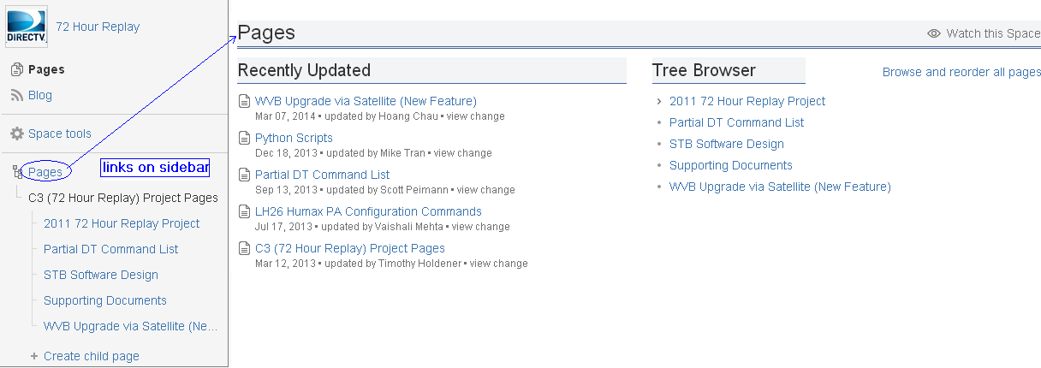
Finding Content
Finding pages and blog posts
These are the quickest ways to find your content:
Use Space Directory and filter to display the related spaces.
Use the links in the sidebar to find your pages, blog posts, and other parts of the space.
Go to the pages view for a list of pages in the space. You can see recently updated pages or browse through a hierarchical (tree) view.
Type the page name or key words into the search box at the top right of the Wiki screen.

Slide 32
Managing Changes, Notifications and Tasks
Watching for changes to pages/blog posts
Watching for changes to a space
Following the updates made by specific people
Managing Tasks
Managing watchers

Slide 33
Managing Changes, Notifications, and Tasks
Wiki provides several ways in which you can:
watch for changes to single pages, all pages in a space, and all spaces on the site.
follow the updates made by specific people.
manage tasks on a task list on a page.
manage watchers.
Note: You can only track updates to contents that you have permission to see.

Slide 34
Watching for changes to pages/blog posts
Watching a Page or Blog Post
To start watching a page or blog post:
1. Go to the page or blog post.
2. Choose Tools > Watch.
To stop watching a page or blog post:
1. Go to the page or blog post.
2. Choose Tools > Stop watching.

Slide 35
Watch for changes to a space
Watching all pages in a space
To start watching a space:
1. Go to a Space you want to watch for changes.
2. Choose Pages in the space sidebar.
3. Choose Watch this space at the top right.
To stop watching a space:
1. Choose Pages in the space sidebar.
2. Choose Stop watching this space at the top right.
Watching all Spaces on the Site
To start watching for content changes across the whole site:
1. Choose your profile picture at top right of the screen, then choose Settings.
2. Choose Email.
3. Choose Edit then choose Subscribe to daily updates.
4. Choose Submit.

Slide 36
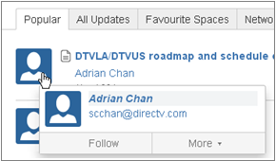
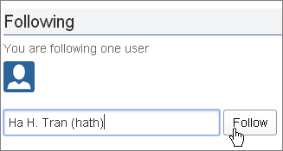
Following the updates made by specific people
You can follow the activities of people who interest you :
Follow other users to create network: Wiki will send you notifications on the activity of users that you choose to follow. The types of tracked activities are:
Additions or edits to pages or blog posts
Comments added to a page or blog post or edits to existing comments
Updates to a user's User Profile
To follow/stop following a user with the Hover Profile:
1. Move your mouse pointer over a user's linked name or
profile picture. The hover profile popup will appear.
2. Choose Follow/Stop following.
To follow a user from your Network view:
1. Choose your profile picture at top right of the screen, then
choose Network.
2. Enter the first few characters of the name (or username) and
choose the user from the list of suggestions.
3. Choose Follow.

Slide 37
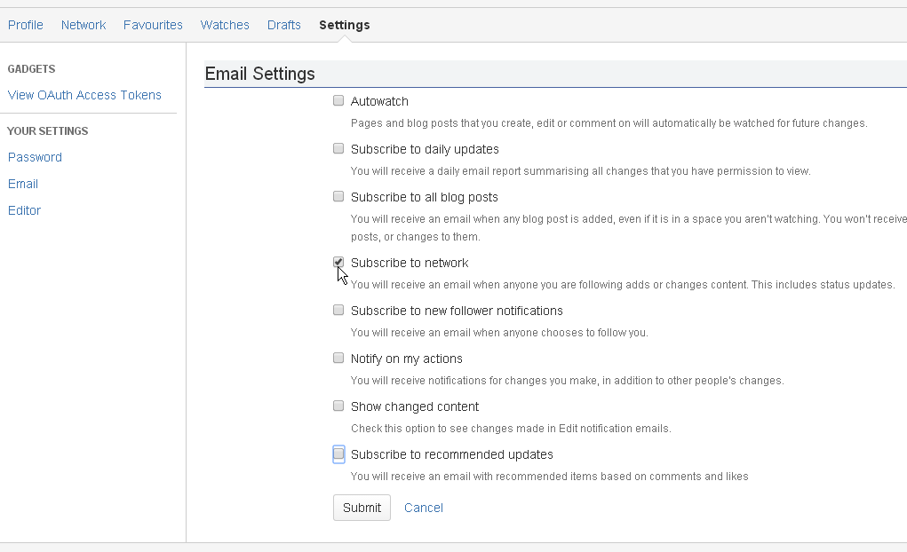
Following the updates made by specific people (cont.)
You can also receive a notification when someone follows you:
Edit Email settings to receive emails generated by Wiki in specific situations.
Go to Profile > Settings > Email.

Slide 38
Managing watchers
Manage watchers from your User Profile: The 'Watches' page in your user profile displays a list of all pages and spaces you are currently watching.
To manage your watchers:
1. Choose your profile picture at top right of the screen, then choose Watches.
2. Choose Stop Watching for any unwanted spaces or pages.
Manage your watchers for a page/blog post:
To manage your watchers for a page/blog post:
1. Navigate to the page or blog post for which you want to manage the watchers.
Note: you must be a space administrator for the space that the page is in.
2. Choose Tools > Manage Watchers.
To remove an existing page watcher, click the icon (trash can) next to the user's name.
To add a user as a watcher of the page, type in the box and choose the user's name from the list.

Slide 39

Managing Tasks
Manage Personals tasks in Wiki:
On Wiki page header, select icon , then icon to show personal tasks list.
Enter Task name > click on Add task button.
Check on a task to mark it as completed.
Select ">" icon to show task detail.
Click on View completed link to view completed tasks.
Add a notification to your tasks list:
On Wiki page header, select icon , then icon to show notifications list.
Choose a notification to be added to your tasks list, then select icon.

Slide 40
Customising Content
Personal Customisations
Customising the Look and Feel of a Wiki Space

Slide 41
Customize Wiki
You can customise or configure some aspects of Wiki:
Customising Personal information:
Editing User Profile.
Changing Profile Picture/ Password.
Editing default Home Page
Customising the Look and Feel of a Wiki Space
Applying a Theme to a Space
Configuring a Sidebar
Changing a Space's Logo
Editing a Space's Colour Scheme

Slide 42
Giving People Access to Content
Page restrictions
Space permissions
Users and Groups

Slide 43
Giving People Access to Content
Wiki gives you the choice to make the site as open or as closed as you wish. Here are some points to consider:
Page Restrictions: allow you to control who can view or edit individual pages.
You set the page restrictions using the Page Restrictions dialog, either directly by choosing Tools > Restrictions, or when editing a page.
Space Permissions Overview: Every space has its own independent set of permissions. Space permissions can only be granted by a space administrator.
These are the permissions that can be assigned at the space level:
View
Pages: Add/Restrict/Remove
Blog: Add/Remove
Comments: Add/Remove
Attachments: Add/Remove
Mail
Space: Export/Admin
Users and Groups: a permission or restriction can be granted for specific users or groups.

Slide 44
Thank you!

