Slide 1
Question Generation Question Answering
With NLP techniques with deep learning architectures

Slide 2

Preprocessing Text :

Slide 3
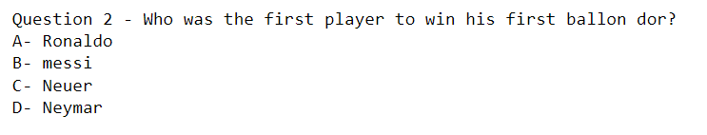
Generate MCQs 1. high level pipeline
Medicine is the science and practice of caring for a patient, managing the diagnosis, prognosis, prevention, treatment, palliation of their injury or disease, and promoting their health. Medicine encompasses a variety of health care practices evolved to maintain and restore health by the prevention and treatment of illness. Contemporary medicine applies biomedical sciences, biomedical research, genetics, and medical technology to diagnose, treat, and prevent injury and disease, typically through pharmaceuticals or surgery, but also through therapies as diverse as psychotherapy, external splints and traction, medical devices, biologics, and ionizing radiation, amongst others.
The Amazon River in South America is the largest river by discharge volume of water in the world, and the disputed longest river system in the world in comparison to the Nile.
The headwaters of the Apurímac River on Nevado Mismi had been considered for nearly a century as the Amazon basin most distant source, until a 2014 study found it to be the headwaters of the Mantaro River on the Cordillera Rumi Cruz in Peru.
The Mantaro and Apurímac rivers join, and with other tributaries form the Ucayali River, which in turn meets the Marañón River upstream of Iquitos, Peru, forming what countries other than Brazil consider to be the main stem of the Amazon. Brazilians call this section the Solimões River above its confluence with the Rio Negro.
forming what Brazilians call the Amazon at the Meeting of Waters (Portuguese: Encontro das Águas) at Manaus, the largest city on the river.
The Amazon was initially known by Europeans as the Marañón, and the Peruvian part of the river is still known by that name today. It later became known as Rio Amazonas in Spanish and Portuguese.Recent geological studies suggest that for millions of years the Amazon River used to flow in the opposite direction - from east to west. Eventually the Andes Mountains formed, blocking its flow to the Pacific Ocean, and causing it to switch directions to its current mouth in the Atlantic Ocean.
The Nile is a major north-flowing river in northeastern Africa.
the nile is the longest river in africa and has historically been considered the longest river in the world,though this has been contested by research suggesting that the amazon river is slightly longer. it later became known as rio amazonas in spanish and portuguese.recent geological studies suggest that for millions of years the amazon river used to flow in the opposite direction from east to west. the amazon river in south america is the largest river by discharge volume of water in the world, and the disputed longest river system in the world in comparison to the nile.
Find important
Sentences
(Abstractive or
Extractive
Summarization)
Sentence2MCQ

Slide 4

1 Generate wrong choices 1. for MCQ options
Medicine is the science and practice of caring for a patient, managing the diagnosis, prognosis, prevention, treatment, palliation of their injury or disease, and promoting their health. Medicine encompasses a variety of health care practices evolved to maintain and restore health by the prevention and treatment of illness. Contemporary medicine applies biomedical sciences, biomedical research, genetics, and medical technology to diagnose, treat, and prevent injury and disease, typically through pharmaceuticals or surgery, but also through therapies as diverse as psychotherapy, external splints and traction, medical devices, biologics, and ionizing radiation, amongst others.
The Amazon River in South America is the largest river by discharge volume of water in the world, and the disputed longest river system in the world in comparison to the Nile.
The headwaters of the Apurímac River on Nevado Mismi had been considered for nearly a century as the Amazon basin most distant source, until a 2014 study found it to be the headwaters of the Mantaro River on the Cordillera Rumi Cruz in Peru.
The Mantaro and Apurímac rivers join, and with other tributaries form the Ucayali River, which in turn meets the Marañón River upstream of Iquitos, Peru, forming what countries other than Brazil consider to be the main stem of the Amazon. Brazilians call this section the Solimões River above its confluence with the Rio Negro.
forming what Brazilians call the Amazon at the Meeting of Waters (Portuguese: Encontro das Águas) at Manaus, the largest city on the river.
The Amazon was initially known by Europeans as the Marañón, and the Peruvian part of the river is still known by that name today. It later became known as Rio Amazonas in Spanish and Portuguese.Recent geological studies suggest that for millions of years the Amazon River used to flow in the opposite direction - from east to west. Eventually the Andes Mountains formed, blocking its flow to the Pacific Ocean, and causing it to switch directions to its current mouth in the Atlantic Ocean.
The Nile is a major north-flowing river in northeastern Africa.
Multiple Choice Question
Given the Messi as input, we will see how we can generate distractors (wrong choices) like Ronaldo, Neymar, Neuer, using Wordnet or sentence2MCQ

Slide 5
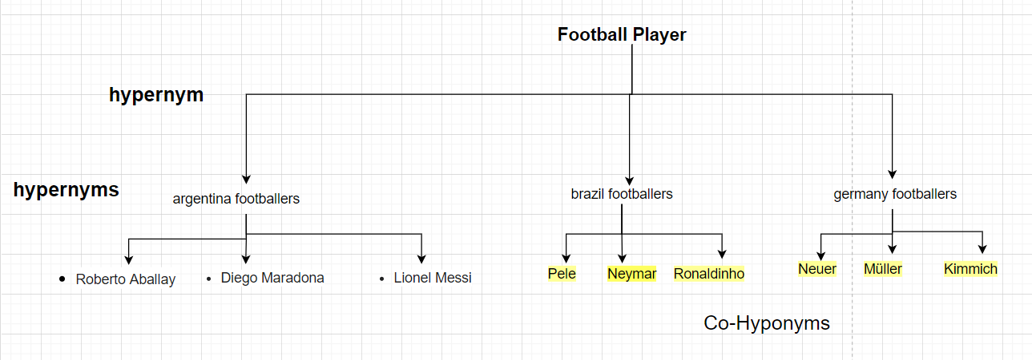
Generate distractors 1. using Wordnet
WordNet® captures relations
Our goal is to extract Co-Hyponyms as
distractors

Slide 6
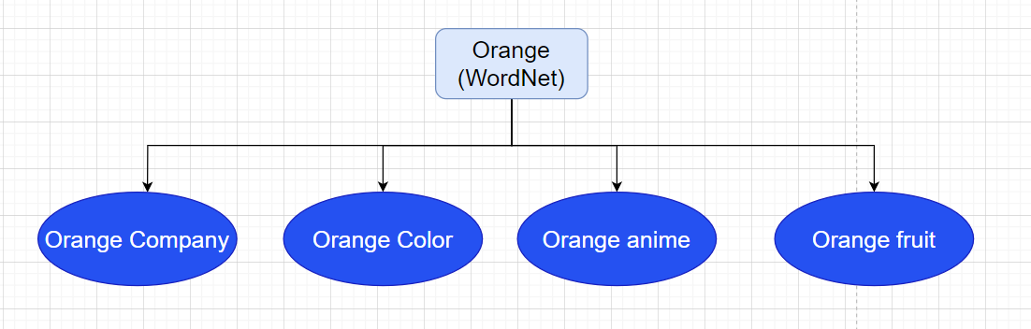



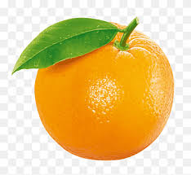
1.3 Word Sense Disambiguation (WSD)
How to disambiguate in our story? A word's meaning is defined by the group it keeps.
Collect sentences that contain “Orange" from the story

Slide 7
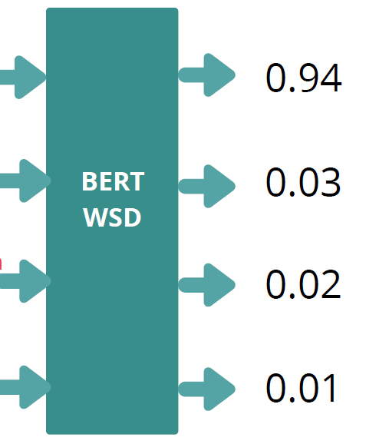
1.4 BERT Word Sense Disambiguation (WSD)
[CLS] Orange has been the company's main brand for mobile, landline, internet and Internet Protocol television (IPTV) services since 2006.. [SEP] Orange Company. [SEP]
[CLS] Orange has been the company's main brand for mobile, landline, internet and Internet Protocol television (IPTV) services since 2006.. [SEP] Orange Fruit. [SEP]
[CLS] Orange has been the company's main brand for mobile, landline, internet and Internet Protocol television (IPTV) services since 2006.. [SEP] Orange Anime. [SEP]
[CLS] Orange has been the company's main brand for mobile, landline, internet and Internet Protocol television (IPTV) services since 2006.. [SEP] Orange Color. [SEP]

Slide 8
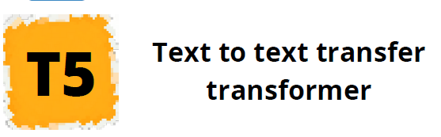
Context
Generate a question using 1. T5 Transformer model
he established himself as an integral player for the club within the next three years, and in his first uninterrupted season in he helped barcelona achieve the first treble in spanish football that year, aged , messi won his first ballon dor. it later became known as rio amazonas in spanish and portuguese.recent geological studies suggest that for millions of years the amazon river used to flow in the opposite direction from east to west. according to france football, he was the worlds highest paid footballer for five years out of six between and , and was ranked the worlds highestpaid athlete by forbes in .
Answer
Answer is : years
Question
How long did Messi play for Barcelona?

Slide 9

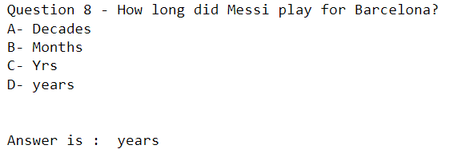
Context
1.7 Generate MCQs from any content
Key Words
he established himself as an integral player for the club within the next three years, and in his first uninterrupted season in he helped barcelona achieve the first treble in spanish football that year, aged , messi won his first ballon dor. it later became known as rio amazonas in spanish and portuguese.recent
Extract Key word
MultipartiteRank
Transformer Model
Generated Question

Slide 10
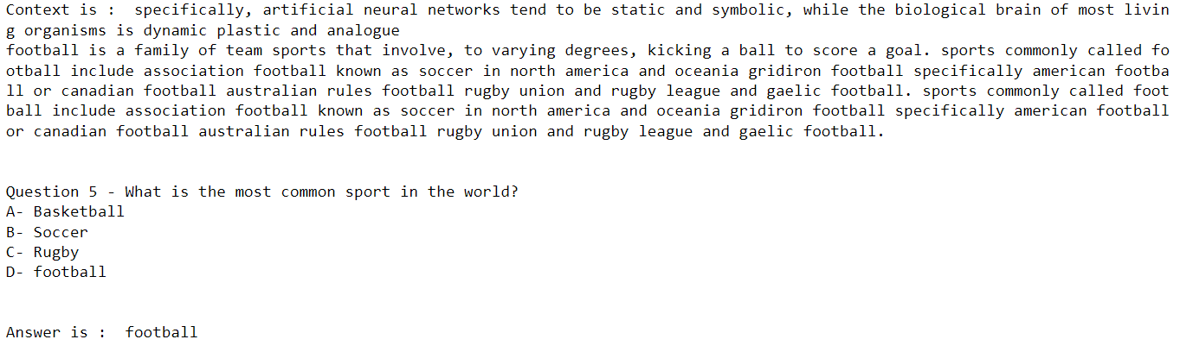
1.7 Generate MCQs from any content
Example From Code:

Slide 11

Context
1.8 Question Answering
Question
specifically, artificial neural networks tend to be static and symbolic, while the biological brain of most living organisms is dynamic plastic and analogue
football is a family of team sports that involve, to varying degrees, kicking a ball to score a goal. sports commonly called football include association football known as soccer in north america and oceania gridiron football specifically american football or canadian football australian rules football rugby union and rugby league and gaelic football.
What is the most common sport in the world?
Generated Answer
Transformer Model

Slide 12
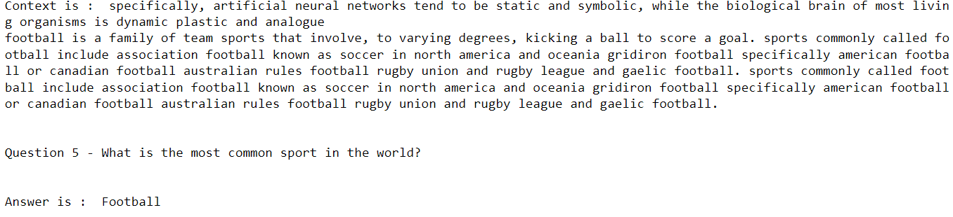
1.8 Question Answering
Example From Code:

Slide 13
Thanks

